Slide 1
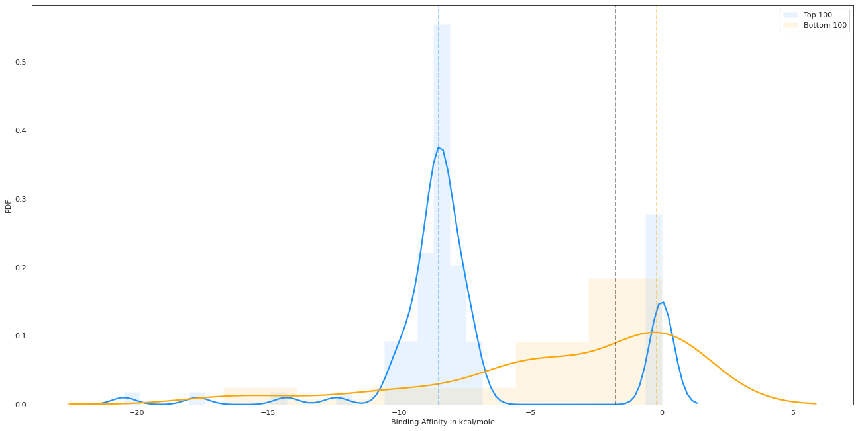
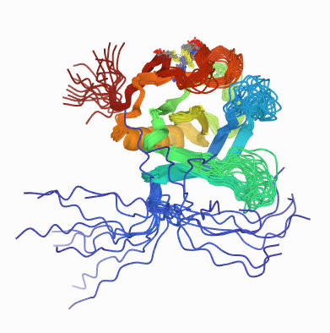
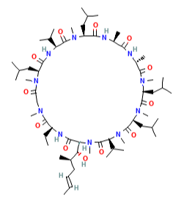
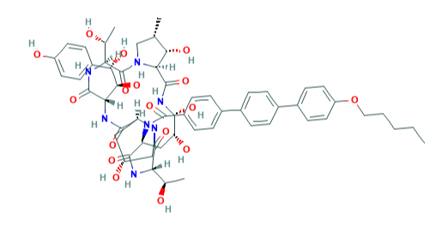
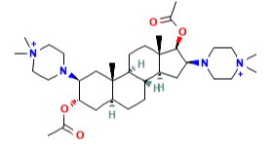
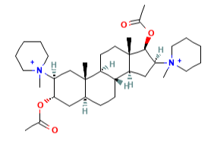
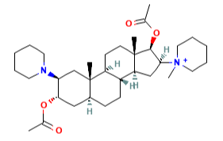
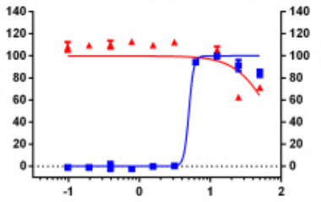
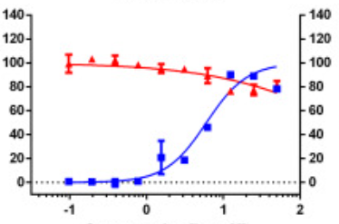
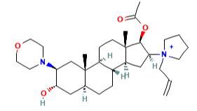
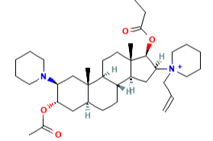
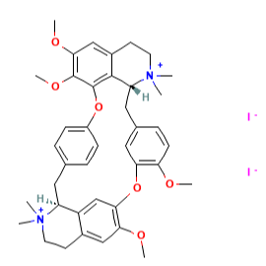
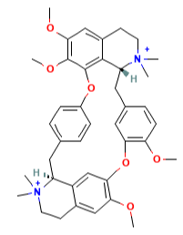
A
B
Threshold of
-1.75 kcal/mole
Top Predictions
Predicted Label (AI-Bind)
Bottom Predictions
Binding
Non-binding
72
22
Binding
PDF
True Label (Auto-docking)
15
21
Non-binding
F1-Score = 0.80
MCC = 0.33
Binding Affinity in kcal/mole
C
c_{Spearman}(p_{ij}^{VecNet}, ΔG) = -0.40
D
Prediction Percentile
0
0
-3
-1
-2
+3
+3
99.99976
99.99955
99.99901
99.99701
99.99691
99.99687
99.99671
-7.6
-7.6
-7.5
-7.5
-7.3
-7.1
-6.9
Tyrosine-protein kinase Tec
Binding Affinity (kcal/mole)
Change in Rank
Pipecuronium
Pancuronium
Anidulafungin
Cyclosporin
Vecuronium
Rocuronium
% Inhibition
% Inhibition
% Cell ratio
% Cell ratio
Rapacuronium
Metocurine iodide
Concentration [log μM]
*
Concentration [log μM]
*
IC₅₀=4.64; CC₅₀>50; SI=10.78
IC₅₀=5.82; CC₅₀>50; SI=8.59
Metocurine
*Adapted from Jeon, S.et al. Identification of antiviral drug candidates against SARS-CoV-2 from FDA-approved drugs. Antimicrobial Agents and Chemotherapy 64 (2020). URL https://doi.org/10.1128/aac.00819-20. Adapted with permission.

