Slide 1
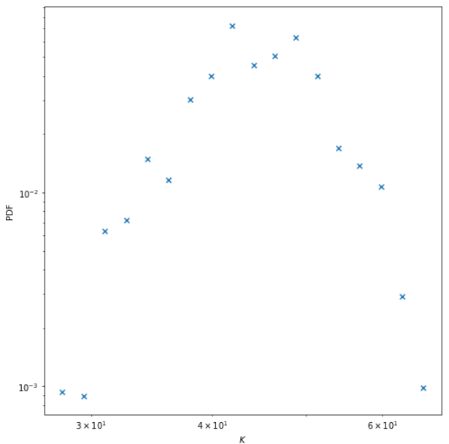
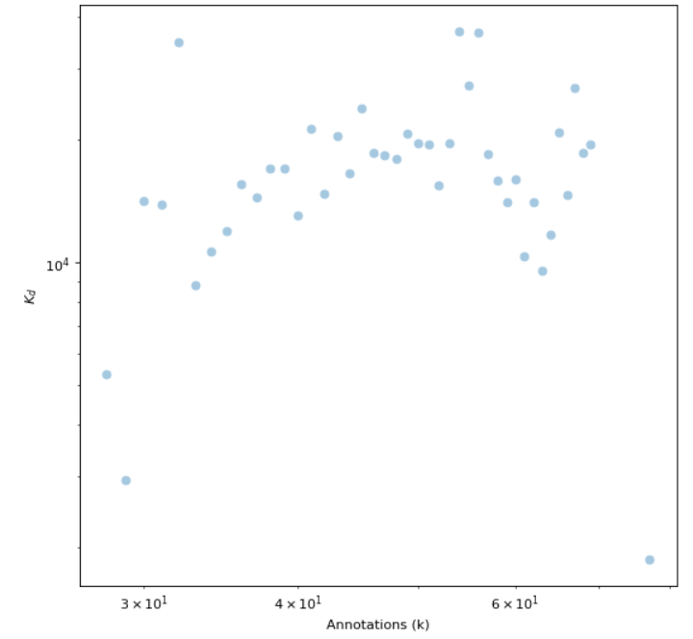
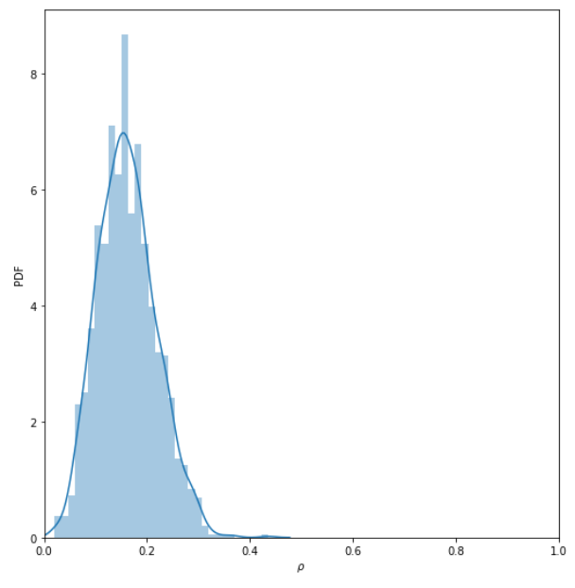
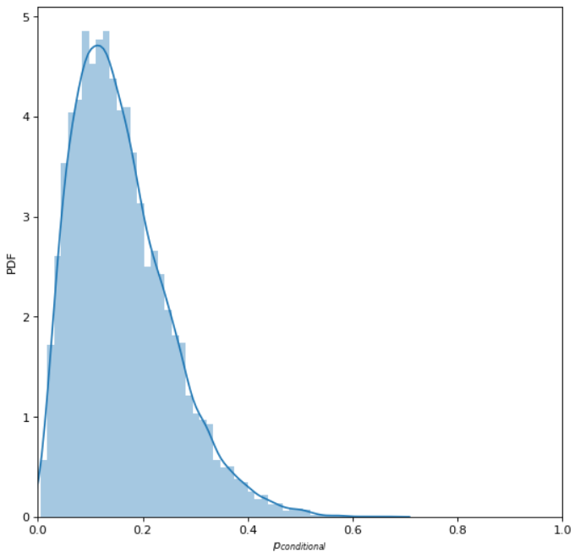
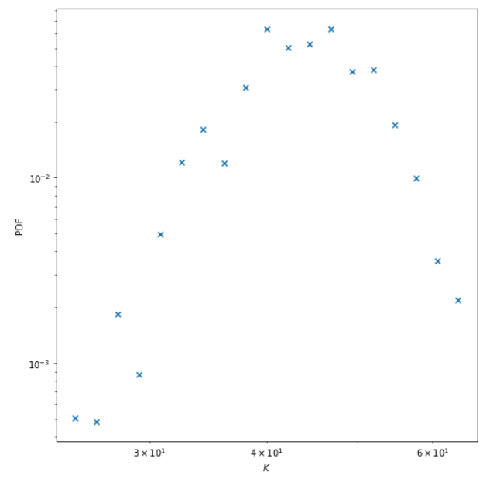
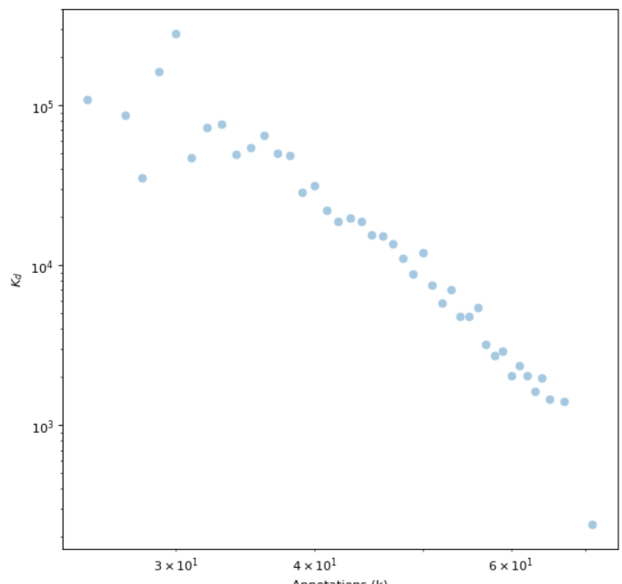
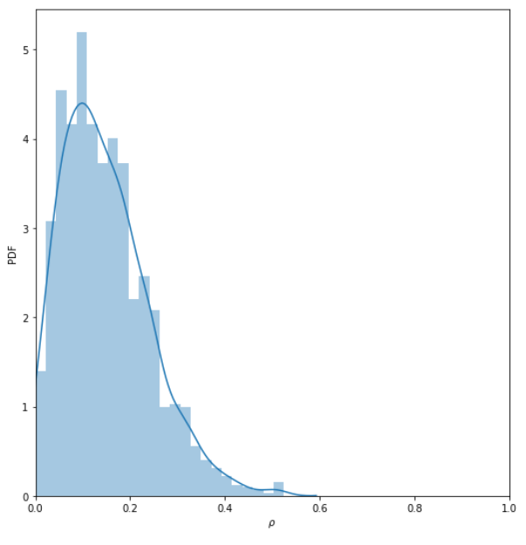
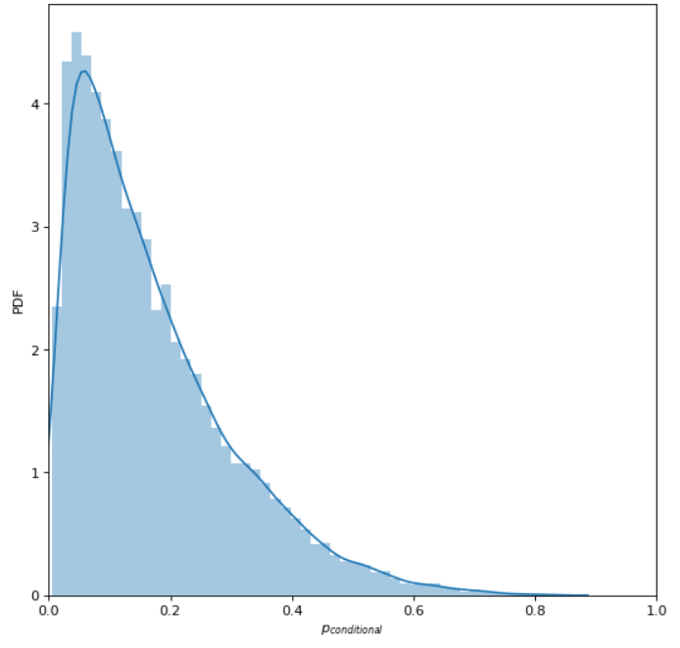
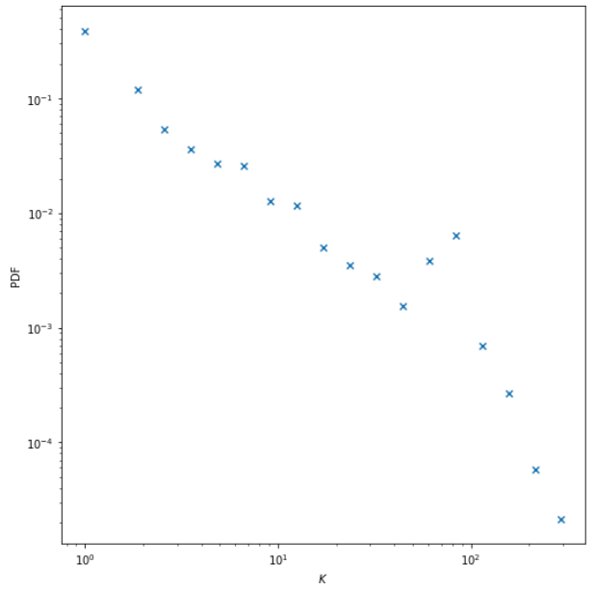
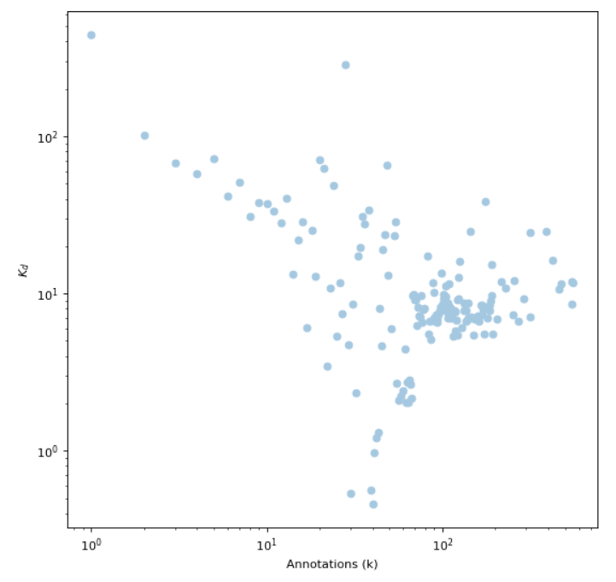
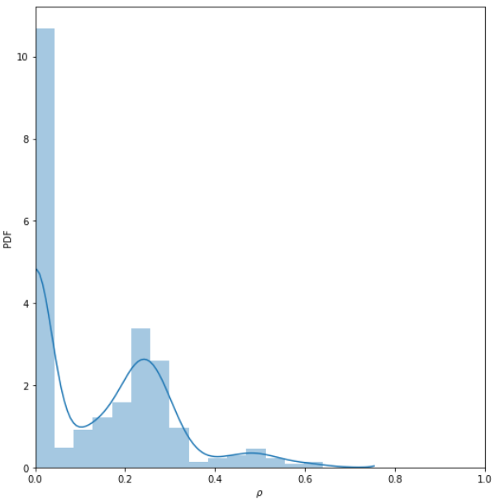
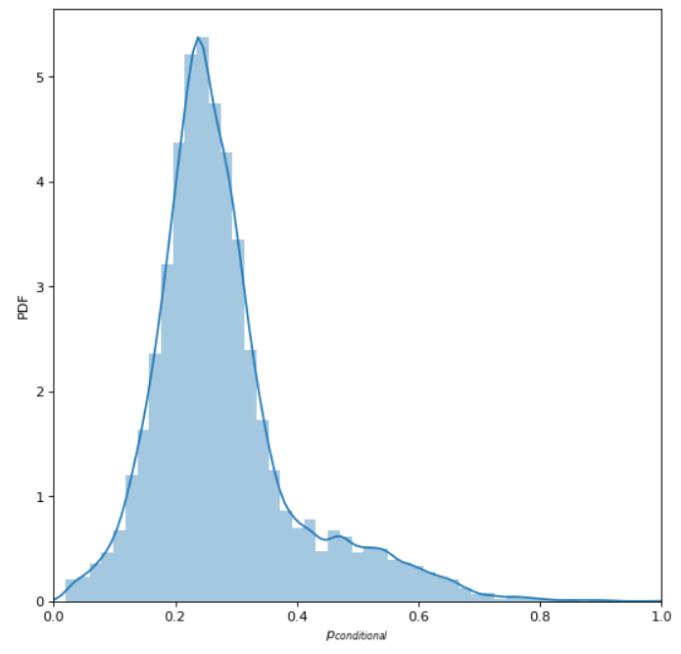
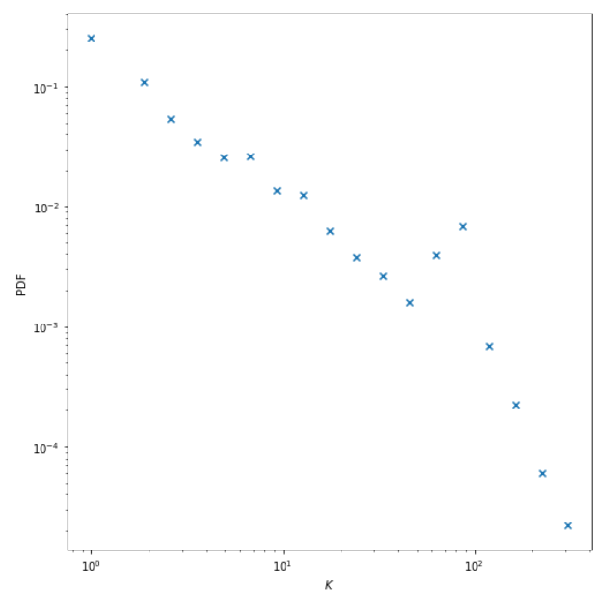
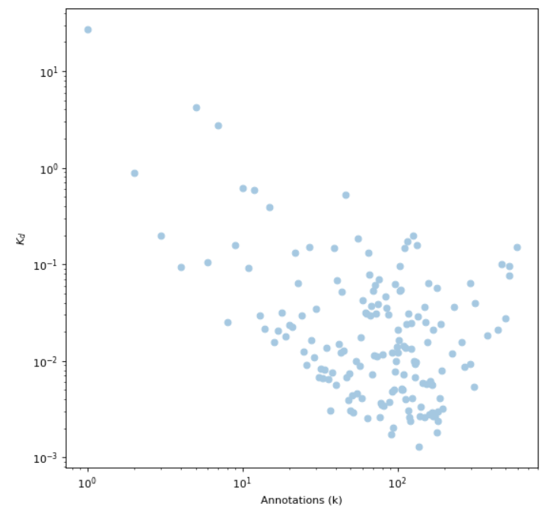
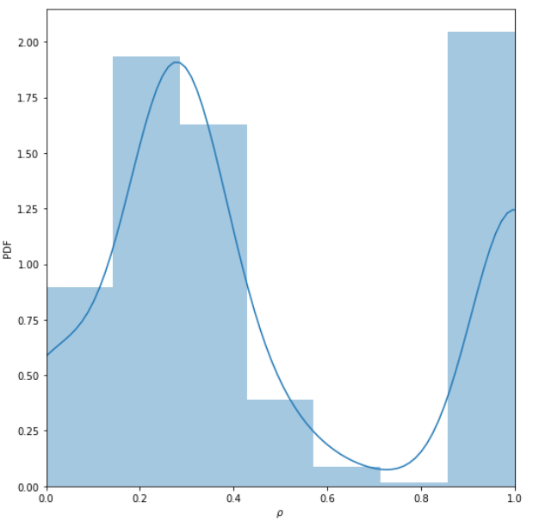
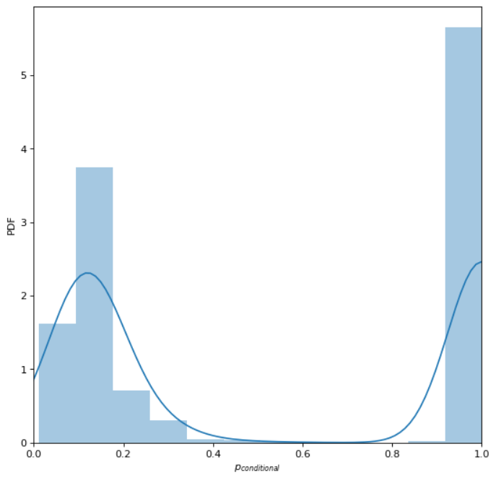
Annotation distribution
Association between Annotations and K_{d}
Degree ratio distribution
Duplex Configuration Model Predictions
Poisson
+
No Correlation
in Gaussian Copula
<K_{d}>
PDF
<K_{d}>
PDF
PDF
Annotations (k)
Annotations (k)
ρ
p_{conditional}
Annotations (k)
Poisson
+
Correlation
in Gaussian Copula
PDF
<K_{d}>
PDF
PDF
Annotations (k)
Annotations (k)
ρ
p_{conditional}
Power-law
+
No Correlation in Gaussian Copula
<K_{d}>
PDF
PDF
PDF
Annotations (k)
Annotations (k)
ρ
p_{conditional}
Power-law
+
Correlation in Gaussian Copula
<K_{d}>
PDF
PDF
PDF
Annotations (k)
Annotations (k)
ρ
p_{conditional}

