Slide 1
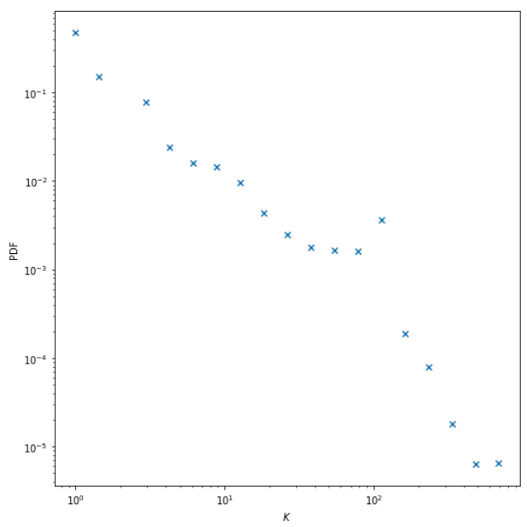
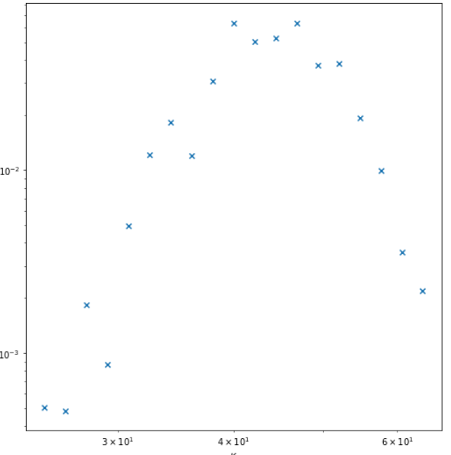
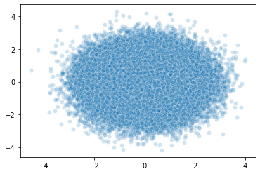
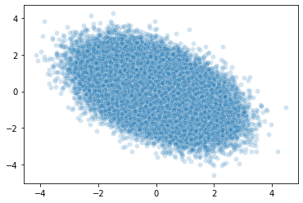
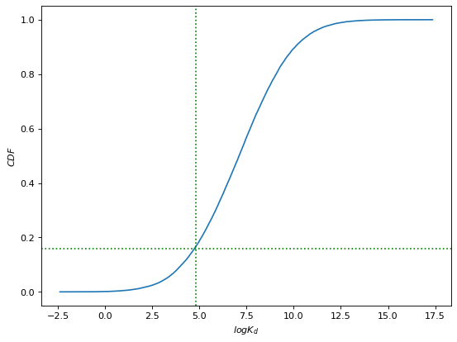
A
Benchmark BindingDB data
Target degree sequence
Configuration Model
{d₁, d₂, …, d_{N}}
Power-law degree distribution with N=1,507
γ=2.8
k_{max} = 1,426
PDF
PDF
Annotations (k)
ER Graph
Poisson degree distribution with
N=1,507
<k>=47
PDF
Annotations (k)
B
Gaussian Copulas
c_{Spearman} = 0
Annotations (k)
x₂
K_{d}^{i}
x₁
k = degree_seq_CDF⁻¹ (U1)
log <K_{d}> = <log K_{d} > + STD(log K_{d}) * Gaussian_CDF⁻¹ (U2)
K_{d} = exp(Gaussian(log <K_{d}>, STD(k)))
K_{d}^{(i,j)} = √ K_{d}^{i} K_{d}^{j}
c_{Spearman} = -0.47
K_{d}^{j}
x₂
x₁
C
K_{d}^{(i,j)} < Threshold
Positive Edge
CDF
p_{bind} = 0.16
K_{d}^{(i,j)} ≥ Threshold
log Threshold
Negative Edge
log K_{d}
Notes:
k_{cut-off} = 1,426

