Slide 1
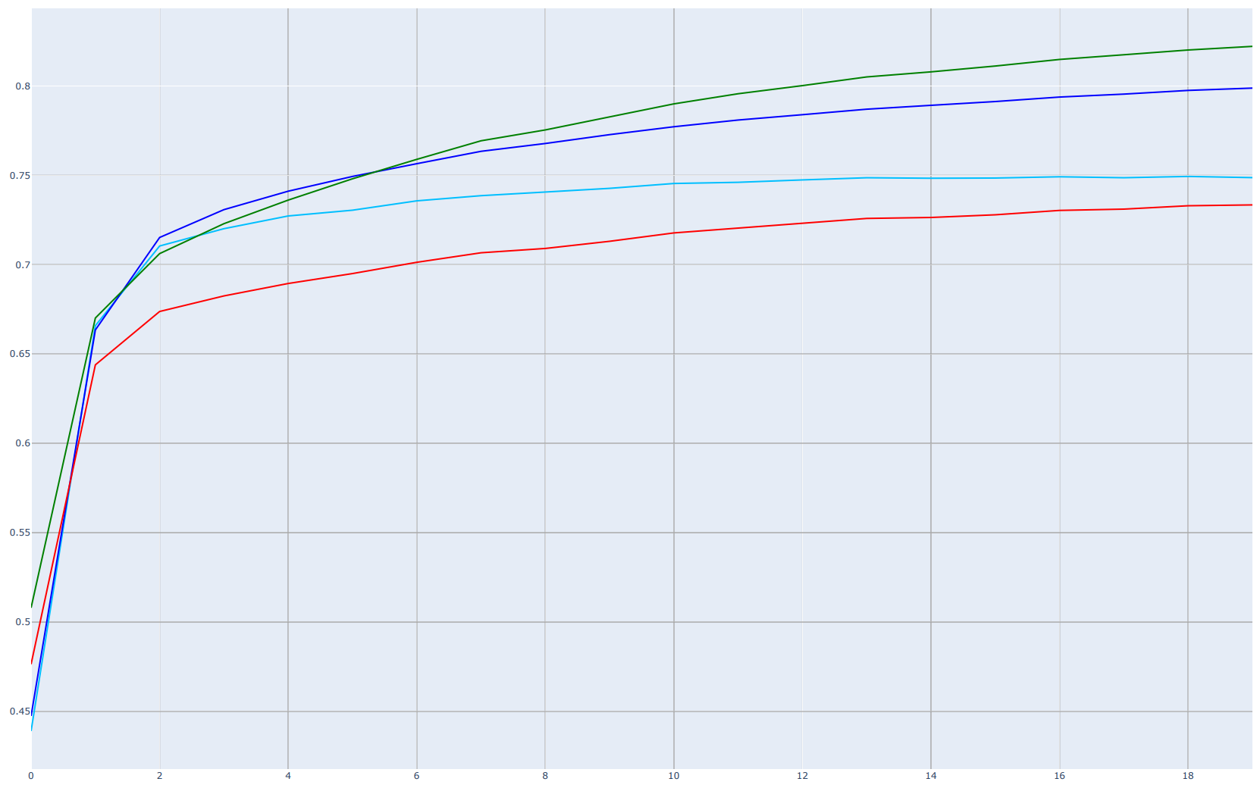
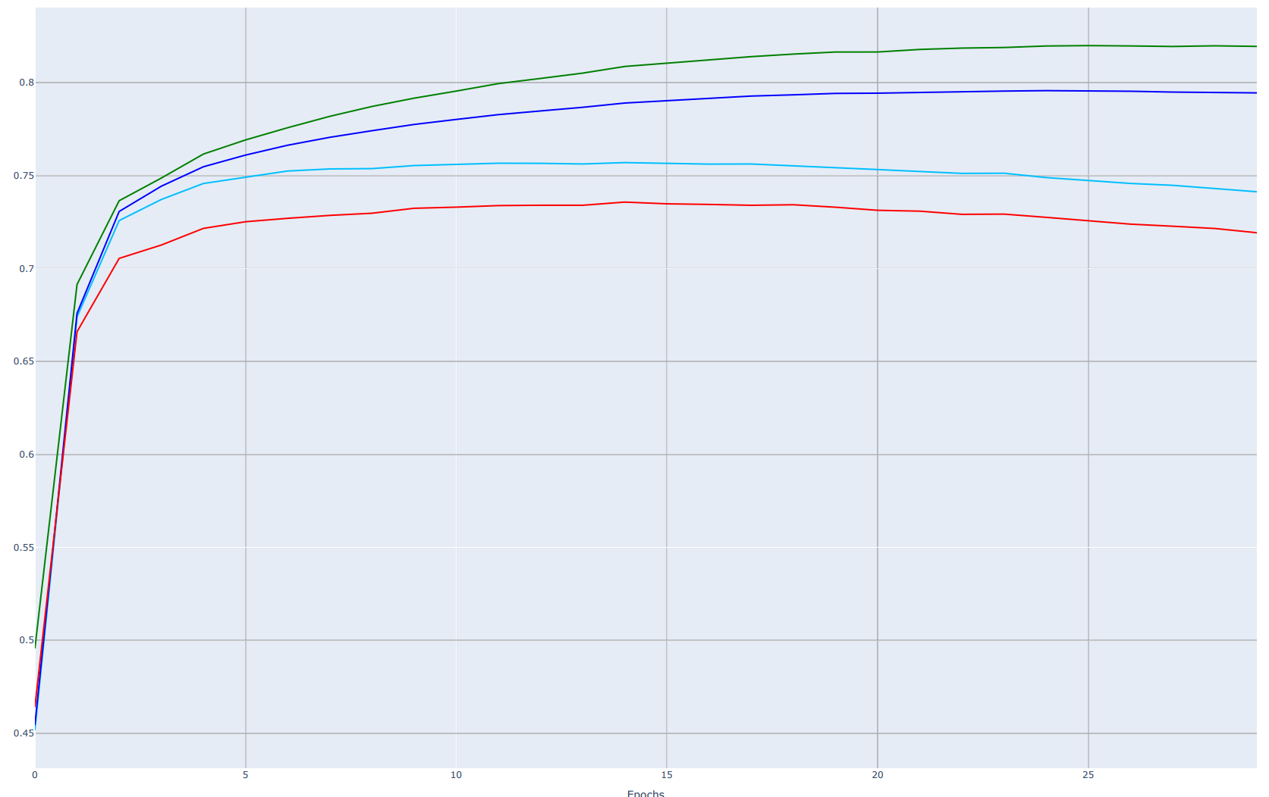
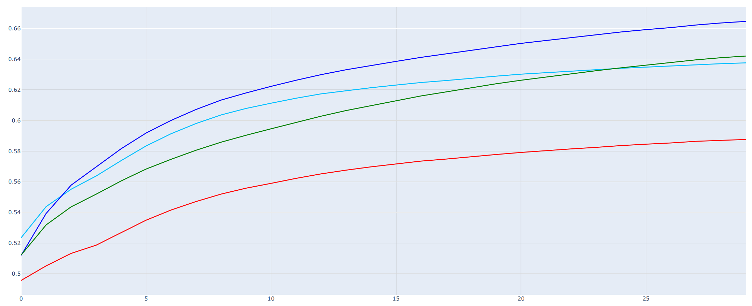
A
Performance
Inductive AUC
Transductive AUC
Inductive AUP
Transductive AUP
B
Epochs
Performance
Inductive AUC
Transductive AUC
Inductive AUP
Transductive AUP
C
Epochs
Performance
Inductive AUC
Transductive AUC
Inductive AUP
Transductive AUP
Epochs

