Slide 1
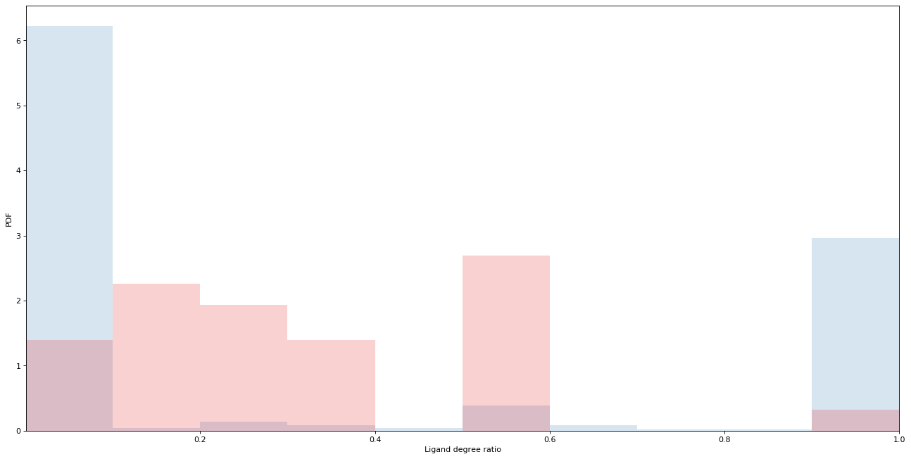
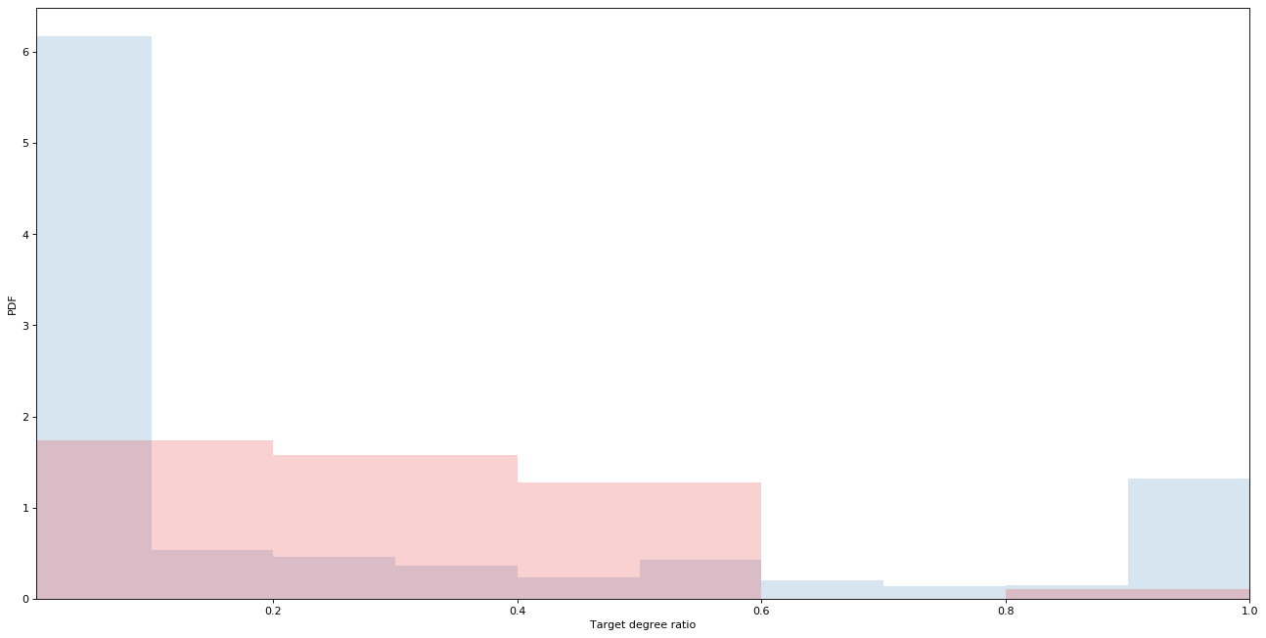
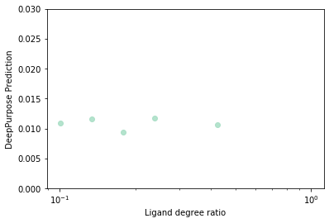
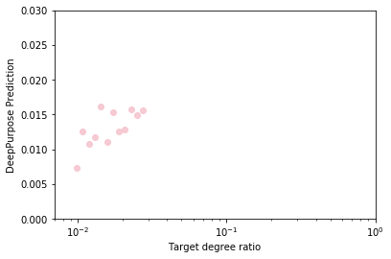
a
A
Whole BindingDB
False Negatives
PDF
B
Ligand degree ratio (ρ)
Whole BindingDB
False Negatives
PDF
Target degree ratio (ρ)
C
D
DeepPurpose Prediction
DeepPurpose Prediction
Ligand degree ratio (ρ_{l})
Protein degree ratio (ρ_{p})

