Slide 1
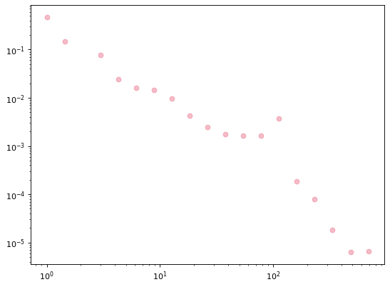
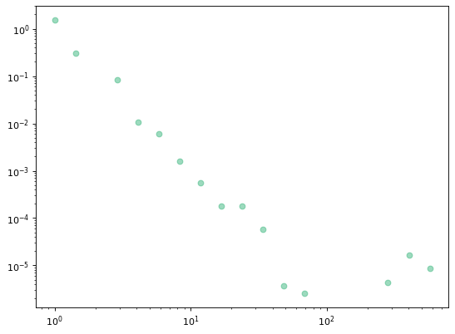
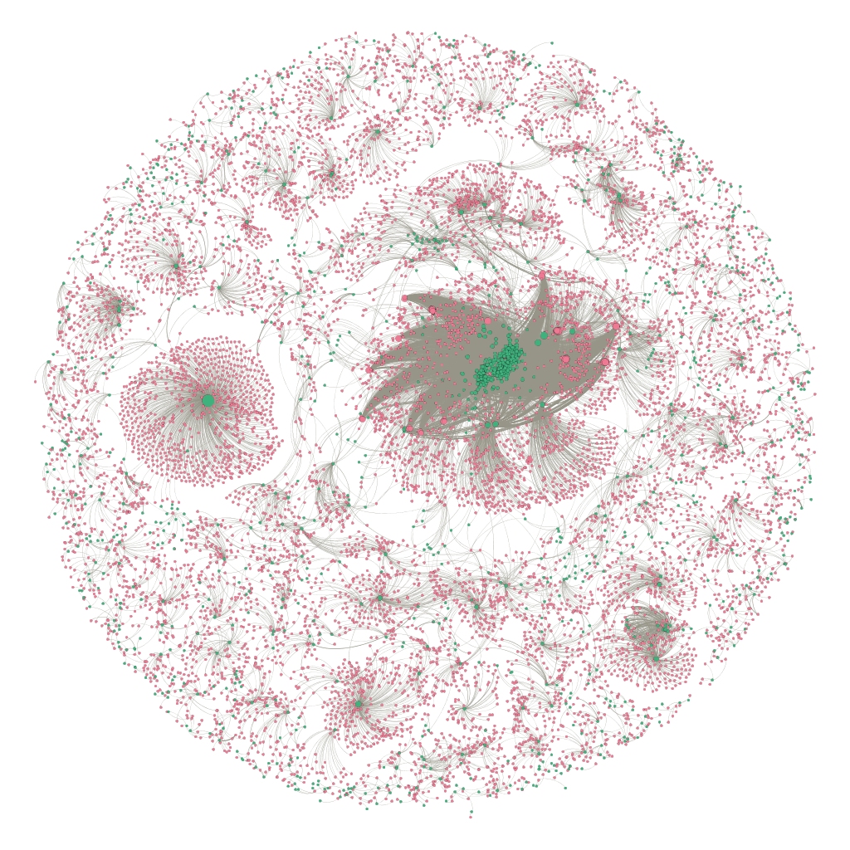
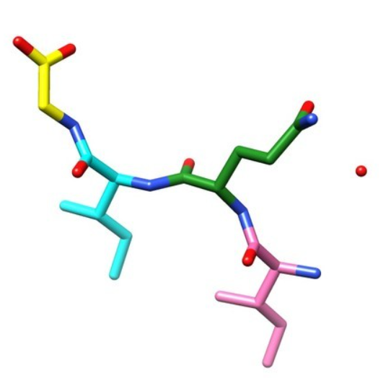
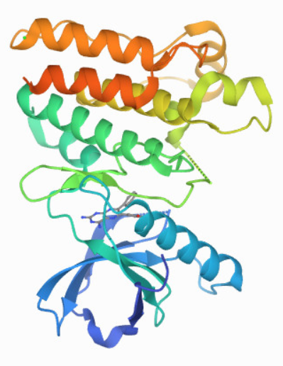
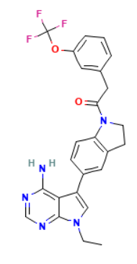
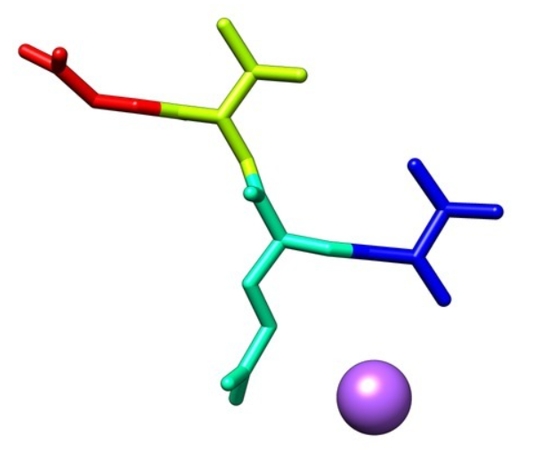
A
Proteins
Ligands
γ_{p} = 2.84
γ_{l} = 2.94
P(k_{p})
P(k_{l})
B
Annotations (k_{p})
Annotations (k_{l})
DTI Network Statistics
Nodes | 11,807
Proteins | 1,391
Ligands | 10,416
Positive Edges | 5,591
Negative Edges | 31,976
C
Ligand
Protein
Annotation
Amyloid core of RIP1
Positive/Binding
Negative/Non-binding
Threonine-protein kinase 4
Ligand: Ripk1-IN-7
Ripk1-IN-7
k_{i}⁺ = 1
k_{i}⁻ = 2
ρ_{i} = 1/(1+2) = 0.33
Threonine-protein kinase 3

