Slide 1
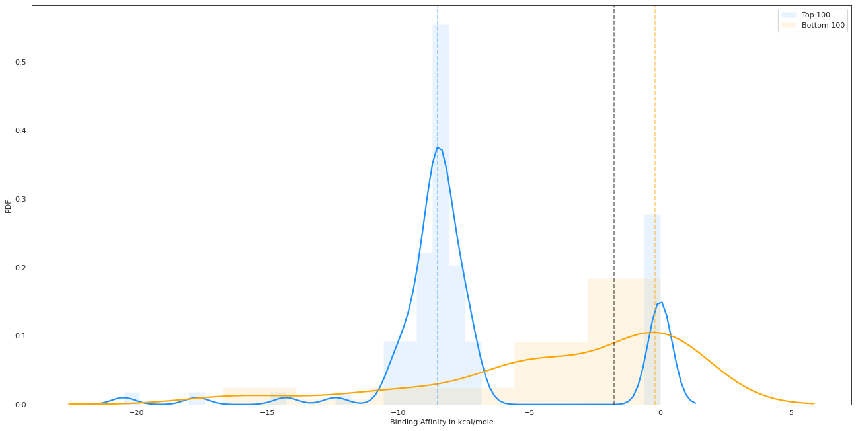
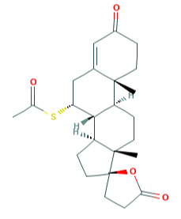
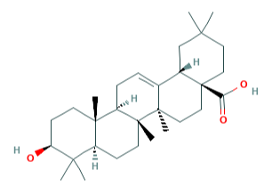
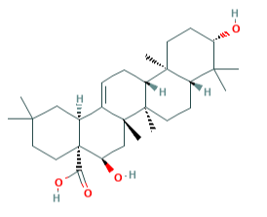
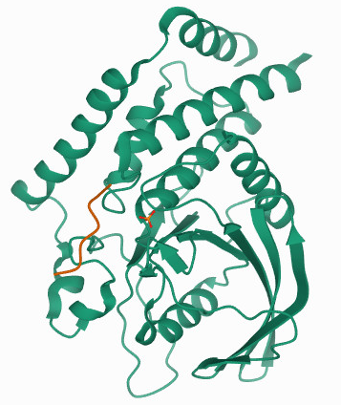
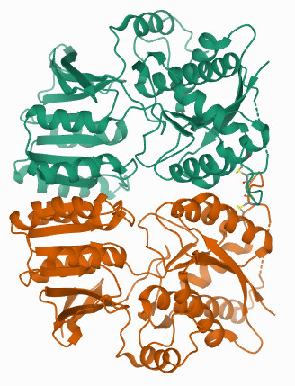
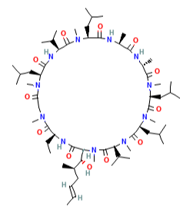
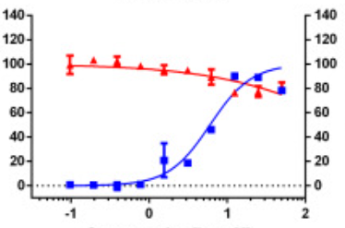
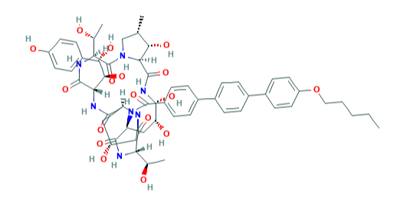
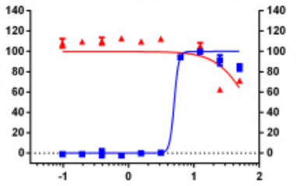
A
Threshold of
-1.75 kcal/mole
Top Predictions
Bottom Predictions
PDF
B
Binding Affinity in kcal/mole
Spironolactone
Oleanolic acid
Echinocystic acid
-9 kcal/mole
-8.3 kcal/mole
-8.3 kcal/mole
-10 kcal/mole
PTPN22
GRIA2
PTPN22
PTPN22
C
% Inhibition
% Inhibition
% Cell ratio
% Cell ratio
Concentration [log μM]
Cyclosporin
Concentration [log μM]
*
Anidulafungin
*
IC₅₀=5.82; CC₅₀>50; SI=8.59
IC₅₀=4.64; CC₅₀>50; SI=10.78
*Adapted from Jeon, S.et al. Identification of antiviral drug candidates against SARS-CoV-2 from FDA-approved drugs. Antimicrobial Agents and Chemotherapy 64 (2020). URL https://doi.org/10.1128/aac.00819-20. Adapted with permission.

