Slide 1
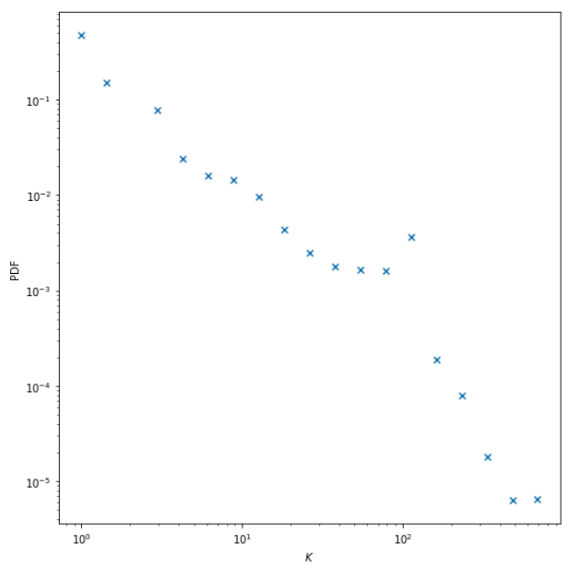
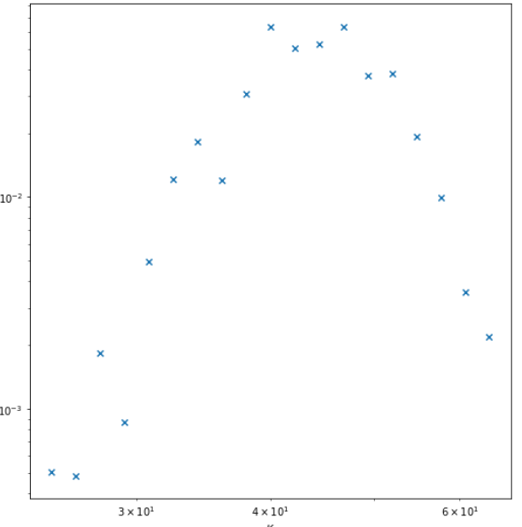
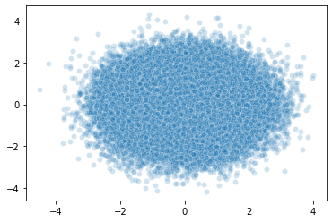
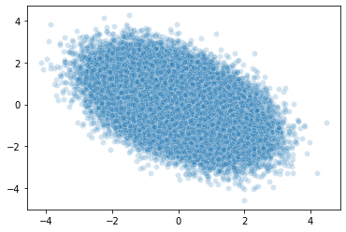
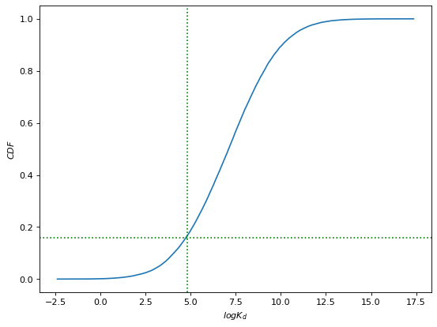
A
Benchmark BindingDB data
Target degree sequence
Configuration Model
{d₁, d₂, …, d_{N}}
Power-law degree distribution with N=1,507
γ_{p}=2.8
k_{p}^{min} = 1
k_{p}^{max} = 1,426
PDF
PDF
Annotations (k)
ER Graph
Poisson degree distribution with
N=1,507
<k_{p}>=47
PDF
Annotations (k)
B
Gaussian Copulas
c_{Spearman} = 0
Annotations (k)
x₂
K_{d}^{i}
k_{i} = degree_seq_CDF⁻¹ (U1)
log(<K_{d}>^{i}) = <log(K_{d})> + σ_{log(Kd)}* Gaussian_CDF⁻¹ (U2)
For each edge containing node i,
K_{d} ^{i} = exp(Gaussian(log(<K_{d}>^{i}), σ^{ki}_{log(Kd)}))
x₁
K_{d}^{(i,j)} = √ K_{d}^{i} K_{d}^{j}
c_{Spearman} = -0.47
K_{d}^{j}
x₂
x₁
Unipartite Version
C
K_{d}^{(i,j)} < Threshold
Positive Edge
CDF
p_{bind} = 0.16
K_{d}^{(i,j)} ≥ Threshold
log(Threshold)
Negative Edge
log K_{d}^{(i,j)}

