Slide 1
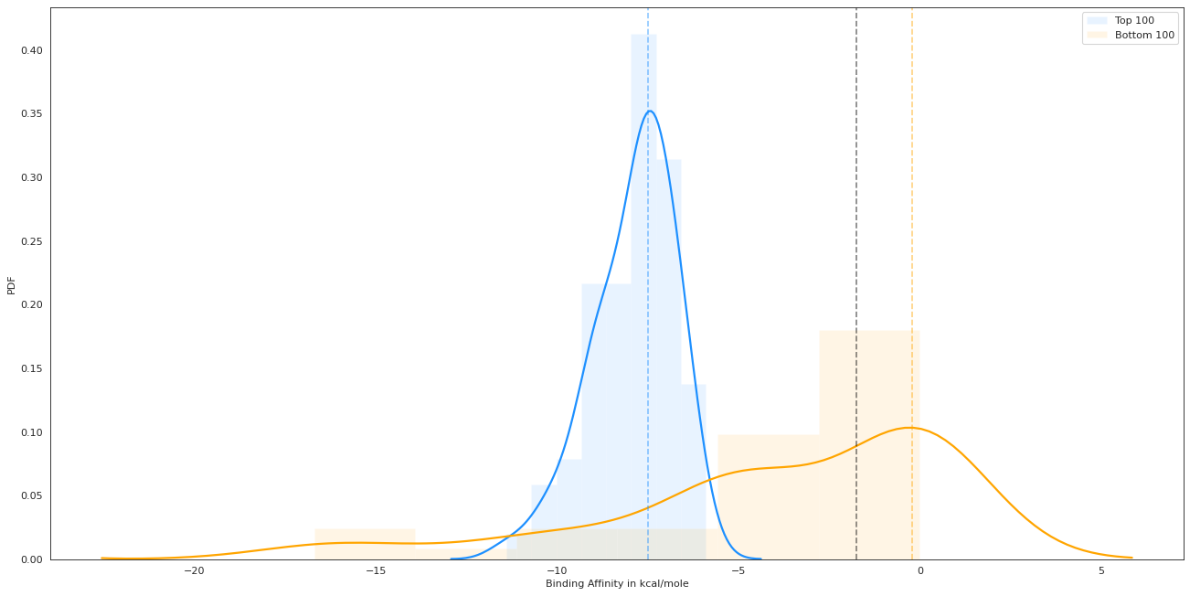
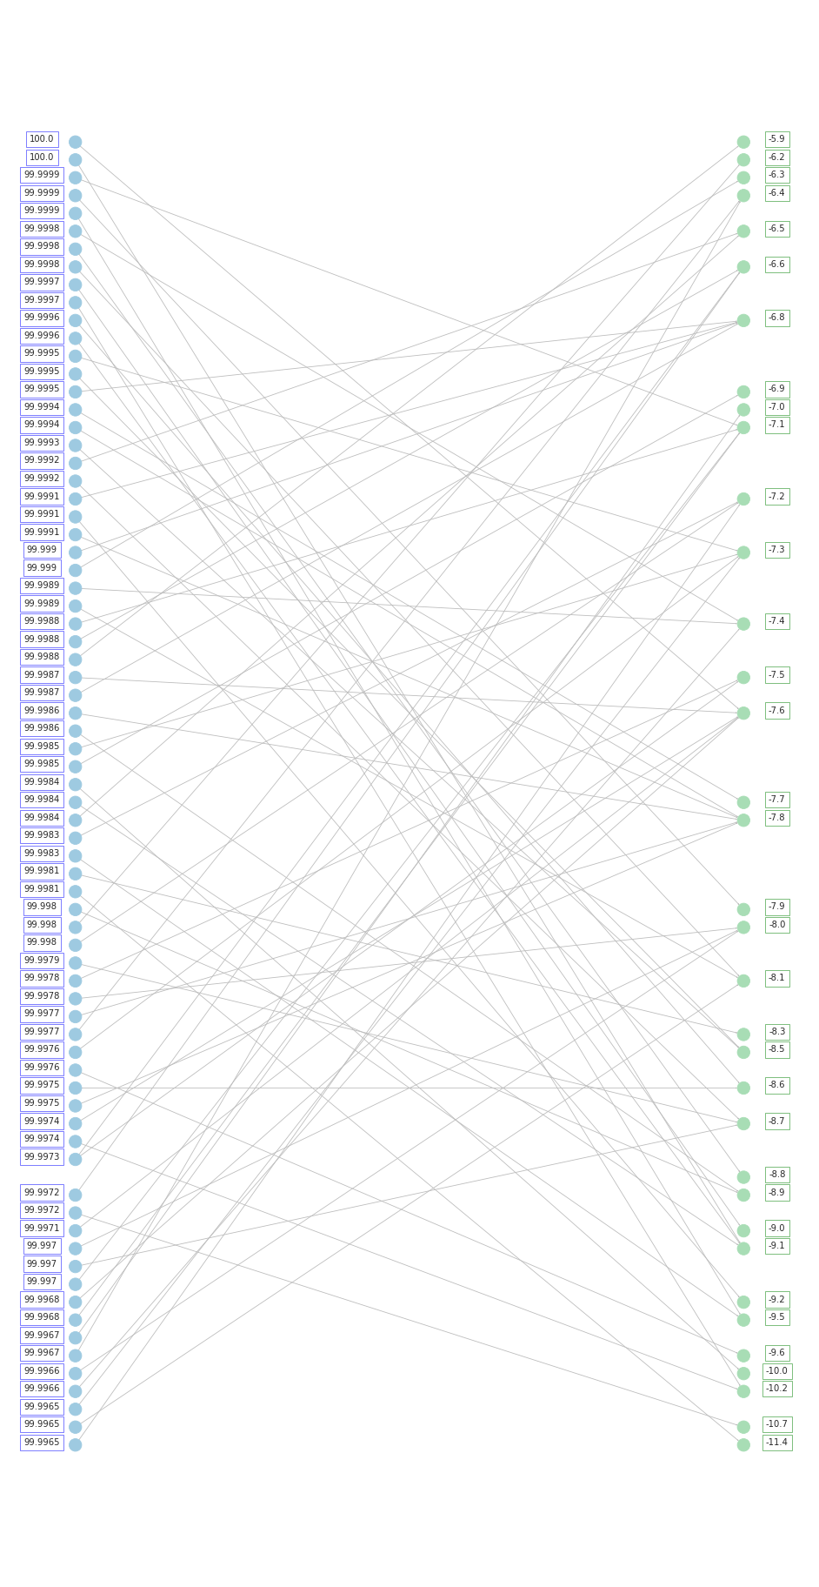
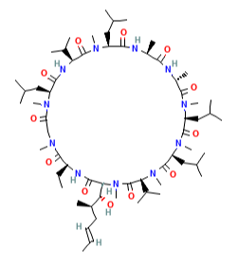
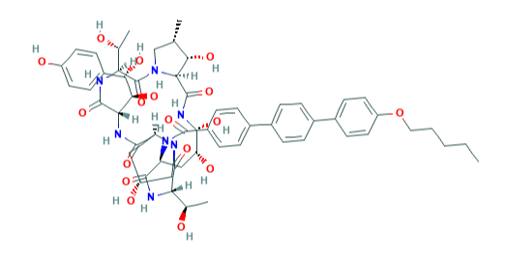
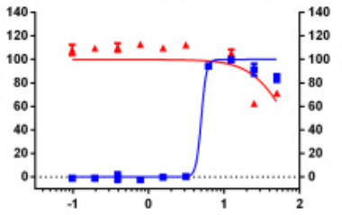
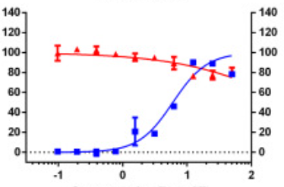
A
D
c_{Spearman}(p_{ij}^{VecNet}, ΔG) = -0.51
Threshold of
-1.75 kcal/mole
Top Predictions
Bottom Predictions
Higher AI-Bind Prediction p_{ij}^{VecNet}
Lower Binding Affinity
Stronger Binding
Prediction Percentile
Binding Affinity (kcal/mole)
PDF
B
Binding Affinity in kcal/mole
Predicted Label (AI-Bind)
Binding
Non-binding
74
10
Binding
True Label (Auto-docking)
23
21
Non-binding
F1-Score = 0.82
C
Anidulafungin
Cyclosporin
% Inhibition
% Inhibition
% Cell ratio
% Cell ratio
Concentration [log μM]
Concentration [log μM]
*
IC₅₀=4.64; CC₅₀>50; SI=10.78
*
IC₅₀=5.82; CC₅₀>50; SI=8.59
*Adapted from Jeon, S.et al. Identification of antiviral drug candidates against SARS-CoV-2 from FDA-approved drugs. Antimicrobial Agents and Chemotherapy 64 (2020). URL https://doi.org/10.1128/aac.00819-20. Adapted with permission.

