Slide 1
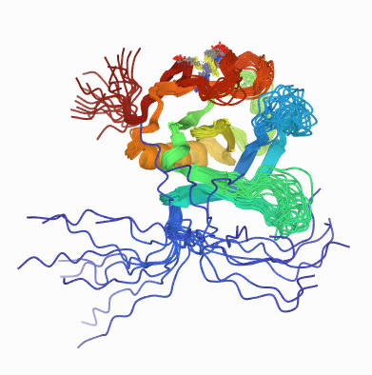
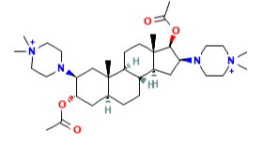
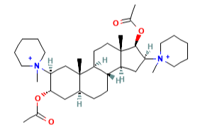
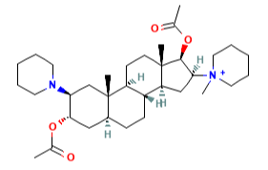
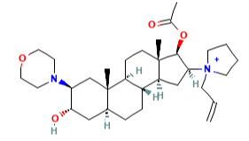
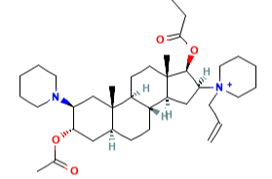
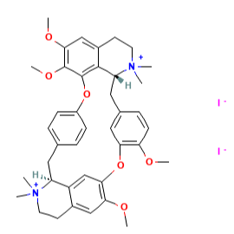
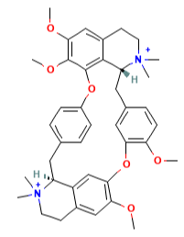
c_{Spearman}(p_{ij}^{VecNet}, ΔG) = -0.40
Prediction Percentile
0
0
-3
-1
-2
+3
+3
99.99976
99.99955
99.99901
99.99701
99.99691
99.99687
99.99671
-7.6
-7.6
-7.5
-7.5
-7.3
-7.1
-6.9
Tyrosine-protein kinase Tec
Binding Affinity (kcal/mole)
Change in Rank
Pipecuronium
Pancuronium
Vecuronium
Rocuronium
Rapacuronium
Metocurine iodide
Metocurine

