Slide 1
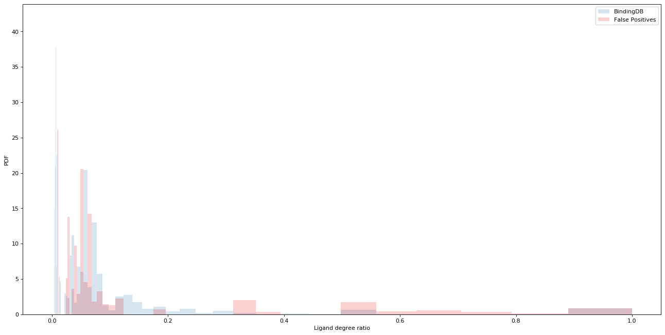
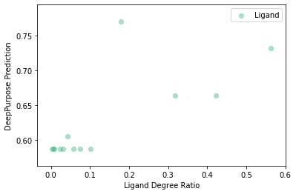
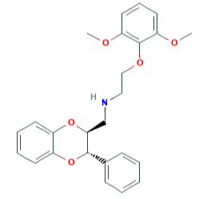
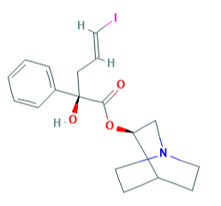
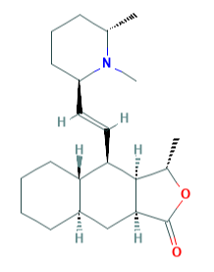
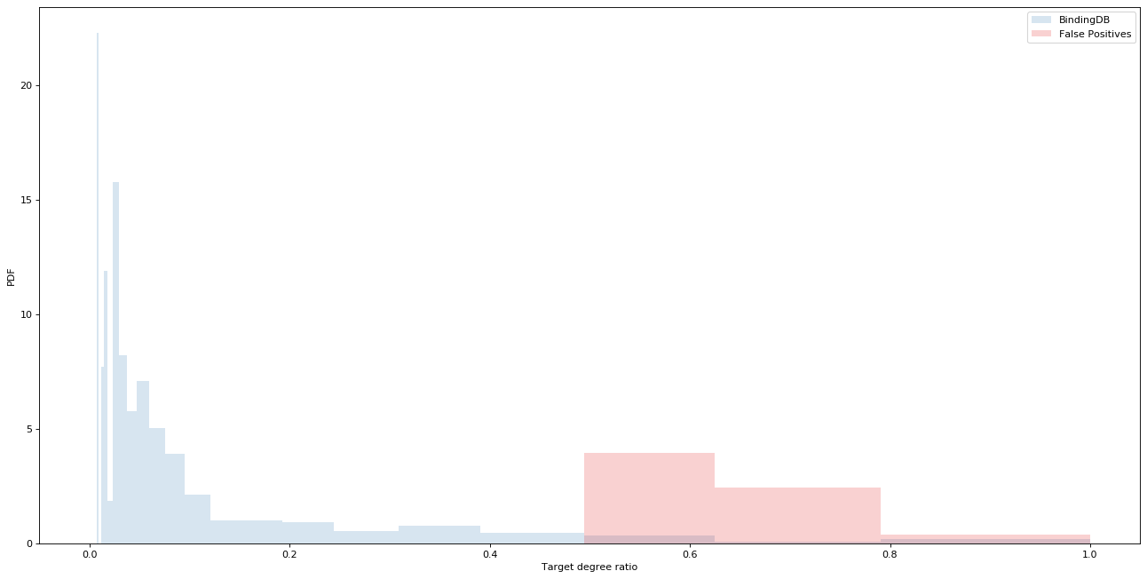
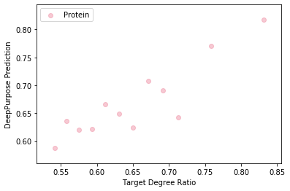
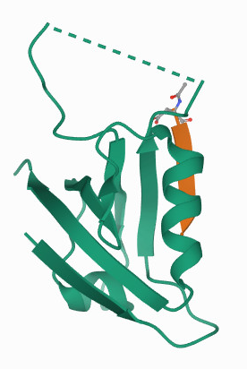
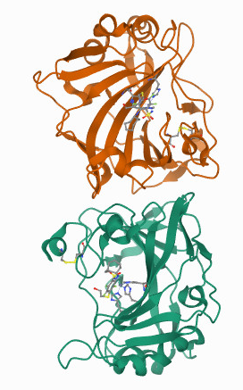
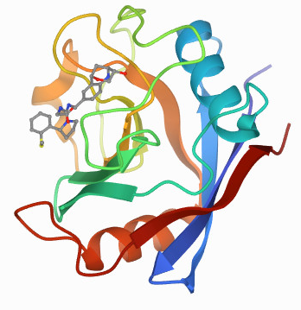
a
a
BindingDB Training Data for DeepPurpose
Node Type | Has Only Positive Annotations | Has Only Negative Annotations | Has both annotations | Total Node Count
Ligand | 3,084 | 6,539 | 793 | 10,416
Protein | 168 | 556 | 667 | 1,391
b
b1
BindingDB
False Positives
Phendioxan
IQNP
Himbacine
DeepPurpose Prediction
PDF
Ligand degree ratio (ρ)
k_{i}⁺ = 2
k_{i}⁻ = 1
ρ_{i} = 0.67
k_{i}⁺ = 4
k_{i}⁻ = 1
ρ_{i} = 0.8
k_{i}⁺ = 1
k_{i}⁻ = 0
ρ_{i} = 1.0
c
Ligand Degree Ratio
c1
BindingDB
False Positives
SSTR2
CA9
PPIF
DeepPurpose Prediction
PDF
Target degree ratio (ρ)
k_{i}⁺ = 10
k_{i}⁻ = 5
ρ_{i} = 0.67
k_{i}⁺ = 60
k_{i}⁻ = 18
ρ_{i} = 0.77
k_{i}⁺ = 3
k_{i}⁻ = 0
ρ_{i} = 1.0
d
Target Degree Ratio
Assigning SMILEs and Amino Acid Sequences Randomly
Version | AUROC | AUPRC
Original | 0.85 | 0.63
Randomized | 0.84 | 0.61
Notes:
Number of false positives per degree – not for the full range – distribution of the false positives per degree
Phendioxan -> 2-(2,6-Dimethoxyphenoxy)-N-[[(2S,3S)-3-phenyl-2,3-dihydro-1,4-benzodioxin-2-yl]methyl] ethanamine
3. IQNP -> (E)-(R)-2-Hydroxy-5-iodo-2-phenyl-pent-4-enoic acid (R)-(1-aza-bicyclo[2.2.2]oct-3-yl) ester

