Slide 1
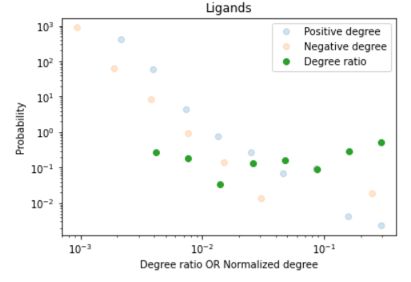
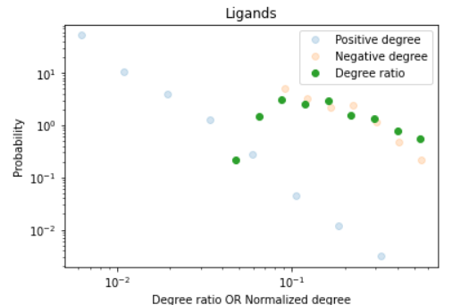
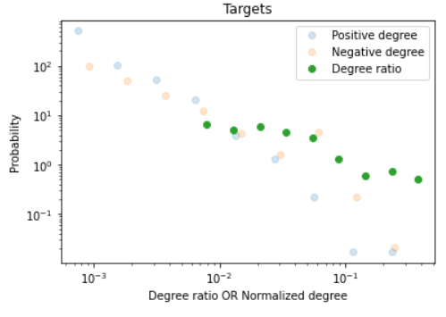
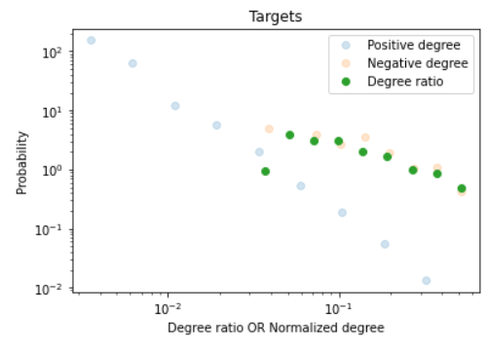
Benchmark BindingDB data
Network-Derived Negatives
A
Ligands
B
Ligands
Probability
Probability
Degree ratio OR Normalized Degree
Degree ratio OR Normalized Degree
C
Targets
D
Targets
Probability
Probability
Degree ratio OR Normalized Degree
Degree ratio OR Normalized Degree

