Slide 1
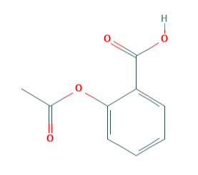
Molecule
Encoder Neural Network
Latent Representation (Embeddings)
Decoder Neural Network
Reconstructed Molecule

