Slide 1
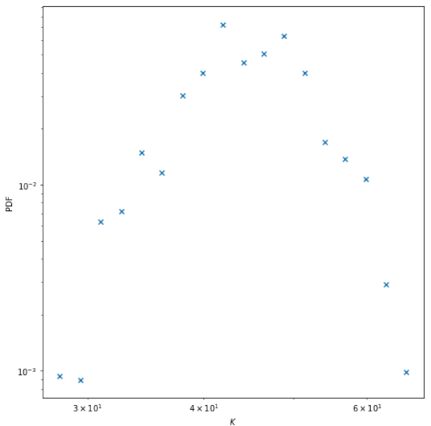
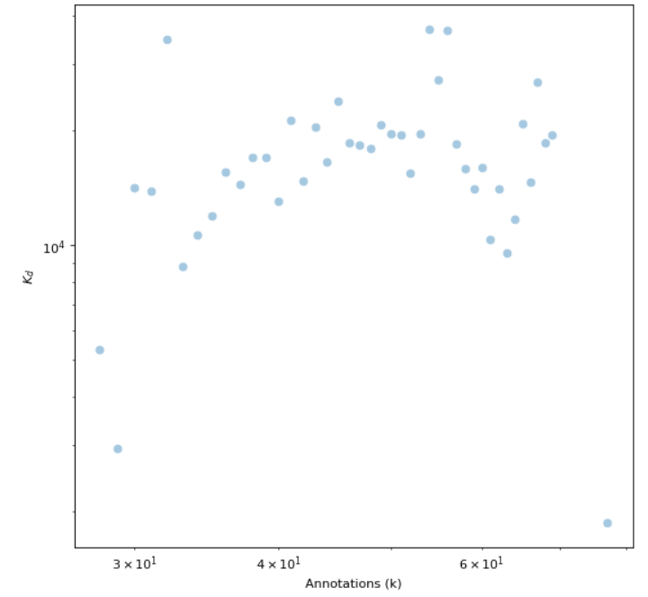
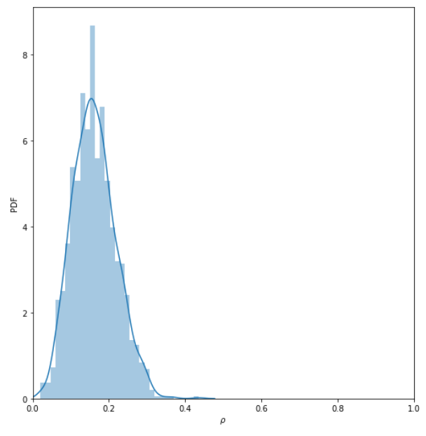
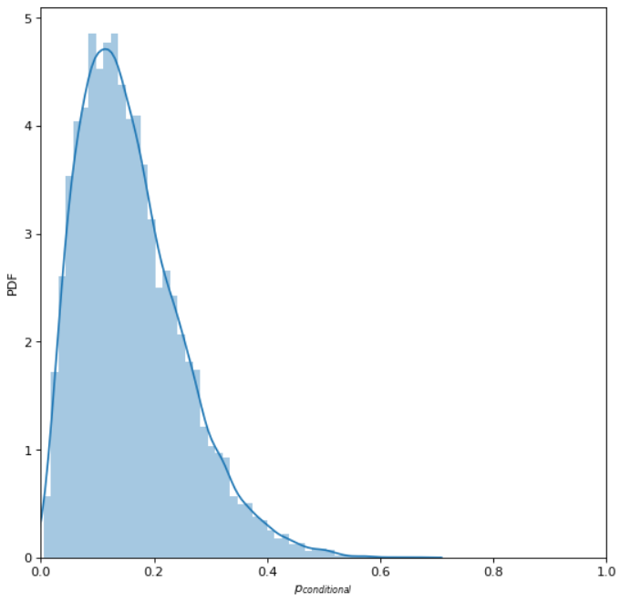
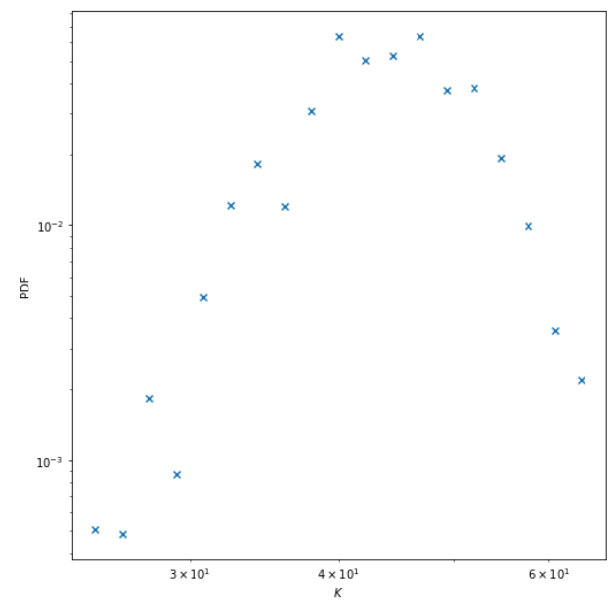
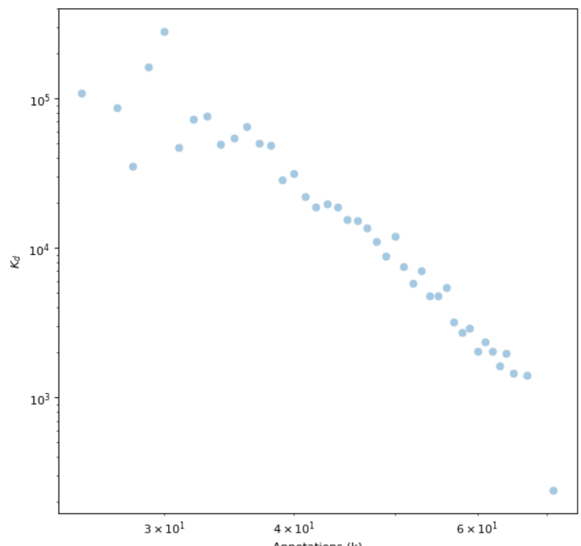
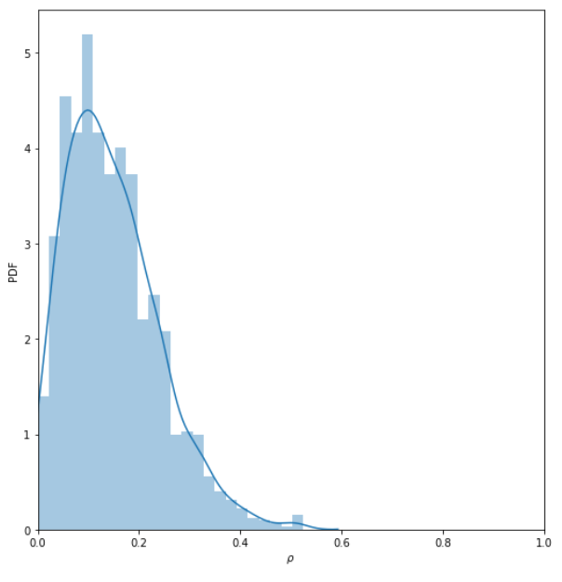
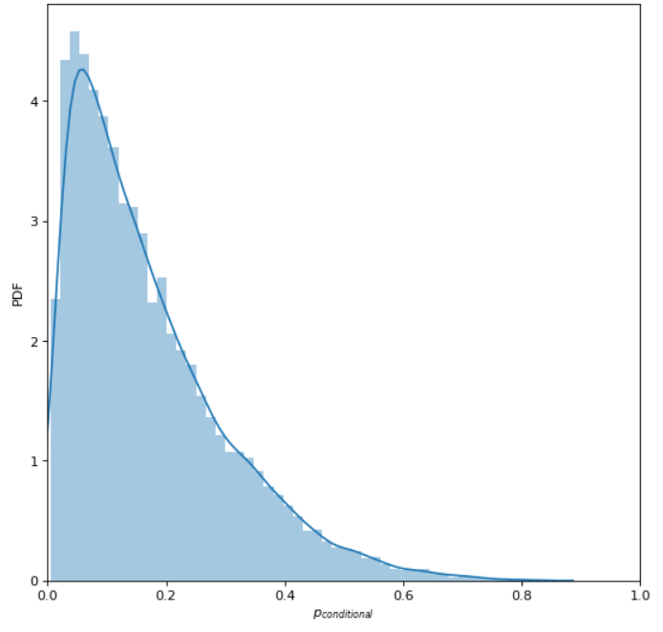
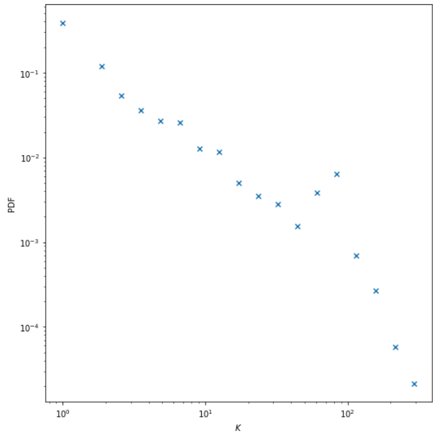
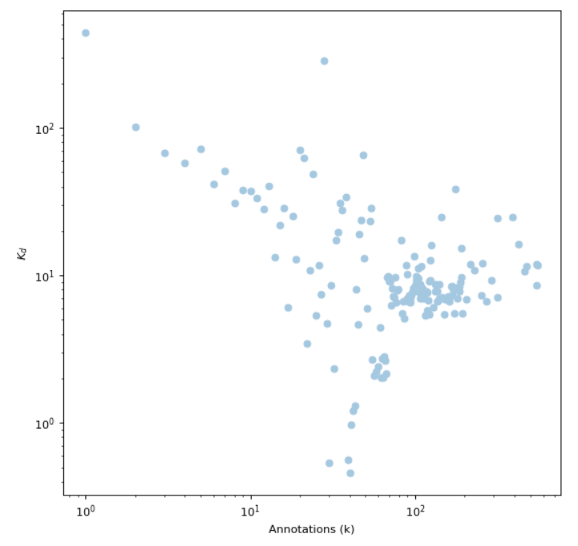
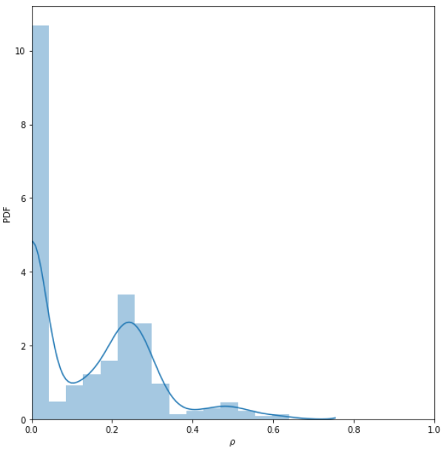
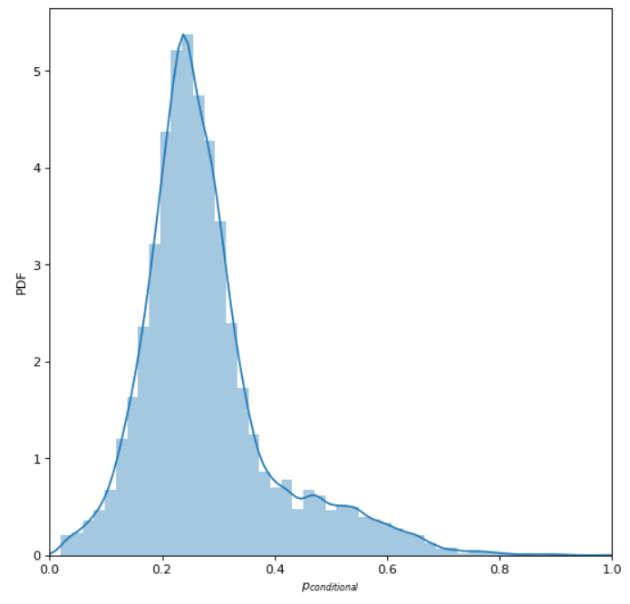
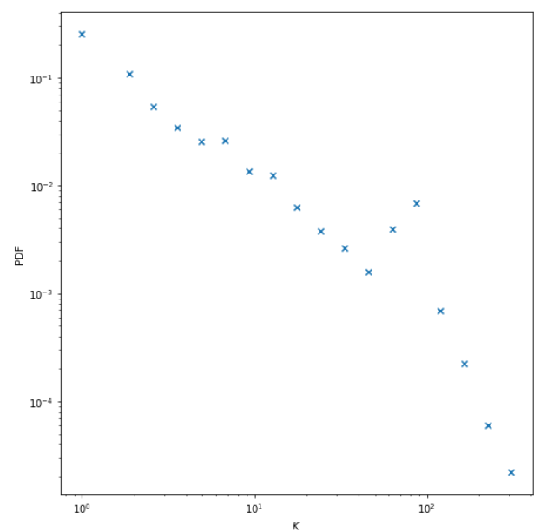
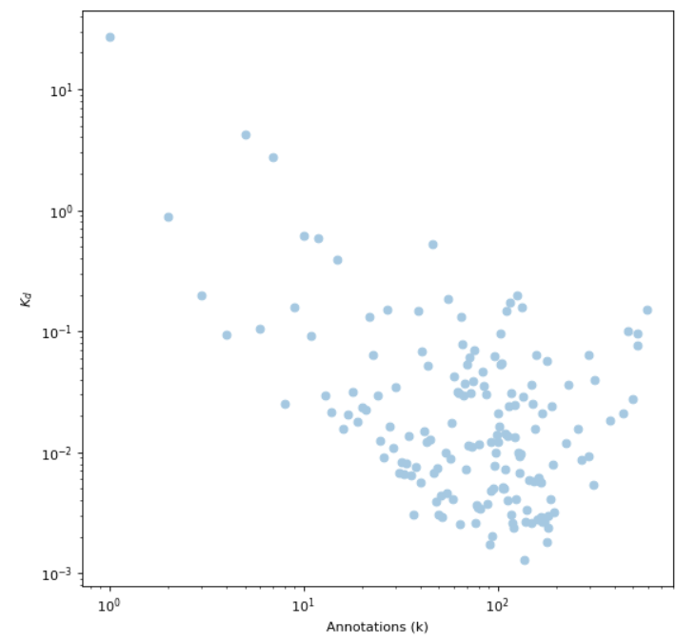
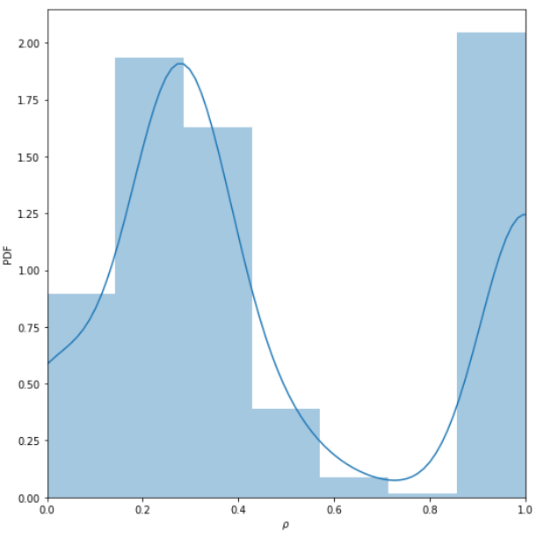
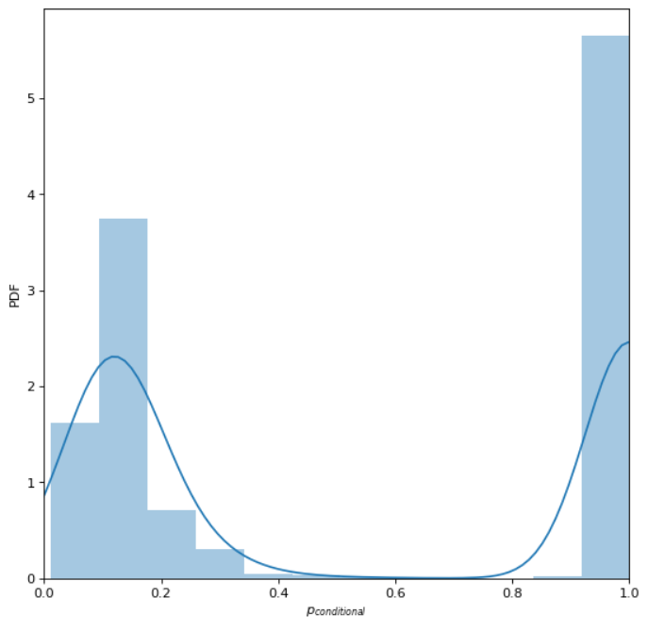
Annotation distribution
Association between Annotations and K_{d}
Degree ratio distribution
Duplex Configuration Model Predictions
Poisson
+
c_{Spearman}(k,<K_{d}>) ≈ 0
<K_{d}>
PDF
<K_{d}>
PDF
PDF
Annotations (k)
Annotations (k)
ρ
p_{ij}^{conditional}
Annotations (k)
Poisson
+
c_{Spearman}(k,<K_{d}>) ≈ -0.47
PDF
<K_{d}>
PDF
PDF
Annotations (k)
Annotations (k)
ρ
p_{ij}^{conditional}
Power-law
+
c_{Spearman}(k,<K_{d}>) ≈ 0
PDF
<K_{d}>
PDF
PDF
Annotations (k)
Annotations (k)
ρ
p_{ij}^{conditional}
Power-law
+
c_{Spearman}(k,<K_{d}>) ≈ -0.47
<K_{d}>
PDF
PDF
PDF
Annotations (k)
Annotations (k)
ρ
p_{ij}^{conditional}

