Slide 1
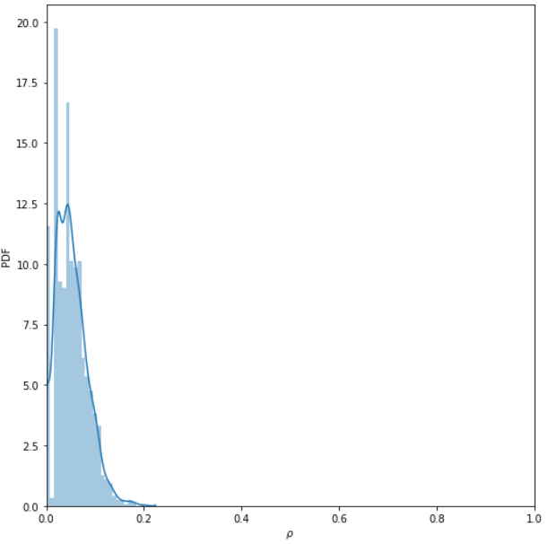
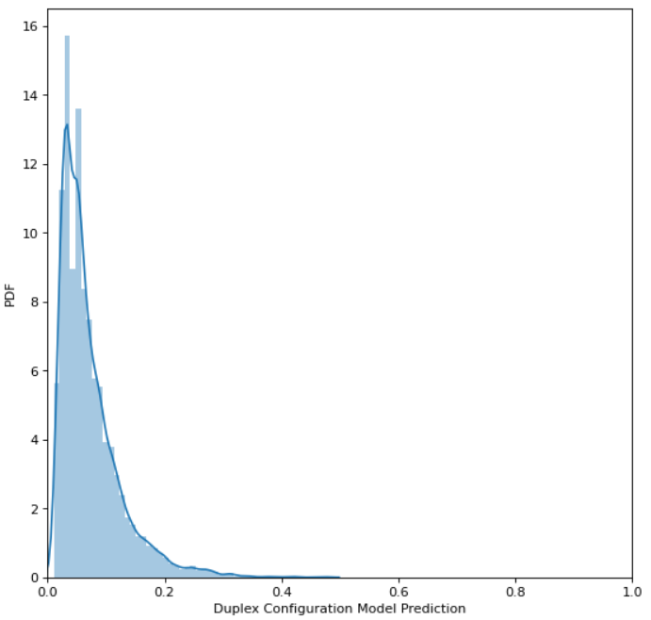
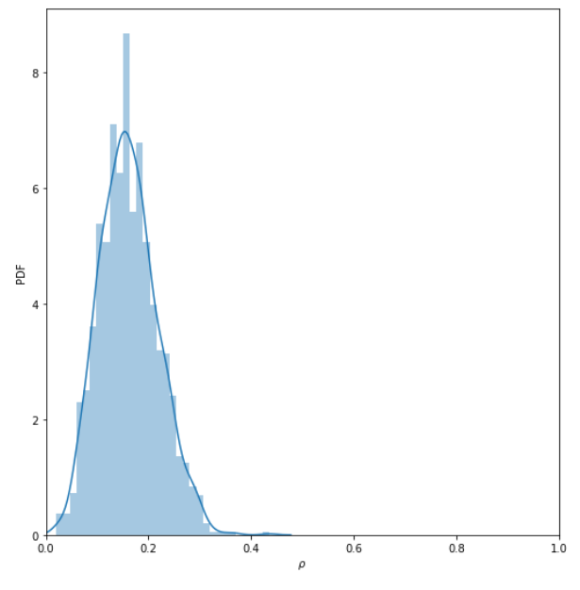
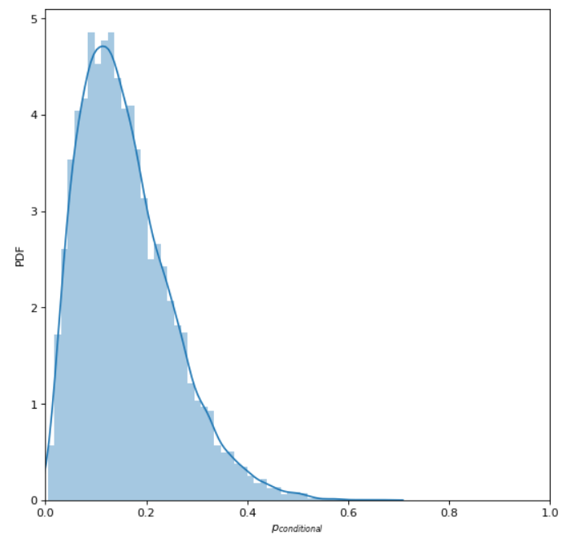
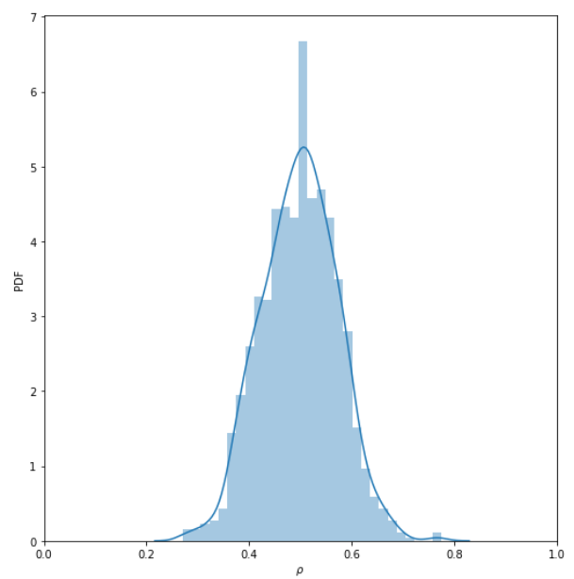
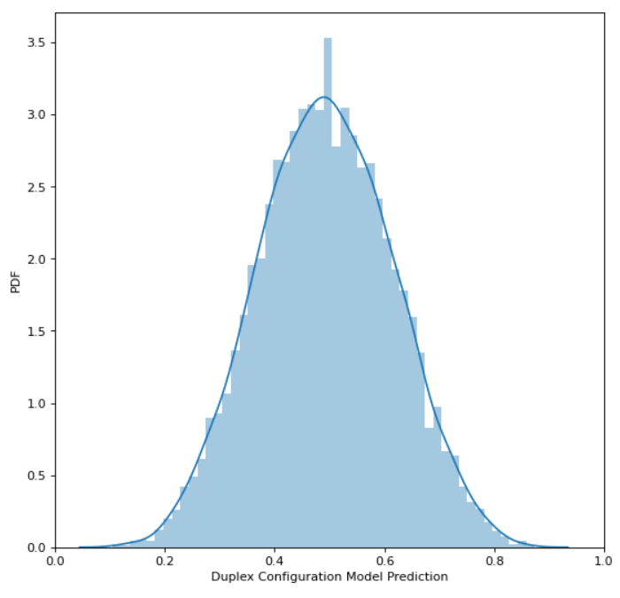
p_{bind} = 0.05
PDF
PDF
ρ
p_{bind} = 0.16
p_{ij}^{conditional}
PDF
PDF
ρ
p_{ij}^{conditional}
p_{bind} = 0.5
PDF
PDF
ρ
p_{ij}^{conditional}

