Slide 1
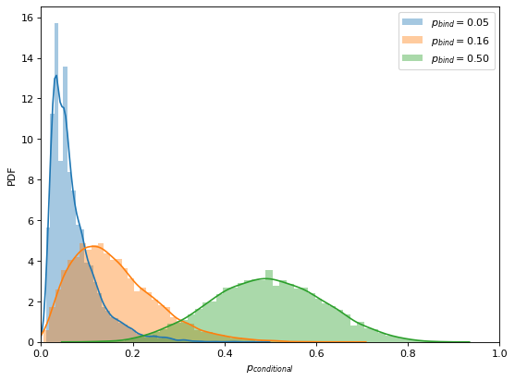
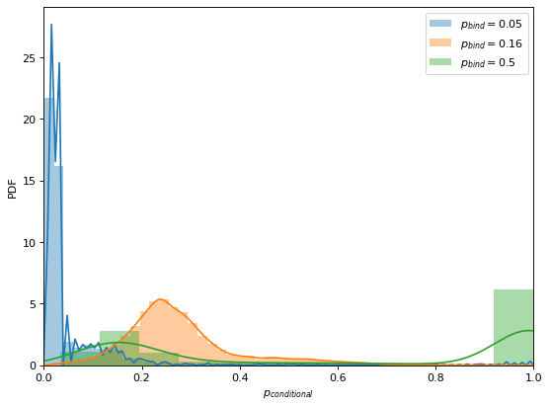
A
PDF
p_{conditional}
B
PDF
p_{conditional}

