Slide 1



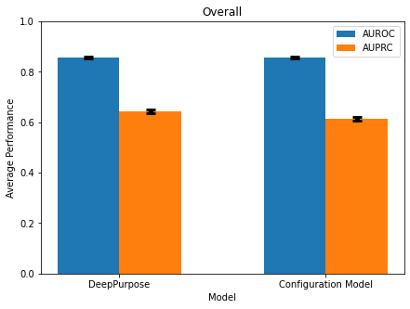
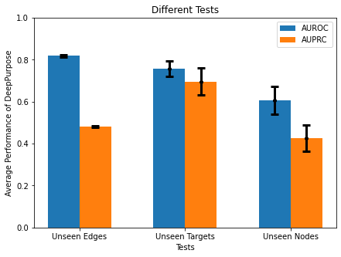
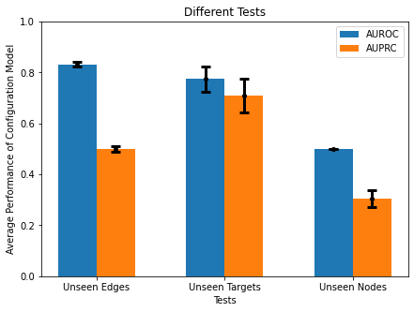






A
Layer 1
$$\vec{m}=(1,0)$$
Positive
Entropy Maximization
Layer 2
$$\vec{m}=(0,1)$$
Negative
Binding
Protein
Non-binding
Ligand
$$\vec{m}=(0,0)$$
$$\vec{m}=(0,1)$$
$$\vec{m}=(1,0)$$
$$\vec{m}=(1,1)$$
Annotation
Unknown
Negative
Positive
Not Possible
B
C
D
Overall
Different Tests on DeepPurpose
Different Tests on Configuration Model
Performance
Performance of DeepPurpose
Performance of Configuration Model
DeepPurpose
Model
Configuration Model
Unseen Edges
Unseen Targets
Unseen Nodes
Unseen Edges
Unseen Targets
Unseen Nodes
Test
Test

