Slide 1
EDUCATION RESOURCE PLATFORM

Slide 2
Problem statement
The purpose of the project is to help students to manage their activities through a single platform.
It will also help teaching assistants and research assistants to manage and log their activities through this platform.
The professor can easily release and review assignments, grade students, track TA`s and RA`s activities and view statistical reports such as TA`s and RA`s weekly hours, average student grades etc.

Slide 3
Introduction
Education resource platform is an application to manage all the academic functionalities of the university.
Academic functionalities like uploading assignments, grading of the assignments by TA’s, final grading by the professor, discussion feeds, addition of courses by program coordinator etc.

Slide 4
ROLES
1. Professor.
2. Teaching Assistant.
3. Research Assistant.
4. Student.
5. Program Director.
6. Program Coordinator.
7. Admin.

Slide 5
Administrator Types
1. Admin – managing countries and universities.
2. University Admin – managing colleges and students.
3. College Admin – managing majors, program director, program coordinator and professors.

Slide 6
Task List
1. Professor:
Release Assignments.
Final Grading.
Assign TA’s and RA’s.
Teaching Assistant:
Assignment reviews.
Knowledge hours.

Slide 7
Task List
3. Research Assistant:
Working hours.
Reports.
4. Program Director:
Manage requests submitted by Program Coordinator.
5. Program Coordinator:
Manage Courses.
Assign Professors.

Slide 8
Special Functionalities
Feed Page.
Discussion thread on assignments.
Live TA\RA hours tracking.
Clocked TA\RA working hours.
Clocked assignment reviews.
Interactive Dashboards.

Slide 9
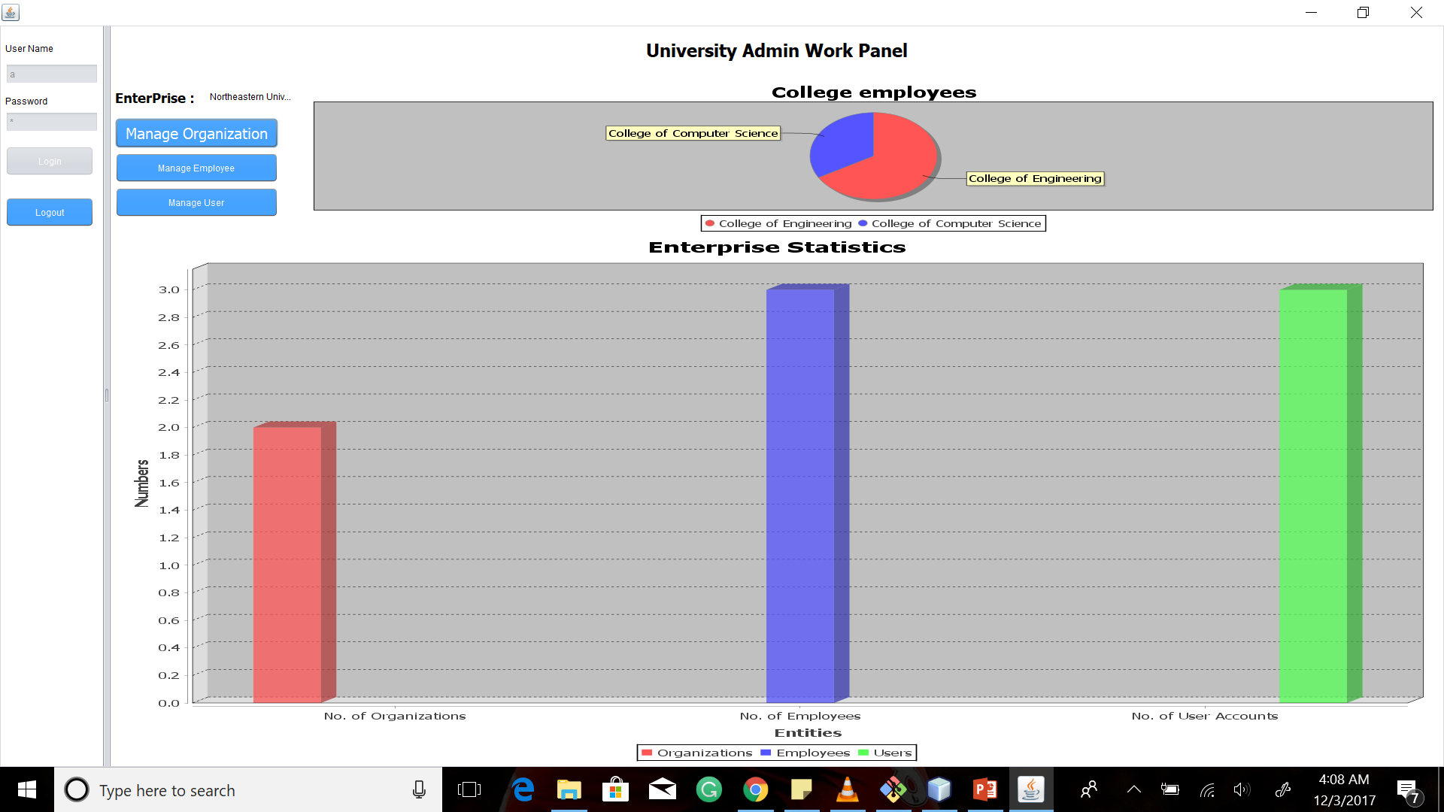
Dashboard showing all the Statistics for the University admin

Slide 10
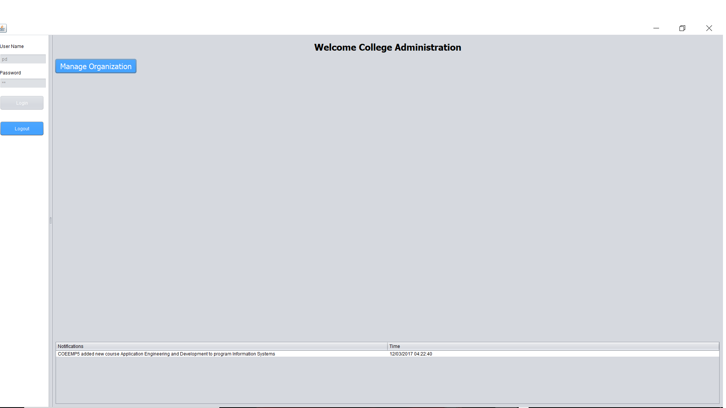
Live Feed share regarding all the courses

Slide 11
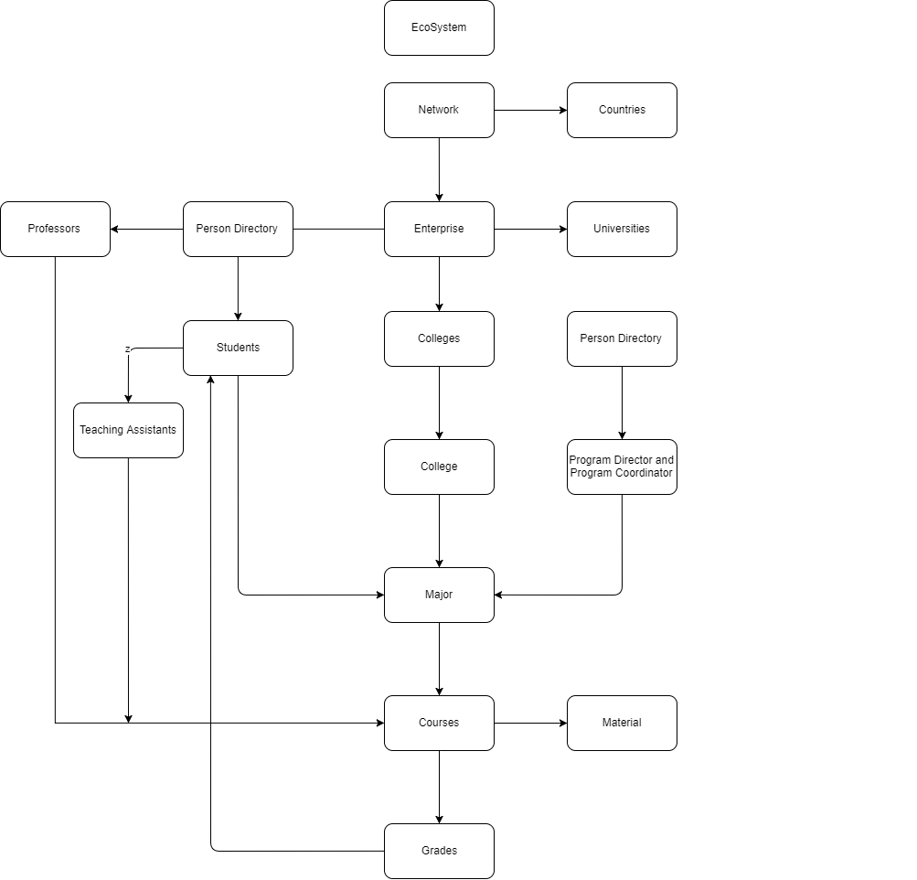

Slide 12
Thank you!

