Slide 1
EDUCATION RESOURCE PLATFORM

Slide 2
Introduction
Education resource platform is an application to manage all the academic functionalities of the university.
Academic functionalities like uploading assignments, grading of the assignments by TA’s, final grading by the professor, discussion feeds, addition of courses by program coordinator etc.

Slide 3
ROLES
1. Professor.
2. Teaching Assistant.
3. Research Assistant.
4. Student.
5. Program Director.
6. Program Coordinator.
7. Admin.

Slide 4
Administrator Types
1. Admin – managing countries and universities.
2. University Admin – managing colleges and students.
3. College Admin – managing majors, program director, program coordinator and professors.

Slide 5
Task List
1. Professor:
Release Assignments.
Final Grading.
Assign TA’s and RA’s.
Teaching Assistant:
Assignment reviews.
Knowledge hours.

Slide 6
Task List
3. Research Assistant:
Working hours.
Reports.
4. Program Director:
Manage requests submitted by Program Coordinator.
5. Program Coordinator:
Manage Courses.
Assign Professors.

Slide 7
Special Functionalities
Feed Page.
Discussion thread on assignments.
Live TA\RA hours tracking.
Clocked TA\RA working hours.
Clocked assignment reviews.
Interactive Dashboards.

Slide 8
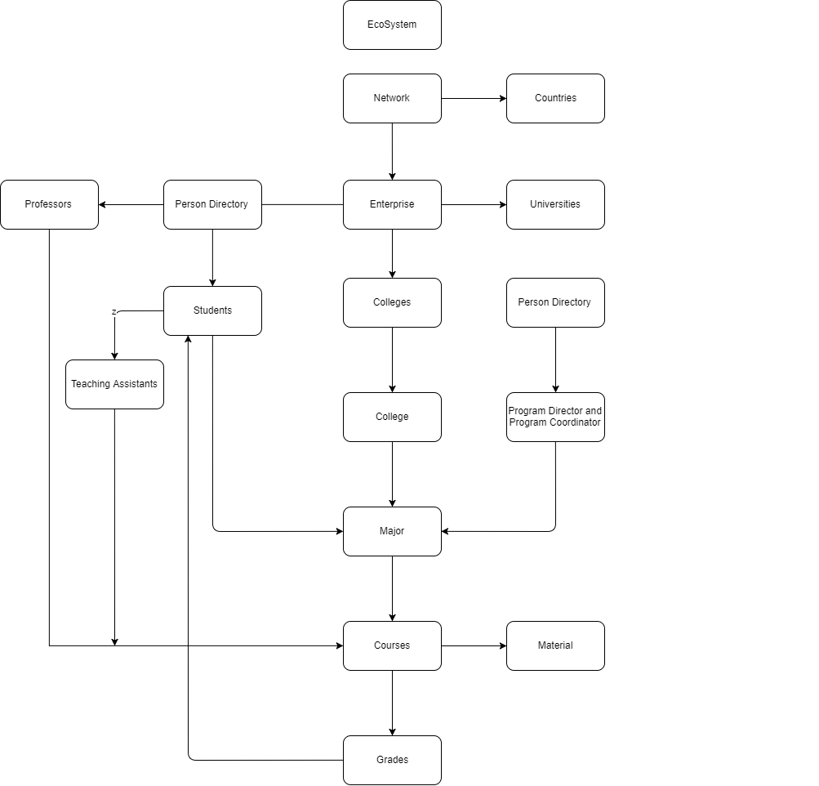

Slide 9
Thank you!

