Slide 1
Application Of Brain-Computer Interface In Augmentative And Alternative Communication For Non-Speaking Autistic
A feasibility Study

Slide 2
Literature Review (2015 to 2022)
BCI studies in autism
Identification/Classification
To identify music preferences
Mental stress during arithmetic tasks
Emotional state (distress vs non-distress)
Interest to tasks, engagement level in task, and mental workload
Social joint attention
Rehabilitation /training
Attention
Social skills
Social joint attention
Interpretation of emotional facial expressions
learning driving

Slide 3
Method
Participants (N~15; age : +12)
Formal diagnosis of autism or unspecified neurodevelopmental disability
Mild intellectual disabilities (ID) or without ID
Understand speech
Speak minimally or cannot speak
No history of epilepsy (risk of photosensitivity)
Measure
Vineland Adaptive Behavior Scales (VABS)-Third edition

Slide 4
Paradigm
Selected BCI Modality:
Steady-State Visual Evoked Potentials(SSVEP)
Benefits:
No need for training sessions
No need for overt behavioral responses
High signal-to-noise ratio (SNR)
High information transfer rate (ITR)

Slide 5
Task Design
A total of 12 pictures (i.e., AAC) will be selected for the task.
In each trial, 4 pictures will randomly be presented on an LCD monitor in front of the subject and 4 LEDs placed in the top left (1), top right (2), down left (3), and down right (4), of the monitor.
LEDs flicker with 8, 10, 12, and 15 Hz respectively.
Subjects try to select the output command (i.e., one of 4 pictures on the monitor) by paying attention to a sound that defines the number of the picture.
Each session includes 120 trials and each picture will be presented 10 times.
Each trial time is equal to 7 seconds including 5 seconds picture presentation followed by a 2-second rest black/white screen.
Overall, 3 sessions will be presented by inserting about a 5-minute break between sessions.

Slide 6
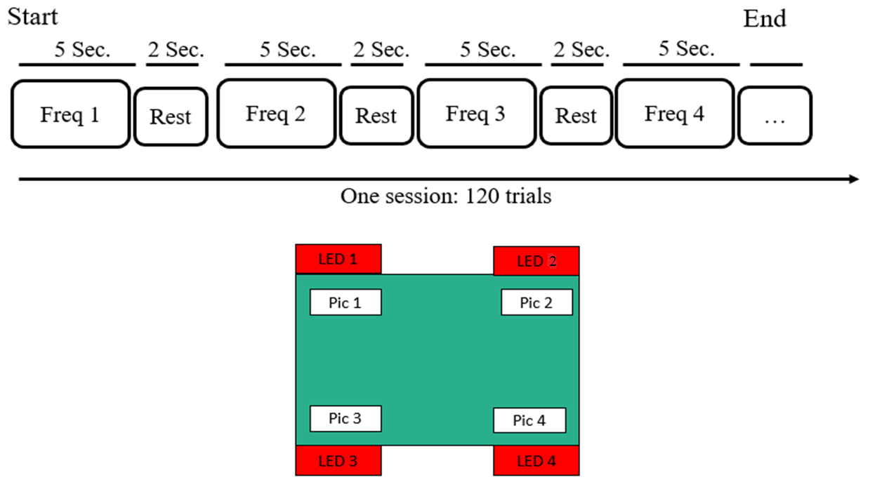

Slide 7
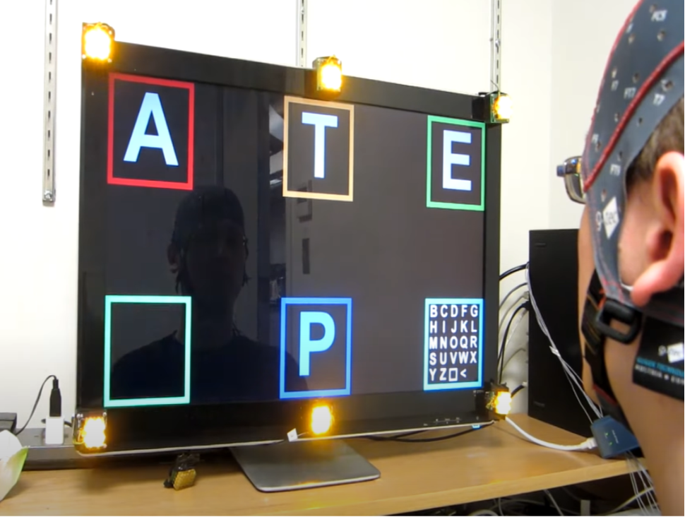
The SSVEP Shuffle Speller associates a letter (task symbol) with a particular SSVEP response (brain symbol) by placing it near the LED array which stimulates that response. The square and less-than characters represent space and backspace respectively.

Slide 8
EEG acquisition
Feasible with 8-channel EEG, using a 10-20 standard system
Location of EEG electrodes placement: Occipital and Parietal lobs
The right ear and Fpz will be dedicated to reference and ground electrodes respectively
Online notch (50 Hz) and bandpass filters (2-100 Hz) will be used
The frequency sampling frequency in this study is 512 Hz. Synchronization pulses/trigger signals should be recorded simultaneously with EEG signals.

Slide 9
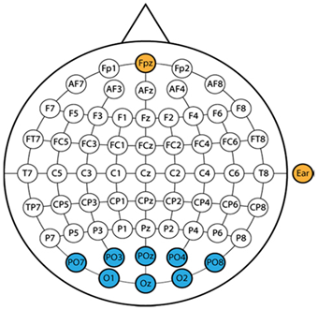
The location of EEG electrodes

Slide 10
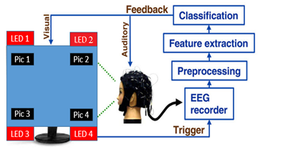
General block diagram of the experimental setup and data analysis

Slide 11
SSVEP Evaluation
Accuracy of classification
ACC=correct trials/all trials
Information Transfer Rate (ITR)
Measured in bits per minute
This project: Expected one command in 1-2 seconds

