Slide 1
INCOMPLETE CASE K NEAREST NEIGHBOUR IMPUTATION [ICKNNI] AND COMPLETE CASE K NEAREST NEIGHBOUR IMPUTATION [CCKNNI]
Arulpiruthiviraj Arunthavaraja (105212573)
Baranidharan Pasupathi (110007279)
Sariat Sultana (110028032)

Slide 2
Presentation Outline
Imputation Based on Closest Neighbor
K Nearest Neighbor (KNN)
Complete Case K Nearest Neighbor Imputation (CCKNNI) & Incomplete Case K Nearest Neighbor Imputation (ICKNNI) Algorithms
Complexity Analysis
References

Slide 3

Imputation Based on Closest Neighbor
The imputation technique of CCKNNI and ICKNNI relies on the value of nearest neighbor.
To identify the closest example/instances Euclidean metric is used.

Slide 4
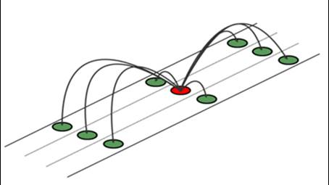
K Nearest Neighbor (KNN)
K Nearest Neighbor is a non-parametric method used for classification and regression.
KNN Classification predicts the class to which the output variable belong by computing the local probability.
KNN Regression predicts the value of the output variable by using a local average.

Slide 5
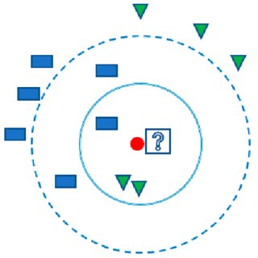
KNN Regression
Both CCKNNI and ICKNNI uses KNN regression technique to compute the nearest neighbor.
KNN regression is basically an application of shortest distance method (Euclidean metric) to obtain neighbors.
The Euclidean method clearly justifies that theses algorithms are only suitable for numerical datasets.

Slide 6

CCKNNI vs. ICKNNI
Both algorithm makes use of Euclidean distance to find their closest neighbor.
The CCKNNI algorithm segregates the datasets by their absolute attribute values and computes the shortest distance while the ICKNNI includes all examples (including missing ones) for imputation.
ICKNNI provides persuasive unbiased solutions for analysis over CCKNNI since it includes incomplete instances for imputation.
The segregation of dataset is the key difference between them.

Slide 7
Algorithms

Slide 8
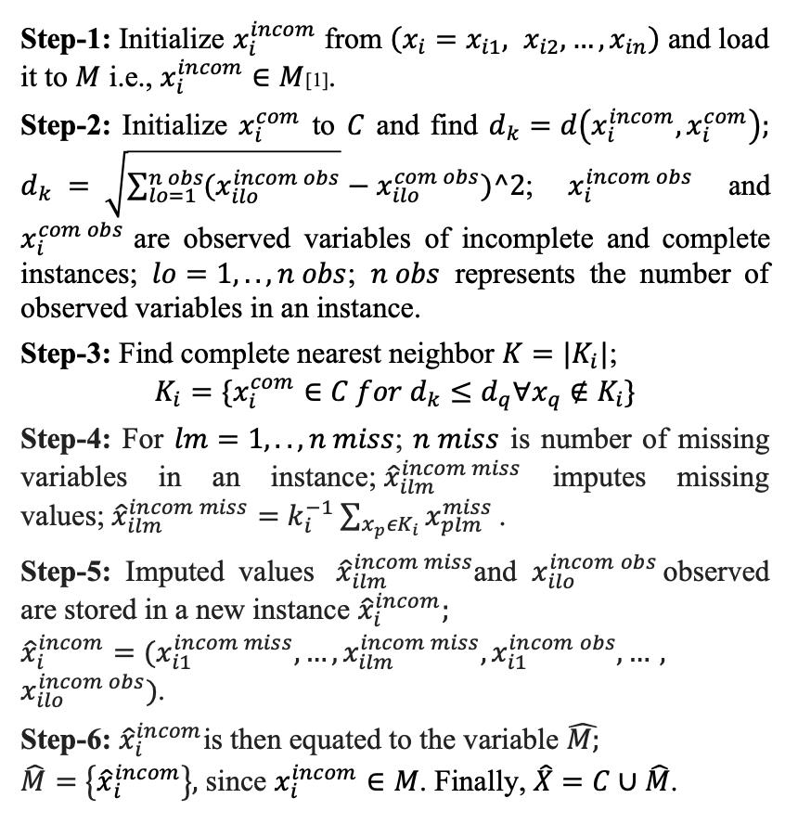
Complete Case K Nearest Neighbor Imputation (CCKNNI)

Slide 9
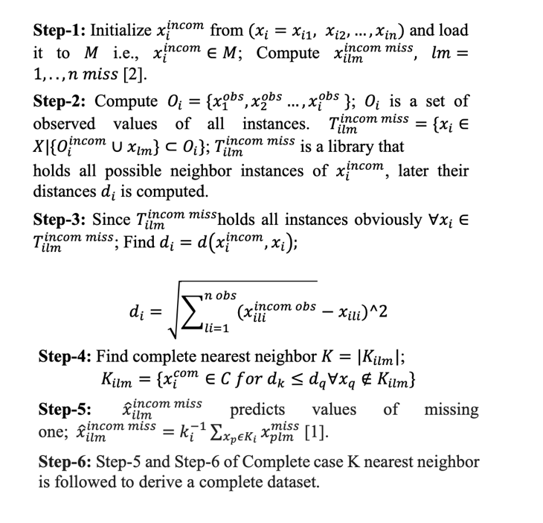
Incomplete Case K Nearest Neighbor Imputation (ICKNNI)

Slide 10


Complexity Analysis
Considering dataset $X$ with $m$X$n$ records & attributes. The computational complexity of KNN impute method is approximately $O\left(m2n\right), assuming m≫ k.$
The execution of both cases will be almost similar since they follow KNN procedure. In ICKNNI where maximum percent of missing cases are considered there might be a slightly longer execution is expected while in CCKNNI its not.
In-reality software empirical analysts use list deletion LD in CCKNNI datasets to avoid biased output which will make the execution time much faster when compared with ICKNNI.

Slide 11
References
[1] J. V. Hulse, T. M. Khoshgoftaar, “Incomplete-Case Nearest Neighbor Imputation In Software Measurement Data,” An International Journal, Computer, and Electrical Engineering, Florida Atlantic University, Florida, USA, 2011.

