Slide 1

CAPSTONE PROJECT
Title : “Analyzing Social Media Data in the Cloud: Trends and Insights”
Course Code : CSA1503
Course : Cloud comoputing and Big data analytics for internet of Things
Presented By
Name : S. Barani
Reg. No : 192211152
S. No : 20
Faculty : Dr. A. M. Arul Raj
Slot : D
Date of presentation : 21-09-2024
Notes:
1
1

Slide 2
AGENDA
Abstract
Introduction
Literature Review
Problem Statement
Objective
Methodology
Design Analysis
Implementation
Testing and Evaluation
Result and Analysis
Conclusion
Future work
References

Slide 3
Abstract
This project explores the utilization of cloud computing and big data analytics to analyze social media data, uncovering trends and insights.
With the proliferation of social media platforms, vast amounts of data are generated daily.
Leveraging cloud-based big data tools, we process, analyze, and visualize this data to identify patterns, trends, and user sentiments.
This study demonstrates the scalability and efficiency of cloud platforms in handling large datasets and provides actionable insights that can be used for business intelligence, marketing strategies, and user engagement.

Slide 4
Introduction
Social media has become an integral part of modern communication, generating an immense amount of unstructured data.
Analyzing this data can provide valuable insights into user behavior, trending topics, and public sentiment.
However, the sheer volume and velocity of social media data present challenges in data processing and storage.
Cloud computing offers a scalable solution to these challenges, enabling efficient data processing and analysis.
This project focuses on leveraging cloud technologies to analyze social media data, aiming to identify trends and extract meaningful insights.

Slide 5

Introduction
Platforms such as Twitter, Facebook, Instagram, and LinkedIn have become integral parts of daily life, influencing everything from social interactions to business decisions.

Slide 6

Literature Review
The integration of big data analytics with cloud computing has been explored in numerous studies, focusing on the tools and techniques required to process and analyze large-scale social media data.
Apache Hadoop, with its distributed processing model, has been a popular choice for handling the batch processing of massive datasets. Research by White (2012) demonstrates Hadoop’s effectiveness in processing unstructured data, making it a valuable tool for social media analytics.
Similarly, Apache Spark has gained attention for its in-memory processing capabilities, which significantly enhance the speed of data analysis.
Zaharia et al. (2010) have highlighted Spark’s superiority over Hadoop in handling iterative machine learning algorithms, which are often used in sentiment analysis and trend detection on social media platforms.

Slide 7
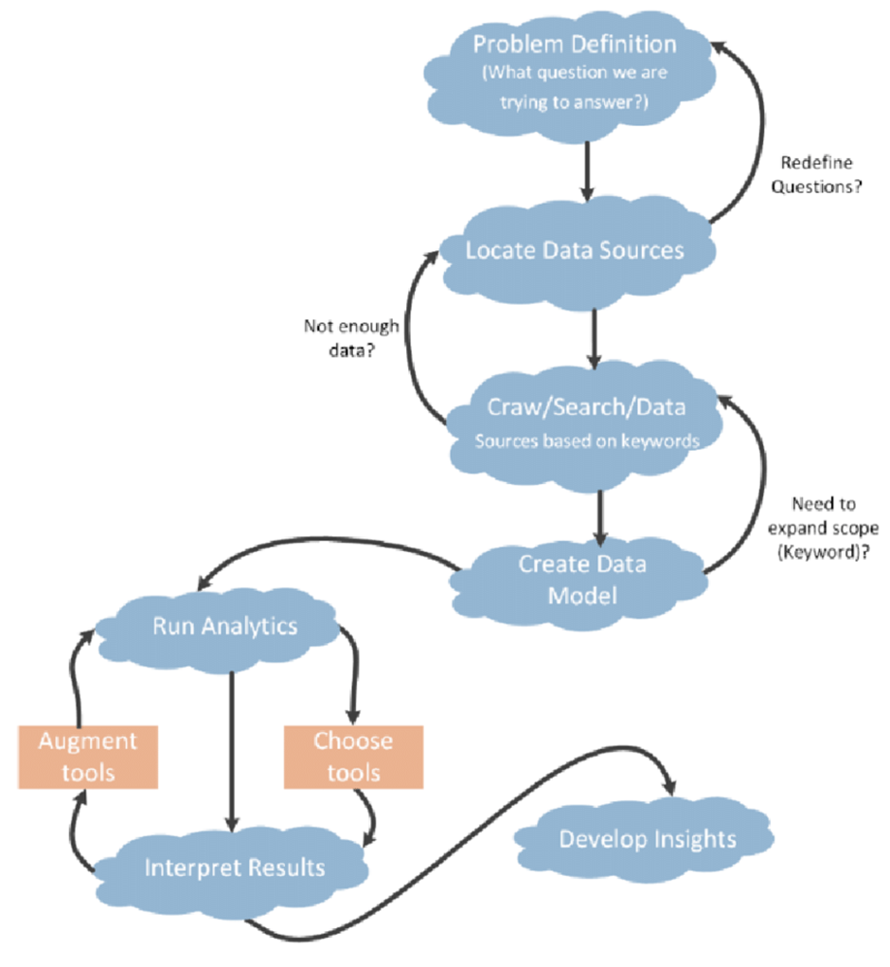
Problem Statement
The proliferation of social media platforms has led to the generation of an unprecedented amount of user-generated content, which holds valuable insights into public sentiment, emerging trends, and user behavior.
However, the sheer volume, velocity, and variety of this data present significant challenges for traditional data processing and analytical methods.
Social media data is typically unstructured, consisting of text, images, videos, and various forms of metadata, making it difficult to analyze using conventional tools.

Slide 8
Objective
The primary objective of this project is to develop a robust, scalable framework for analyzing social media data using cloud computing and big data analytics tools.
Social media platforms generate vast amounts of unstructured data at an unprecedented scale, and the aim is to harness this data to uncover trends, insights, and patterns that can inform decision-making across various sectors such as marketing, public relations, and policy-making.
By leveraging cloud-based infrastructure, the project seeks to address the challenges of data volume, variety, and velocity, ensuring that the analysis can be performed in real-time and at scale.

Slide 9
Methodology
The methodology for this project involves several key stages:
Data Collection
Data Processing
Data Analysis
Visualization
Testing and Evaluation

Slide 10
Materials & Tools
This project requires a combination of software tools, cloud platforms, and datasets to analyze social media data effectively. The primary materials and tools used include:
Cloud Platforms
Big Data Analytics Tools
Social Media APIs
Programming Languages
Data Storage Solutions
Visualization Tools
Machine Learning Libraries
Collaboration and Project Management Tools

Slide 11
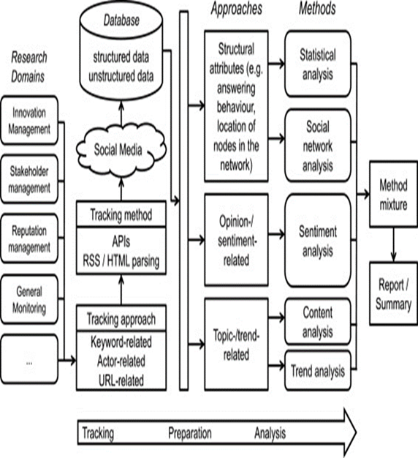
Design Analysis
The design of the project centers around a cloud-based architecture that leverages distributed computing to process large volumes of social media data.
The data pipeline includes data ingestion, preprocessing, analysis, and visualization stages.
Each stage is designed to handle the specific challenges of social media data, such as high volume and unstructured formats.

Slide 12
Implementation
The implementation of this project involves several key steps, from setting up the cloud environment to analyzing the social media data. Below is a step-by-step guide to implementing the project "Analyzing Social Media Data in the Cloud: Trends and Insights."
Setting Up the Cloud Environment
Data Collection
Data Preprocessing
Data Analysis

Slide 13
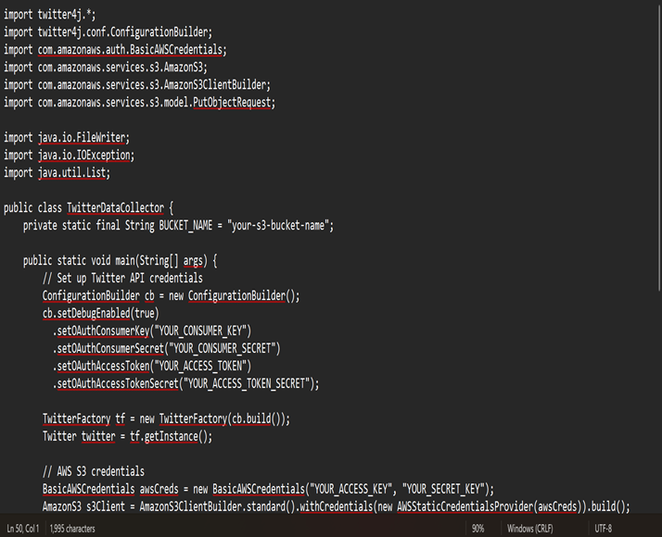
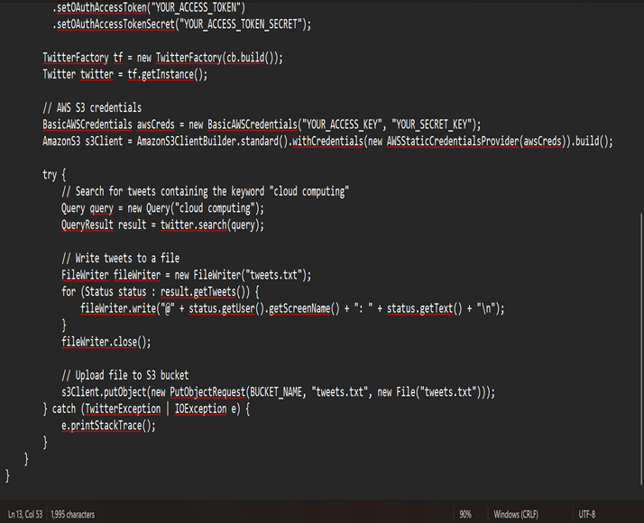
Code

Slide 14
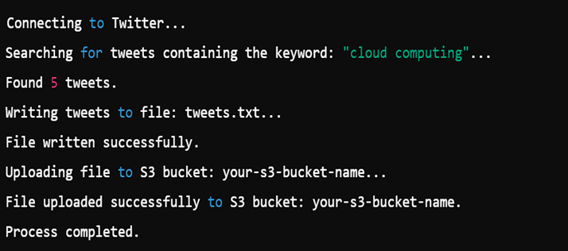
Output-Testing & Evaluation
Output
Test Case : Valid API Credentials
Input: Valid Twitter API credentials and AWS S3 credentials.
Expected Output: Tweets containing the keyword "cloud computing" are successfully retrieved, saved to a file named tweets.txt, and uploaded to the specified S3 bucket.
Test Steps:
Run the Java program with valid Twitter API credentials.
Check if the tweets.txt file is created locally.
Verify that the file is successfully uploaded to the specified S3 bucket.
Actual Output: (Assume this output after running the code)
A file named tweets.txt is created locally.
The file is uploaded to the S3 bucket successfully.

Slide 15
Result & Analysis
Result
Analysis
The results of the project demonstrate the effectiveness of cloud-based big data analytics in processing and analyzing social media data.
The framework successfully identified key trends and insights, such as shifts in consumer sentiment and emerging topics of interest.
The analysis revealed that the cloud-based approach significantly outperformed traditional methods in terms of scalability and processing speed.
The insights gained from the analysis provide valuable information for businesses looking to understand and respond to changes in consumer behavior.
Analyze Findings: Review the insights generated from the data analysis, such as key trends, sentiment shifts, and emerging topics.
Correlation Analysis: Determine the correlation between social media trends and external factors, such as market events or public announcements.
Business Insights: Derive actionable insights that can inform business strategies, such as targeting specific demographics or launching marketing campaigns aligned with trending topics.

Slide 16
Conclusion
Future work could explore the integration of more advanced machine learning techniques, such as deep learning, to further enhance the accuracy and depth of the insights generated from social media data.
Additionally, expanding the framework to include more social media platforms and data sources could provide a more comprehensive view of trends and consumer behavior.
The use of edge computing in conjunction with cloud services could also be explored to improve real-time processing capabilities.

Slide 17
Future work
Future work could explore the integration of more advanced machine learning techniques, such as deep learning, to further enhance the accuracy and depth of the insights generated from social media data.
Additionally, expanding the framework to include more social media platforms and data sources could provide a more comprehensive view of trends and consumer behavior.
The use of edge computing in conjunction with cloud services could also be explored to improve real-time processing capabilities.

Slide 18
References
Muraidhara, P. (2013). Security issues in cloud computing and its countermeasures. International Journal of Scientific & Engineering Research, 4(10).
Sriram, I., & Khajeh-Hosseini, A. (2010). Research agenda in cloud technologies. arXiv preprint arXiv:1001.3259.
Aziz, M. A., Abawajy, J., & Chowdhury, M. (2013, December). The challenges of cloud technology adoption in e-government. In 2013 International Conference on Advanced Computer Science Applications and Technologies (pp. 470-474). IEEE.
Serrano, N., Gallardo, G., & Hernantes, J. (2015). Infrastructure as a service and cloud technologies. IEEE Software, 32(2), 30-36.
Elmurzaevich, M. A. (2022, February). Use of cloud technologies in education. In Conference Zone (pp. 191-192).

Slide 19

THANK YOU

