Slide 1

FOOD ORDERING SYSTEM
SRS –TASK 1

Slide 2
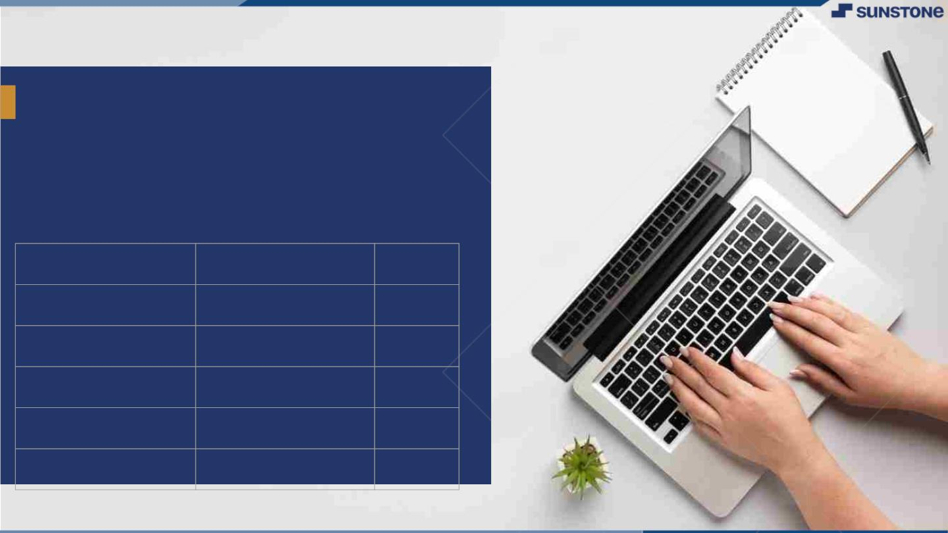
FOOD ORDERING SYSTEM
▪
Online food ordering system is a digital platform or software that allows customer to browse menus, place order and makes payments for food from restaurants or eateries.
LMS Username
Name
Batch
BARANI S
1
JEEVITHA G
1
KEERTHIGA M
1
NITHYA K
1

Slide 3

Step-WiseꢀDescription
1.Registration
2.Login
3.Display the menu
4.Modify menu
5.Select food items
6.Change the order
7.Review the order before submitting
8.Payment & Provide delivery
Summaryꢀofꢀyourꢀtask
A food ordering system is an online platform that allows customers to browse menus, select dishes and place order from restaurants. It Typically involves features like menu display , order customization and delivery or pickup options. These system have become increasingly popular , especially with the growth of food delivery services, offering convenience and a wide range of food choices to customers.

Slide 4

AssessmentꢀParameter
Gatherꢀrequirementsꢀforꢀtheꢀ
project
addꢀReadme.mdꢀfileꢀwithꢀ
descriptionꢀofꢀtheꢀproject
Prepareꢀdatabaseꢀdesignꢀ
schemas
Check-List
Commitꢀallꢀchangesꢀwithꢀ"firstꢀ
commit"
Getꢀyourꢀinitialꢀprojectꢀ
Structureꢀready
createꢀaꢀrepositoryꢀonꢀgithubꢀ
realtedꢀtoꢀproject
Initiateꢀaꢀgitꢀrepository
Pushꢀyourꢀchangesꢀtoꢀgithub

Slide 5
INTRODUCTION: Online food ordering system is a digital platform or software that allows customers to browse menus, place orders, and make payments for food from restaurants or eateries. These systems have become increasingly popular, offering convenience and a wide range of options for customers. They typically include features such as menu customization for making it easier for both customers and restaurants to manage food orders.

Slide 6
ABSTRACT
It is a modern solution that revolutionizes the way customers interact with restaurants and food establishments.
This food ordering process, reducing wait times and errors, ultimately improving the overall dining experience.
It includes the key components such as User-friendly interface, Extensive Menu Selection, Secure online payments and the Customer support.

Slide 7
SOFTWARE REQUIREMENTS
WEB DEVELOPMENT FRAMEWORK : HTML, CSS, Javascript
TEXT EDITOR : Visual Studio
BACK-END : MySQL
HARDWARE REQUIREMENTS
PC
Mobile
Hard disk : 160 GB
Processor : INTEL CHIPSET(2.50GHz)

Slide 8

Submission Github
Insert Your Github Link Here
https://github.com/Baranisekar/SUNSTONE

Slide 9


