Slide 1
Clustering

Slide 2
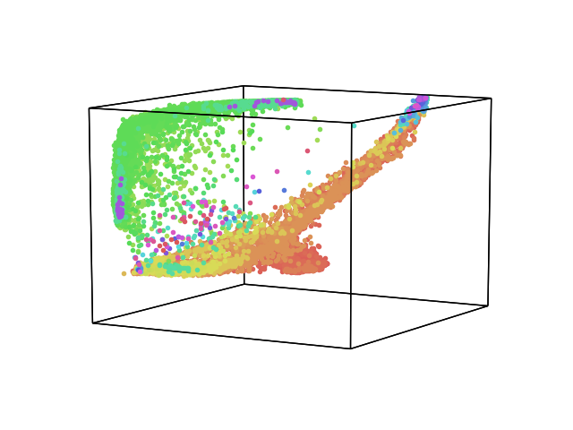
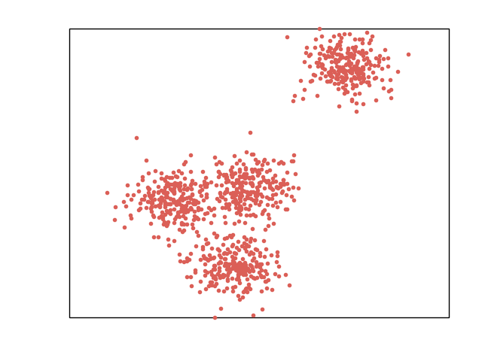
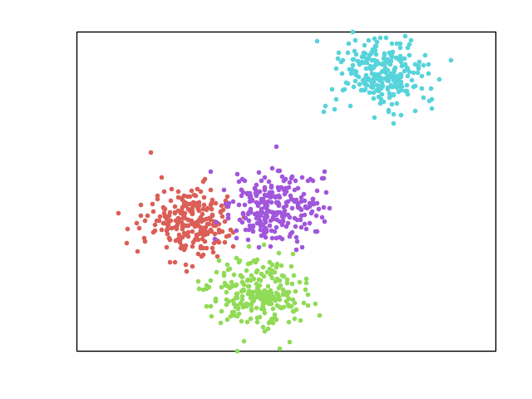
What is clustering
Cluster analysis or clustering is the task of grouping a set of objects in such a way that objects in the same group are more similar (in some sense) to each other than to those in other groups

Slide 3
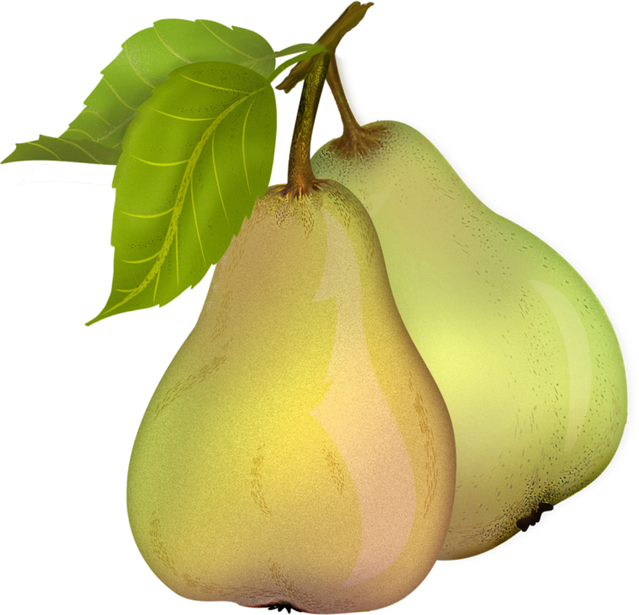


What is clustering

Slide 4
What is clustering
X – dataset
y – labels

Slide 5
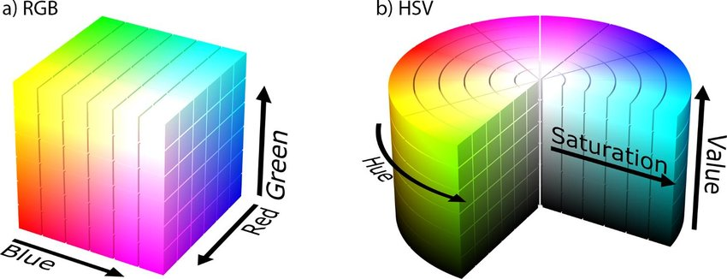
Clustering for image segmentation
Image is set of pixel
Each pixel belongs to some color space

Slide 6
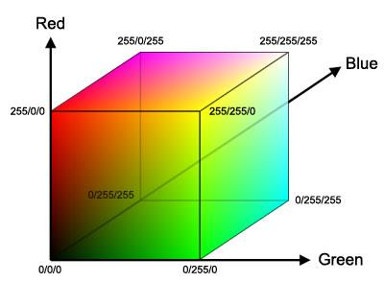

Clustering for image segmentation

Slide 7

K-Means
Basic idea: define K centroids and move each to the center of each cluster

Slide 8
K-Means
Step 0: define K centroids
Step 1: Assign each point to one of centroids
Let
dataset,
number of clusters
centroids
So
is clusters
Step 2: Update centroids

Slide 9
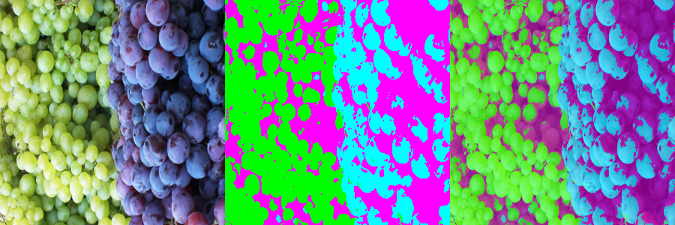
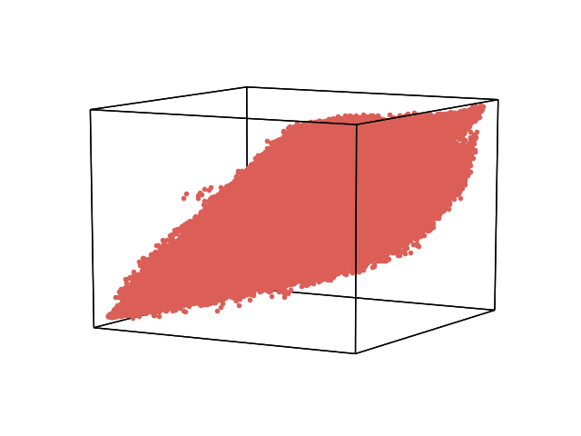
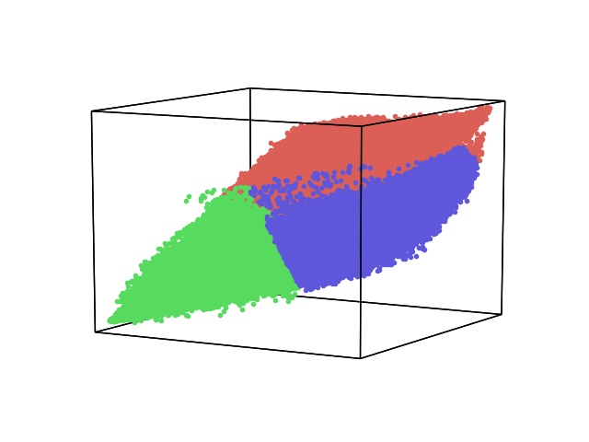
K-Means

Slide 10
K-Means
Weakness:
Requires predefined centroids
Requires centroids count

Slide 11
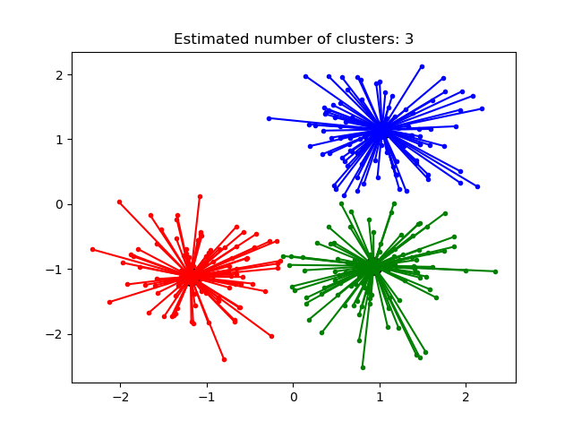
Affinity Propagation
Basic idea: algorithm based on the concept of "message passing" between data points. Method find cluster exemplars and decide for each point to which cluster it belongs

Slide 12
Affinity Propagation
Let
- matrix of similarity
between data points
- preference

Slide 13
Affinity Propagation
Step 1: Update responsibility matrix
Step 2: Update availability matrix
Step 3: Update self-availability
Step 4: Apply dumping factor

Slide 14
Affinity Propagation
Point k is an exemplar if
Point k is the exemplar for i if

Slide 15
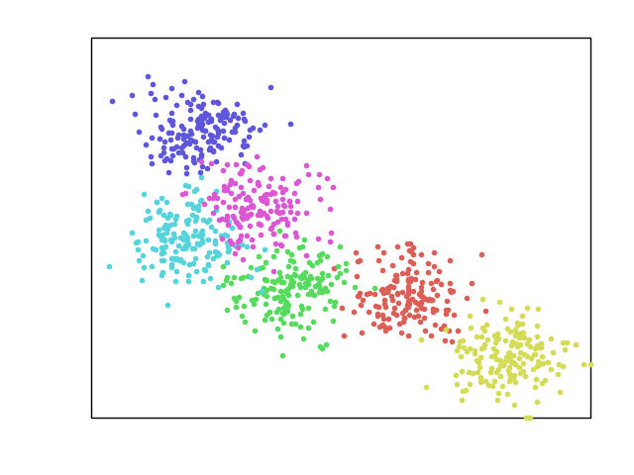
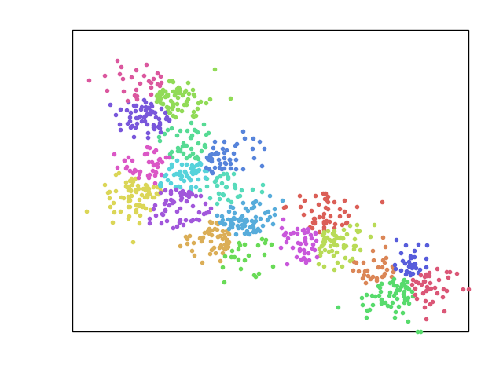
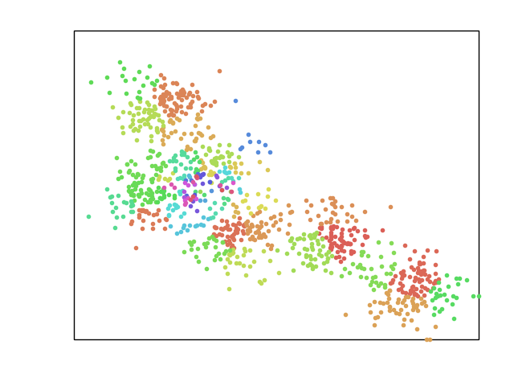
Affinity Propagation
Original
λ = 0.9
λ = 0.5

Slide 16
Affinity Propagation
Weakness:
Needs quadratic memory to store matrix
Speed
For image 100x100 requires ~1.5 GB memory

Slide 17
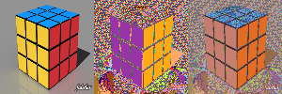
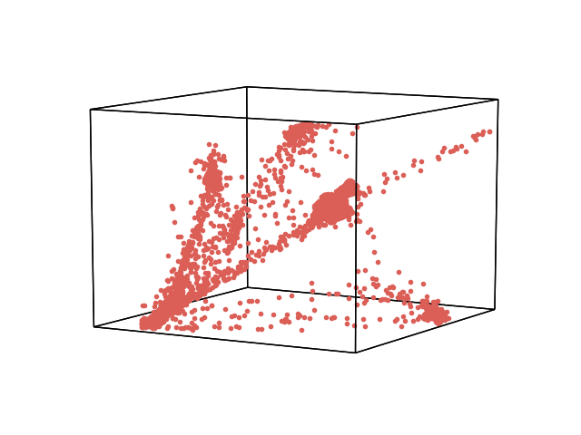
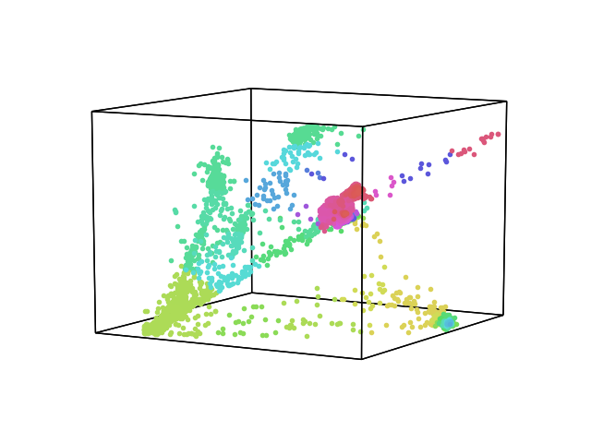
Affinity Propagation

Slide 18
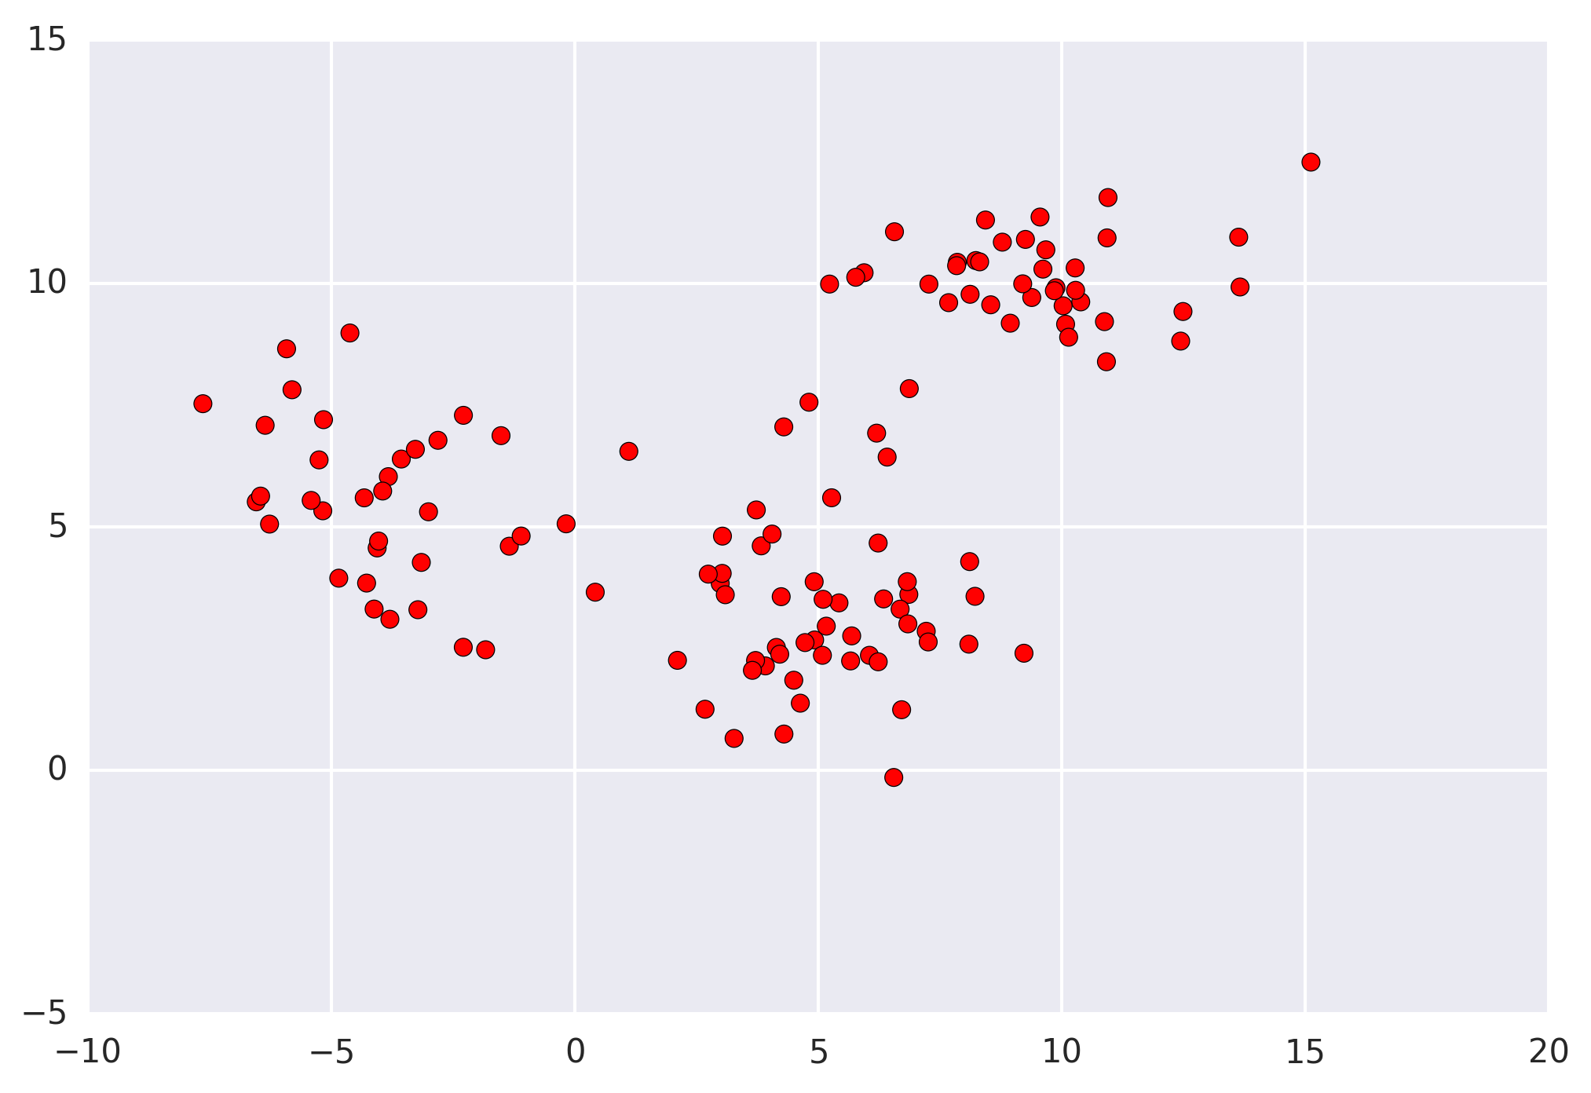
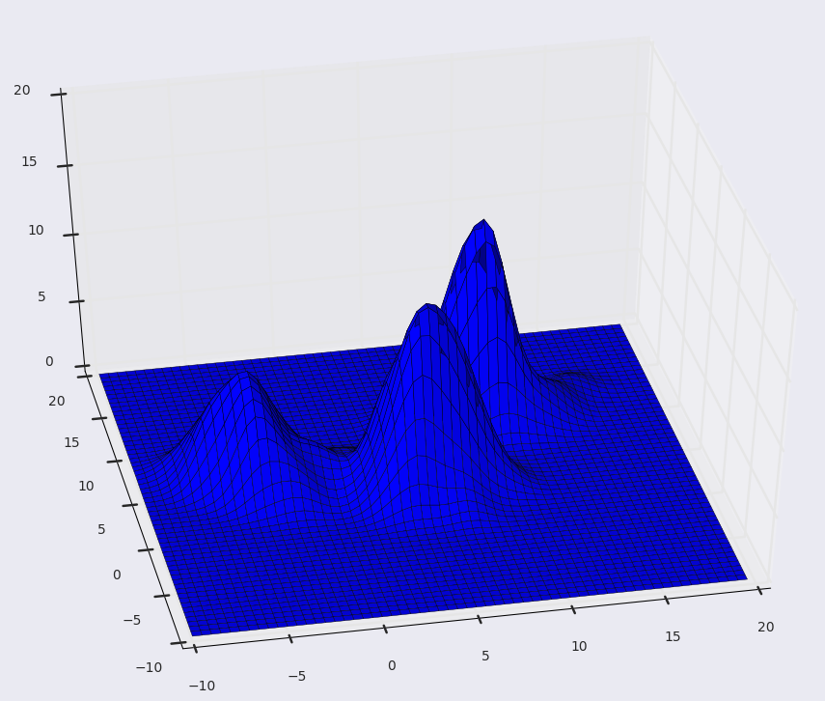
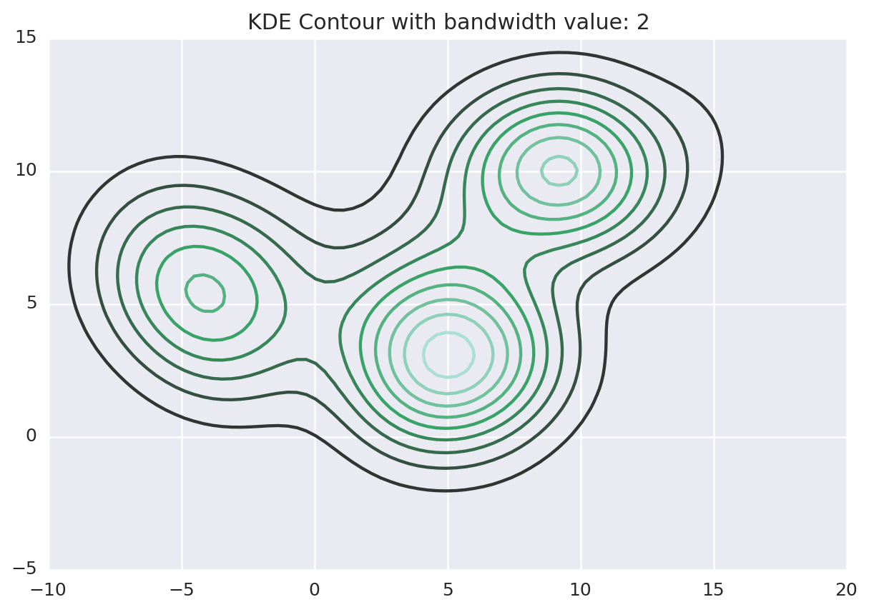
Mean Shift
Mean shift is a clustering algorithm that assigns the datapoints to the clusters iteratively by shifting points towards the mode.

Slide 19
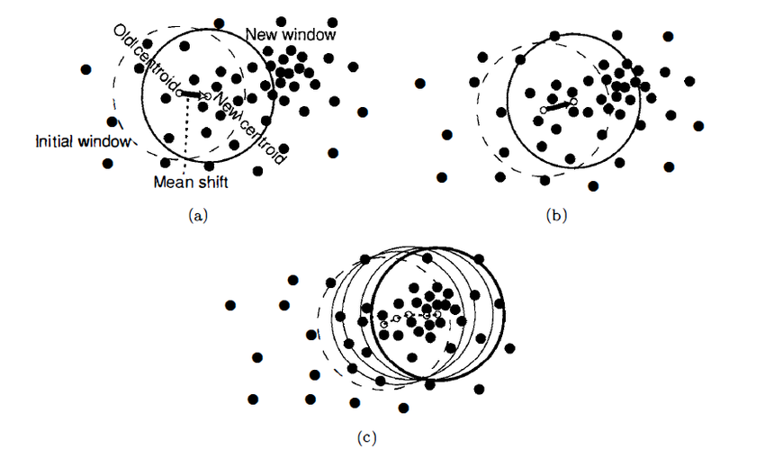
Mean Shift
Let
determines what
are neighbors
kernel to use
in algorithm

Slide 20
Mean Shift

Slide 21
Mean Shift

Slide 22
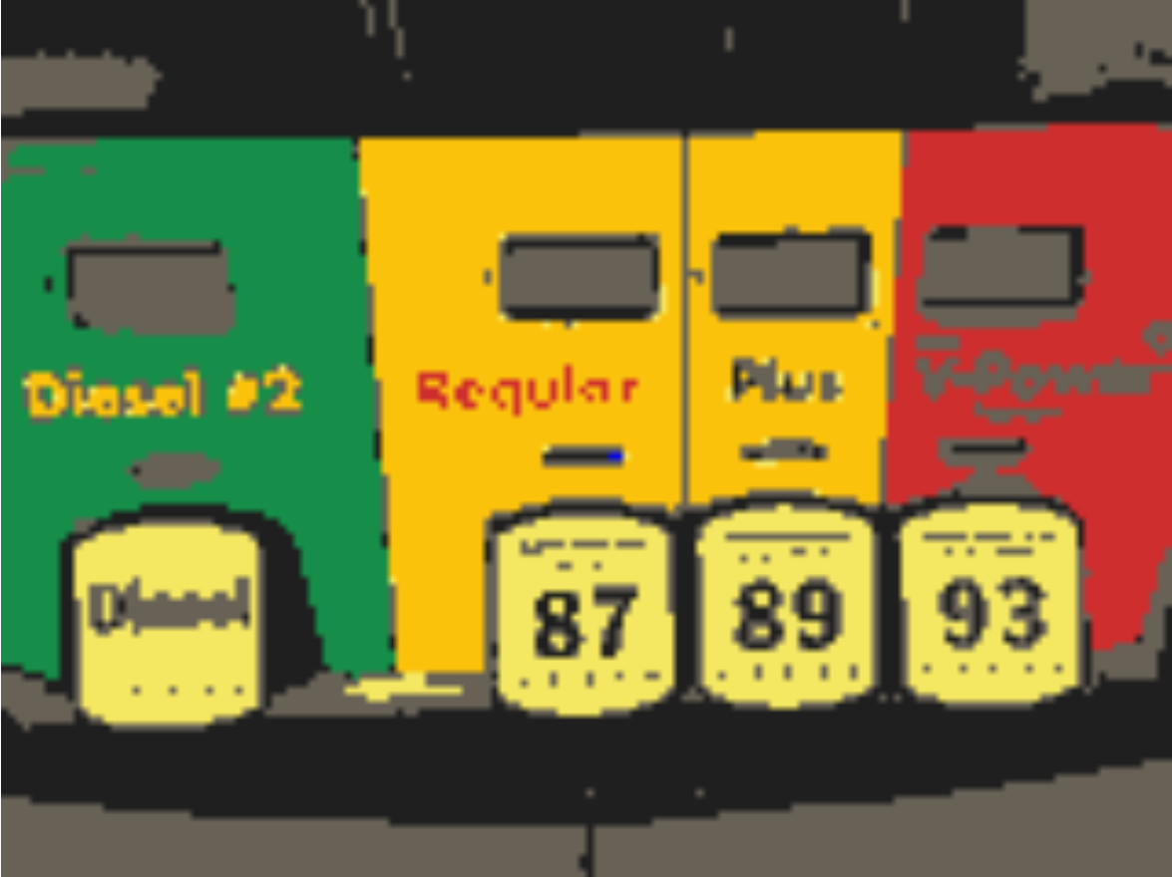
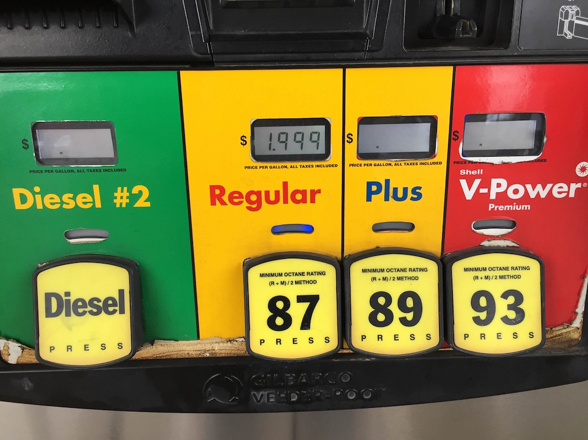
Mean Shift

Slide 23
Mean Shift

Slide 24
Mean Shift
Weakness:
Bandwidth parameter choosing
Speed

Slide 25
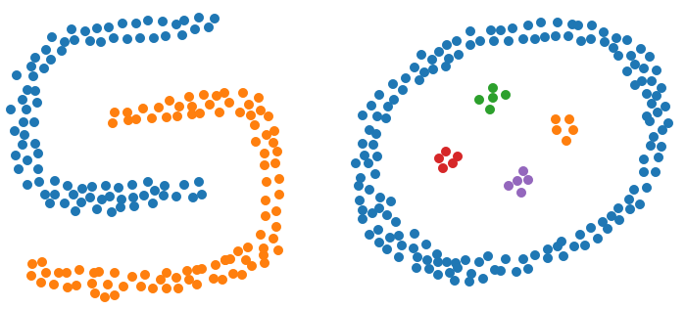
DBSCAN
Density-based spatial clustering of applications with noise is a density-based clustering algorithm

Slide 26
DBSCAN
Point q directly
reachable from q
Let M - minimal points count
- maximum neighbor distance
Point q reachable from q if there are path
K - set of core points
are reachable from
Other pointers are outliers

Slide 27
DBSCAN

