Slide 1
Baseline metabolomic profile as a biomarker for weight change after Roux-en-Y gastric bypass
A 13-metabolite risk score predicts five-year weight regain
Wanjun Gu
Baranzini Lab
Department of Neurology, Weill Institute for Neurosciences, UC San Francisco

Slide 2

Background
Two patients, the same operation, different outcomes
2

Slide 3
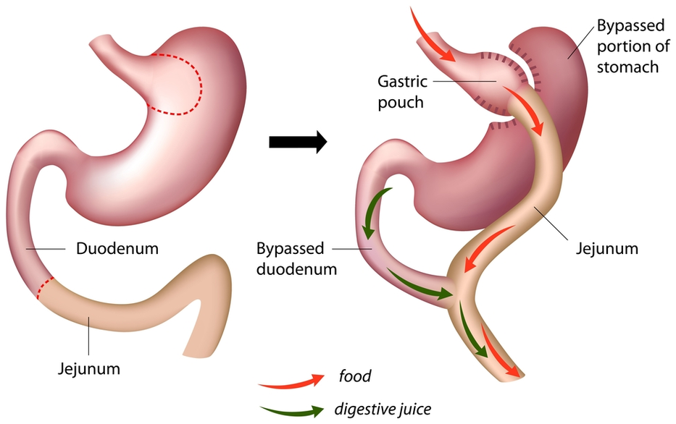
Roux-en-Y gastric bypass
Background
The most effective durable therapy for severe obesity
The stomach is reduced to a pouch of about 30 mL
The pouch is joined directly to the jejunum
Distal stomach, duodenum and proximal jejunum are bypassed
Most of the benefit is hormonal, not mechanical
Bile acid flow, GLP-1 secretion and gut microbes all change
About 280,000 procedures were done in the US in 2022
Typical result: 35 to 40% total weight loss
A 30 mL pouch, a Roux limb, and a biliopancreatic limb
Clapp et al., Surg Obes Relat Dis 2024; Sharples & Mahawar, Obes Surg 2020; Courcoulas et al., JAMA Surg 2018. Illustration: angelcabanmd.com.
3
Notes:
Roux-en-Y gastric bypass is both restrictive and malabsorptive by design, but the durable metabolic effect comes mainly from rerouting nutrient and bile flow. Bile acids reaching the distal ileum activate FXR and TGR5 on enteroendocrine L-cells, which amplifies the post-prandial GLP-1 response. That hormonal shift, rather than pouch size alone, accounts for much of the weight loss and diabetes remission.\n\nRoughly 280,000 metabolic and bariatric procedures were performed in the US in 2022, about 1% of the eligible population. Sleeve gastrectomy is now the most common procedure, but RYGB gives greater long-term weight loss and more durable type 2 diabetes remission in head-to-head comparisons. Seventy to eighty percent of patients keep the weight off for at least five years.

Slide 4
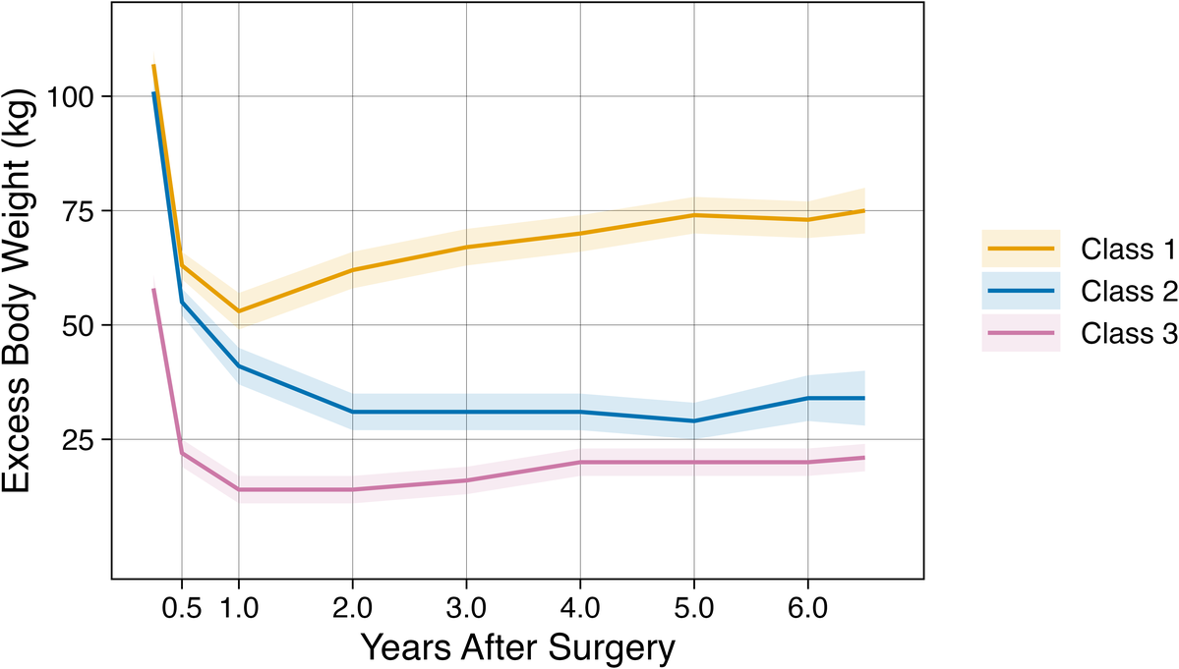
Long-term outcomes diverge sharply
Background
Latent class modelling of 7-year weight data in 1,590 LABS-2 patients
Three trajectory classes emerged
Class 1 (n = 100): lost weight, then regained 16.1 kg by year 5
Class 2 (n = 108): kept losing, a further 14.0 kg
Baseline weight was the same in both (101.0 vs 105.5 kg, p = 0.09)
Class 3 (n = 1,382) started much lighter and was set aside
Fig. 1a · mean excess body weight over 7 years, by latent trajectory class
Can preoperative metabolites tell these two groups apart?
Courcoulas et al., JAMA Surg 2018 (LABS-2 seven-year weight trajectories).
4
Notes:
The three-class solution was chosen over two-, four- and five-class models on BIC, sample-size-adjusted BIC, the Vuong-Lo-Mendell-Rubin test and the bootstrap likelihood-ratio test, with entropy above 0.80 and mean posterior class-membership probability above 0.90.\n\nThe key point is that Classes 1 and 2 start from the same place. Baseline excess body weight was 101.0 kg in the regain class and 105.5 kg in the sustained loss class, a difference that is not significant. So whatever separates them is not how heavy they were going in.\n\nClass 3 held 87% of the cohort but started at 58.1 kg excess body weight, far lighter. Including it would have meant that any metabolite difference we found was really a signal of baseline adiposity. That is why the metabolomic contrast uses only the two extreme classes.

Slide 5
Study design and methods
Extreme phenotypes, untargeted LC-MS, four independent cohorts
5

Slide 6
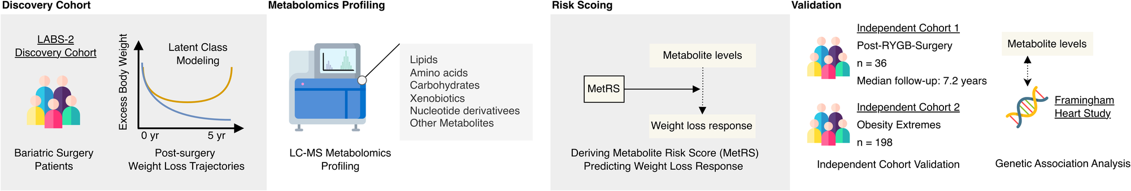
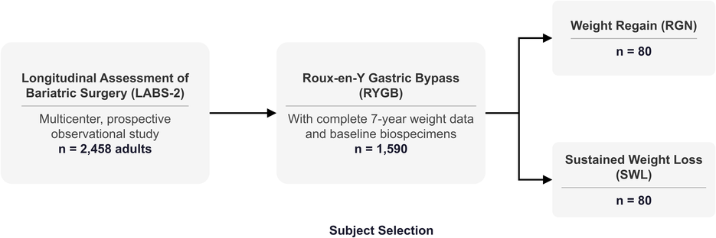
An extreme-phenotype design across four cohorts
Methods
Fig. 1f · study workflow
Discovery: 80 sustained weight loss (SWL) participants matched 1:1 to 80 weight regain (RGN) participants
Matched on baseline BMI, age, sex, race and renal function
Untargeted LC-MS on preoperative fasting plasma, four modes
786 features, 591 unique compounds, 541 kept after QC
Replication: post-RYGB cohort, median 7.2 years after surgery (n = 35)
Generalisation: Estonian Biobank obesity extremes (n = 198)
Genetics: GWAS in Framingham Offspring (n = 1,508)
Fig. 1b · participant selection
Abidi et al., Obes Surg 2020 (post-RYGB cohort); Hsu et al., Nat Commun 2020 (Estonian Biobank); Courcoulas et al., JAMA Surg 2018 (LABS-2).
6
Notes:
The extreme-phenotype design profiles the tails of the trajectory distribution rather than the whole cohort. This maximises discovery power for a fixed number of expensive assays, and it is an established approach in omics biomarker work. The trade-off is that effect sizes estimated from the tails are optimistic relative to an unselected population, so they should be read as upper bounds.\n\nThe LC-MS panel ran two HILIC modes, positive and negative, plus C18-negative and C8-positive reversed phase. That gives coverage of amines, polar metabolites, central carbon intermediates, free fatty acids and lipids. No samples failed QC.\n\nBaseline clinical and biochemical measures, including fasting glucose, insulin, lipids, ghrelin, leptin and inflammatory markers, were similar between the two groups. Weight trajectories were not influenced by sex or by surgical centre.

Slide 7
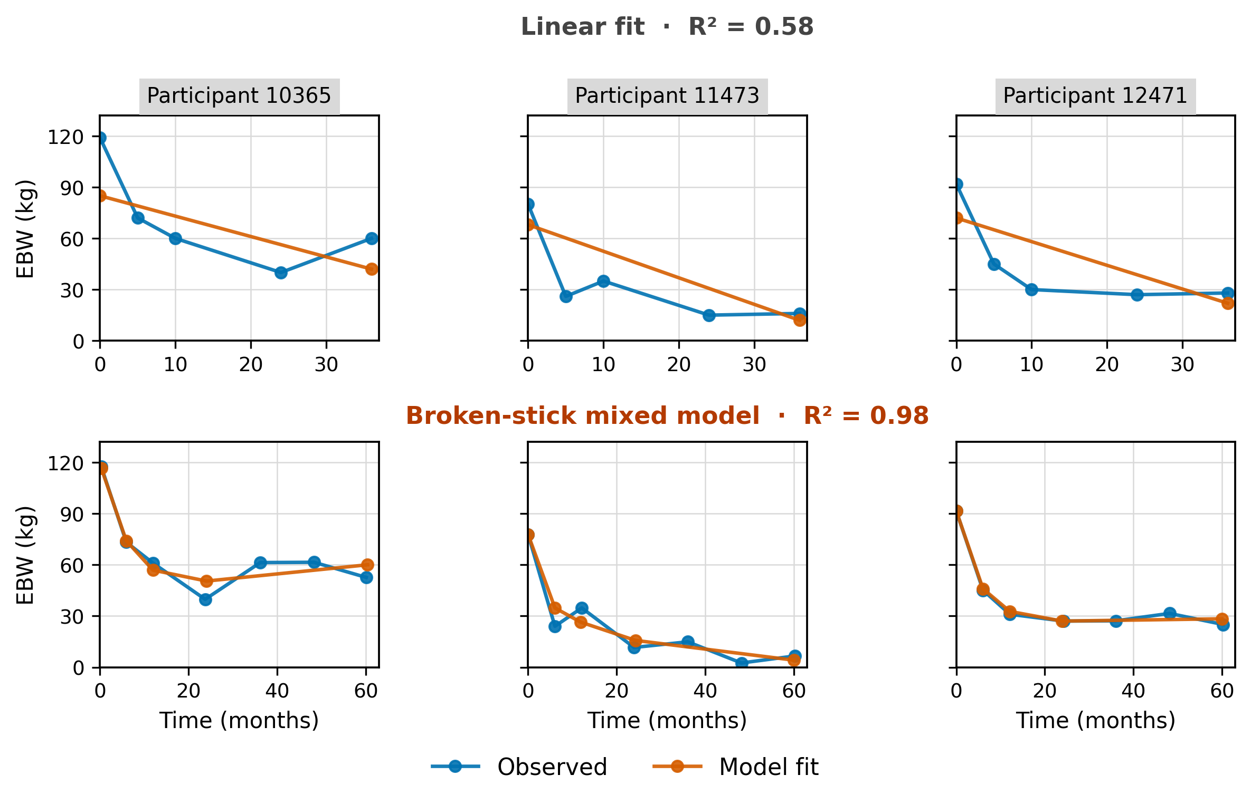
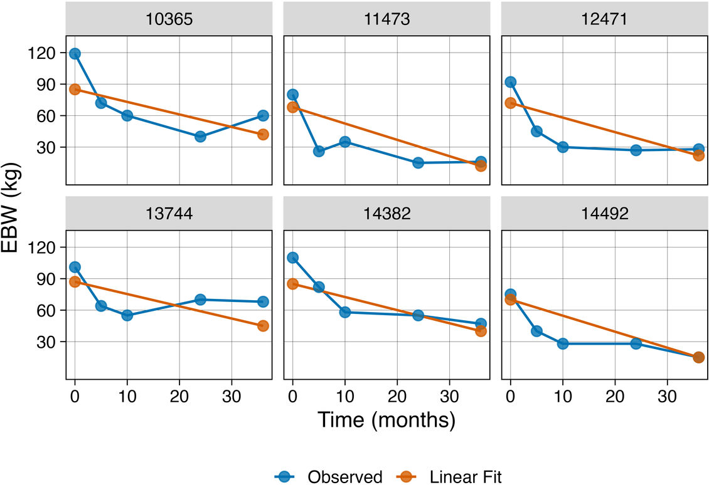
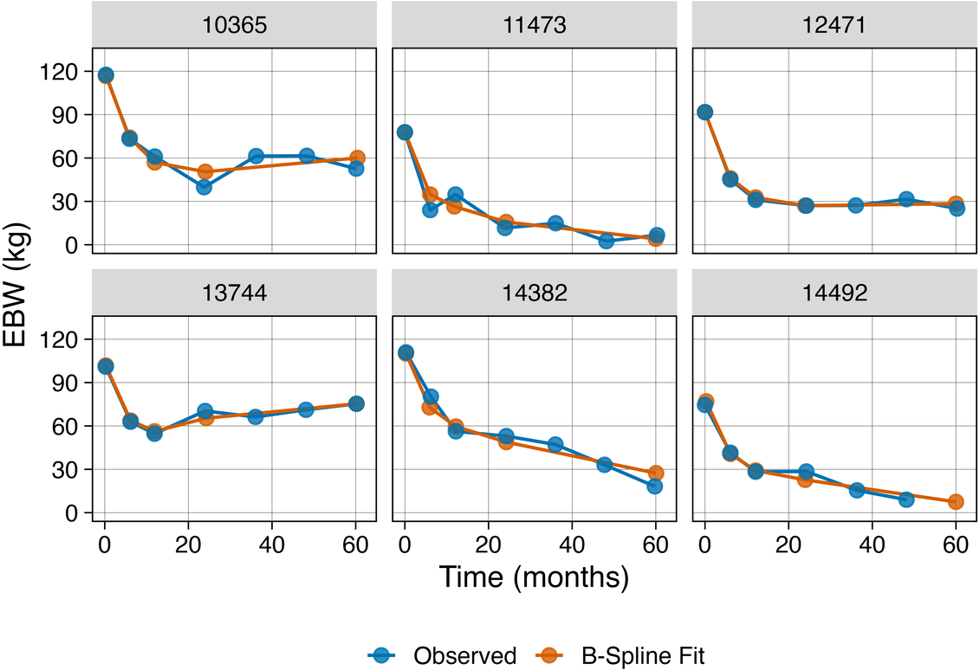
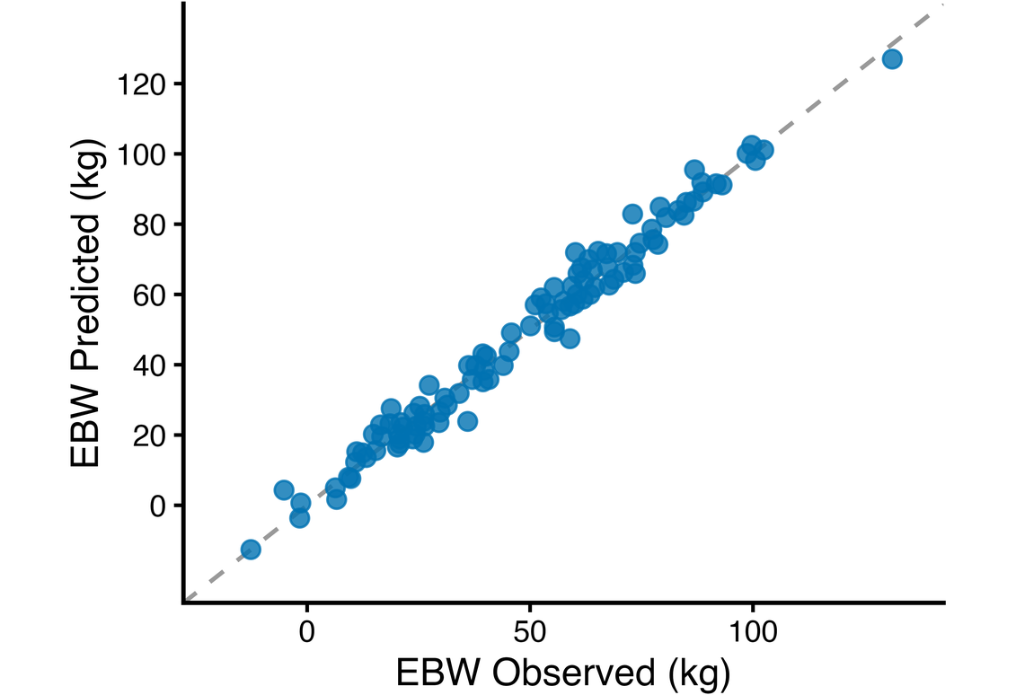
Weight trajectories need a non-linear model
Methods
Weight change after surgery is not linear
A straight line fits badly (R² = 0.58)
A broken-stick mixed model fits well (R² = 0.98)
Knots at 6, 12 and 24 months
EBW can then be read off at exactly five years for everyone
Outcome is %EBW5, the share of baseline excess weight still there at year 5
Year 5: 72.4 kg in RGN, 29.1 kg in SWL
69.8% vs 27.0% of baseline excess weight
Fig. 1c linear fit, 0–36 mo (top) · Fig. 1d broken-stick fit, 0–60 mo (bottom) · three representative participants
7
Notes:
Post-surgical weight change has a characteristic shape: very rapid loss in the first six months, a nadir somewhere between one and two years, then either a plateau or slow regain. A single straight line through that trajectory averages away the whole story, which is why the linear R-squared is only 0.58.\n\nThe broken-stick linear mixed-effects model places knots at 6, 12 and 24 months, letting the slope change at each. R-squared rises to 0.98. Because it is a mixed model it borrows strength across participants, so individuals with sparse visit data still get a sensible curve.\n\nNote on the animation: the same frame cycles through Fig 1c, then 1d, then 1e.\n\n%EBW5 is defined as year-5 EBW divided by baseline EBW, times 100. Higher values mean a less effective operation, whether that came from poor initial loss or from later regain.

Slide 8
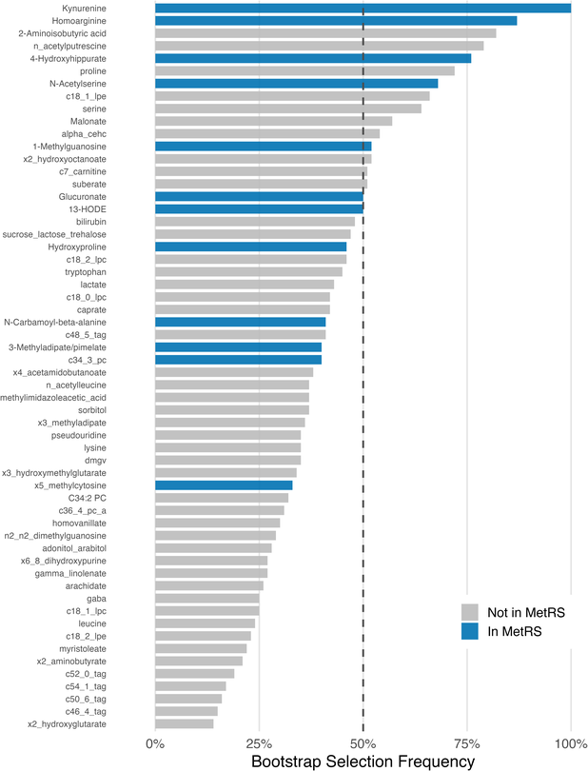
From 541 metabolites to a 13-metabolite score
Methods
All 541 metabolites were tested against %EBW5
62 were nominally associated (p < 0.05)
Five passed FDR correction (q < 0.05)
3-methyladipate/pimelate, glucuronate, DMGV, 13-HODE, BAIBA
The Q-Q plot departs from the null (λ = 1.87)
Stepwise regression narrowed the 62 down to 13
DMGV was dropped for collinearity with BAIBA (r = −0.56)
MetRS is a weighted sum of standardised metabolite levels
Most stable features: kynurenine 98.5%, homoarginine 81.7%, BAIBA 79.0%
Bootstrap selection frequency; blue = kept in the MetRS
Geidenstam et al., Obesity 2019 (metabolite risk score construction).
8
Notes:
Twelve of the 62 nominally associated metabolites went up with worse outcomes, including kynurenine, bilirubin, CEHC, leucine, tryptophan, GABA and homoarginine. The other 50 went the opposite way, among them seven triacylglycerols, three lysophosphatidylcholines, four phosphatidylcholines and two lysophosphatidylethanolamines. That pattern suggests a broadly favourable lipid profile in people who sustain their weight loss.\n\nFeature selection was bidirectional stepwise regression on AIC, restricted to the 62 candidates. Restricting the candidate pool and using AIC keeps the model from chasing noise. Residual diagnostics showed no serious violation of linearity, homoscedasticity or normality, and variance inflation factors were acceptable.\n\nDMGV reached FDR significance but correlated with BAIBA at r = -0.56, above the prespecified cut-off of 0.5, so it was excluded from the score. It is kept later in the network analysis for completeness.\n\nBootstrap resampling ran the whole stepwise procedure 1,000 times. Seven of the 13 were picked in more than half of resamples; kynurenine, homoarginine and BAIBA were picked in more than three quarters, which is the stable core of the score.

Slide 9
Results
What the score contains, what it predicts, where it comes from
9

Slide 10
The MetRS panel: thirteen metabolites
Results · the score
Fig. 2a · effect on %EBW5 per SD of metabolite
Metabolite | Effect on %EBW5 (95% CI) | p-value | Variance (%) | Metabolite class
3-Methyladipate / pimelate* | −4.48 (−8.11, −0.86) | 1.6 × 10⁻² | 10.54 | Medium-chain fatty acids
13-HODE* | −3.66 (−7.03, −0.29) | 3.4 × 10⁻² | 6.88 | Linoleic acid derivatives
Glucuronate* | −4.27 (−7.91, −0.63) | 2.2 × 10⁻² | 5.04 | Glucuronic acid derivatives
2-Aminoisobutyric acid* | 6.26 (3.01, 9.50) | 2.0 × 10⁻⁴ | 6.28 | Alpha amino acids
Kynurenine | 9.23 (5.78, 12.67) | 4.4 × 10⁻⁷ | 4.04 | Alkyl-phenylketones
Homoarginine | 5.86 (2.52, 9.21) | 7.0 × 10⁻⁴ | 2.90 | L-alpha-amino acids
Hydroxyproline | −4.29 (−7.65, −0.94) | 1.3 × 10⁻² | 2.84 | Proline and derivatives
Malonate | 4.96 (1.65, 8.27) | 3.5 × 10⁻³ | 2.47 | Dicarboxylic acids
1-Methylguanosine | −3.82 (−7.05, −0.60) | 2.0 × 10⁻² | 2.04 | Purine nucleosides
4-Hydroxyhippurate | −3.24 (−6.78, 0.30) | 7.3 × 10⁻² | 1.26 | Hippuric acids
N-Acetylserine | 3.80 (−0.18, 7.79) | 6.1 × 10⁻² | 1.20 | N-acyl-α-amino acids
N-Carbamoyl-β-alanine | −2.74 (−6.29, 0.82) | 1.3 × 10⁻¹ | 0.84 | Ureas
C34:2 phosphatidylcholine | −0.02 (−0.06, 0.01) | 1.7 × 10⁻¹ | 0.23 | Glycerophospholipids
Red: a higher preoperative level predicts a worse outcome. Blue: a higher level predicts sustained weight loss.
Five metabolites (*) passed FDR correction. DMGV also passed but was excluded for collinearity with BAIBA.
The panel spans fatty acid oxidation, bile acid conjugation, tryptophan catabolism, nitric oxide and microbial co-metabolism.
10
Notes:
Estimates are the change in %EBW5 per standard deviation of the metabolite, so a positive coefficient means a higher preoperative level goes with more excess weight left at year five, that is, a worse surgical outcome.\n\n3-methyladipate/pimelate is a composite feature. The two are structural isomers that the platform cannot separate, so they are reported together and split into two nodes later in the network analysis. Both candidate identities point to mitochondrial fatty acid oxidation, one through omega-oxidation and the other through branched-chain fatty acid catabolism.\n\nMost of these metabolites have not been linked to obesity or bariatric outcomes before, which is part of what makes the signature novel. The four with prior literature are kynurenine, BAIBA, homoarginine and glucuronate.\n\nBAIBA is the surprise. It is usually described as a protective exercise-induced myokine, yet here a higher level predicts worse outcomes. One reading is that it is a compensatory response to early mitochondrial dysfunction rather than a cause of benefit.

Slide 11
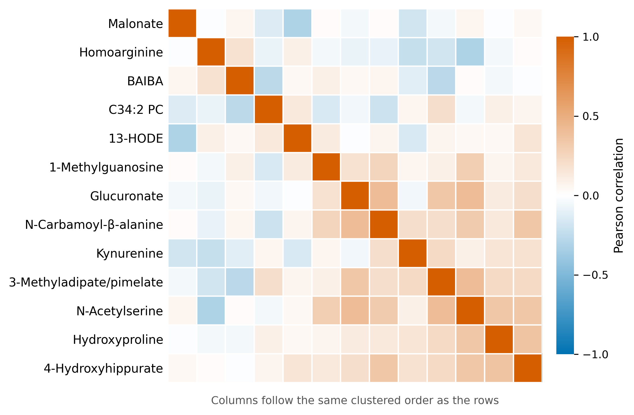
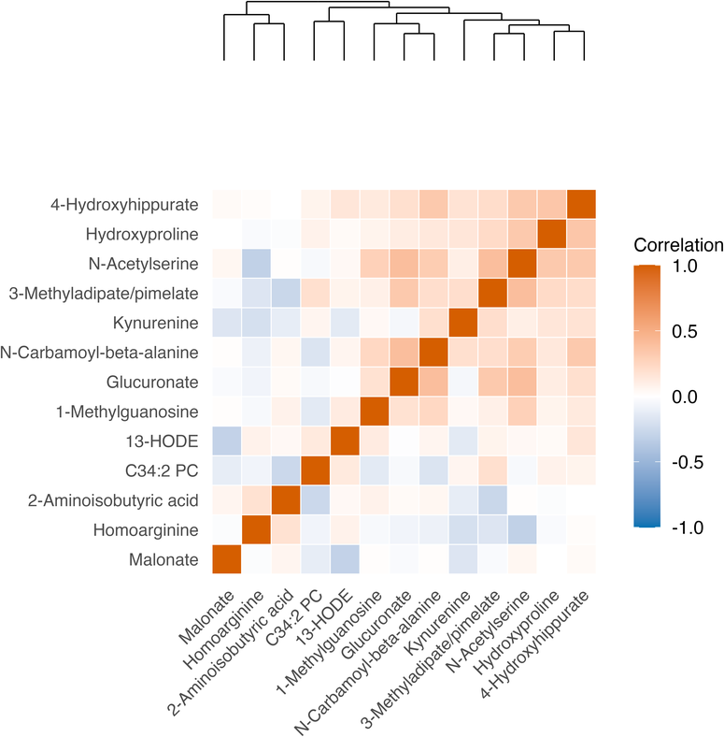
The panel carries independent signal
Results · the score
Correlations between the 13 metabolites are mostly weak
The score is not one signal measured thirteen times
Clustering shows two loose groups
Lipids and dicarboxylates: malonate, homoarginine, BAIBA, C34:2 PC, 13-HODE
Amino acids and microbial products: kynurenine, N-carbamoyl-β-alanine, glucuronate, hydroxyproline, 4-hydroxyhippurate
Only DMGV and BAIBA crossed the |r| > 0.5 threshold
Variance inflation factors were acceptable
Each assay adds something the others do not
Fig. 2b · Pearson correlations among the 13 MetRS metabolites, hierarchically clustered
11
Notes:
This matters practically. If the 13 metabolites were all measuring the same underlying axis, you could drop twelve of them and lose nothing, and the score would be fragile to any one assay failing. The weak off-diagonal structure says the opposite: the panel is compact but not redundant, which is what you want if this is ever going to become a clinical assay.\n\nThe clustering is soft. These are not tight modules, just a tendency for the lipid-derived features to travel together and the amino acid and microbial features to travel together.\n\nDMGV and BAIBA are the one genuinely collinear pair, at r = -0.56. Both are handled by AGXT2 biology, which is probably why. DMGV was dropped and BAIBA kept.

Slide 12
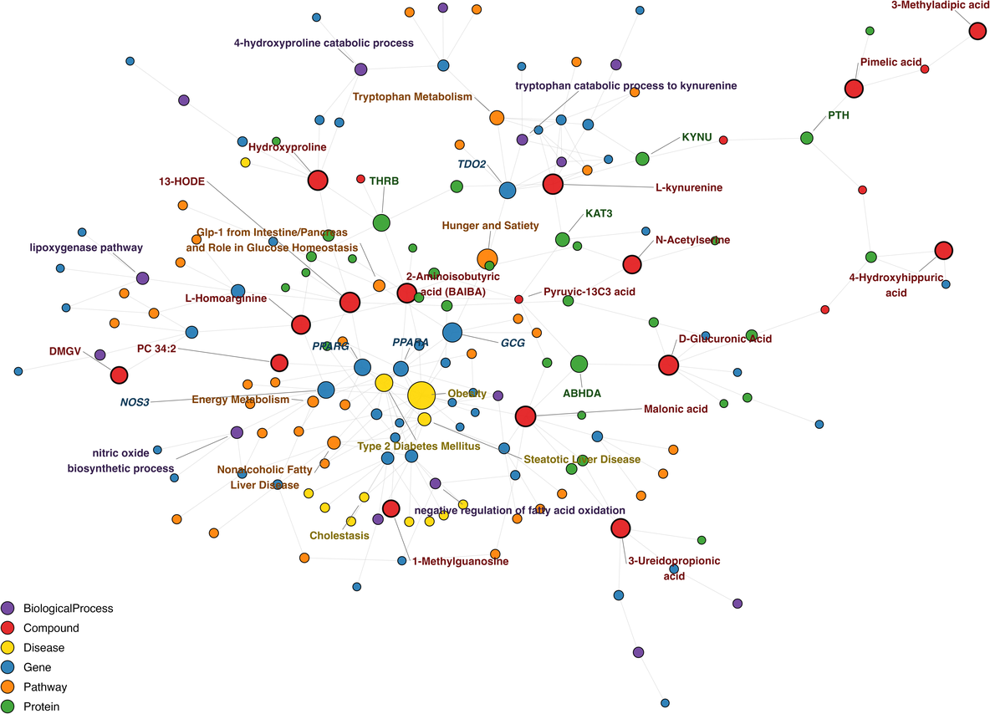
Connecting MetRS metabolites reveals key biology
Results · biology
15 MetRS compounds seeded SPOKE, a curated biomedical knowledge graph
The first-degree subgraph has 169 nodes and 235 edges
21 compounds, 52 genes, 32 proteins
38 pathways, 14 biological processes, 12 diseases
Expanding the metabolites into their neighbourhood is where the biology appears
Bile acid and GLP-1 module: glucuronate links to UGT1A1/UGT1A3 and DPP4, and reaches GCG, GLP1R, NR1H4 (FXR), CYP7A1 and FGF19
Lipid and fatty acid oxidation module: malonate and BAIBA link to PPARA, PPARG and CPT1A
The neighbours are cardiometabolic biology, not unrelated nodes
Fig. 2d · curated first-degree SPOKE subgraph, Kamada-Kawai layout; node colour = entity type
Morris et al., Bioinformatics 2023 (SPOKE knowledge graph).
12
Notes:
SPOKE is a heterogeneous knowledge graph built at UCSF that links compounds, genes, proteins, pathways, biological processes and diseases from curated sources including Gene Ontology, Reactome, WikiPathways and HMDB. Seeding it with the MetRS metabolites and pulling first-degree neighbours is an unbiased way to ask what biology these molecules already sit in.\n\nFifteen compounds were seeded rather than thirteen. 3-methyladipate and pimelate are entered separately because SPOKE holds them as distinct entities, and DMGV was added back for network completeness even though it is not in the score.\n\nThe layout is Kamada-Kawai, which positions nodes so that on-screen distance reflects path length in the graph. The visual clustering is therefore meaningful, not decorative.\n\nAn interactive version is in the project code repository at github.com/baranzinilab/GastricBypass.

Slide 13
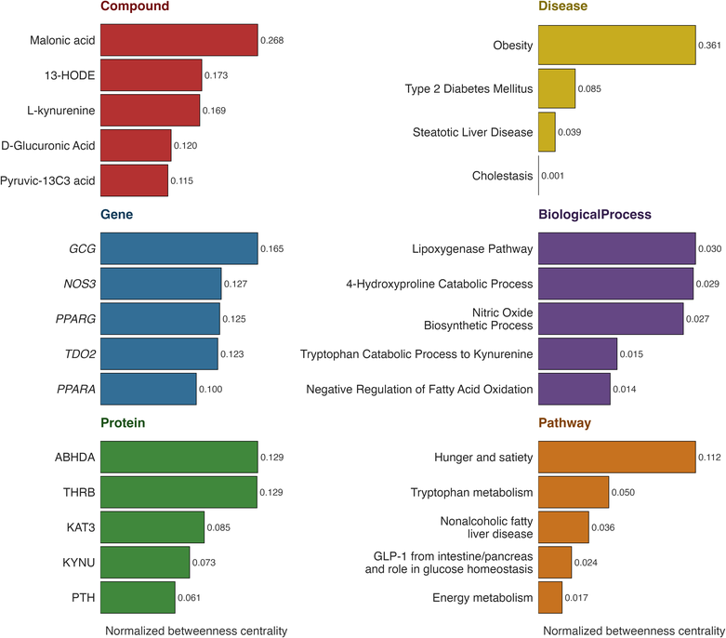
Four cardiometabolic axes, bridged by obesity
Results · biology
Obesity is the top disease bridge node (betweenness 0.36)
Type 2 diabetes 0.085, steatotic liver disease 0.039
Bile acid and GLP-1: glucuronate to UGT1A1/A3, DPP4, GCG, NR1H4 (FXR), CYP7A1, FGF19, GLP1R
Tryptophan: kynurenine to TDO2, KYNU, KYAT3, GOT2
Fatty acid oxidation: malonate and BAIBA to PPARA, PPARG, CPT1A
Nitric oxide: homoarginine to NOS3
GCG is the top gene bridge (0.165), malonic acid the top compound (0.27)
All four axes already have drugs that target them
Fig. 2c · top bridge nodes per type, by betweenness centrality
Morris et al., Bioinformatics 2023 (SPOKE); Penney et al., Int J Obes 2015; Roberts et al., Cell Metab 2014 (BAIBA).
13
Notes:
Obesity sitting at the top of the disease bridge ranking is the most important result on this slide. The graph traversal was unbiased, so the score did not have to land on obesity. That it does argues against the signature being a surgical epiphenomenon and for it indexing a pre-existing cardiometabolic state that the operation only partly corrects.\n\nBile acid and GLP-1 axis: after Roux-en-Y reconstruction, bile acids reaching the distal ileum activate FXR and TGR5 on L-cells and amplify post-prandial GLP-1. D-glucuronic acid is the sugar donor for UGT-mediated bile acid conjugation, and it connects straight through to GCG, the proglucagon gene. If preoperative glucuronate is a readable proxy for that circuit, it would be clinically useful, because GLP-1 response after surgery varies a lot between individuals and predicts outcome.\n\nTryptophan axis: TDO2-driven tryptophan catabolism is induced by adipose tissue macrophage inflammation, and circulating kynurenine tracks BMI and insulin resistance. Kynurenine was also the most stably selected metabolite in the bootstrap.\n\nFatty acid oxidation: BAIBA is a PGC-1-alpha-dependent myokine that amplifies PPARA signalling, drives white adipose browning and hepatic beta-oxidation.\n\nNitric oxide: low circulating homoarginine, an endogenous NOS substrate, is an independent risk marker for cardiovascular and renal mortality. Its presence here points to endothelial dysfunction as part of the regain phenotype.

Slide 14
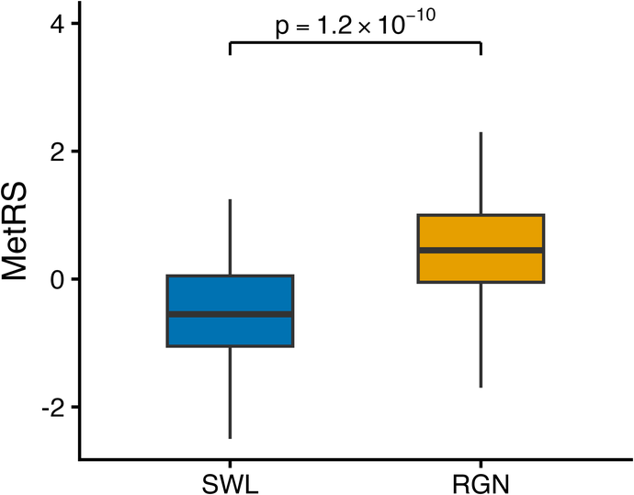
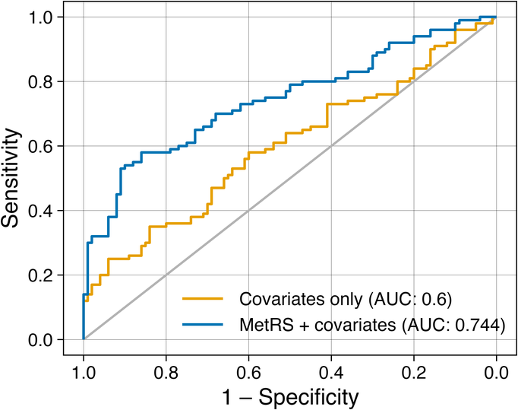
MetRS outperforms clinical variables alone
Results · performance
Fig. 3a · MetRS by outcome group, LABS-2
Fig. 3c · ROC with and without the MetRS
MetRS is higher in RGN than in SWL participants (p = 1.2 × 10⁻¹⁰)
Higher baseline EBW raises the odds slightly: OR 1.03 (1.01 to 1.05), p = 0.01
Older age lowers them: OR 0.95 (0.91 to 0.99) per year, p = 0.02
Adding MetRS lifts the AUC from 0.600 to 0.744 (p < 0.001)
14
Notes:
The odds ratios come from conditional logistic regression on the matched pairs. The age result means younger patients regain more, which matches prior reports that younger age at surgery is a risk factor for long-term regain.\n\nThe AUC gain from 0.60 to 0.74 is the headline number. Age, sex and baseline excess body weight are what a surgeon already has in front of them, and on their own they classify barely better than chance in this cohort. Adding the metabolite score moves it into a range that could plausibly change management.\n\nOne caveat worth saying out loud: because the discovery cohort is drawn from the tails of the trajectory distribution, this AUC should be read as an upper bound. In an unselected population with many intermediate trajectories it would be lower.

Slide 15
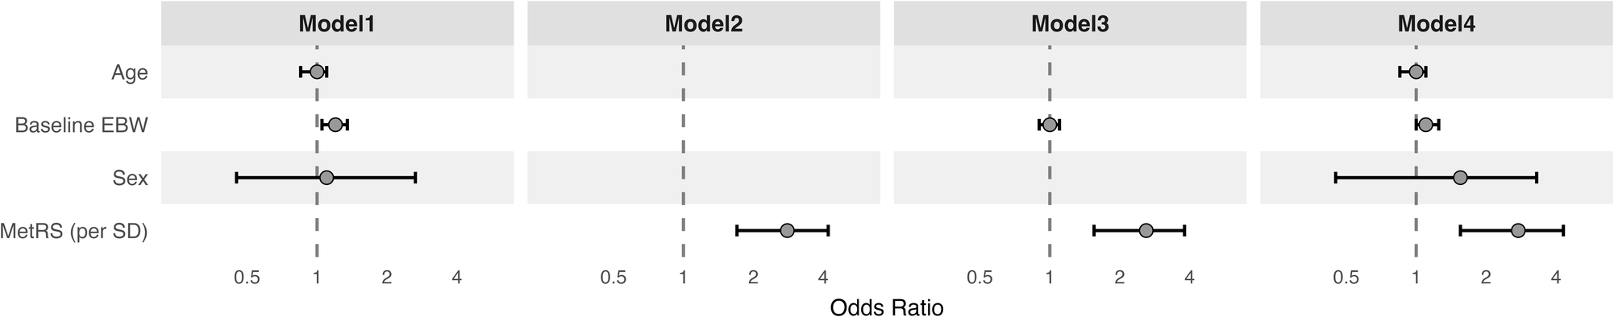
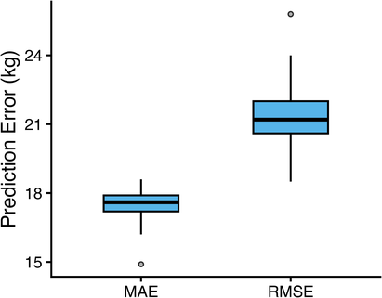
The effect holds across model specifications
Results · performance
Fig. 3d · odds ratios and 95% CI across four nested logistic models
MetRS per SD gives an odds ratio near 2.8 for weight regain
The estimate barely moves across all four models
Age, sex and baseline EBW alone do not carry the signal
Cross-validation: RMSE 21.45 ± 1.32 kg, MAE 17.24 ± 1.10 kg
Tight error distributions, so no sign of overfitting
Fig. 3b · cross-validation error
15
Notes:
Model 1 is baseline EBW, age and sex. Model 2 is MetRS alone. Model 3 adds baseline EBW to MetRS. Model 4 is the full model with baseline EBW, age, sex and MetRS.\n\nThe point of showing all four is that the MetRS coefficient is stable across them. If the score were really a proxy for age or starting weight, adding those covariates would shrink it. It does not shrink.\n\nThe cross-validation ran 100 repetitions of 10-fold CV. RMSE being larger than MAE is expected in weight data, where a few large residuals pull the squared error up. An RMSE of about 21 kg on an EBW range of roughly 40 to 165 kg is moderate accuracy for a molecular biomarker predicting a five-year surgical outcome.

Slide 16
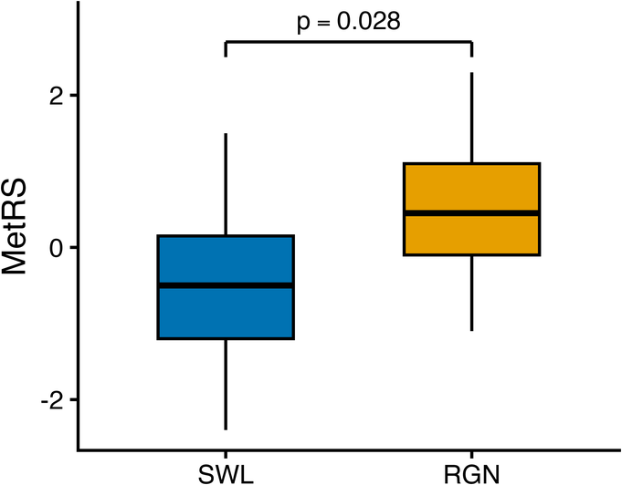
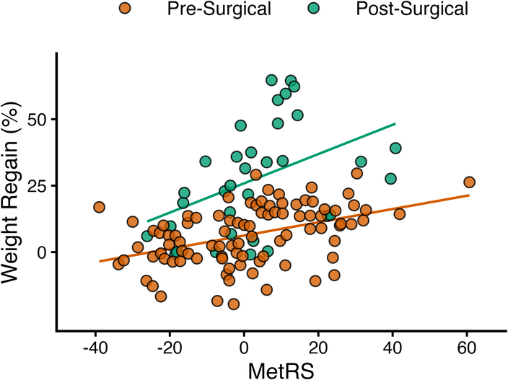
Replication in an independent post-RYGB cohort
Results · replication
Fig. 4a · MetRS-10 by outcome, median 7.2 y after surgery
Fig. 4c · MetRS vs how much weight was regained
MetRS-10 was applied to 35 patients, median 7.2 years after surgery
Three of the 13 metabolites were not measured on that platform
Higher in documented regain (p = 0.028)
Tracks how much weight came back (r = 0.56, p < 0.001)
Each SD of MetRS goes with 12.93% more regain (95% CI 7.01 to 18.85)
MetRS-10 still separates the groups in LABS-2 (p = 8.1 × 10⁻⁵)
Abidi et al., Obes Surg 2020 (post-RYGB replication cohort).
16
Notes:
This is the real replication of the predictive claim, in a cohort profiled at a different site on a different platform, years after surgery. The sample is small at n = 35, so treat it as supportive rather than definitive.\n\nThe dose-response in Fig 4c is the more informative panel. It is not just that regainers have a higher score on average; the score scales with the magnitude of regain, and it does so independently of baseline clinical characteristics.\n\nThe sensitivity check matters. Dropping three metabolites and re-scoring LABS-2 still gives p = 8.1 x 10-5, so the reduced score is not a different instrument. It also means a clinical assay would not have to carry all thirteen.\n\nThe main limitation here is that this cohort has no preoperative samples, so we cannot resolve how the score changes over time within a person.

Slide 17
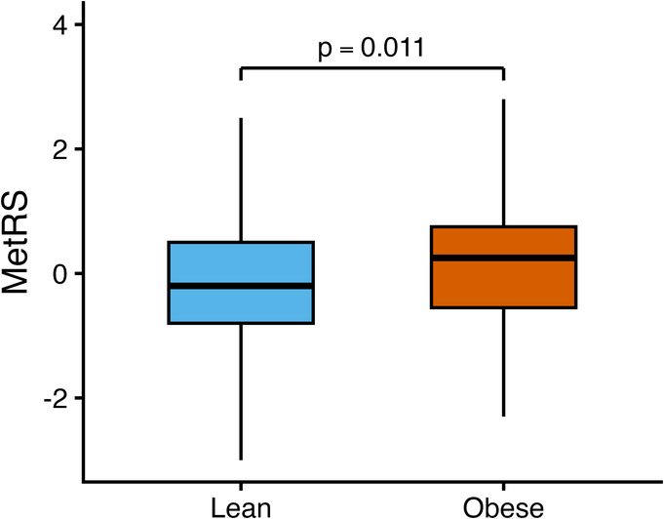
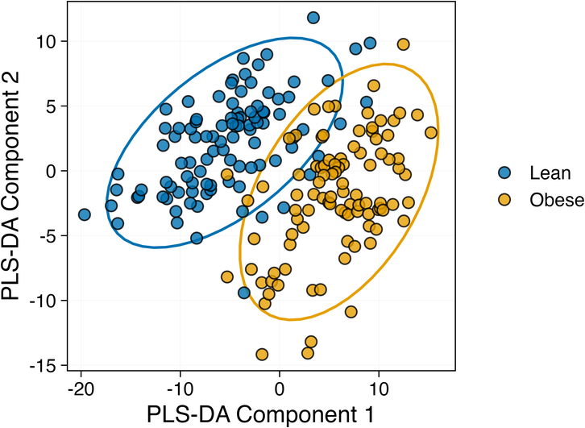
The signature tracks adiposity outside surgery
Results · generalisation
Fig. 4b · MetRS-8 in lean vs obese, Estonian Biobank
Suppl. Fig. 6b · PLS-DA of the metabolomic profile
198 Estonian Biobank participants at the extremes of BMI, none operated on
MetRS-8 was higher in obesity than in lean controls (p = 0.01)
The link to BMI itself is small: 0.10 kg/m² per SD, p = 0.05
PLS-DA separates lean from obese on the underlying profile
The signature is not specific to surgery
Hsu et al., Nat Commun 2020 (Estonian Biobank obesity extremes).
17
Notes:
This cohort was never designed as a second replication of the surgical prediction, and it should not be presented as one. It answers a different question: does this metabolic signature mean anything outside a surgical setting?\n\nThe answer is a qualified yes. MetRS-8 is elevated in people with a BMI around 40 compared with people at a BMI around 18, and the metabolomic profiles separate in PLS-DA space. But the continuous association with BMI is weak, at 0.10 kg per square metre per standard deviation.\n\nOnly eight of the thirteen metabolites were available on the Estonian platform, five fewer than the full score. The sensitivity analysis showed MetRS-8 still discriminates in LABS-2 at p = 2.6 x 10-6.\n\nTaken with the network result, the reading is that the score indexes a pre-existing cardiometabolic state, and surgery only partly corrects it.

Slide 18
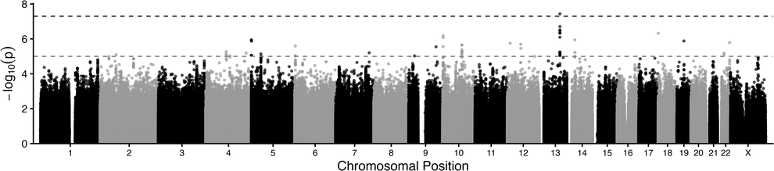
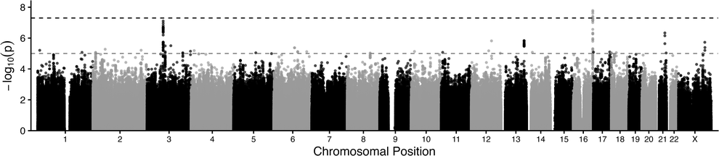
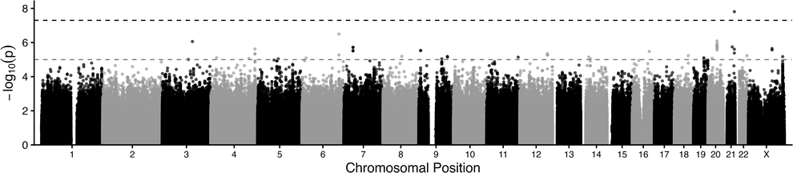
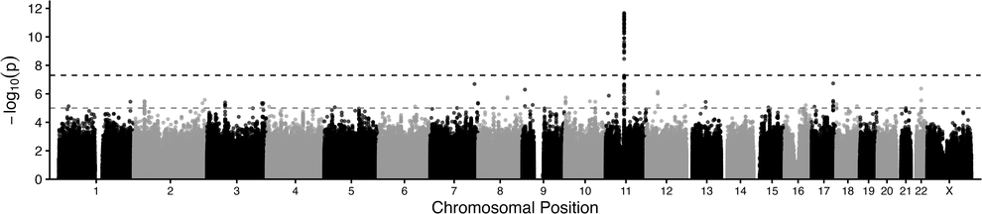
Genetic architecture of the MetRS metabolites
Results · genetics
Glucuronate, rs9594030 near LINC00351
Kynurenine, SLC7A5 (LAT1 transporter)
Hippurate, novel intergenic locus on chr21
C34:2 phosphatidylcholine, FADS2
GWAS in 1,508 Framingham Offspring participants
The MetRS and five of its metabolites reached p < 5 × 10⁻⁸
SLC7A5 and kynurenine is a known metabolite QTL; SLC7A5 encodes LAT1
Glucuronate, hippurate and N-carbamoyl-β-alanine signals appear novel
Bagheri et al., Circ Genom Precis Med 2021; Sinclair et al., Nat Commun 2018.
18
Notes:
LAT1, encoded by SLC7A5, is the large neutral amino acid transporter that carries kynurenine across the blood-brain barrier. Finding it here is genetic support for the tryptophan axis that came out of the network analysis, and it is reassuring that it has been reported before in metabolite-QTL studies.\n\nThe other loci look new. LINC00351 for glucuronate, an intergenic locus on chromosome 21 for hippurate, and a signal for N-carbamoyl-beta-alanine. C34:2 phosphatidylcholine maps to FADS2, which is a canonical fatty acid desaturase locus and a sanity check that the pipeline works.\n\nThe broader point is that these are enzymes and transporters. Genetic variation in the machinery that makes and moves these metabolites feeds into the score, which supports the idea of a partly inherited metabolic set point rather than a purely dietary or environmental signature.\n\nGenomic inflation was lambda = 1.87, consistent with polygenic architecture, though some population stratification cannot be ruled out in a cohort this size.

Slide 19
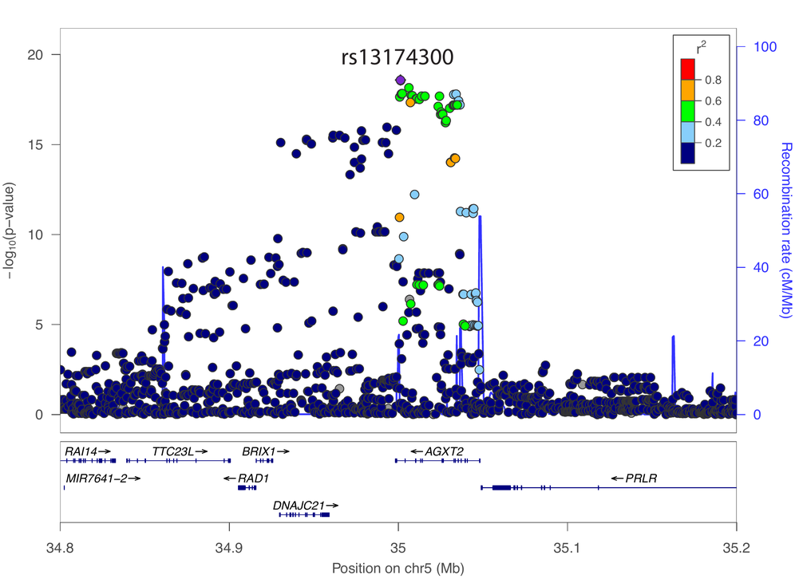
AGXT2 carries at least four independent signals
Results · genetics
BAIBA (β-aminoisobutyric acid): a myokine-like metabolite of valine, tied to fatty acid oxidation and insulin sensitivity
rs13174300 is associated with both the MetRS and BAIBA, and survives conditioning on three nearby BAIBA variants
Three more independent BAIBA signals: rs37376, rs163910, rs11749934
All pairwise r² < 0.2
AGXT2 encodes the enzyme that degrades BAIBA
rs13174300 is intronic, about 39% frequency in non-Finnish Europeans
Much rarer in African (17%) and East Asian (12%) ancestries
Phenome-wide hits: age at menarche and serum triglycerides
Part of the signature is inherited, not acquired
Suppl. Fig. 7c · regional association at AGXT2 (chr5p13) for the composite MetRS
Lüneburg et al., Circulation 2014 (AGXT2 and BAIBA); gnomAD v4; HugeAMP; UK Biobank PheWeb.
19
Notes:
AGXT2 is already known to be polygenic. Missense variants V140I and V498L independently affect enzyme activity and BAIBA metabolism, so finding four independent signals here is consistent with the existing literature rather than surprising.\n\nWhat is interesting is rs13174300. It is associated with the composite score and with BAIBA, but it stays genome-wide significant after conditioning on the three BAIBA variants. That means it is contributing to the score through something other than BAIBA alone, either another component metabolite or a regulatory mechanism distinct from the known missense variants.\n\nThe phenome-wide picture supports the fatty acid oxidation reading. Nominal association with age at menarche at p = 2.4 x 10-6 and with serum triglycerides at p = 5.6 x 10-5, both consistent with BAIBA's role in adipose browning and mitochondrial beta-oxidation. In the UK Biobank binary disease analysis nothing reached genome-wide significance, so its footprint is at the metabolite-QTL level rather than as overt disease risk.

Slide 20
Conclusions
Toward precision bariatrics
Thirteen preoperative metabolites predict five-year weight trajectory after RYGB
The score adds to what clinical variables already give: AUC 0.60 to 0.74
It replicated in an independent post-RYGB cohort seven years after surgery
It also tracks obesity in people who never had surgery
The metabolites organise into four axes that already have drugs: bile acid and GLP-1, tryptophan, fatty acid oxidation, nitric oxide
Genome-wide signals at AGXT2, SLC7A5, LINC00351 and FADS2 point to an inherited component
20
Notes:
Limits: extreme-phenotype design inflates effect sizes; validation cohorts were small and used reduced scores; 82.5% female and mostly European ancestry
Next: test a preoperative screening score prospectively, alongside microbiome and GLP-1 dynamic profiling

Slide 21



Acknowledgements
Thank you
With thanks to every member of
Thaker Lab
Vidhu Thaker, MD · Pediatric endocrinology
Columbia University
whose collaboration made this study possible
Salem Lab
Herbert Wertheim School of Public Health and Human Longevity Science, UC San Diego
and the LABS-2 participants and study teams
Baranzini Lab
Department of Neurology, Weill Institute for Neurosciences, UC San Francisco
21

