Slide 1

CYBERSECURITY ENGINEERING PROJECT
Real-Time MAC Spoofing Detection
with Wazuh SIEM
Automated endpoint telemetry capture, custom detection rules, MITRE ATT&CK alignment, and instant incident response.
Kali Linux & Ubuntu 24.04
Wazuh Agent & Manager 4.14
Active Response & SMTP Alerting

Slide 2

The Threat of MAC Spoofing
Layer 2 Impersonation Vector
MAC address spoofing modifies network interface hardware addresses to evade filtering, clone trusted assets, and conduct unauthorized lateral movement within enterprise local area networks.
Traditional monitoring tools rely on post-breach inspection and lack real-time correlation, leaving SOC teams blind to unauthorized physical identity modification.

Slide 3
System Limitations vs Innovation
Traditional Monitoring
Proposed Wazuh Solution
■
Manual Log Inspection: Security teams inspect syslog entries after unauthorized activity occurs.
■
Sub-Second Detection: Continuous Python polling generates structured JSON logs on NIC change.
■
No Real-Time Visibility: Layer 2 MAC frame updates remain undetected across subnets.
■
Automated Ingestion: Wazuh Agent forwards telemetry directly to Wazuh Manager.
■
Extended MTTD & MTTR: High alert latency gives attackers prolonged dwell time.
■
MITRE ATT&CK Mapping: Instant correlation to adversarial techniques and defense evasion.
■
Decentralized Audits: Lack of unified dashboards and missing forensic artifacts.
■
Proactive Active Response: Automatically generates forensic summaries and triggers SMTP alerts.

Slide 4



Project Core Objectives
Continuous Monitoring
SIEM Event Correlation
Automated Response
Deploy a lightweight Python daemon capturing hardware MAC, permanent factory MAC, gateway, and DNS metadata in real-time JSON format.
Develop custom Wazuh XML rules to detect MAC_INVESTIGATION triggers, classify severity level 10, and tag MITRE tactics.
Execute Wazuh Active Response scripts, dispatch instant Postfix SMTP notifications, and present live telemetry in OpenSearch dashboards.

Slide 5

System Architecture & Stack
Wazuh Manager: Hosted on Ubuntu 24.04 Server, parsing telemetry, applying rule engine logic, and triggering responses.
Monitored Endpoint: Kali Linux workstation executing the mac_monitor.py daemon alongside Wazuh Agent 4.14.7.
Log Collector: Monitors /var/ossec/logs/mac_monitor.log and transmits events through encrypted channel.
OpenSearch Dashboard: Provides centralized data indexing, forensic search, and timeline visualization.

Slide 6
End-to-End Detection Pipeline
2. JSON Ingestion
4. Active Response
Wazuh Agent reads forensic JSON entries from the designated log path.
Automated script executes containment and dispatches SMTP alerts.
1. NIC Polling
3. Rule Correlation
Python script polls network interfaces and detects MAC address modifications.
Manager executes Rule ID 100510 (Severity 10) and maps MITRE ATT&CK.

Slide 7
Validation & Attack Benchmarks
Empirical Validation with Macchanger
100%
During live testing on Kali Linux, hardware MAC randomization and spoofing scenarios were simulated using macchanger -r eth0.
The system successfully recognized every address state transition, populated the Wazuh manager log pipe within 1.2 seconds, and prevented alert suppression through robust JSON schema indexing.
Detection & Alert Accuracy

Slide 8
Forensic Telemetry Fields
Field Name | Sample Extracted Value | SOC Security Purpose
permanent_mac |  | Ground-truth hardware burned-in address verification
new_mac |  | Active spoofed MAC address identification
vendor |  | OUI vendor lookup to pinpoint device discrepancy
randomized |  | Identifies pseudo-randomized evasion tools like macchanger
change_count |  | Frequency tracking for rapid hopping and MITM assaults
08:00:27:8a:35:d2
7e:b6:9f:15:d1:74
CADMUS COMPUTER SYSTEMS
YES
5

Slide 9
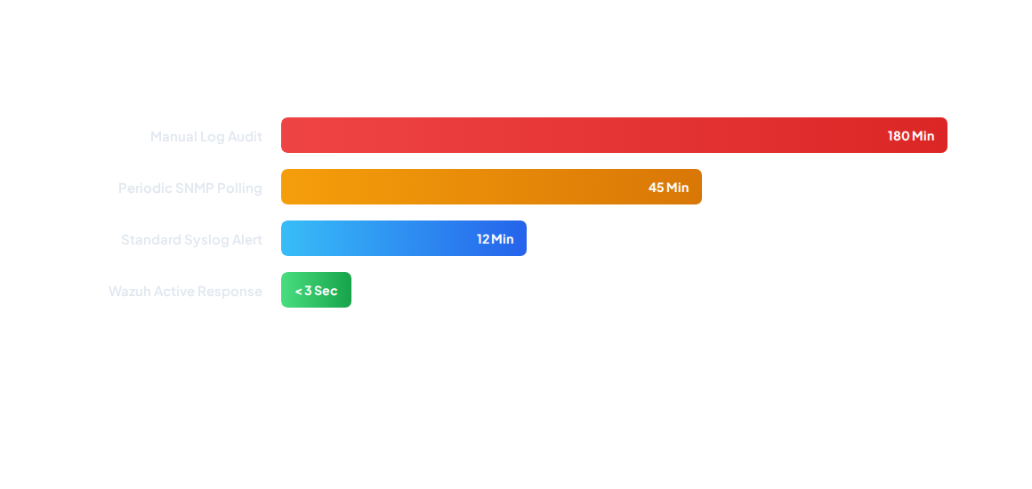
Incident Response Time Metric
The proposed automated Wazuh pipeline slashes incident turnaround time from hours down to sub-second execution, neutralizing impersonation windows before threat actors pivot.

Slide 10
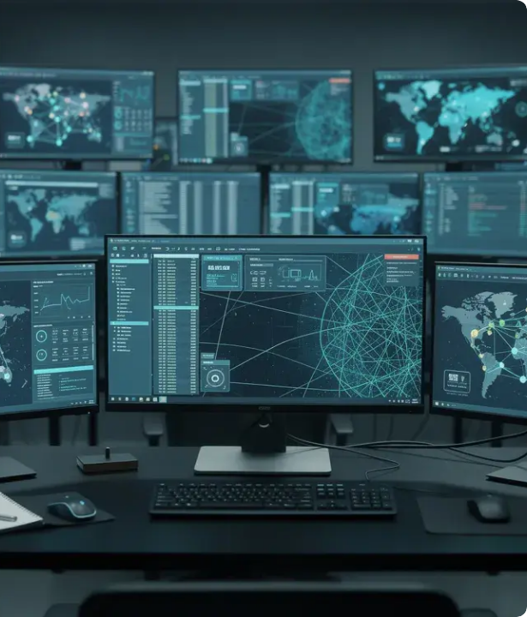
Automated Incident Alerting
Multi-Channel Dispatch
When unauthorized MAC modifications trigger Rule ID 100510, Wazuh dispatches instant High-Severity (Level 10) alerts via Postfix SMTP and Slack webhooks.
Security administrators immediately receive rich forensic summaries detailing hostname, IP, old MAC, new MAC, and vendor telemetry for rapid triage.

Slide 11
Future Strategic Roadmap
Multi-Interface Enterprise Support: Expand monitoring coverage across virtual bridges, Docker/Kubernetes interfaces, and wireless adapters.
Machine Learning Behavioral Anomaly Scoring: Implement baseline analysis to distinguish legitimate admin maintenance from malicious address cycling.
Historical Forensic Telemetry Vault: Long-term database retention for Layer 2 telemetry to support deep post-incident compliance audits.
Autonomous Remediation: Automate immediate network quarantine via 802.1X port isolation or managed switch ACL reconfigurations.

Slide 12
Questions & Discussion
Real-Time MAC Address Spoofing Detection using Wazuh SIEM
Wazuh SIEM & Active Response
Kali Linux & Ubuntu Server
SOC Security Operations

Slide 13



Image Sources
https://www.splunk.com/en_us/blog/learn/media_1ad0e73fe5a9597fd5a517b6e3c8d9ba5efa2b654.webp?width=1200&format=pjpg&optimize=medium
Source: www.splunk.com
https://pikwizard.com/pw/small/b08cb7026350a30db29c7c184eb9c756.jpg
Source: pikwizard.com
https://d2nzy1qhita6w.cloudfront.net/media/magefan_blog/Blog_14_-_Jun_-_feat_image.webp
Source: www.quickstart.com

