Slide 1

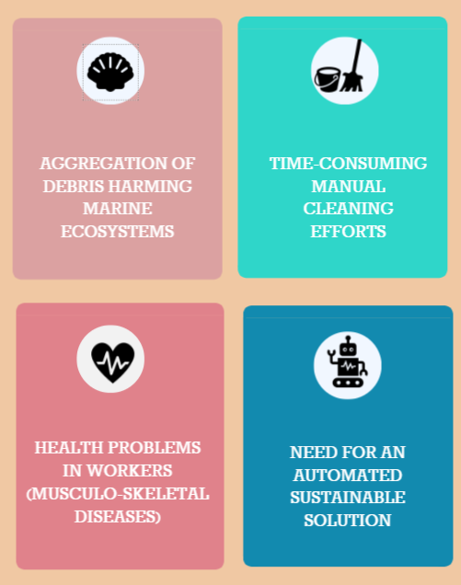
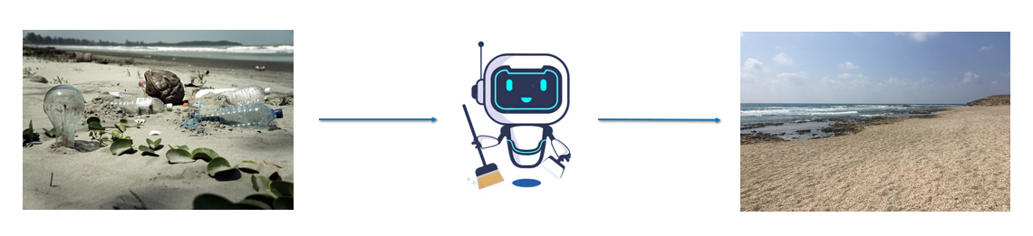
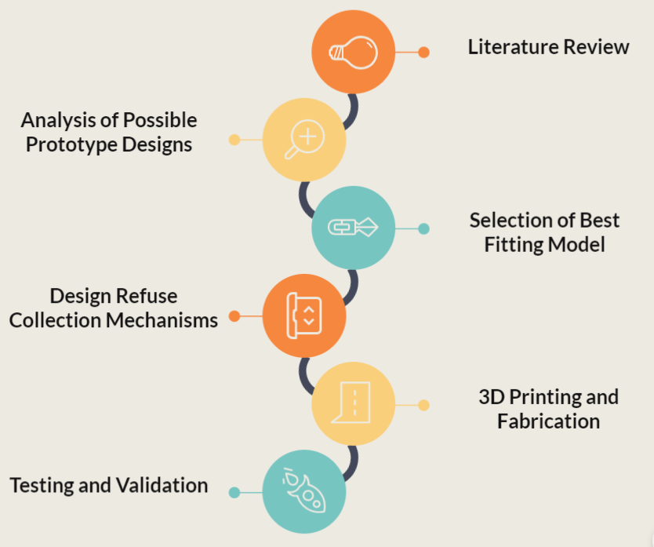
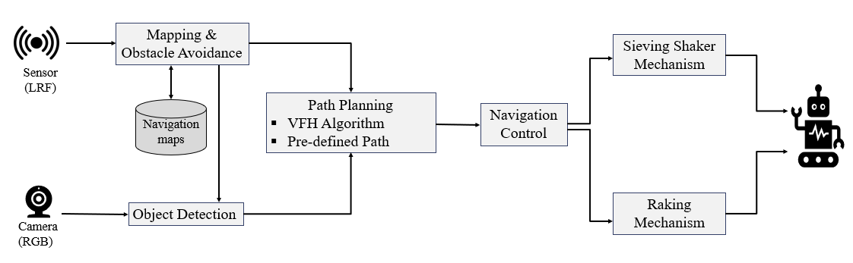
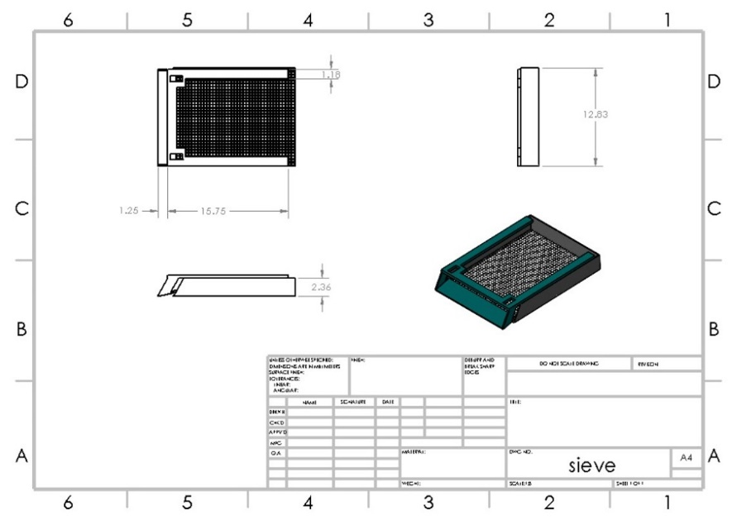
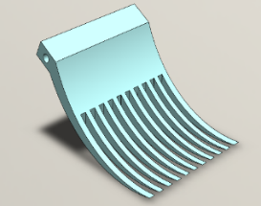
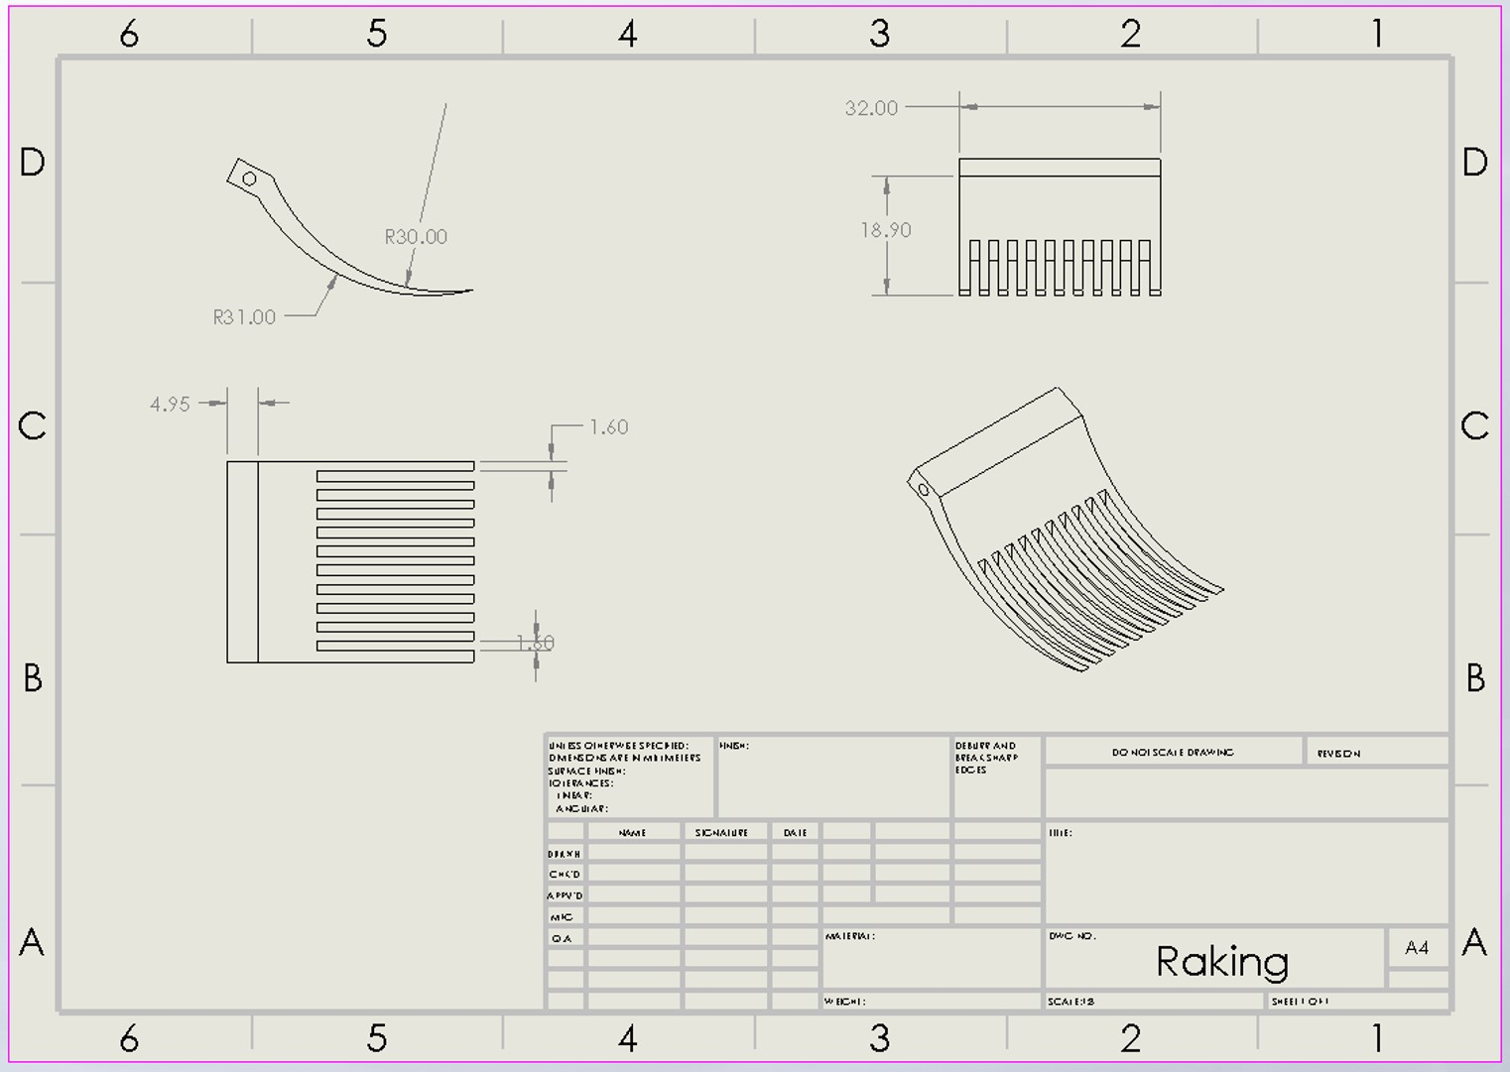
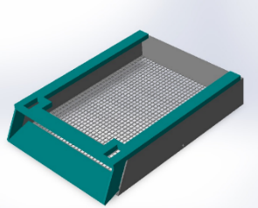
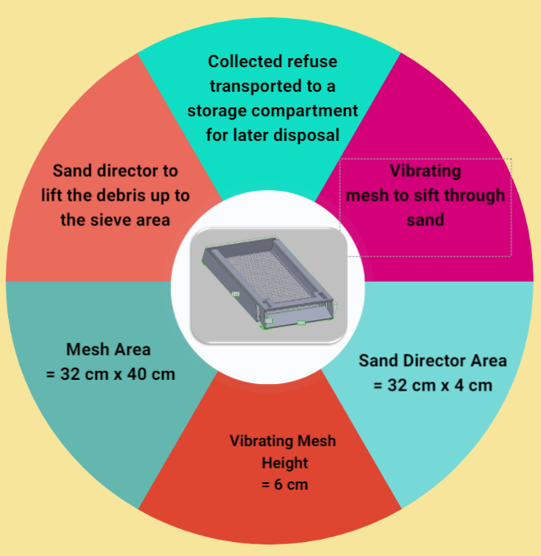


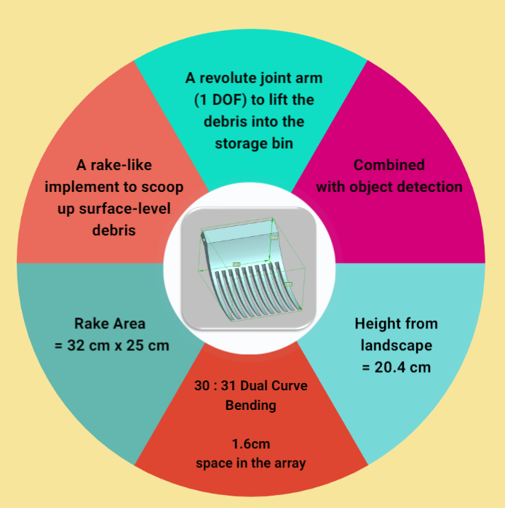
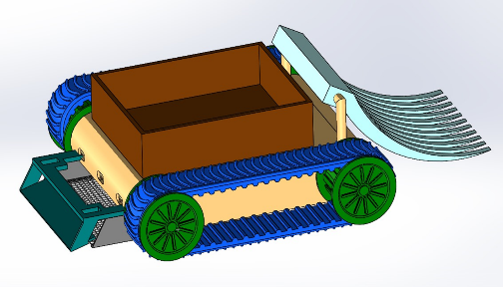
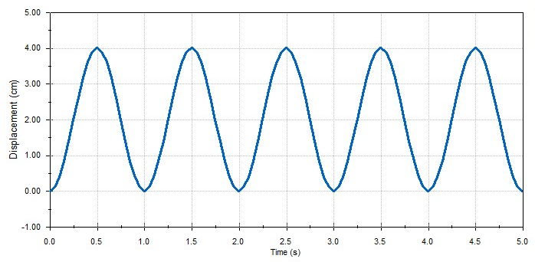
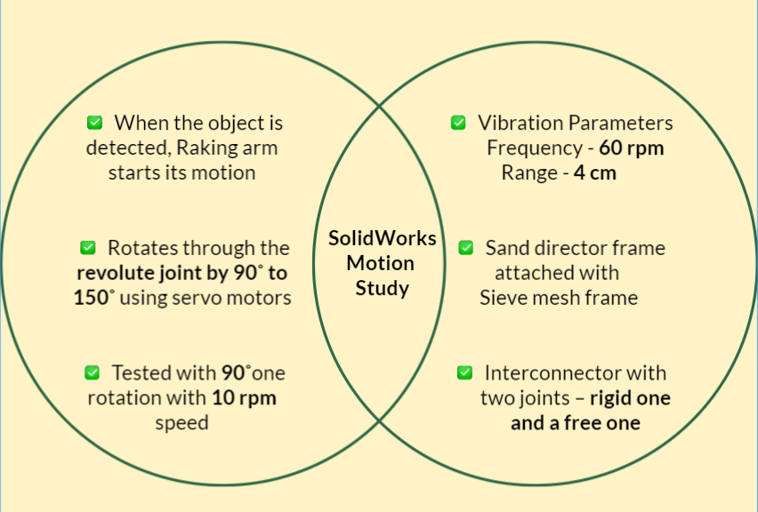
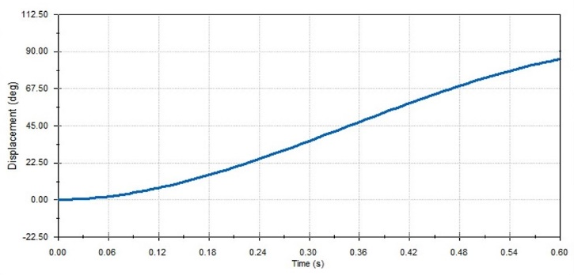
Design of Refuse Collection Mechanisms for an Intelligent Beach Cleaning Robot
Yathunanthanasarma B. ¹, Barathraj M. ¹, Mahiliny J. ¹, A. G. B. P. Jayasekara ¹
¹ Department of Electrical Engineering, University of Moratuwa, Moratuwa, Sri Lanka.
Introduction & Background
Methodology
Uncleaned Beach
System Overview
Cleaned Beach
Sieving Shaker Mechanism
Raking Mechanism
Mesh Area
Raking Array
Sand Director
Combined Robot Vehicle
Sieving Shaker
Raking Hand
Results and Discussion
Displacement(cm) vs Time(s) graph for Sieving Mechanism
Displacement(degrees) vs Time(s) graph for Raking Mechanism
Conclusions
Future Work
References
The 3D model of the mechanisms was designed as planned and subsequently subjected to simulation using specific parameters.
Our singular prototype selection driven by identified research gaps, is grounded in a thorough literature review.
Filling the void of models with integrated essential mechanisms, the prototype prioritizes cost-effectiveness, positioning it as an innovative force.
Separating seashells from beach debris by analysis and comparison of FTIR (Fourier Transform Infrared) and Raman spectra of seashells with real-time spectrum data.
Develop a proactive behavior with an algorithm to execute tasks autonomously without explicit human guidance.
[1] D. Varghese and A. Mohan, "Binman: An Autonomous Beach Cleaning Robot," 2022 IEEE 2nd Mysore Sub Section International Conference (MysuruCon), Mysuru, India, 2022, pp. 1-5, doi: 10.1109/MysuruCon55714.2022.9972499.
[2] T. Ichimura and S. -i. Nakajima, "Development of an autonomous beach cleaning robot “Hirottaro”," 2016 IEEE International Conference on Mechatronics and Automation, Harbin, China, 2016, pp. 868-872, doi: 10.1109/ICMA.2016.7558676.
[3] Roza, Felippe & Silva, Vinicius & Pereira, Patrick & Bertol, Douglas. (2016). Modular robot used as a beach cleaner. Ingeniare. Revista chilena de ingeniería. 24. 643-653. 10.4067/S0718-33052016000400009.
[4] N. Bano et al., "Radio Controlled Beach Cleaning Bot," 2019 IEEE 6th International Conference on Engineering Technologies and Applied Sciences (ICETAS), Kuala Lumpur, Malaysia, 2019, pp. 1-6, doi: 10.1109/ICETAS48360.2019.9117269.
[5] J. S. Priya, K. T. Balaji, S. Thangappan and G. Yuva Sudhakaran, "Beach Cleaning Bot Based On Region Monitoring," 2019 International Conference on Computation of Power, Energy, Information and Communication (ICCPEIC), Melmaruvathur, India, 2019, pp. 1-4, doi: 10.1109/ICCPEIC45300.2019.9082368.

