Slide 1
Digital Image Processing
Convolutional Neural Network for Image Super Resolution
Barath Mohan U

Slide 2
Problem Description
The inherent problem is that the output image has to be filled with information which is essentially unknown.
Natural images are usually not band limited. Thus, while going to a higher resolution, the higher resolution components need to be predicted.

Slide 3
Data
A training set with around 9000 was obtained from the following databases:
https://yingqianwang.github.io/Flickr1024/
https://www.robots.ox.ac.uk/~vgg/data/
The images cropped into 512x512 (output) resolution images. They were then decimated into 256x256 (input). A low pass filter was used for two reasons:
It is assumed that the images we would want to upscale do not having aliasing.
Since we want to let the neural network predict the higher frequency components that are not present in the input image but present in the output images.

Slide 4
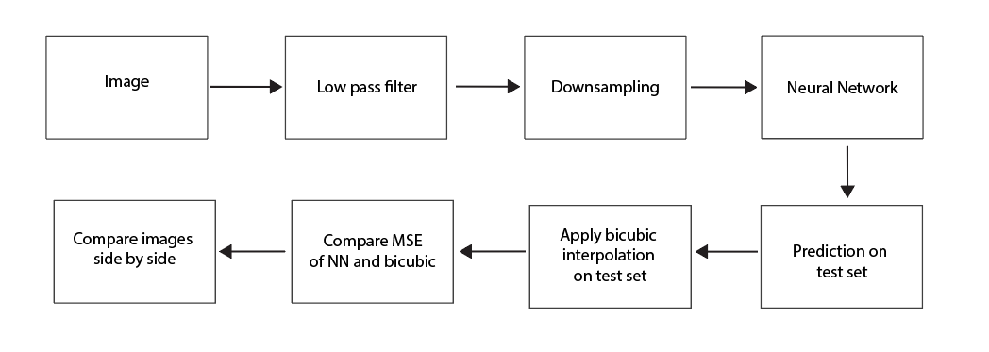
Algorithm Pipeline

Slide 5
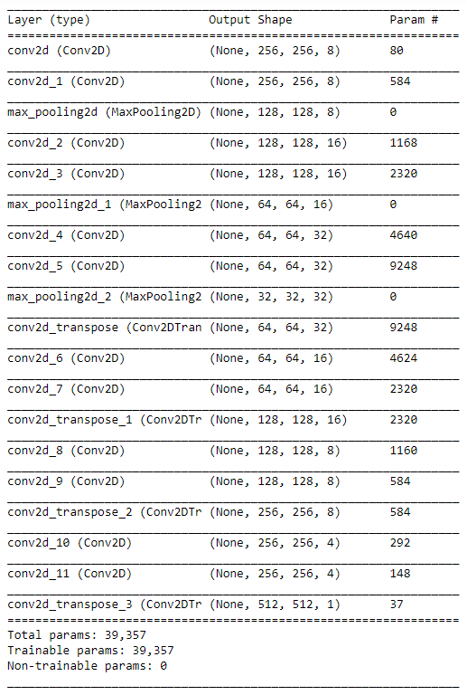
Network Architecture
Decoding part (Image reduces in size)
Encoding part (Image increases in size)

Slide 6
U-net based architecture
The decoding part of the network can learn useful features from the image. This learning will also be translational invariant due to pooling. Ex: edges and corners.
The encoding part can then upscale the image and learn local upscaling techniques based on the features the decoding part learnt. Ex: blur different at edges to preserve them.
MSE with ground truth
Bicubic error – 452.5749
Neural network trained with ~2000 images – 1109.8956
Neural network trained with ~8000 images – 644.4095
[Ronneberger et al., 2015]

Slide 7
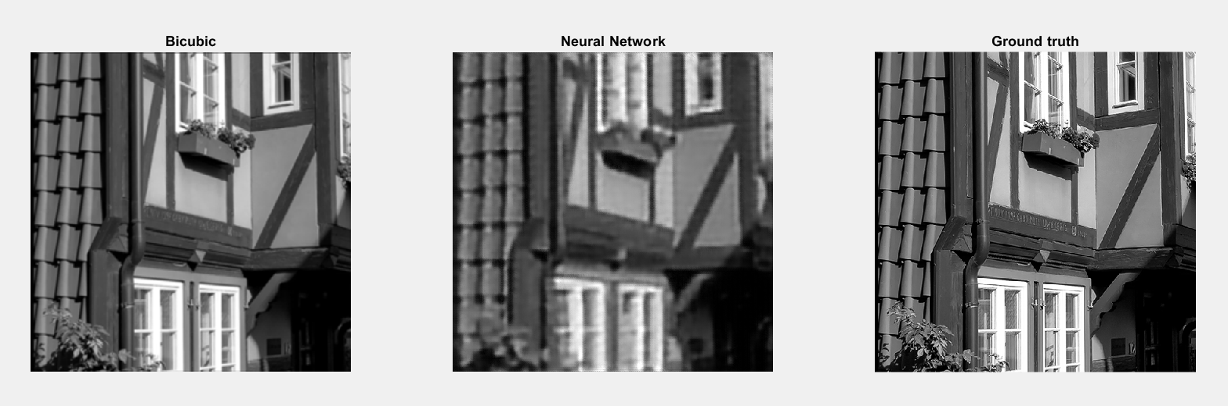
The neural network seems to perform worse than bicubic interpolation (in every image).
The neural network seems to scale well with more training data. A naïve approach would be to increase the dataset and network complexity. Let us try something else!

Slide 8
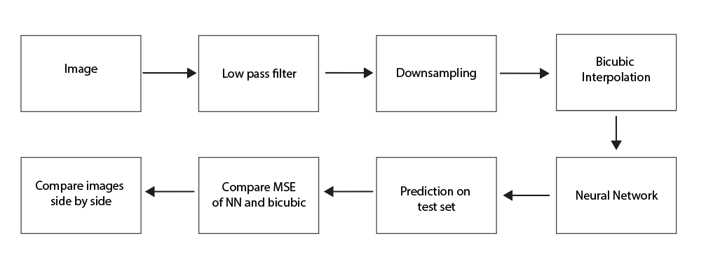
What if we start from the bicubic interpolated image and try to get to the ground truth?
Pipeline

Slide 9
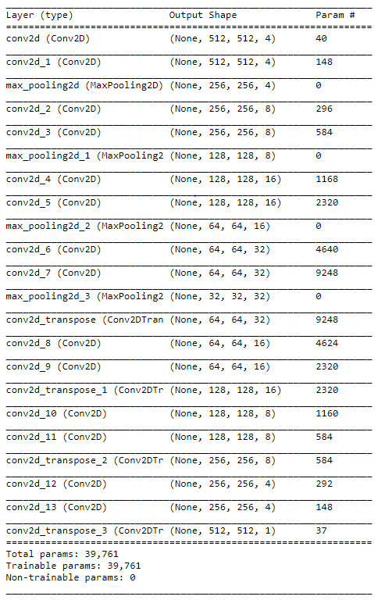
Similar Network Architecture
Decoding part
MSE - 622.9396
Encoding part

Slide 10
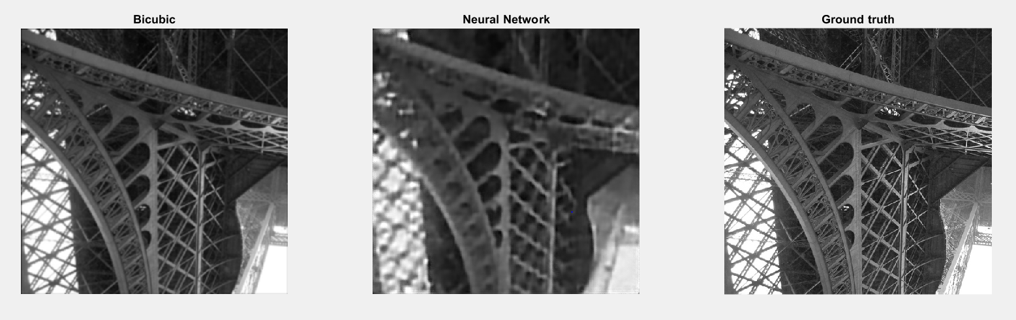
This neural network performs slightly better than the previous one. But it takes the output image farther away from the ground truth than the input image.

Slide 11
Drawbacks and possible extensions
The convolutional neural networks could match or outperform bicubic interpolation with more training data, longer training, and bigger networks. Just to match bicubic’s performance it requires a lot of computational horsepower. Generative adversarial network could be a better alternative.
One would expect the network to perform better starting from the output of bicubic interpolation. It rather does worse than the input. Do we really require a U-net in this case? It is possible that a series of convolutional layers without reducing or increasing the image dimensions could work better. In that case the network only has to learn how to make corrections to the bicubic interpolation.

Slide 12
The training set, test set, codes, and the results can all be found in the following drive link:
https://drive.google.com/drive/folders/1bn2wxCCUa8TI-NGHkrDm_w2fCKeTPjuz?usp=sharing
Data
imagedata.mat – Input images and ground truth for the network.
imagetestdata.mat – Test set.
bicubic.mat – Input images which are bicubic interpolated and ground truth for the network.
bicubictest.mat – Test set for model 2.
TestResults.mat – contains a {1000,5} cell of images. Col 1 is the 256x256 input image. Col 2 is the bicubic interpolated 512x512 image. Col 3 is the prediction by model 1. Col 4 is the prediction by model 2. Col 5 is the ground truth.
Codes
Preparation.m – prepares the dataset by reading all images and decimating them.
Upscale.py – training and hyperparameter search for model 1.
Bicubic.py – training and hyperparameter search for model 2.
Accuracy.m – calculates MSE of bicubic and network prediction with ground truth.
concatresults.m – concatenates all the results to give TestResults.mat

