Slide 1

CricLens
An Intelligent IPL Analytics & Decision Support Platform
From Every Ball to Every Insight.
Amitesh Ram | 24BDS1030
Barath T | 24BDS1178

Slide 2


The Problem
Massive, Underutilized Data
19 years, 250+ matches, 150K+ balls annually — yet insights remain buried and inaccessible.
Fragmented Intelligence
Stats scattered across platforms with no way to correlate player, team, and venue data meaningfully.
Intuition Over Evidence
Coaches and analysts rely on gut feel rather than structured, data-driven decision support.
No Unified Source of Truth
Coaches, analysts, and fans each need one authoritative platform — and none currently exists.

Slide 3
Why IPL?
Rich, Structured Data
T20 Strategic Complexity
Ball-by-ball records, player stats, and venue conditions — publicly available and well-documented.
The format demands split-second tactical decisions where analytics delivers measurable edge.
400M+ Global Fans
High-Stakes Business Impact
Deeper insights drive engagement, viewership, and commercial value at an enormous scale.
Teams invest millions per season — superior analytics translates directly to competitive advantage.

Slide 4

The Dataset
IPL 2008–2028
19 complete seasons of ball-by-ball records
Coverage
250+ matches, 150K+ deliveries, player performance metrics, venue conditions, match outcomes
Structure
Cleaned and normalized for EDA and statistical modeling
Scope
All-format data enabling cross-season trends, player consistency analysis, and venue behaviour patterns

Slide 5






Why R?
Statistical Computing
Data Wrangling
Native support for hypothesis testing, regression analysis, and probabilistic modeling
tidyverse (dplyr, tidyr) for efficient data cleaning and transformation at scale
Visualization
Predictive Modeling
ggplot2 for publication-quality EDA and interactive charts via plotly
caret, randomForest, and forecast for ML and time-series analysis
Interactive Dashboards
Reproducibility
Shiny for real-time, reactive web applications — entirely within the R ecosystem
Single language from raw data to final output ensures transparency and auditability
Key Packages: dplyr · tidyr · ggplot2 · plotly · caret · randomForest · forecast · shiny

Slide 6
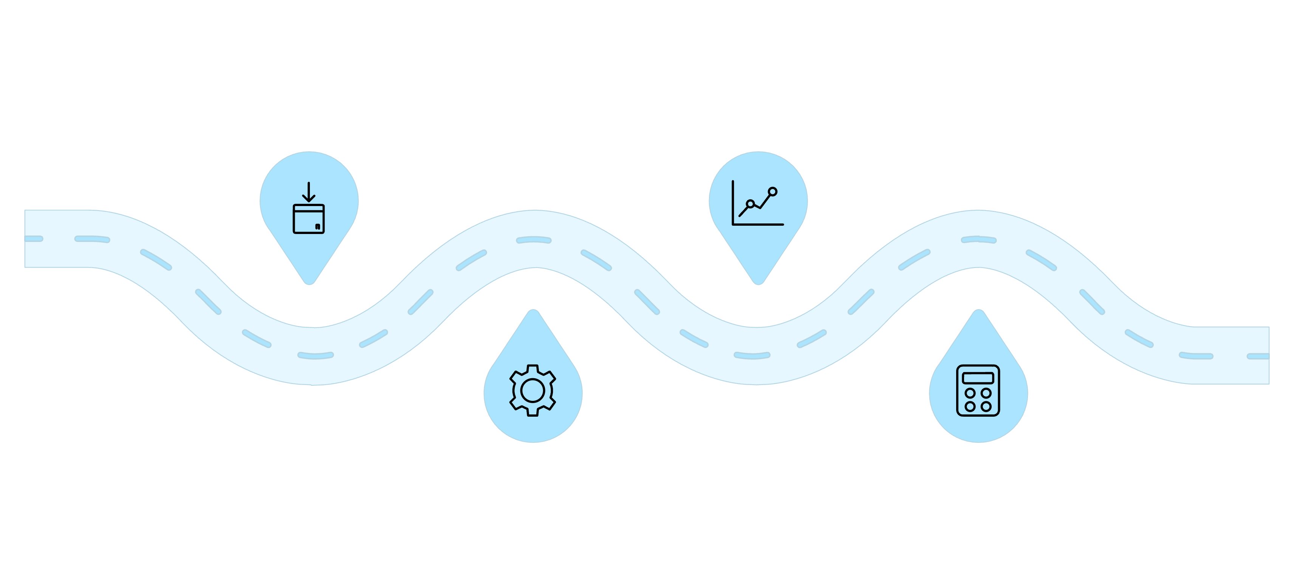
System Architecture
A rigorous data science pipeline — from raw ball-by-ball records to an interactive decision support platform.
Ingest & Clean
Exploratory
Collect raw ball-by-ball records
Visualize patterns and anomalies
Feature Eng.
Statistical
Derive match and player features
Run rigorous tests and models
Every stage is implemented entirely in R. The Natural Language Interface (NVIDIA NIM) sits at the top as a query layer — all analytical logic remains in the R pipeline beneath it.

Slide 7
Analytics Modules
Player Intelligence
Team Intelligence
Venue Intelligence
Predictive Analytics
Consistency Analysis — performance variance across seasons and match phases
Phase-wise Performance — powerplay, middle, and death over metrics
Custom Impact Score — weighted contribution to team wins
Win Probability Modeling — in-game match outcome forecasting
Toss Analysis — impact of toss decision by venue
Chase Analysis — run-chase success rates and strategy
Pitch Behaviour Patterns — scoring trends and surface characteristics
Average Scores & Variance — batting difficulty and home advantage
Toss Influence — optimal batting/bowling strategies by ground
Match Prediction — outcome forecasting from historical patterns
Player Form Forecasting — next-match performance prediction
Player Clustering — unsupervised grouping by role and impact

Slide 8




Example Use Cases
Death Overs Specialist
"Which player performs best in death overs?"
Phase-wise analysis → ranked list with strike rate, consistency score, and impact index
Venue Head-to-Head
"Compare Kohli and Rohit at Chepauk"
Venue-filtered analysis → radar chart + statistical significance testing on sample size
Match Outcome Prediction
"Predict tomorrow's match outcome"
Squad + venue + history → ML win probability with confidence intervals and key drivers

Slide 9
The Role of AI
AI is not responsible for analytics. It only converts natural language queries into predefined R analytical functions.
What AI Does
What AI Does NOT Do
Accepts conversational natural language input
Maps queries to the correct predefined R function via NVIDIA NIM API
Returns results in a readable, user-friendly format
AI performs no statistical analysis or modeling
AI makes no predictions or decisions independently
Every query maps to an auditable R function — no black-box decision-making
All statistical rigor, modeling, and insight generation originates in the R pipeline. AI simply makes the platform conversational.

Slide 10
Tech Stack & Deliverables
Technology Stack
Deliverables
01
Core Engine
Dashboard
R — dplyr, tidyr, ggplot2, plotly, caret, randomForest, forecast
Shiny — interactive, reactive web application built entirely in R
Cleaned IPL Dataset
2008–2026, normalized and validated
02
AI Interface
Analytics Engine & ML Models
NVIDIA NIM API — natural language to R function mapping layer
Reproducible R scripts with validation metrics
03
Interactive Shiny Dashboard
Real-time exploration, filtering, and visual discovery
04
Natural Language Query Assistant
Conversational interface powered by NVIDIA NIM
05
Technical Report
Full documentation with model validation and methodology

Slide 11


Outcomes & Future Scope
Expected Outcomes
Future Roadmap
Fully functional analytics platform with predictive models and interactive dashboards
Real-time match analytics and mobile application
Multi-league expansion — BBL, PSL, and international formats
Data-driven decision support for teams, coaches, and analysts — backed by statistical rigor
Fantasy XI recommendation engine powered by player clustering models

