Slide 1
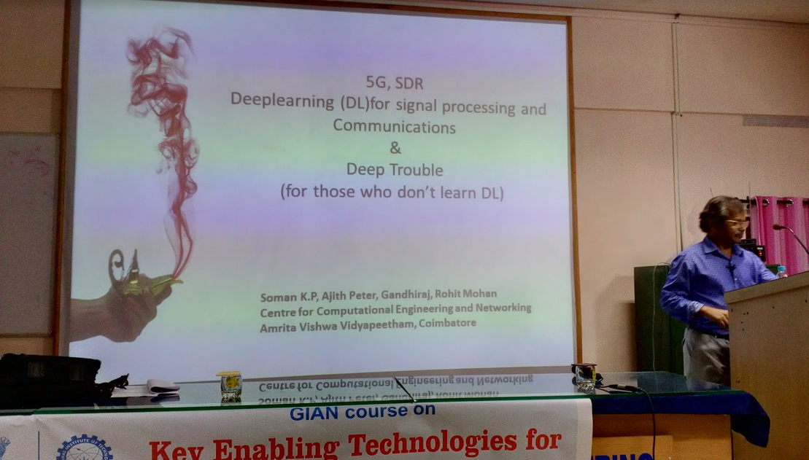
GIAN Course on "Key Enabling Technologies for 5G Wireless Networks" at Department of ECE, NIT Calicut 8-13 December 2017

