Slide 1
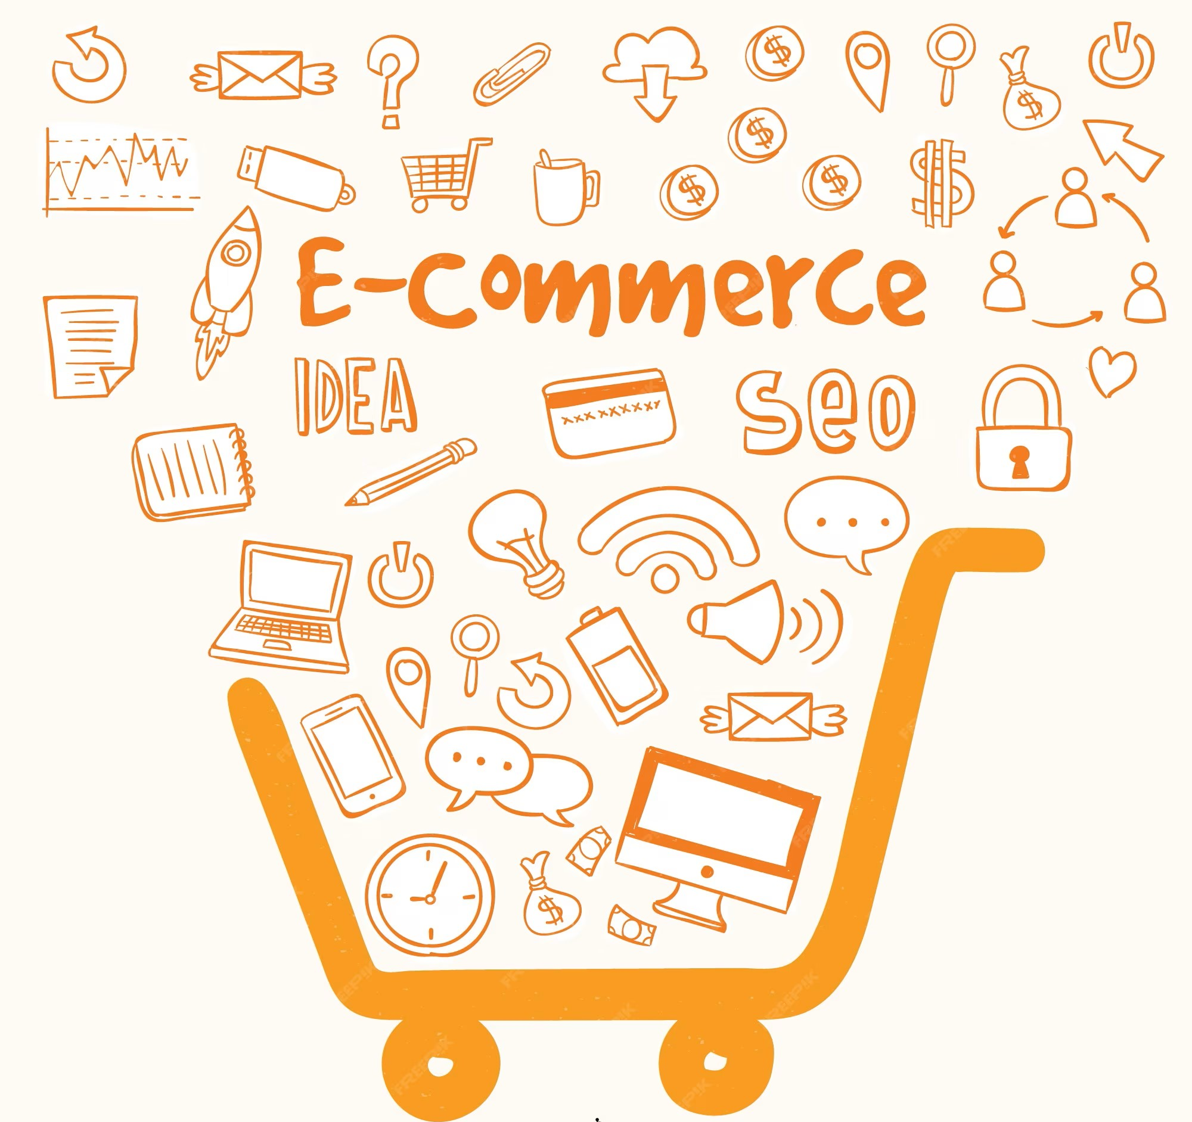

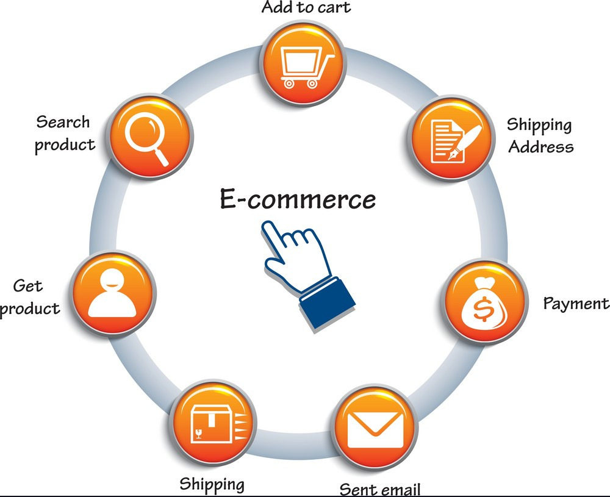

Database Foundations for E-Commerce Product Recommendation System ______________________________________________________________________________________________
Prof . Dr. Lidong Wu
BUAN 6320- Database Foundations
for Business Analytics

Slide 2
CONTENTS
- Introduction
- Relational Schema
- Functions, Triggers, and Stored Procedures
- SQL Queries for Data Analysis
- Conclusion

Slide 3

PROJECT INTRO
Develop an E-Commerce Product Recommendation System to enhance user engagement and improve the shopping experience.
Focus on personalized recommendations to boost sales and stimulate revenue growth.
Implement inventory management for tracking product availability and ensuring a seamless shopping experience.
Establish a competitive edge in the e-commerce market through innovative and tailored product suggestions.
Reinforce user loyalty by addressing the challenge of enhancing engagement and providing a personalized shopping journey.

Slide 4
- Our project focuses on creating an -E-Commerce Product Recommendation System to enhance the user experience on an e-commerce platform.
- OBJECTIVE - Address the challenge of enhancing user engagement, boosting sales, and elevating the shopping experience through personalized product recommendations.
Users Table: Stores detailed customer profiles, including personal information, to personalize the shopping experience.
Product Table: Contains comprehensive product details, aiding in inventory management.
Brands Table: Houses information about brands, facilitating brand-based product categorization.
Product Category Table: Manages product categories and subcategories for efficient product organization.
User Interaction Table: Records user behavior and interactions with products and categories.
Recommendation Table: Stores personalized product recommendations and their associated scores.
LIST OF ENTITIES USED

Slide 5
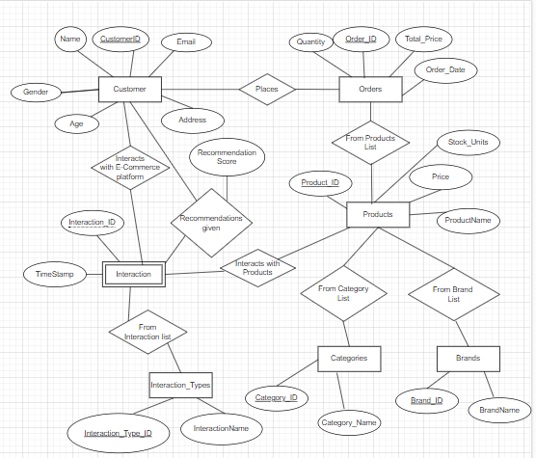
ER Diagram

Slide 6
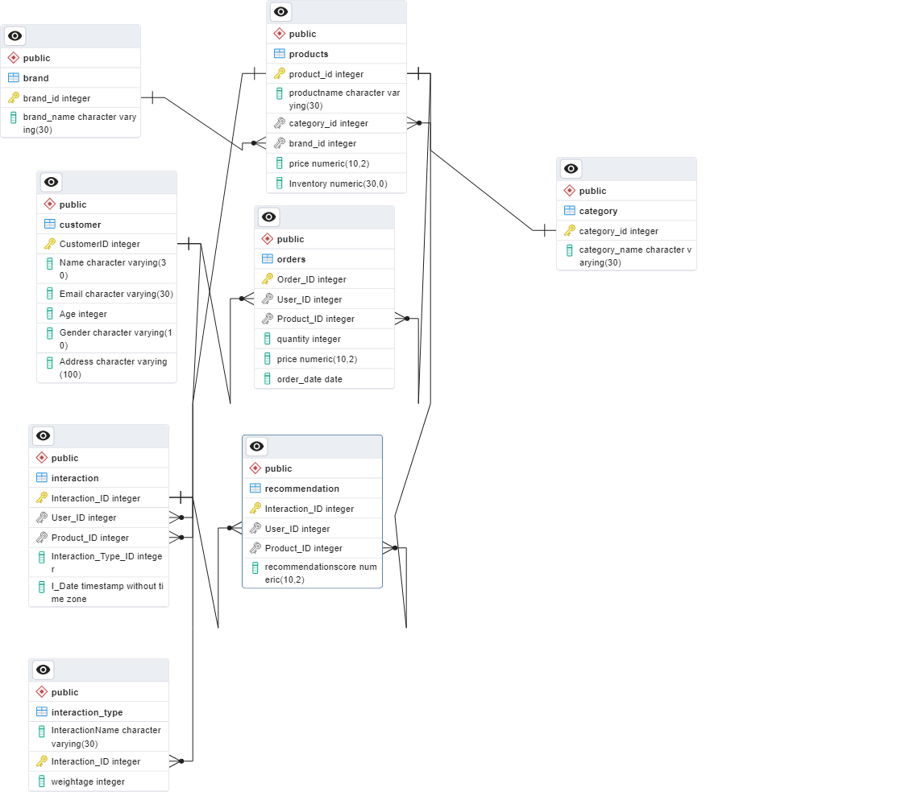
Explanation:
The schema provides a structural framework for our database, connecting key components crucial for the recommendation system's operation.
Orders :OrderId, User_ID ,Product_ID ,Quantity, Price,Order_Date
Customer: CustomerID, Name, Email, Age, Gender, Address
Products :Product_ID, ProductName, Category_ID, Brand_ID, Price, Inventory
Brand : BrandName, Brand_Id
Category : Category_ID, CategoryName.
Interaction_Type: InteractionName, InteractionID, Weightage
Interaction : Interaction_ID,User_ID, Product_ID, Interaction_type_ID, i_date
Recommendation: Interaction_ID,User_ID,Product_ID,
Recommendation Score

Slide 7
Functions, Triggers, and Stored Procedures
- CreateOrder() Function:
Function for placing an order, ensuring data integrity and processing.
- Trigger_placeorder Trigger:
Trigger executed after each order to update product stock and process orders.
- ProcessOrders Stored Procedure:
Processes orders and displays the new order ID.
- Trigger_AddProduct Trigger:
Trigger executed after a new product is added to the products table.
- AddProduct Stored Procedure:
Adds new products to the products table and updates stock size.
- AfterInsertRecommendation Trigger:
Calculates recommendation scores for users after each interaction.
- CalculateRecommendationScore Stored Procedure:
Calculates recommendation scores for each user and updates the recommendation table.

Slide 8
SQL Queries for Data Analysis
1. Top 5 Customers with Maximum Expenditure:
- Identifies the top 5 customers based on their total expenditure.
2. Top 5 Customers with Maximum Interactions:
- Identifies the top 5 customers based on their interaction frequency.
3. Customers without Any Purchase:
- Checks for customers without any purchase, aiding in customer analysis.
4. Most Popular Product:
- Finds the product with the highest sales, indicating its popularity.
5. Top Sales in Each Category:
- Highlights the top-selling products in each category.
6. Hour of Maximum Interactions:
- Identifies the hour with the highest user interactions.
7. Products with Inventory < 200:
- Lists products with inventory below 200 units, aiding inventory management.
8. Top 3 Brands Based on Sales:
- Identifies the top 3 brands based on their sales performance.
9. Revenue per Gender per Category:
- Analyzes revenue generated based on gender and category.

Slide 9
CONCLUSION
- Achievements Recap:
Developed functions, triggers, and stored procedures for a robust recommendation system.
- Importance of SQL Components:
These components form the backbone of our recommendation platform, ensuring seamless functionality.
- Analytical Capacity:
SQL queries facilitate profound data analysis, extracting valuable insights.
- Business Intelligence:
The symbiotic relationship between the technical infrastructure and data analysis empowers the platform with
meaningful business intelligence.

Slide 10

THANK YOU
-CONTACT INFORMATION
Group 14
- Adharsha Velen: axg230033@utdallas.edu
- Arwin Kumar Ravi (axr220249@utdallas.edu)
- Barath Kumar Dhanasekar (bxd220033@utdallas.edu)
- Jesse Jackson Yajjala (jxy230003@utdallas.edu)
- Mahadevan Ramanan (mxr230040@utdallas.edu)
- Prathamesh P Nagraj (pxn230011@utdallas.edu)
- Vijay Refkin Puvvala (vxp230008@utdallas.edu)

