Slide 1
Question 1
Number of orders returned = 10
Percentage of orders returned compared to total orders=0.100060036
Total sales loss due to returns = 2282.806
Total profit loss due to returns = -1331.7647

Slide 2
Question 2
Fastest delivery time = Standard Class (5.006 days on an average)
Slowest delivery time = Same day (0.044 days on an average)

Slide 3
Question 3
The number of customers is highest for the segment range where total sales is 0-5000.
However average profit is more for segment range where total sales is 15000-20000

Slide 4
Question 4
The top selling category is technology (Total sum = 836154.033, Average profit=78.75) and subcategory in technology is Phones
The top selling subcategories in each category are
Phones (Total sales=836154.033, Average profit=78.752), Chairs(Total sales=328449.103, Average profit=43.095), Storage(Total sales=223843.608, Average profit=25.152)

Slide 5
Question 5
The West has the highest total sales amount = 725457.824 with an average profit of 33.849
The South has the lowest total sales amount = 391721.905 with an average profit of 28.857
There seems to be a trend where west and east get higher total sales compared to central and south which gets significantly lower sales

Slide 6
Question 6
Correlation between discount rate and quantity sold = 0.008623
Correlation between discount rate and profit margin = -0.21949
There seems to be less correlation between discount rate and quantity sold
There seems to be a negative correlation between discount rate and profit margin where if discount rate increases then profit margin decreases

Slide 7
Question 7
The south region can be targeted to introduce new markets and strategies as they have higher average profit of 28.85 but lesser count of markets (1620).

Slide 8
Question 8
We can create a customer loyalty program segmented into 4 groups namely based on number of orders placed - 1 to 10, 11 to 20, 21 to 30, 31 to 40
Customers in range 31 to 40 could be given special discounts and membership offers which can be sequentially decreased for other lower ranges

Slide 9
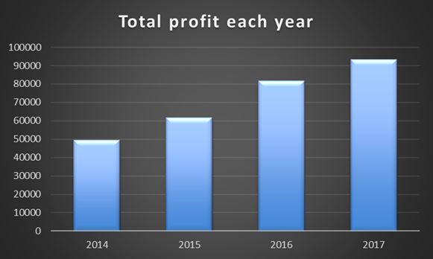
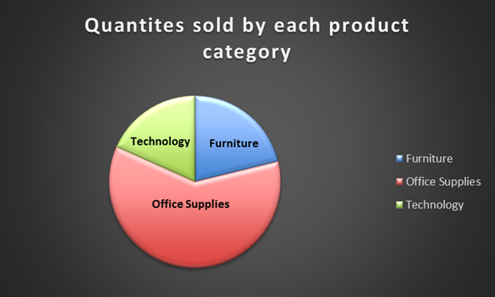
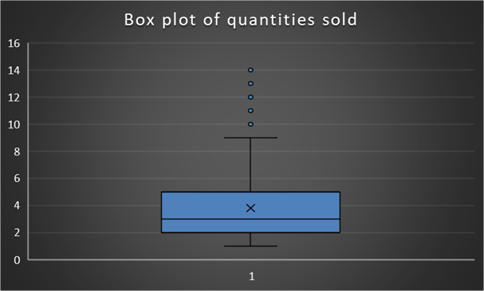
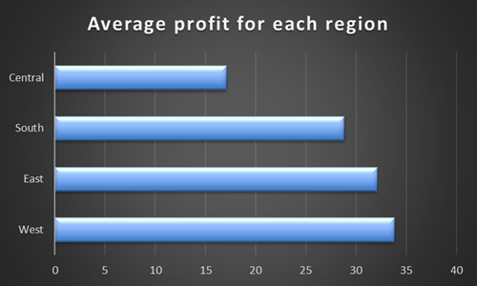
Question 9
Total sales by region
Region | Total sales
Central | 501239.8908
East | 678781.24
South | 391721.905
West | 725457.8245
Grand Total | 2297200.86
Quantities sold | Count
1-5 | 8131
6-10 | 1750
11-15 | 113
Segment | Count
Consumer | 5191
Corporate | 3020
Home Office | 1783

