Slide 1

Question 16

Slide 2
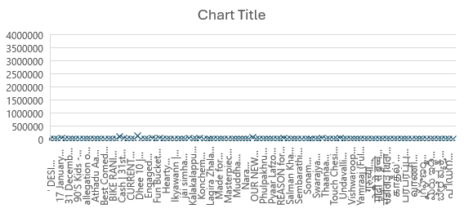
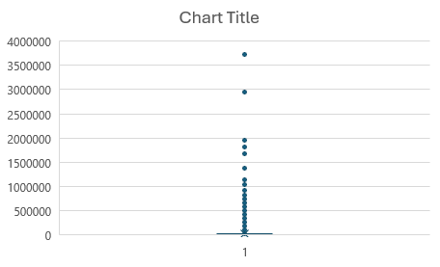
Question 17 – Outlier Detection

Slide 3
Question 18 - Trend Analysis

Slide 4
Question 19 –Growth Analysis

