Slide 1
THE UNIVERSITY OF DODOMA
THE COLLEGE OF INFORMATICS AND VIRTUAL EDUCATION
DEPARTMENT OF COMPUTER SCIENCE AND ENGINEERING.
SPI PROJECT REPORT PRESENTATION.
COURSE CODE: CT 321
INSTRUCTOR: DR. VICTOR CRALLET

Slide 2
INTRODUCTION
Microcontrollers often have limited I/O pins.
This limits how many devices can be controlled directly.
SPI helps send data using fewer wires.
The project uses SPI to expand digital outputs

Slide 3
PROBLEM STATEMENT.
Direct GPIO control becomes impractical when many outputs are needed.
More outputs usually require more pins
The project addresses this by expanding outputs with a shift register.

Slide 4
PROPOSED SOLUTION
ATmega32 acts as the SPI master.
74HC595 acts as the serial-to-parallel output expander.
Serial data is sent through MOSI and SCK.
The latch signal updates the LED outputs

Slide 5
OBJECTIVES
Build SPI communication between ATmega32 and 74HC595.
Develop firmware for pattern generation and output control.
Use buttons for left shift, right shift, and blink patterns.
Design schematic and PCB in KiCad.
Simulate and verify the system in SimulIDE.

Slide 6
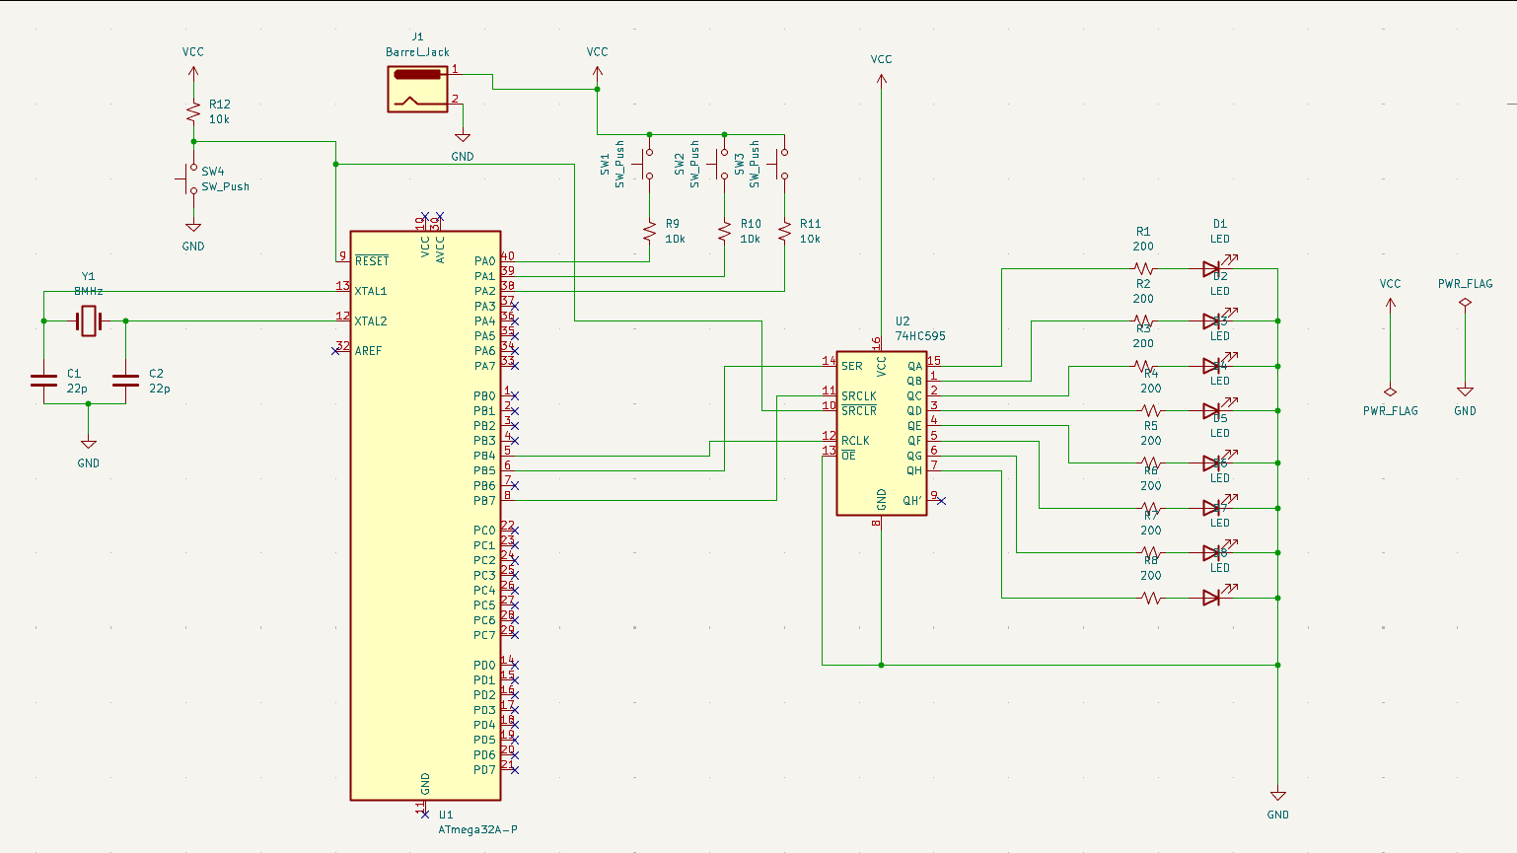
SYSTEM DESIGN
The system has five main blocks:
User input block.
Control block.
Communication block.
Output expansion block.
Display block

Slide 7
HARDWARE COMPONENTS
ATmega32 microcontroller.
74HC595 shift register.
Eight LEDs.
Current-limiting resistors.
Push buttons.
Crystal oscillator and power supply components

Slide 8
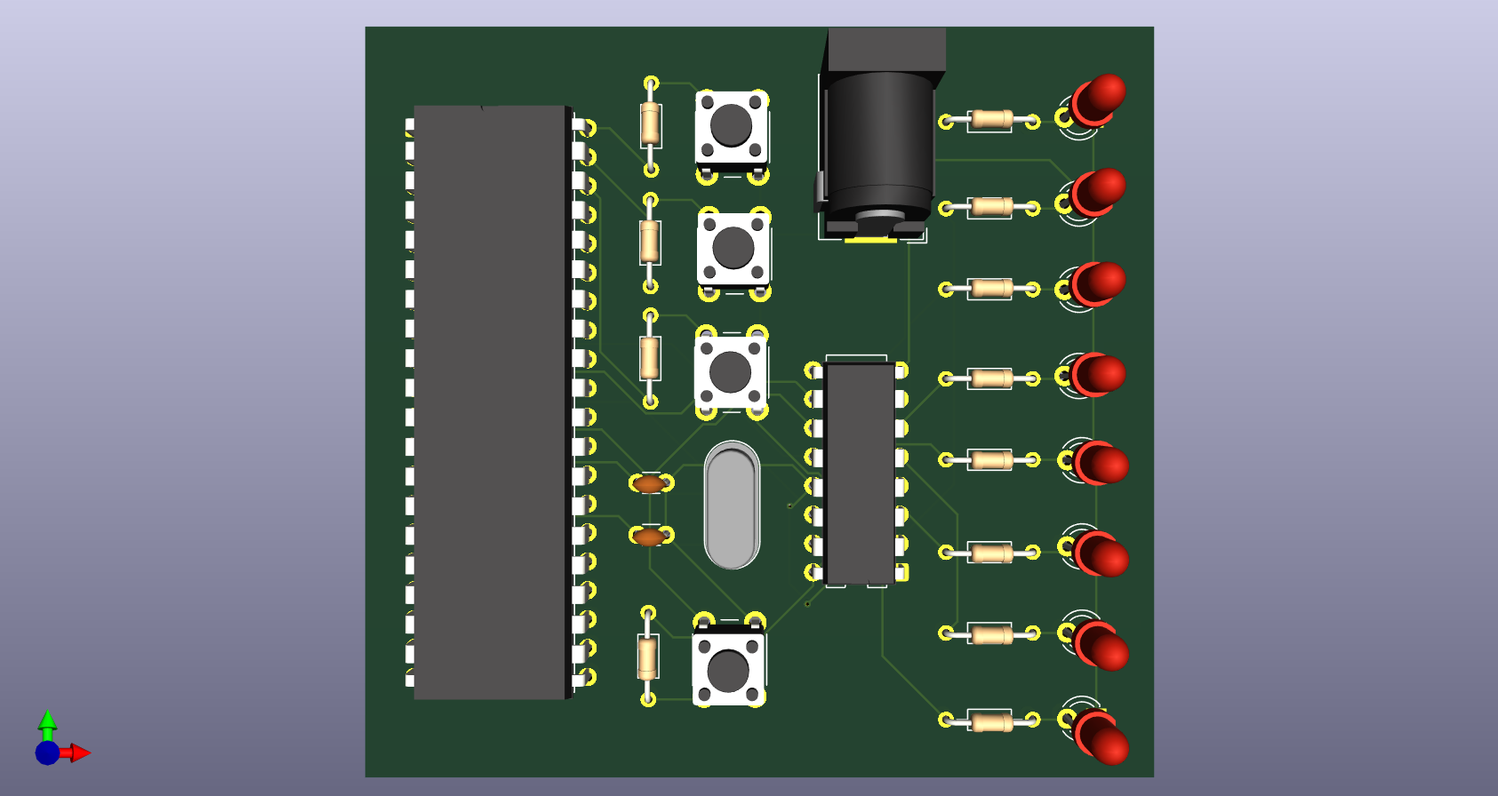
IMPLEMENTATION
Schematic and PCB were designed in KiCad.
Firmware was developed in MPLAB for VS Code using C.
Decoupling capacitors were added for stability.

Slide 9
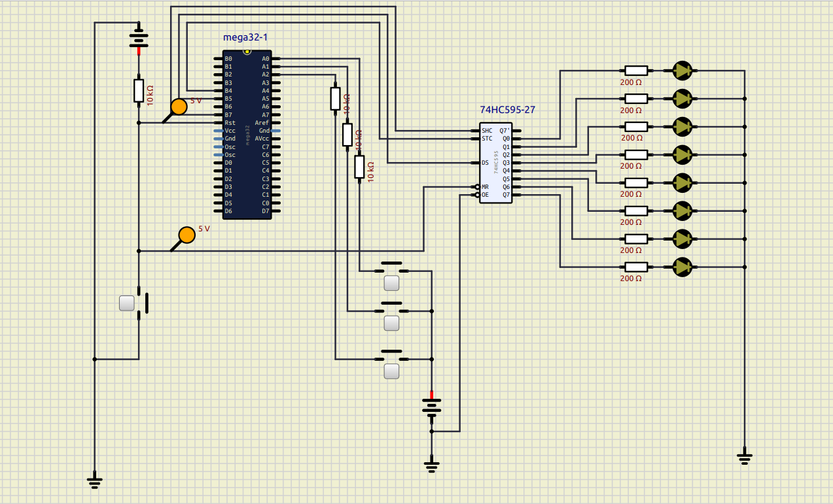
SIMULATION AND TESTING
The circuit was simulated in SimulIDE.
The report states all test cases passed

Slide 10
CONCLUSION
The project successfully expanded digital output using SPI.
It reduced the number of microcontroller pins needed.
The system worked correctly in simulation.

