Slide 1
Seattle Police Department Data Pipeline
University of Washington Data Pipes
Assignment 4 - Low Latency
Option
Team 5 – Fred Yu, Barb Dawdy, Abhishek Agrawal

Slide 2
Initial Brain Storming
Use of Seattle Police Department (SPD) reports and 911 data to be more proactive in assigning resources and redeploying of resources.
Since current resources for each “zone beat” area are not known we are just showing where there is a data stream of crime happening and severity. We do not know the resources available in neighboring areas (mutual aid) that can be deployed so goal of the metrics help show where resources are needed
Future Ideas
Maybe rules on streaming data coming to call Police Officers back into office if needed if threshold limit of offences reached for zone beat area
Ideas on redirecting civilians away from areas closed off or with dangerous crimes in progress via cell phones and online apps besides using SPD.

Slide 3
Background for Business Use
911 dispatches many resources including Police, Fire, EMS, Power, Mutual Aid Departments, Search and Rescue, Hazmat, Medical Air Support and in some communities US Forest Service, Rope Rescue, County Agents and Federal Agencies such as OSHA.
Deployment of resources is reactive to a 911 call and with incident like Mass Casualty Incident (MCI) calls can overwhelm 911 and other services.
https://en.wikipedia.org/wiki/Mass-casualty_incident
Current City hotspots seen in streaming data could be used during police briefings to assign police zone beat and other resources if ongoing crime patterns are shown.
Police Beat (or Zone Beat) is the territory and time that a police officer patrols (patrol sectors)
https://en.wikipedia.org/wiki/Beat_(police)
Besides 911 calls police work crimes in progress, warrants, traffic, DUI stops, investigations, mutual aid etc.

Slide 4
Goals
Design and build a data pipeline from start to finish for a business problem
Best fit deployment of resources and appropriate response to Police Calls in Seattle.
Deploying appropriate resources to area (beat, zone or districts) based on need, call/report type, location and threshold of 911 calls and police reports from the location.
Deploying appropriate resources due to trends seen in data (ongoing crime patterns).

Slide 5
The Metrics for Low Latency
A2) From SPD Reports count Offences for 4 hour time frame on a date in zone beat
A5) Margin of Error
With high 911 call Volume (resource issues), Variety (specialized resource issue) and Velocity (911 line lines jammed) that the application can still track the Zone Beat hot might be a skew of the offences zone beat hot spot by up to 10%
B3) Join Metric
Offence count for date and time for a 4 hour range in a zone beat for SPD Reports and SPD 911

Slide 6
Sample Streaming Data
Seattle Police Department (SPD)
911 calls for Police services (JSON file)
911 reports in last 48 hours were used. http://web6.seattle.gov/mnm/incidentresponse.aspx
SPD reports (CSV file)
Current data for 2016 SPD Reports http://web6.seattle.gov/mnm/policereports.aspx
Future Data like twitter, Facebook and other social media type feeds could be monitored.

Slide 7
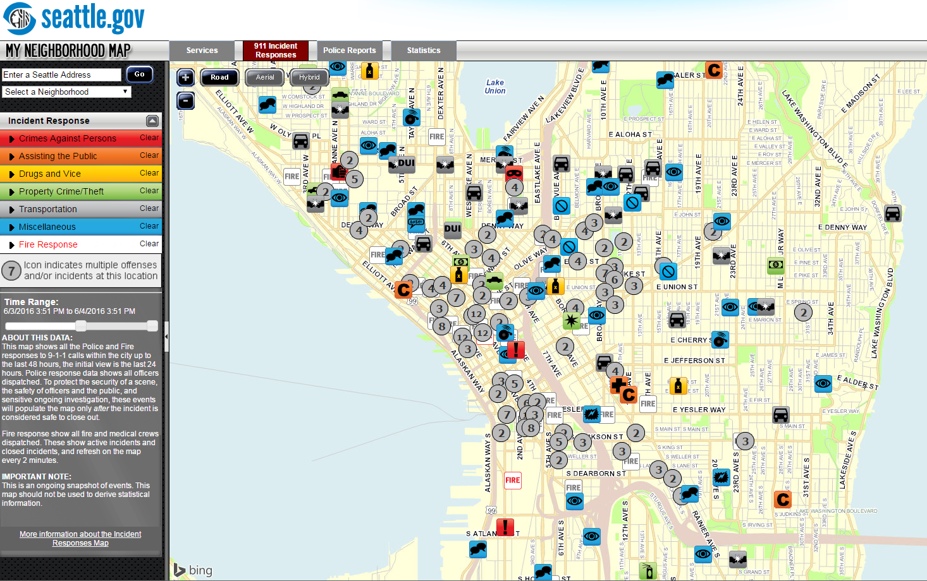

Slide 8
The Tools and Technology
Kafka with JDBC
MySQL
HDFS
Hive
Spark Streaming
http://www.confluent.io/blog/how-to-build-a-scalable-etl-pipeline-with-kafka-connect

Slide 9
The Workflow for Low Latency
MySQL
SPD Reports
Kafka Connect
Topic
SPD_Report
HDFS
Hive
Kafka Connect
Topic
SPD_911
Consumer
A2, A5, B3
SPD 911
Producer
Metric
A
B

Slide 10


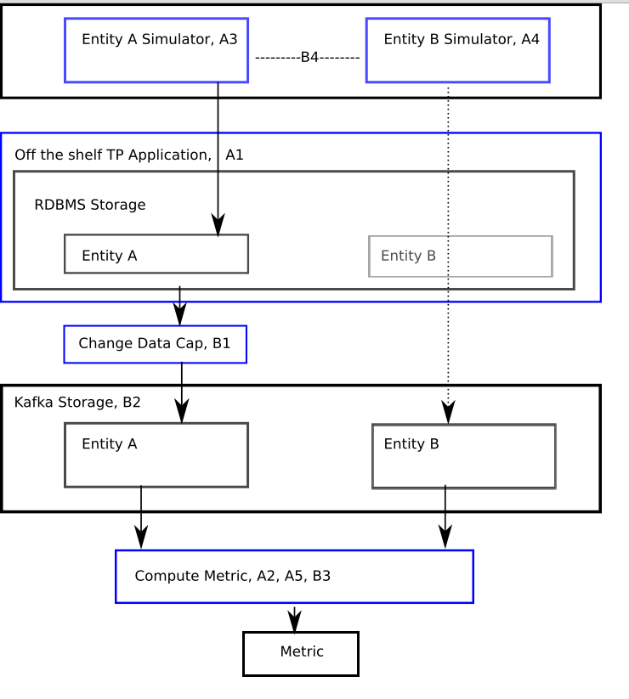

Data and Process

Slide 11
Project Plan
Decide on Project Data Source
Decide on Metrics for A, B and Join/Cogroup
Get Tools Working
Vagrant
Get initial Kafka JDBC working per instructions
http://www.confluent.io/blog/how-to-build-a-scalable-etl-pipeline-with-kafka-connect
Spark (v1.6.1 for Hadoop 2.6) installed in Vagrant

Slide 12
Project Plan
Data Source A – SPD Reports for 2016
Setup MySQL in Vagrant with new Table and Kafka topic
Clean and Transform SPD Report data from 2016
Load MySQL SPD Report data from 2016
Load into Kafka and Hive
Sample working
SPD Reports
Hive Context for SPD_Report data in Spark Steaming
Run Metric A2 – number of offence types by date (4 hour time frame) and zone/beat

Slide 13
Project Plan
Data Source B – 911 Calls
Update Hello Steams to work with the SPD 911 JSON data
Setup Hello Streams with 911 JSON data and Kafka topic
Kafka consumer and producer running for 911 data
Producer Code
Consumer Code which also process Data Source A as Hive Context
Spark Context 911 data in Spark Steaming
Run Metric B3 – number of calls by Date/Time (4 hour range) for zone/beat

Slide 14
Project Plan
Metric A5 or Join/Cogroup
Plan data fields to group
Spark Streaming baskets to Cogroup or join data in Python
Run Metric A5 – number of Offences by Date Time (4 hr range) and zone beat for SPD 911 and SPD Reports

Slide 15
Output
It is OK to not have things working or be perfect.
We had Challenges….

Slide 16
Challenges
Vagrant Install issues and learning file setups and other client changes
Vagrant corrupted when pyspark ran out of memory causing destroy and VM creation again- “Couldn't remount RDWR because of unprocessed orphan inode list”
Explored alternate methods to work with a Data Pipeline like Bottledwater but encountered issues
Needing to understand how to run Kafka in vagrant to setup new topics.
Pyspark and spark-shell out of memory issues even when memory increased in VagrantFile

Slide 17
Challenges
Hive sometimes hanging up in vagrant with very small amounts of data (we think this is vagrant memory issues even though we all increased memory for vagrant in the VagrantFile setup)
Transforming sample to use our data didn’t work though we changed all the required configuration in mysql, hfs etc.
Learn other Kafka and Vagrant commands to work in Vagrant with the tools this took time
Various other posts by Team 5 to Canvas.

Slide 18
Lessons Learned
Learned the process of setting up VMs and getting basic tools running to work with a Data Pipeline.
Various technologies available to build an efficient data pipeline
How a Kafka Producer and Consumer work

Slide 19
Summary
Learned what a Data Pipeline is and how streaming data can be used to improve decision making process.

Slide 20
Future
Future data like Twitter, Facebook and other social media type feeds could be monitored for crime in progress or resource needs.
Thresholds for proactive deployment of resources.
Use of streaming crime and fire data to reroute people to safer locations or warn/no entry on access to neighborhood areas.

Slide 21
Additional Information

Slide 22
Seattle PD Report Data Entity A Additional Details
Contained many fields including; Offence Type, Offence Code, Summary of Offence Date/Time, Hundred Block Location, District, Zone Beat, etc.
https://data.seattle.gov/Public-Safety/Seattle-Police-Department-Police-Report-Incident/7ais-f98f
Date/Time, Summary of Offence, and Zone Beat
2016 data only used
CSV format loaded into MySQL RDBMS

Slide 23
Seattle PD 911 Data Entity B Additional Details
Contained many fields including; Event Clearance Description, Initial Type Group, Initial Type Description, Event Clearance Date/Time, Hundred Block Location, District, Zone Beat, etc.
https://data.seattle.gov/Public-Safety/Seattle-Police-Department-911-Incident-Response/3k2p-39jp
Event Clearance Date/Time, Initial Type Description, and Zone Beat
Latest 48 hours data only used
JSON file processed with python hello streams

