Slide 1
Analyzing the Growth of Hybrid and Electric Vehicles in the U.S.
Daniel Mihok, Erin Cunningham, Jae Lee, Sirish Kanukunta

Slide 2
Motivation & Summary
Historical analysis of Hybrid and Electric Vehicle market shares
How do green initiatives vary from state to state?
With the growth in purchases of electric vehicles, how has air pollution been impacted?

Slide 3
Questions & Data
Historical analysis of Electric Vehicle (EV) Market share
With the growth in purchases of electric vehicles, how has air pollution been impacted?
Data sourced from Kaggle “U.S. Pollution Data” (https://www.kaggle.com/sogun3/uspollution/version/1)

Slide 4
Data Cleanup & Exploration
Read csv into a pandas DataFrame
Get rid of unnecessary data
Handle multiple records for same day (measured in morning and afternoon)
Separate data by Year, and return max AQI value for each pollutant by Year
Using Cartopy, create a US Map Figure while color coding shape based on AQI value for a given year
Using matplotlib, leverage FuncAnimation to create animation that shows Max AQI values for each year from 2000-2016
Repeat for each air pollutant

Slide 5
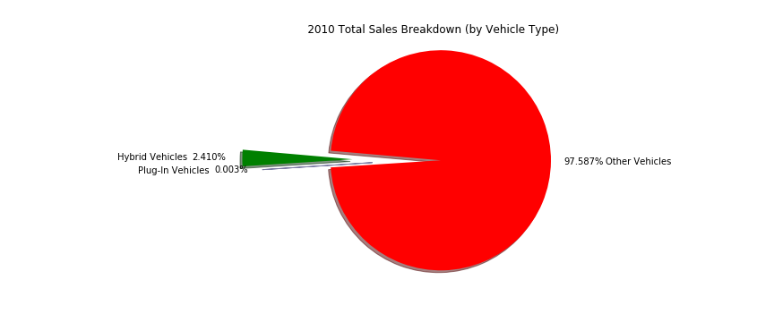
Growth of Hybrid and Electric Vehicle Sales:

Slide 6
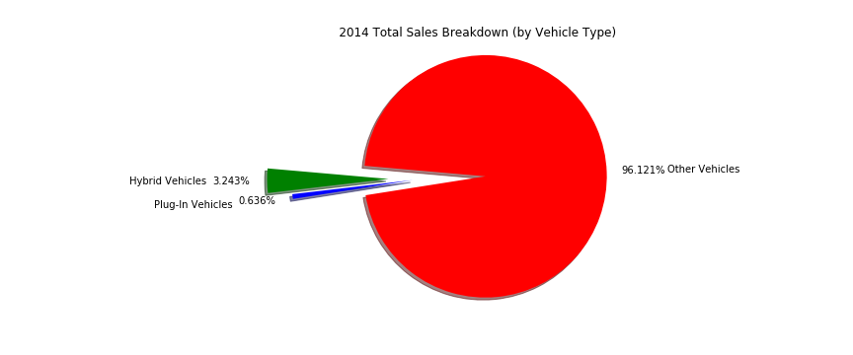
Growth of Hybrid and Electric Vehicle Sales:

Slide 7
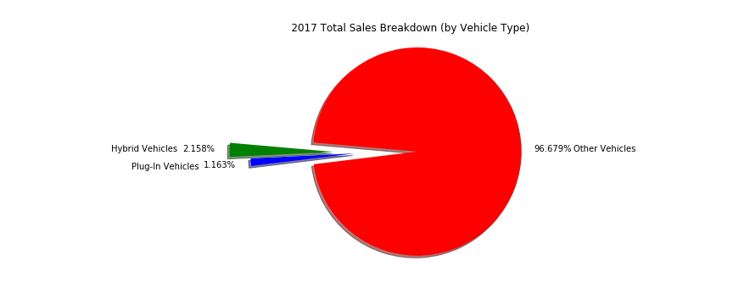
Growth of Hybrid and Electric Vehicle Sales:

Slide 8
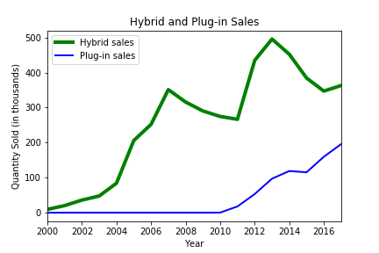
Comparing Sales of Hybrid vs Electric Vehicles:
Why do sales trends vary in this way?

Slide 9
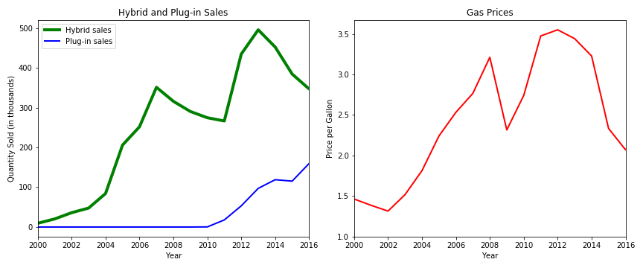
Factors Impacting Sales:
Sales of Hybrid Vehicles appears to be heavily linked to gasoline prices.
Electric Vehicle sales were more resilient to changes in gasoline prices.

Slide 10
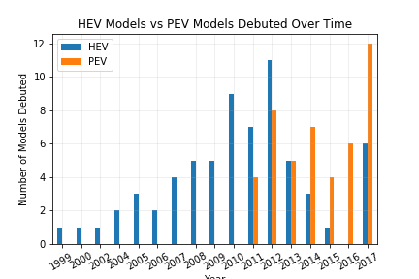

Slide 11
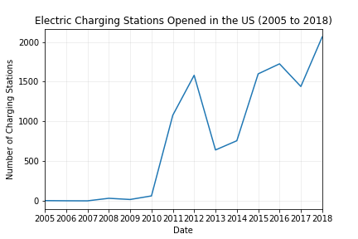

Slide 12
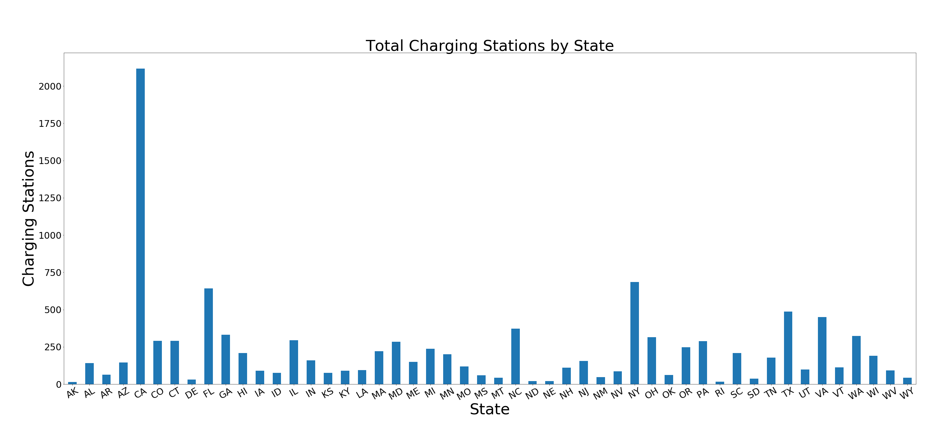

Slide 13
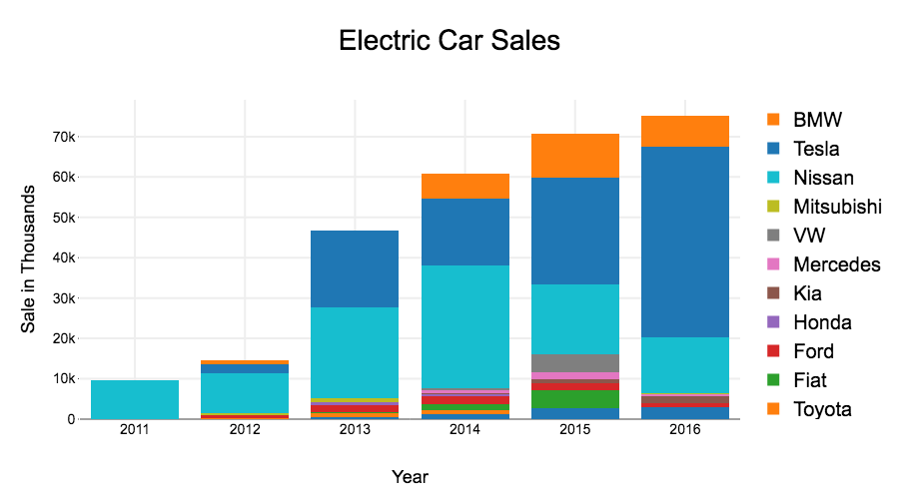

Slide 14
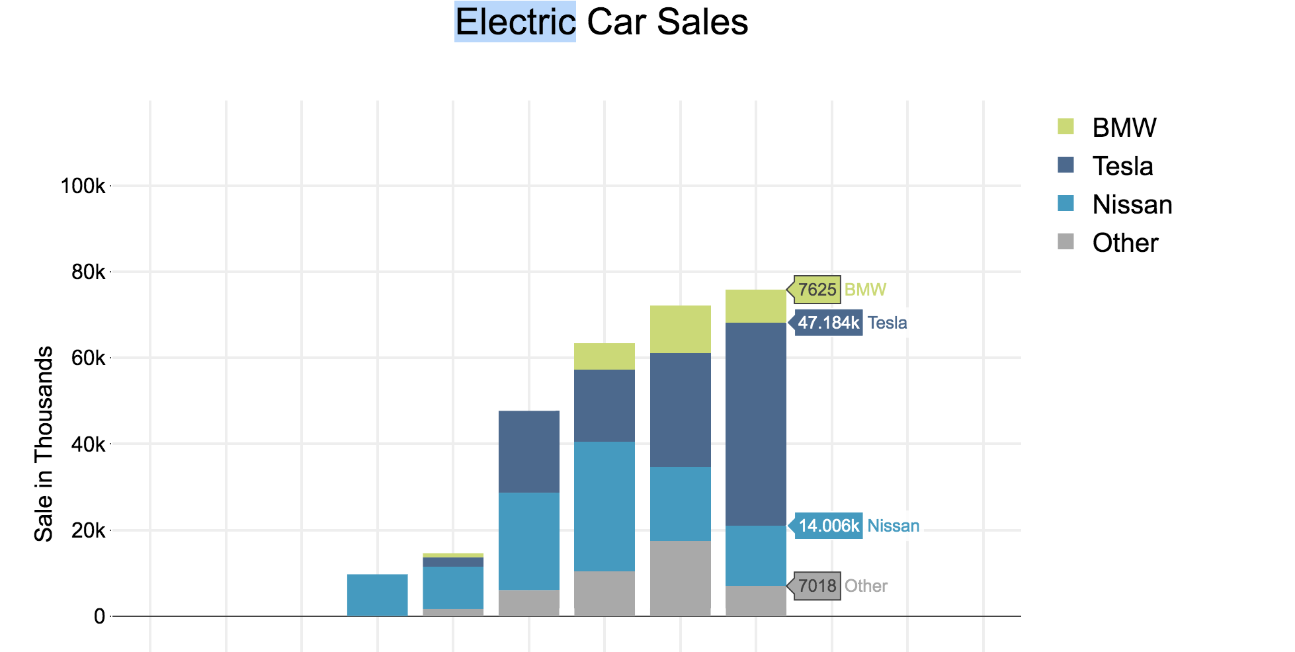

Slide 15
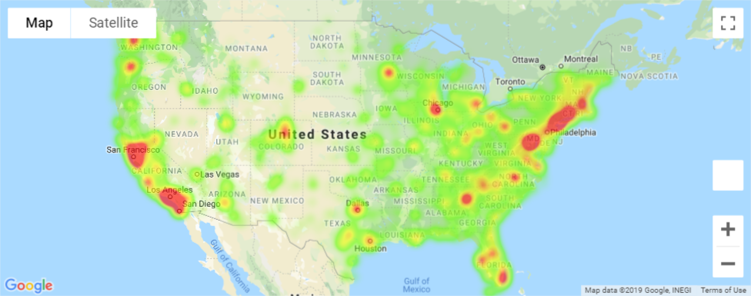

Slide 16
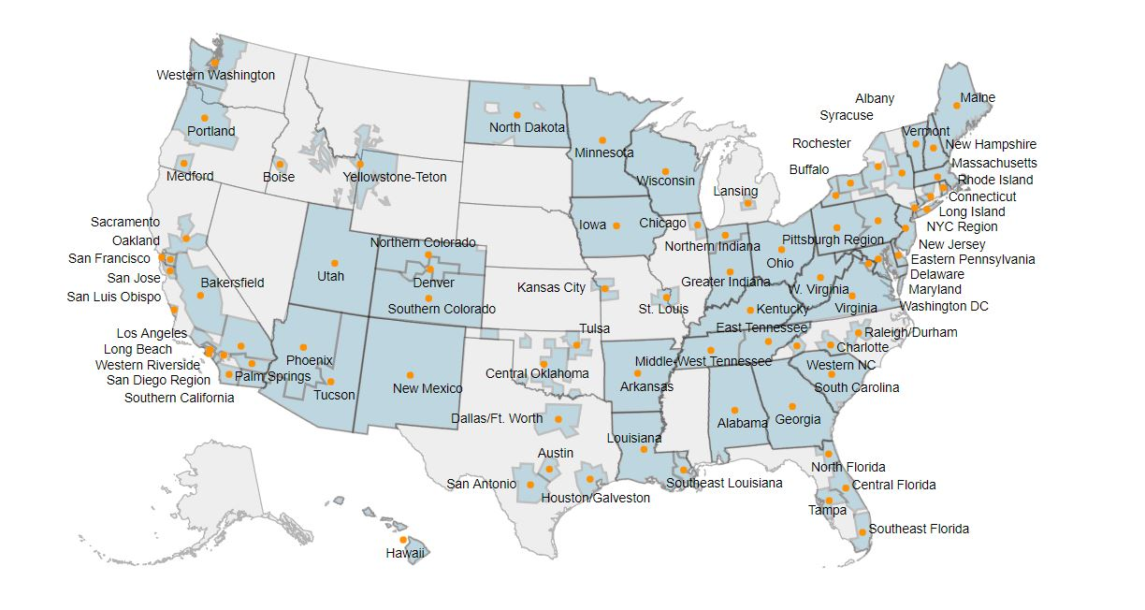

Slide 18
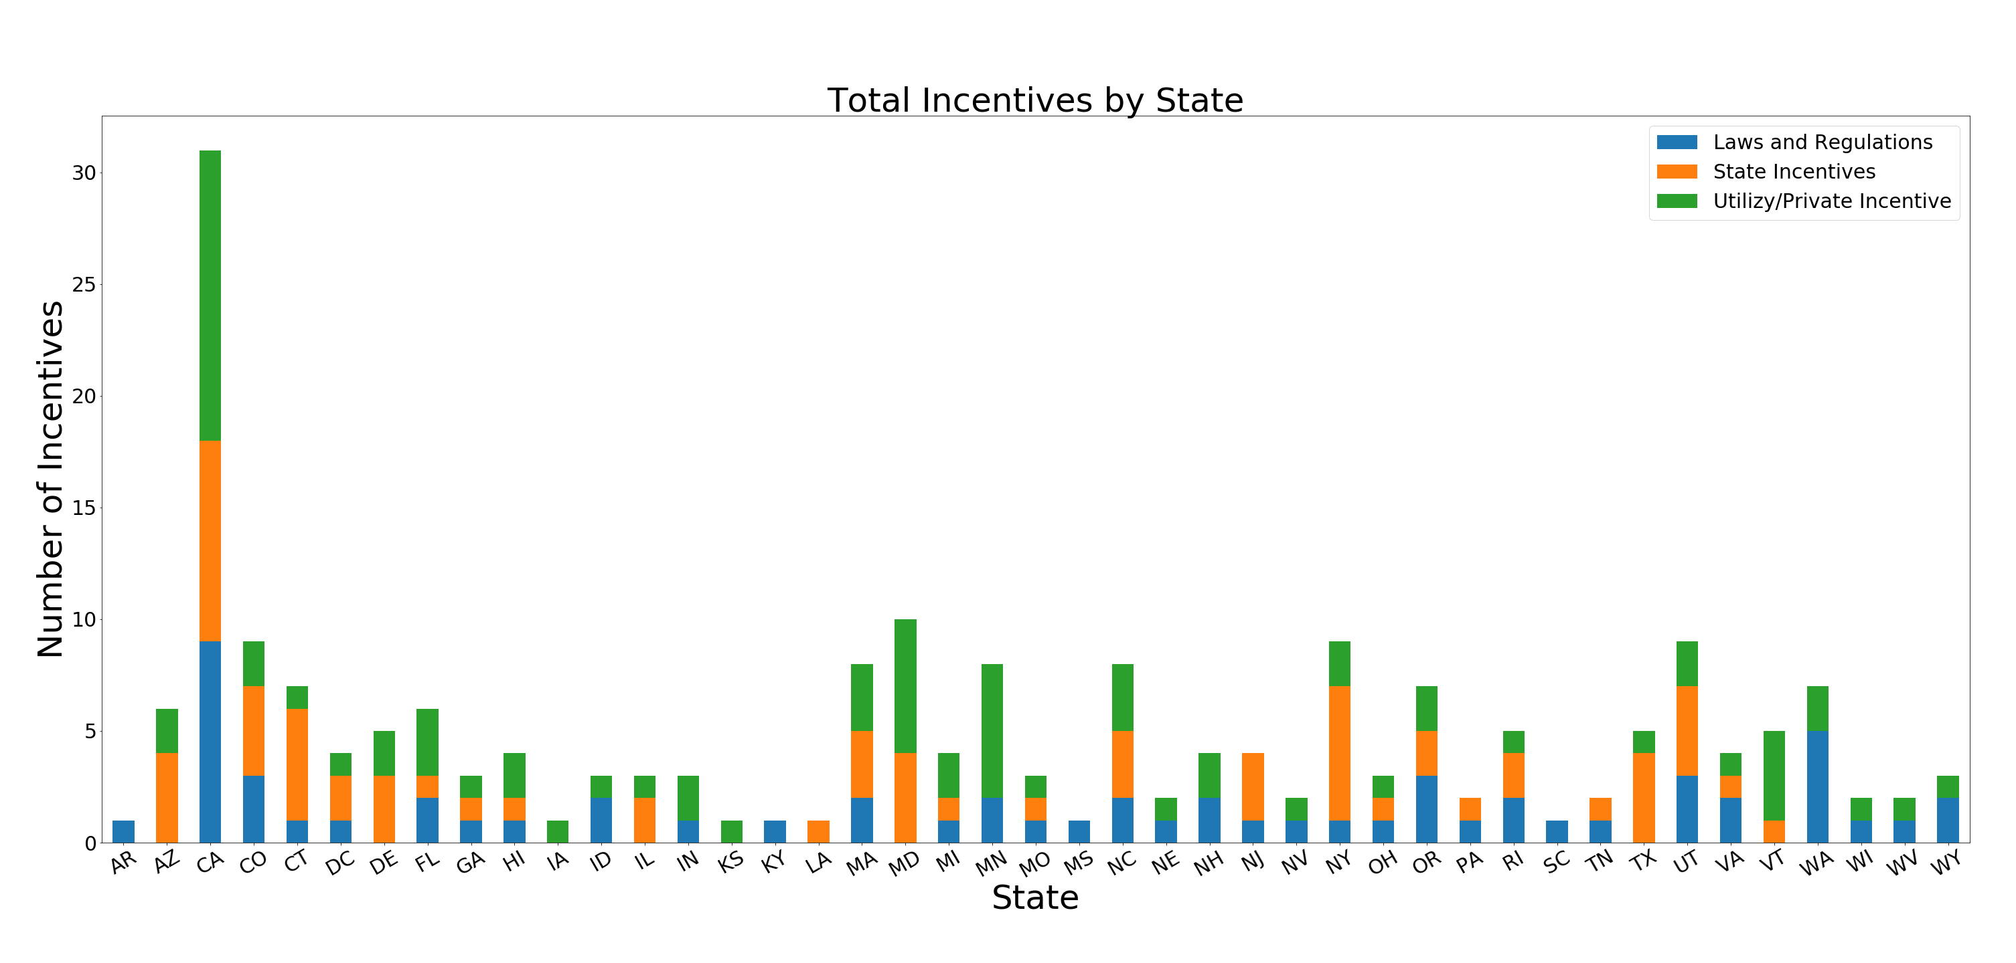

Slide 19
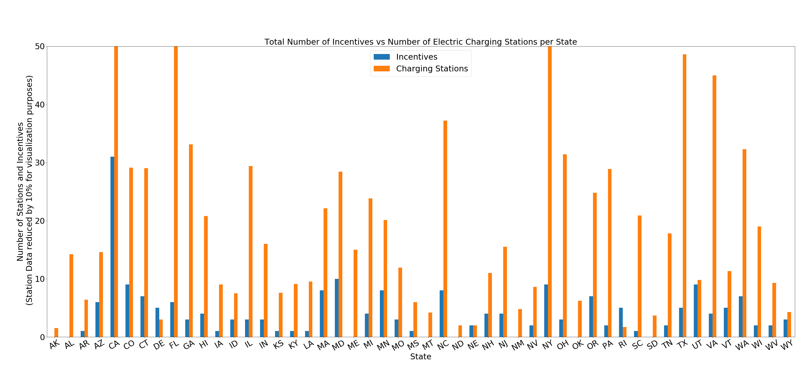

Slide 20
Four Major Air Pollutants & AQI
Nitrogen Dioxide (NO2)
Form Ozone and can cause lung irritation
Sulphur Dioxide (SO2)
Product of burning sulfur-containing fuels
Carbon Monoxide (CO)
Formed by the combustion of fossil fuels. When inhaled, blocks oxygen from the brain, heart, and other vital organs
Ozone (O3)
Main component of smog and is the product of sunlight and emissions from sources such as motor vehicles and industry
Air Quality Index (AQI)
The higher the AQI value, the greater the level of air pollution.
AQI values are generated for each of the major pollutants, and the highest value is reported daily as an indicator of air quality for that day
Source: https://airnow.gov/index.cfm?action=aqi_brochure.index
https://www.ucsusa.org/clean-vehicles/vehicles-air-pollution-and-human-health/cars-trucks-air-pollution

Slide 21
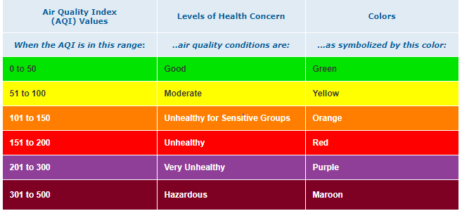
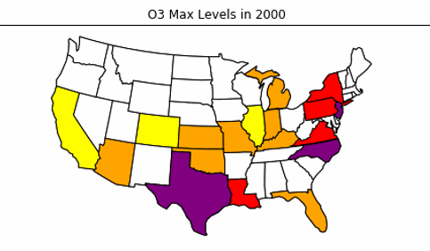
Air Quality Index (AQI) by State & Pollutant
Source: https://airnow.gov/index.cfm?action=aqibasics.aqi

Slide 22
Findings

Slide 23
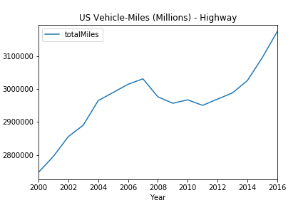
US Vehicle-Miles Trend
Miles traveled via ground vehicles (highway) within the US has increased steadily since 2000
This indicates a negative correlation between air pollution levels and vehicle miles traveled – does this make sense?
Based off this analysis, our next inference would be that the growth of Hybrid/EV sales is dropping pollution levels despite a growth in miles traveled via ground vehicles
Data source: https://www.bts.gov/content/us-vehicle-miles

Slide 24
Post Mortem

Slide 25
Q&A

