Slide 1

Anylogic
Maria Barbarita Camargo García
Juan David Vargas Mora

Slide 2
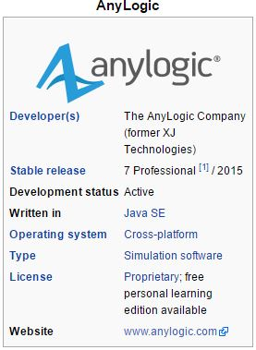
What is AnyLogic ?
Notes:
AnyLogic is a multi method simulation modeling tool developed by The AnyLogic Company (former XJ Technologies). It supports agent-based, discrete event, and system dynamics simulation methodologies. AnyLogic PLE edition is available for free for self-educational and educational purposes.

Slide 3
Features
Support for the three well-known modeling approaches: system dynamics, discrete-event simulation, and agent-based modeling.
Any combination of this approaches can be used within a single model.
Simplified model building.
Includes a graphical modeling language but also allows extensions for the simulation models with Java code.

Slide 4
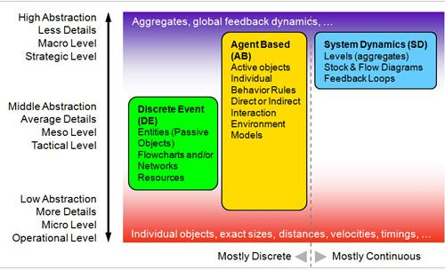
How simulation approaches correspond to the level of abstraction.

Slide 5
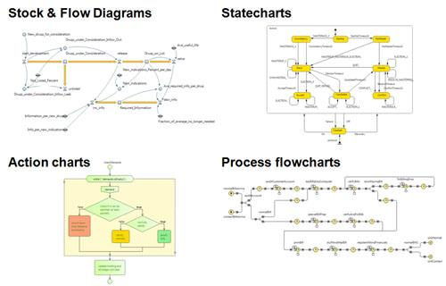
Simulation Language
Notes:
The AnyLogic simulation language consists of following items:
Stock & Flow Diagrams are used for System Dynamics modeling.
Statecharts are used mostly in Agent Based modeling to define agent behavior. They are also often used in Discrete Event modeling, e.g. to simulate machine failure.
Action charts are used to define algorithms. They may be used in Discrete Event modeling, e.g. for call routing, or in Agent Based modeling, e.g. for agent decision logic.
Process flowcharts are the basic construction used to define process in Discrete Event modeling. Looking at this flowchart you may see why Discrete Event style is often called Process Centric.
The language also includes: low level modeling constructions (variables, equations, parameters, events etc.), presentation shapes (lines, polylines, ovals etc.), analysis facilities (datasets, histograms, plots), connectivity tools, standard images, and experiments frameworks.

Slide 6
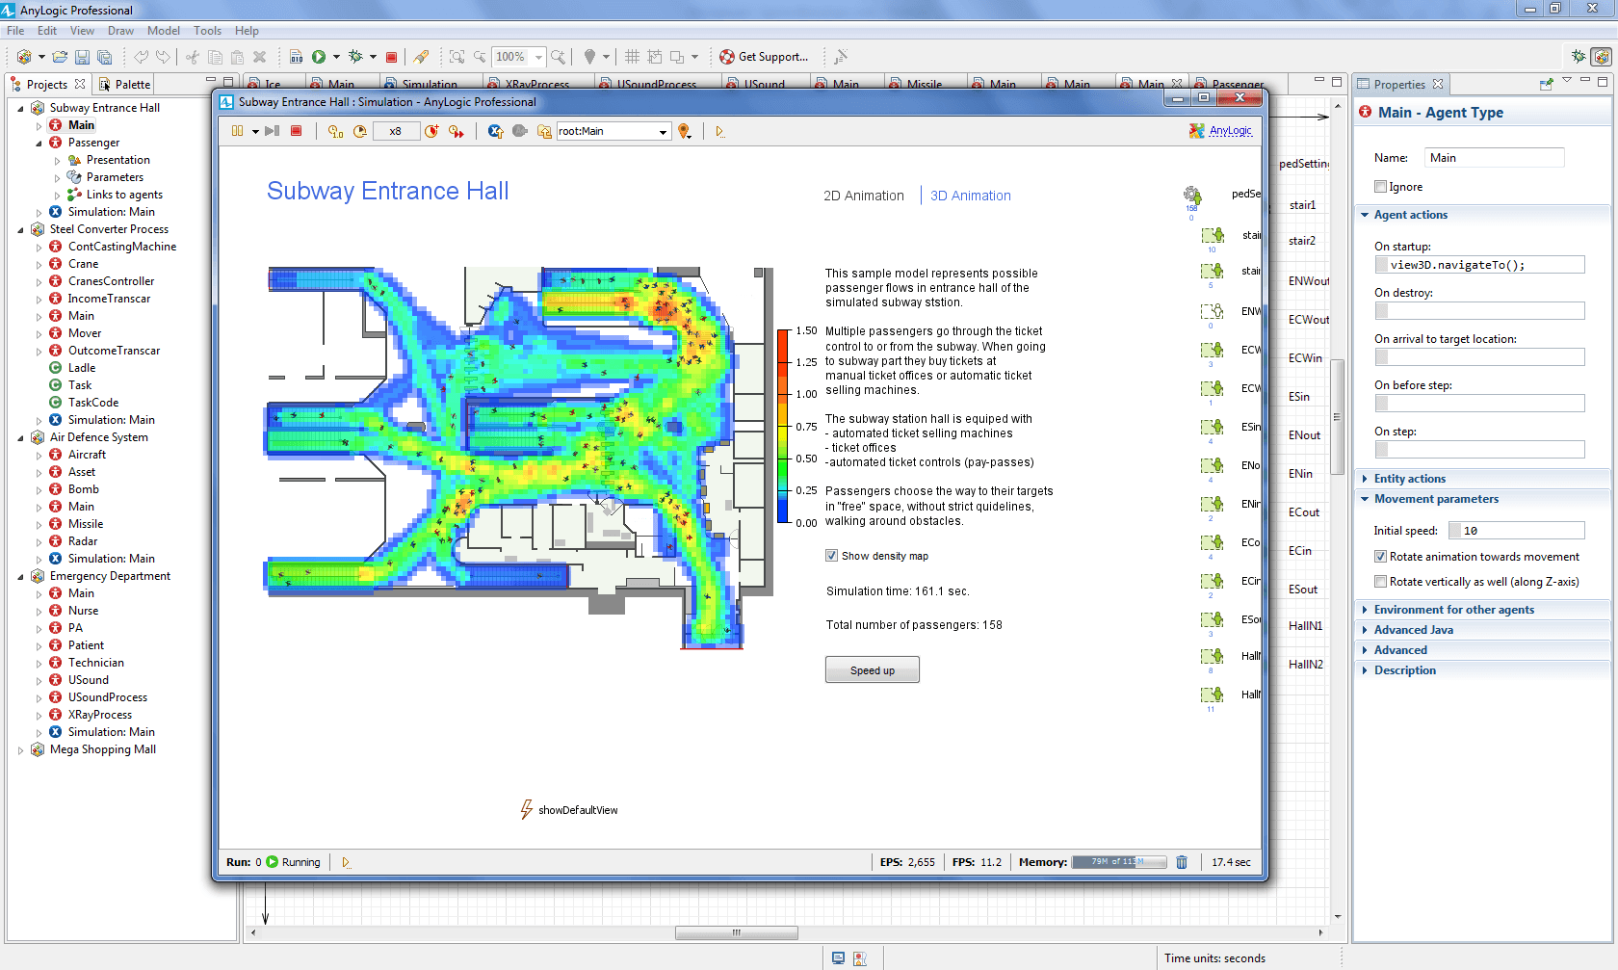

Slide 7
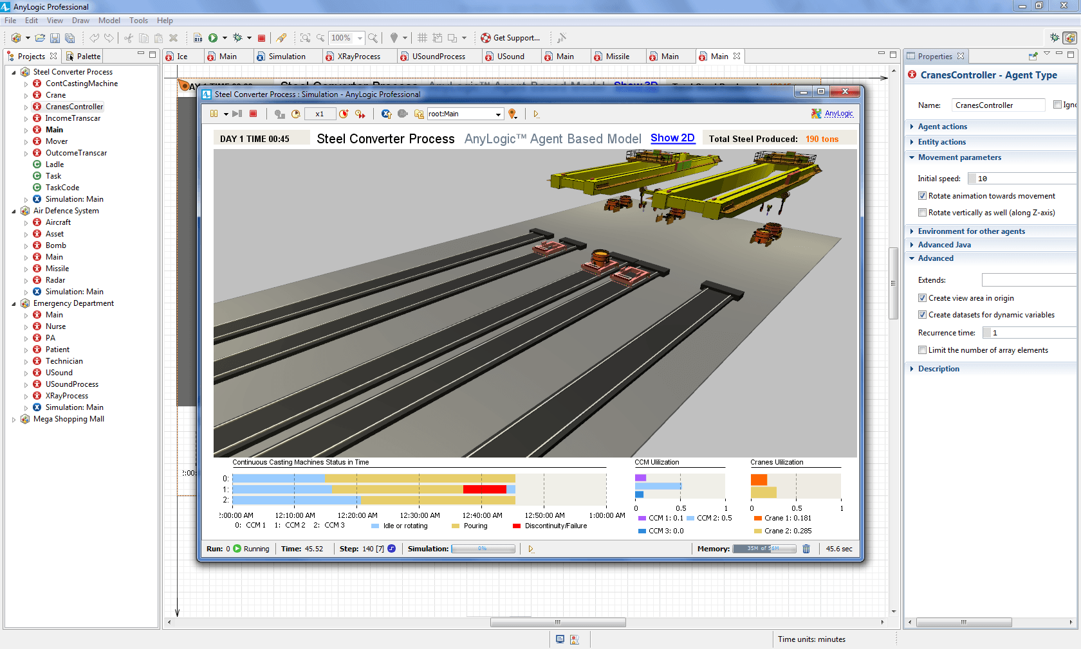

Slide 8
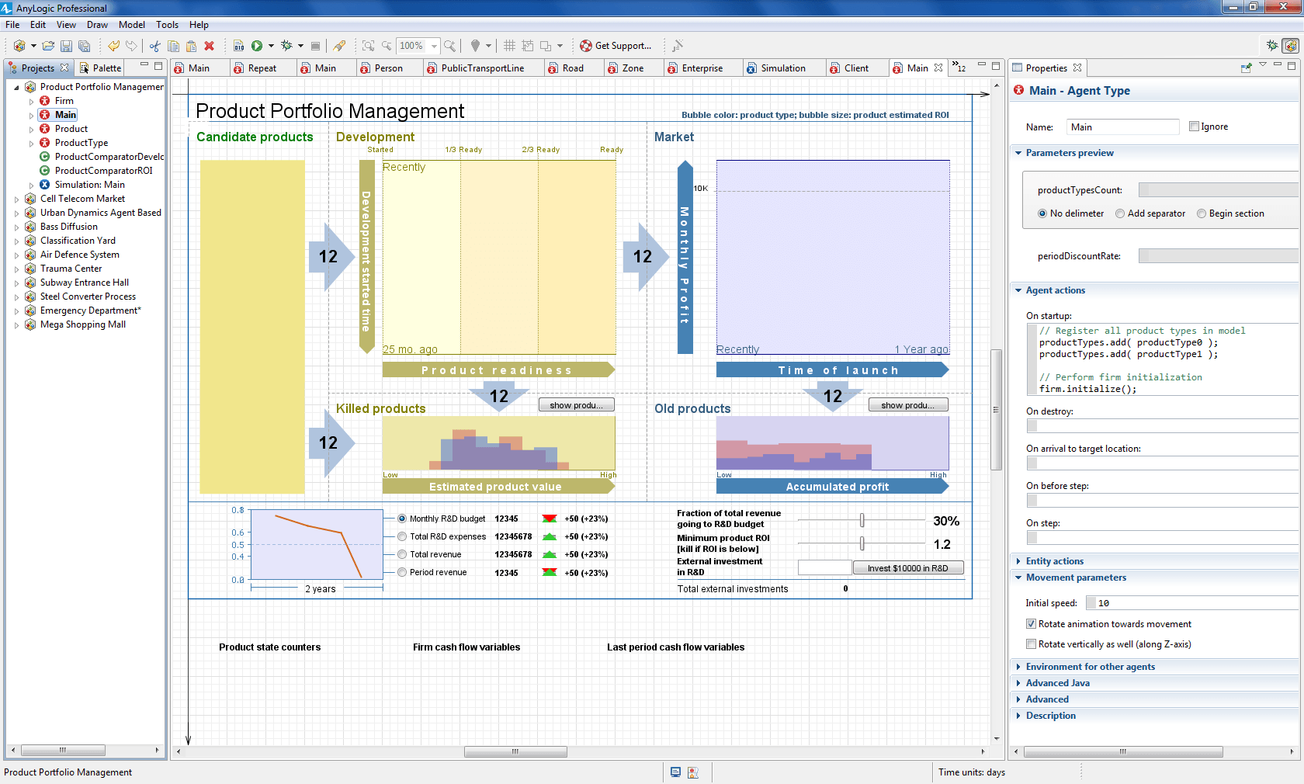

Slide 9
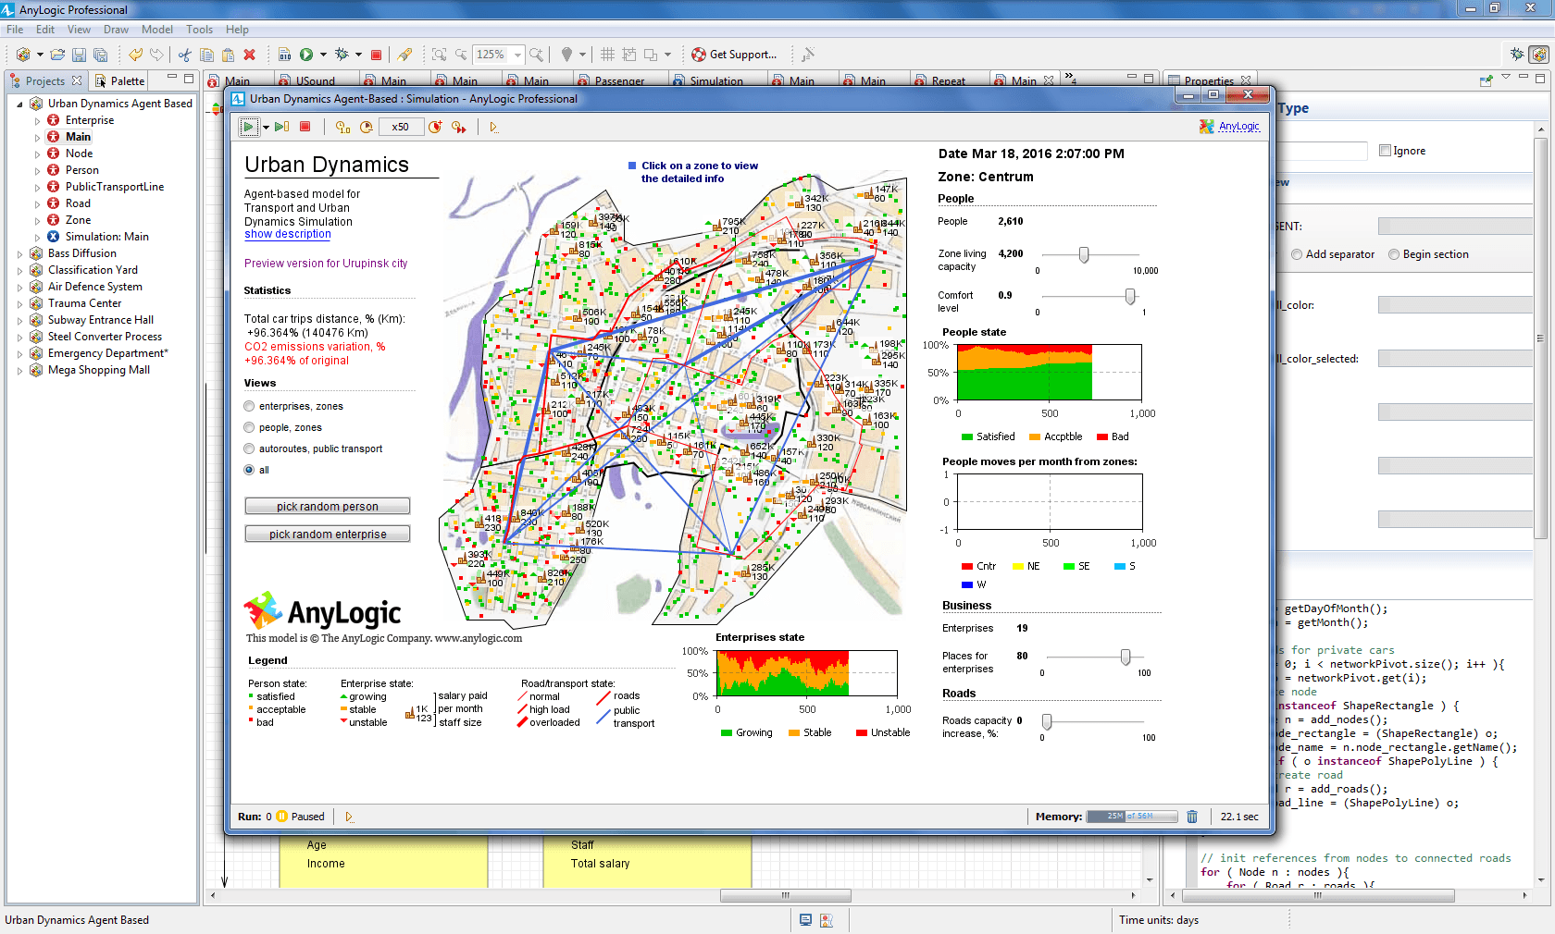

Slide 10
Advantages
Support for multi method modeling.
Decreased need for coding.
Cross-platform.
Big library of sample models.
Easy-to-share models (runthemodel.com)

Slide 11
Disadvantages
Limited use without license purchase.

