Slide 1
The Sharpening House present
DISH SET GO
Team Members:
Barbara Hernandez
Kevin Luu
Phillip Grider
Vita Chen

Slide 2
Idea Started Here . . .
Alex - A busy working professional, trying to cook dinners at home more often to be healthier.
I want to scan ideas quickly, so that I can make a decision on what to cook rather than getting lost in an online cookbook full of irrelevant recipes. I want to see my list of ingredients while I'm on the go, so that I can make sure I have everything before I get home and start cooking.
We Hear you!

Slide 3
Project Description (MVP)
This application will allow users to search for recipes by keyword and/or ingredients
This application will show users recipes and ingredients
This application will allow users to have the recipes sent to them via text

Slide 4
Technologies Used
Food2Fork API
Twilio API
jQuery
JavaScript
HTML5/CSS3
Bootstrap
iziModal.js
Popper.js
Animate.css
Firebase

Slide 5


Lets Take A Peek

Slide 6
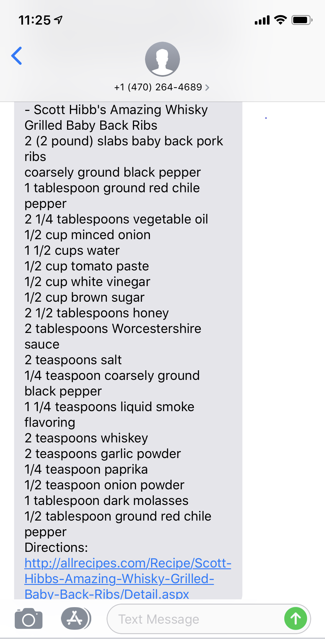
Text From Twilio

Slide 7
What’s Next . . .
Select the time of day to text recipes
Ability to save to favorites
Share recipes with friends
Recommend recipes based on search history
"Surprise me" to get random recipes

Slide 8
QUESTIONS?

Slide 9
THANK YOU !

