Slide 1

LOCAL VOTE
Presented by Team Local Vote

Slide 2
Team Members
Barbara Hernandez
Carolyn Bernier
Johnny King
Vita Chen

Slide 3
Project Idea
An application allow users to share their idea of policies.
An Application allow users to share their opinion about others’ ideal policies.
An application to be a bridge between the residents and government.

Slide 4
Project Description (MVP)
This application will allow users to create their idea of policy as a local resident and share with others.
This application will allow users to read the policies been published and vote to agree or disagree.
This application will request users sign in to publish new policies or vote.

Slide 5
Technologies Used
CSS3
jQuery
JavaScript
Bootstrap
MySQL
Node.js
Express.js
Express-Handlebars
Sequelize
Github
Heroku
Passport

Slide 6
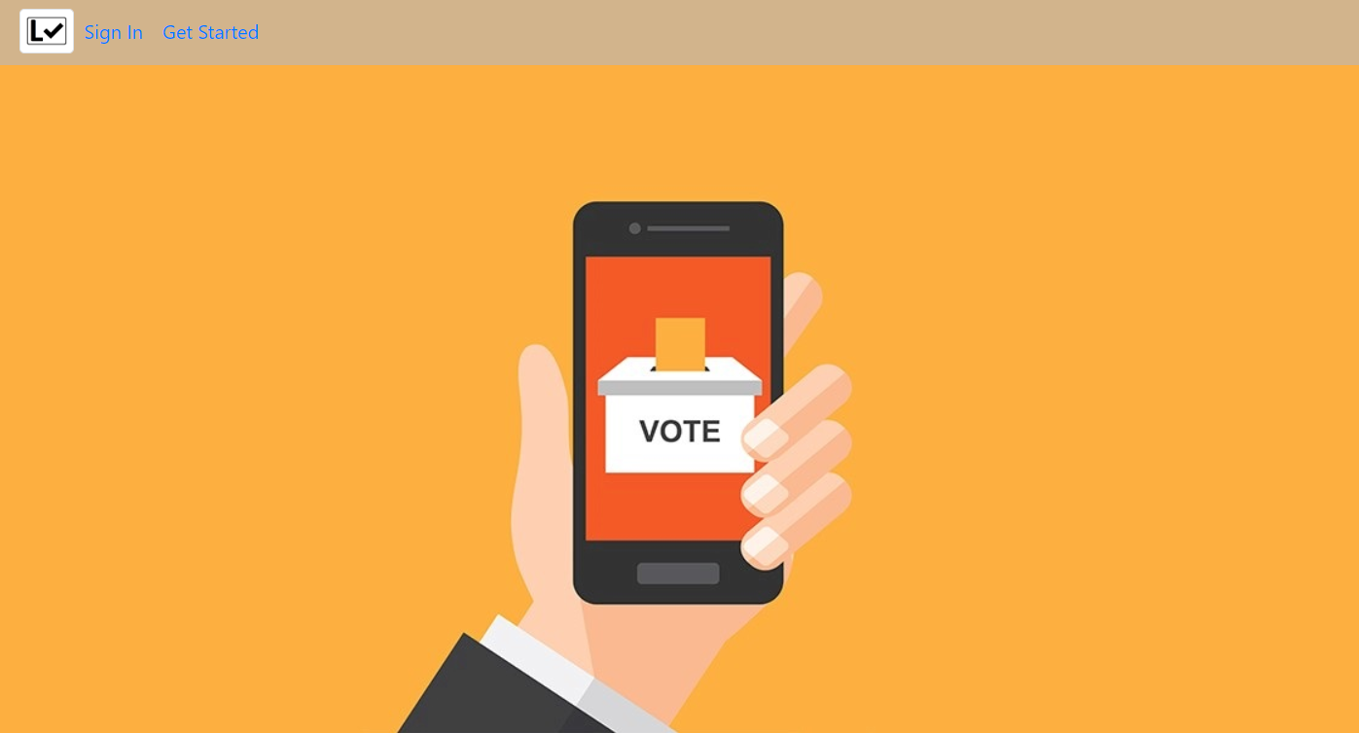
Lets Vote!

Slide 7
What’s Next
Users could use different sorting to reach the topic they are interested in.
System would generate monthly top supported topic and email it to local government.

Slide 8
Questions?

Slide 9
Thank you !

