Slide 1

LOCALVOTE
Presented by Team LocalVote

Slide 2
Team Members
Barbara Hernandez
Carolyn Bernier
Johnny King
Vita Chen

Slide 3
Project Idea
An application that allows users to propose local policies and share them.
An Application which allows users to share their opinions about suggested policies. (by voting).
An application that bridges the communication gap between residents and local government.

Slide 4
Project Description (MVP)
This application should:
Allow users to write new policies and share them with others.
Allow users to read the policies that have been published and vote to agree or disagree.
Prompt users to perform authentication through Facebook.
Allow users to search the database of existing policies.

Slide 5
Technologies Used
Bootstrap
CSS3
JavaScript
jQuery
MySQL
Node.js
Express.js
Handlebars
Sequelize
Passport

Slide 6
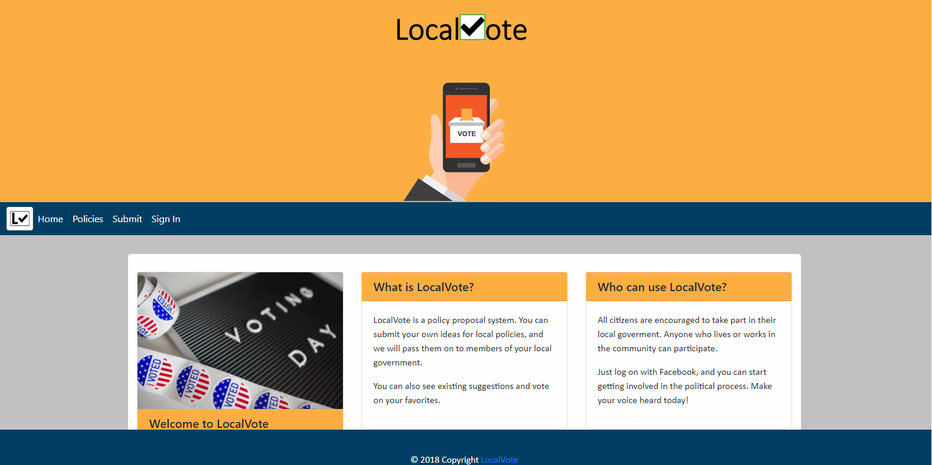
Lets Vote!

Slide 7
What’s Next
Require users sign in to post new policies
Allow users to sort by topics they are interested in.
Generate a short list of the most voted-for policies of the month and send it to local government.
Add an administrator view to moderate policy submissions.

Slide 8
Questions?

Slide 9
Thank you !

