Slide 1

LOCAL VOTE
Presented by Team Local Vote

Slide 2
Team Members
Barbara Hernandez
Carolyn Bernier
Johnny King
Vita Chen

Slide 3
Project Idea
An application that allows users to propose local policies and share them.
An Application which allows users to share their opinions about suggested policies.
An application that bridges the communication gap between residents and local government.

Slide 4
Project Description (MVP)
This application will allow users to write new policies and share them with others.
This application will allow users to read the policies that have been published and vote to agree or disagree.
This application will require that users sign in to publish new policies or vote.

Slide 5
Technologies Used
Bootstrap
CSS3
JavaScript
jQuery
MySQL
Node.js
Express.js
Handlebars
Sequelize
Passport

Slide 6
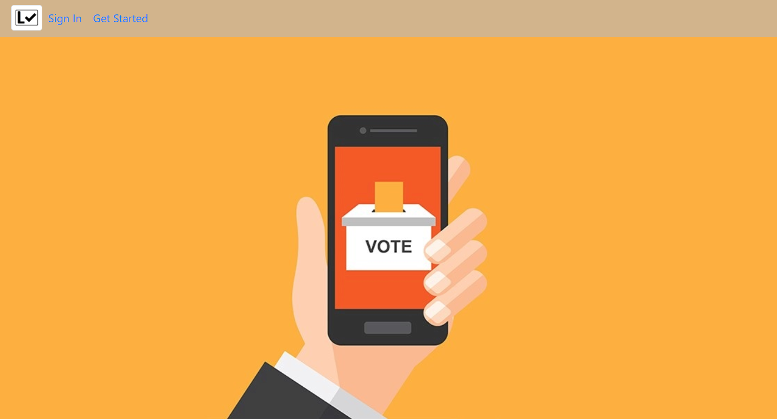
Lets Vote!

Slide 7
What’s Next
Authentication to ensure the users are local residents.
Users could use sorting tools to reach the topic they are interested in.
System would generate monthly top supported topic and email it to local government.

Slide 8
Questions?

Slide 9
Thank you !

