Slide 1
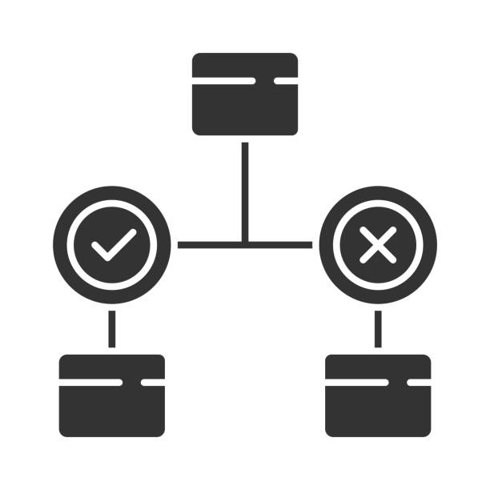
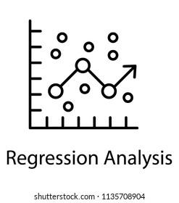
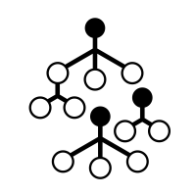
MACHINE LEARNING
Choose A Model!
Good RECALL EQUALS good DETECTION
Decision Trees
Logistic Regression
Random Forest
Recall
Recall
Recall
Train
81%
Test
74%
Train
94%
Test
94%
Train
97%
Test
96%

