Slide 1

Developing a novel methodology for analysing egress utilising graph theory applied to IFC
Presented by Richard Lai

Slide 2

AGENDA
Overview
Market analysis
Campaign success
Metrics & KPIs
Q & A

Slide 3
Aim and Objectives (summarised)
Aim
To develop and validate a novel graph-based methodology for analysing egress within buildings by deriving travel distances from IFC models using IfcOpenShell.
Construct a building model within IFC
Using the IFC model, formulate a graph-based representation of the building egress network
Implement edge weights of based on travel distances between rooms
Develop a pathfinding algorithm that can identify critical egress paths within the building
Validation of the proposed method using Pathfinder

Slide 4
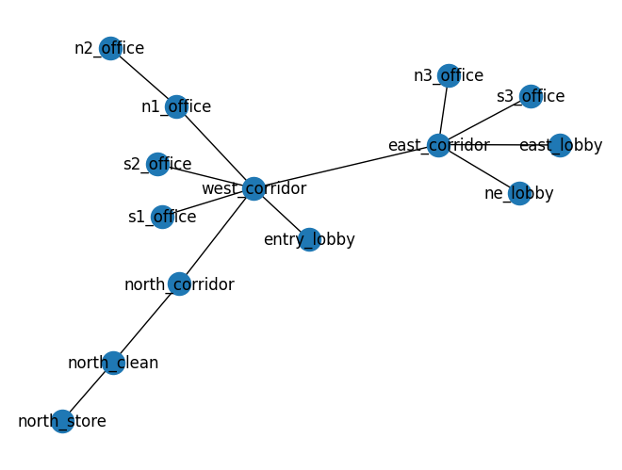
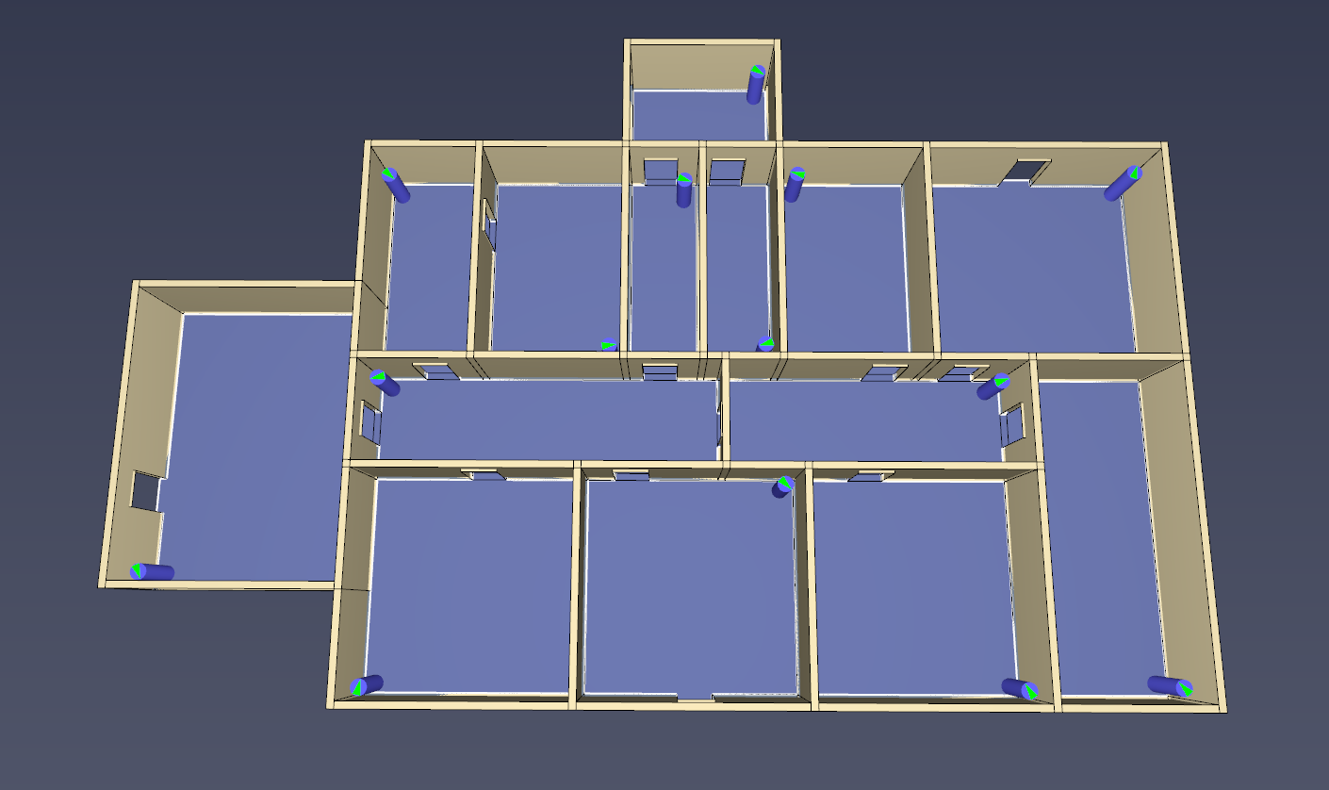
The Building

Slide 5
Overview of Tasks Completed
Constructed geometry of building as an IFC model
Converted the IFC model into a graph
Developed a pathfinding algorithm (A*) to find the distances between two points
Implemented algorithm to calculate distances from every room to each exit

Slide 6
The Situation
14 rooms (starting locations)
3 exits (end goals)

Slide 7
Example Path
Start: Entry Lobby
Goal: North-East Exit
31.14m

Slide 8
Considerations
How do we want to take the egress analysis further?
  Can compare to NCC or other standard requirements
Have a way to categorise egress paths based on risk?
  What is risk?
How feasible are some paths?
  Potential for blocked exits and fire blocking another exit
  Familiarity with building

Slide 9

OUR GOAL
We aim to align our efforts and drive success through effective marketing strategies. Let's dive in and explore how we can achieve our growth objectives together.

Slide 10
NAVIGATING THE LANDSCAPE

Slide 11
Quote
SUCCESSFUL BRANDS EVOLVE WITH THEIR AUDIENCE, NOT DESPITE THEM.

Slide 12
WHO IS OUR TARGET AUDIENCE?

Slide 13

OUR CUSTOMERS
Key demographics
Understanding key demographics is crucial for tailoring successful marketing strategies.
Challenges & needs
Our target audience faces several challenges and needs that our marketing strategies aim to address.

Slide 14
MARKETING STRATEGY
Focus area | Approach | Goal
Brand awareness | Social media campaigns | Increase engagement by 30%
Lead generation | Email marketing & PPC | Grow qualified leads by 20%
Customer retention | Loyalty programs, automation | Boost purchases
Content marketing | SEO optimized short-form videos | Improve organic reach

Slide 15
MARKETING MIX:
THE 4 PS

Slide 16
Ana Bowman, Director of Marketing
“OUR LATEST CAMPAIGN DROVE A 35% INCREASE IN ENGAGEMENT, PROVING THAT STRATEGIC STORYTELLING RESONATES.”

Slide 17
increase in conversion rates through recent marketing efforts
28%

Slide 18
MARKETING THAT DRIVES
RESULTS
By staying data-driven and adaptable, our marketing strategy continues to support growth and long-term success.

Slide 19

Q & A
Let’s discuss questions
as a team.

