Slide 1
Final Project
MULTIPLAYER BLACKJACK

Slide 2
Top 10 Requirements - Initial
System will follow standard Blackjack rules
Players will be able to play accordingly, and be paid accordingly based on the outcome of the game
System will define what a User may be able to do based on the Role linked with the account (Dealer, Player)
Depending on the role of the User, they will be shown different GUI options to interact with the program (Ability to hit, stand, draw cards, etc)
System must have a way to hold a set of “Tables” which contain a game, holding Users
User accounts will be pre-set with Dealer or Player roles linked to the accounts
Login and Logout features, Withdraw and Balance methods
Only dealers will be able to create “Tables” to host a game
Dealers are the only one who can decide whether or not to begin a game at a Table
Players must be able to leave and join Tables appropriately without disrupting a current game
A turn based system must be implemented to ensure no overlap
The current deck of cards should be reshuffled once a limit is reached to use a fresh deck

Slide 3
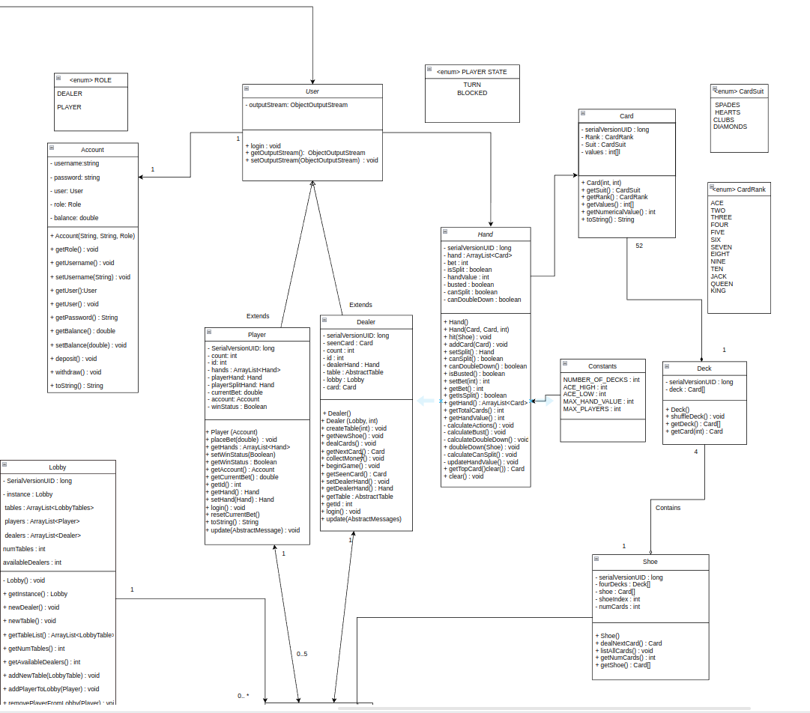

Slide 4
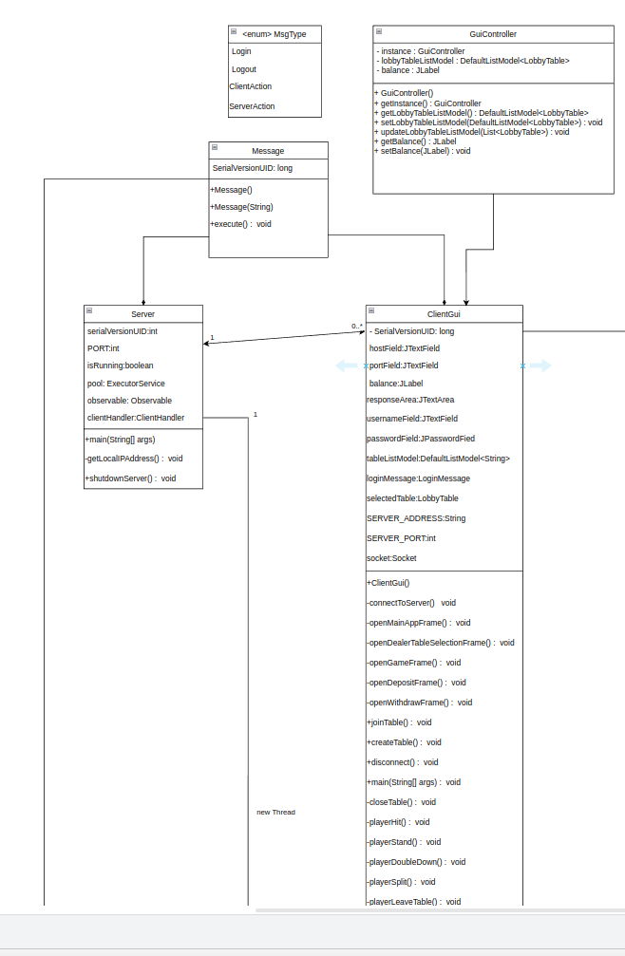

Slide 5
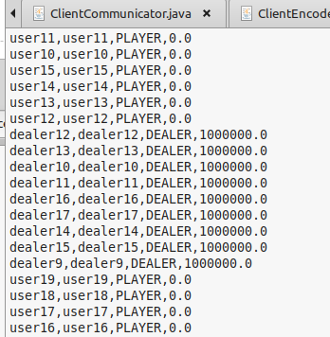

LOGIN PROCESS
CLIENT CONNECTS TO THE SERVER & ENTER CREDENTIALS
SERVER CHECK CREDENTIALS
GUI SETUP (PLAYER/DEALER)
PRESET ACCOUNTS
SEND MESSAGE
SEND RESPONSE = SUCCESS
CLIENT ENTER TO THE APP

Slide 6
Main Use Cases for Blackjack
Account Login
To log into a premade account
Join Game
To select a table to join
Add Funds
To add fund towards the account’s bank
Withdraw Funds
To withdraw funds out of the account’s bank
Leave Game
To leave a table
Create Table
To create a game to allow players to join

Slide 7
Requirements - Phase 3
Multithreaded Design Client - Server
System will define what a User may be able to do based on the Role linked with the account (Dealer, Player)
Different GUI options (Dealer - Player)
Lobby shows list of tables created by Dealer
User accounts will be pre-set with Dealer or Player roles linked to the accounts
Player: Deposit, withdraw funds and balances updates.
Persistence and Data Storage (data.txt)
Only Dealers are authorized to create and host game tables.
Players can join or leave tables at any time.
Dynamic Broadcasting lobby .
Notes:
Lists active game tables created by Dealers.
Updated dynamically for all users.
Tables updated in real-time for all connected users.
The system dynamically updates and displays the list of tables created by Dealers.

Slide 8
DEMO

