Slide 1
CS3315 — Introduction to Machine Learning and Big Data
Aviation Engine Health Diagnosis via Task Decomposition
Anomaly Detection · Fault Classification · End-to-End — on the NGAFID Dataset
Iván Barbosa Mejía
Naval Postgraduate School · MSCS Q3 · June 2026

Slide 2
Motivation & Problem
1/16
▸ General aviation: ~65% of US aviation accidents,
▸ with mechanical failures a persistent factor.
▸
▸ Condition-based maintenance needs to:
▸ Detect anomalous flights (AD)
▸ Identify the specific fault type (FC)
▸ Combine both end-to-end (E2E)
▸
▸ Goal: classical ML vs deep learning on real
▸ Cessna-172 fleet telemetry.
Two-stage diagnosis
Raw flight (23 sensors × 2048)
↓
[ AD ] Healthy / Anomalous
↓ (if anomalous)
[ FC ] 1 of 19 fault types
↓
E2E: 20-class diagnosis

Slide 3
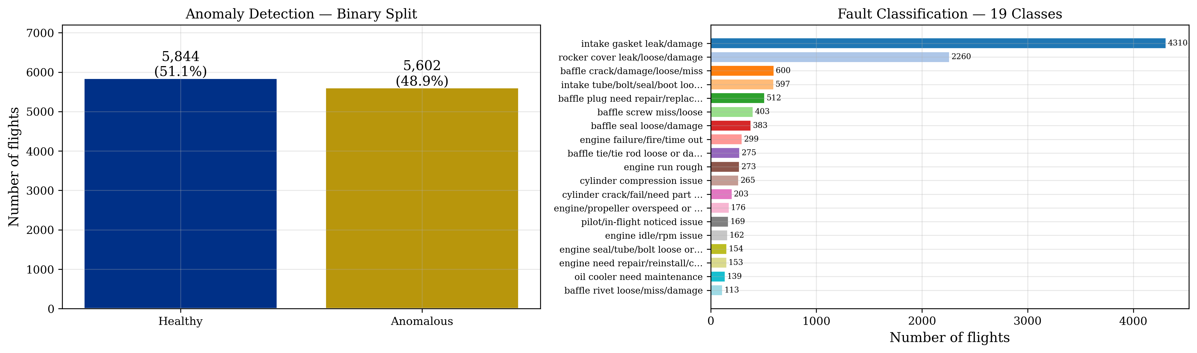
The NGAFID Dataset
2/16
▸ 11,446 Cessna-172 flights
▸ 23 onboard sensors @ 1 Hz
▸ Resampled to 2,048 timesteps
▸
▸ AD: near-balanced 1.04 : 1
▸ 5,844 healthy / 5,602 anomalous
▸
▸ FC: 19 fault classes, long-tail
▸ intake gasket 2,098 : baffle rivet 55
▸ imbalance ratio 38 : 1
▸
▸ 5-fold stratified cross-validation

Slide 4
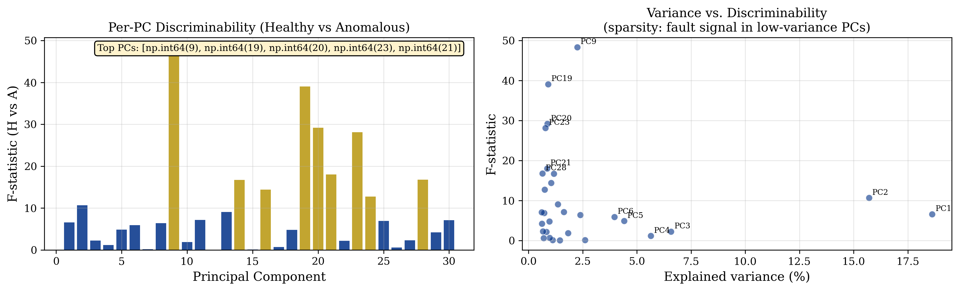
EDA — Challenge 1: Target Component Sparsity
3/16
▸ Dominant PCs encode the flight envelope (altitude, airspeed) — NOT the fault.
▸
▸ Fault signal lives in low-variance components.
▸
▸ CHT/EGT sensors show the largest volatility shift in anomalous flights.
▸
▸ → Global stats are insufficient for FC.

Slide 5
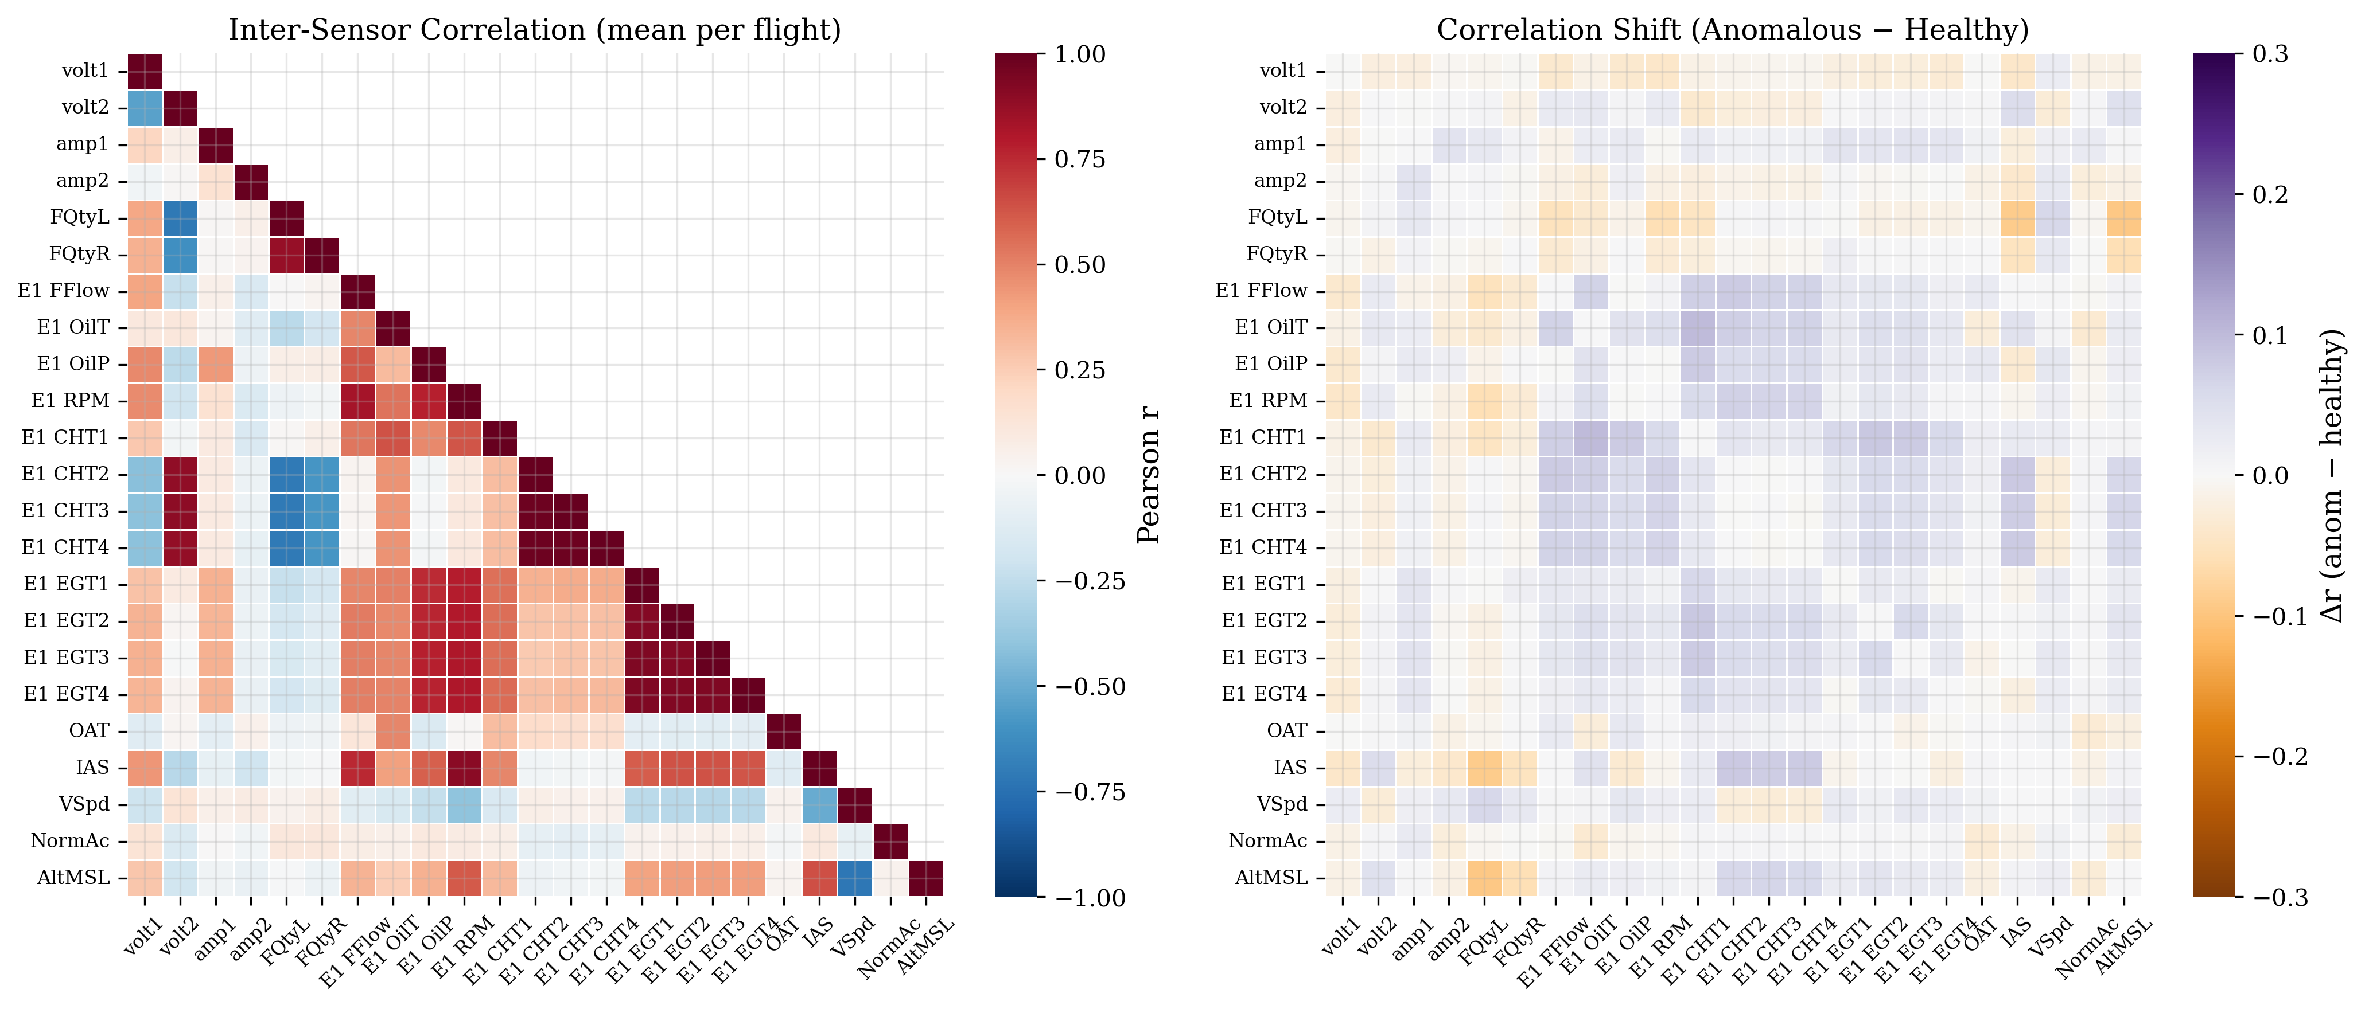
EDA — Inter-Cylinder Coupling → Repr F++
4/16
▸ Healthy: CHT1–4 correlate r > 0.92 (cylinders share combustion).
▸
▸ A single-cylinder fault breaks the symmetry → correlation drops.
▸
▸ Differences CHT_i − CHT_j and CHT_i − EGT_i encode WHICH cylinder fails.
▸
▸ → Motivates Repr F++ (cross-cylinder features).

Slide 6
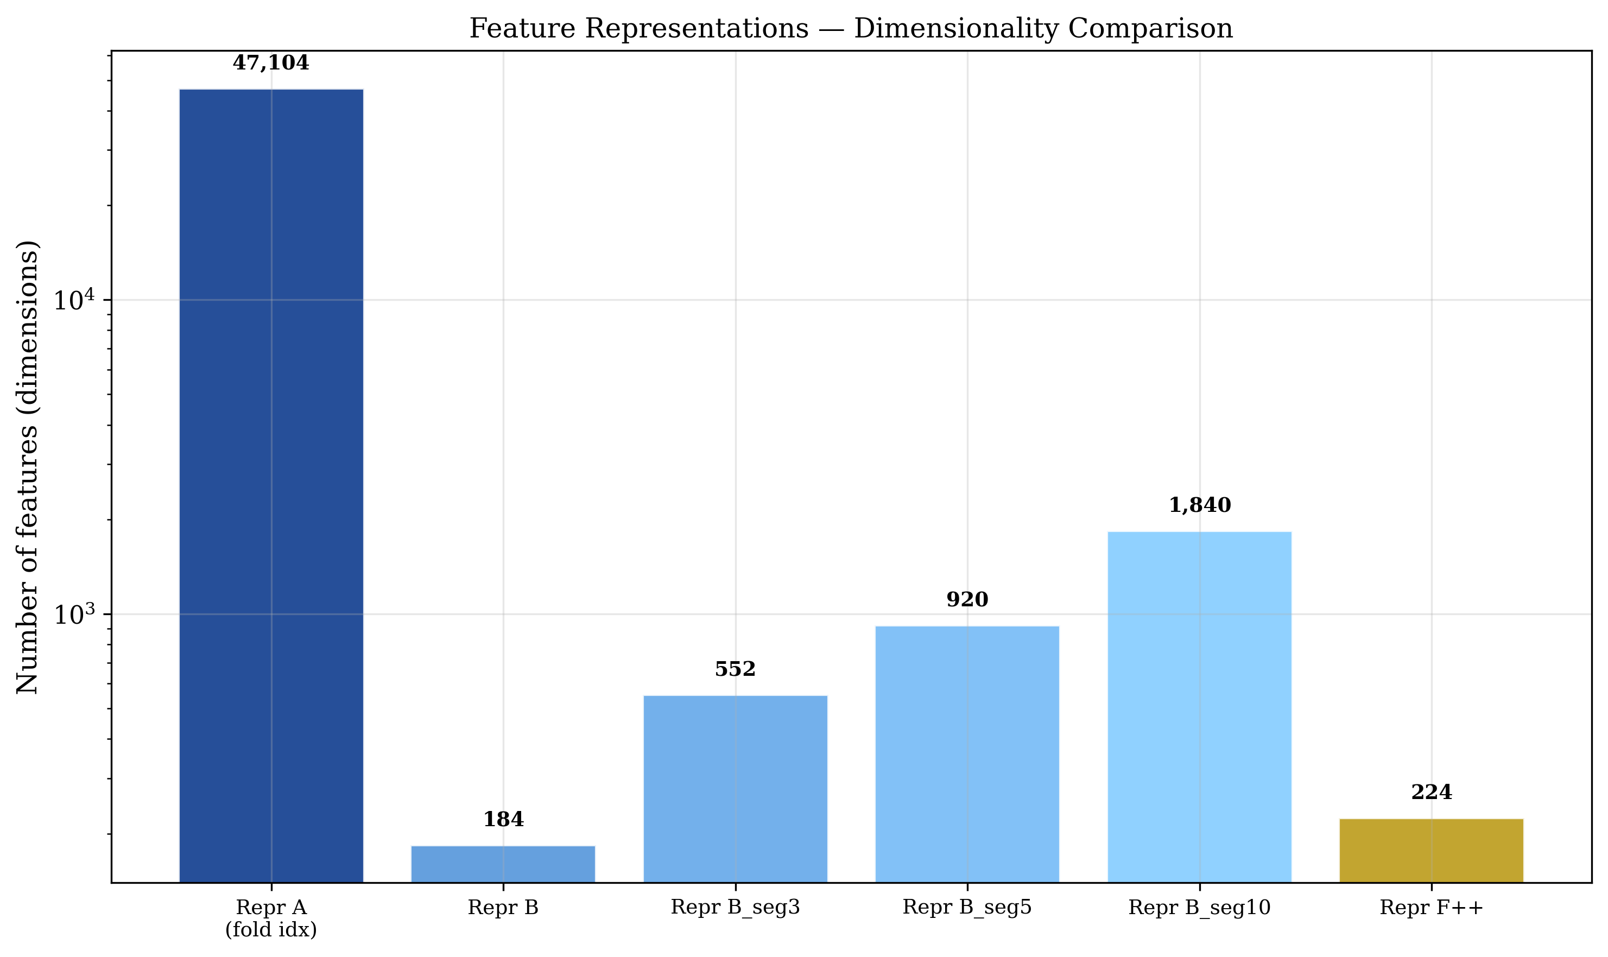
Feature Representations
5/16
▸ Repr A (23×2048)
▸ raw signal → deep learning
▸ Repr B (184-D)
▸ 8 stats × 23 sensors → baseline
▸ Repr B_seg (552–1840-D)
▸ per-phase segments
▸ Repr F++ (224-D)
▸ B + 40 cross-cylinder diffs
▸
▸ Anti-leakage: scaler fit on train only

Slide 7
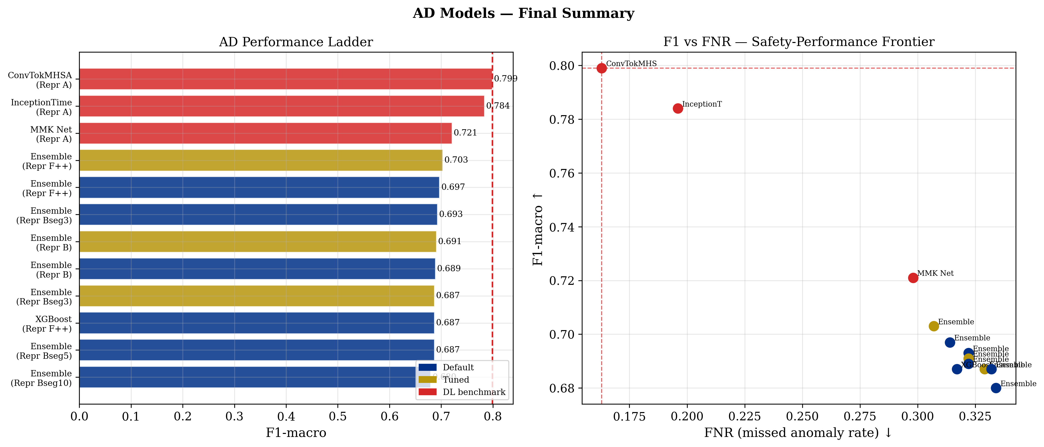
Results — Anomaly Detection
6/16
▸ Best classical:
▸ Ensemble × Repr F++ (tuned)
▸ F1-macro = 0.703
▸ AUC = 0.767 · FNR = 0.307
▸
▸ Repr F++ > Repr B (+0.012)
▸ Segmentation hurts AD
▸
▸ Gap to DL benchmark: 9.6 pp
▸ (ConvTokMHSA 0.799)

Slide 8
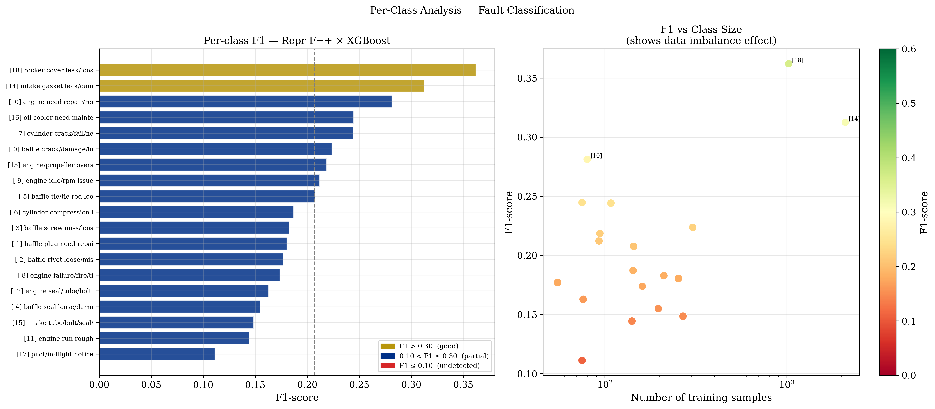
Results — Fault Classification
7/16
▸ Best classical (Ch.5):
▸ XGBoost × Repr F++ (tuned)
▸ F1-macro = 0.207
▸
▸ Repr F++ gain 7× larger than AD (+0.091)
▸
▸ Rare classes (n<150) → F1 ≈ 0
▸ Strong correlation: class size ↔ F1
▸
▸ Accuracy is misleading here →
▸ F1-macro is the only valid metric.

Slide 9
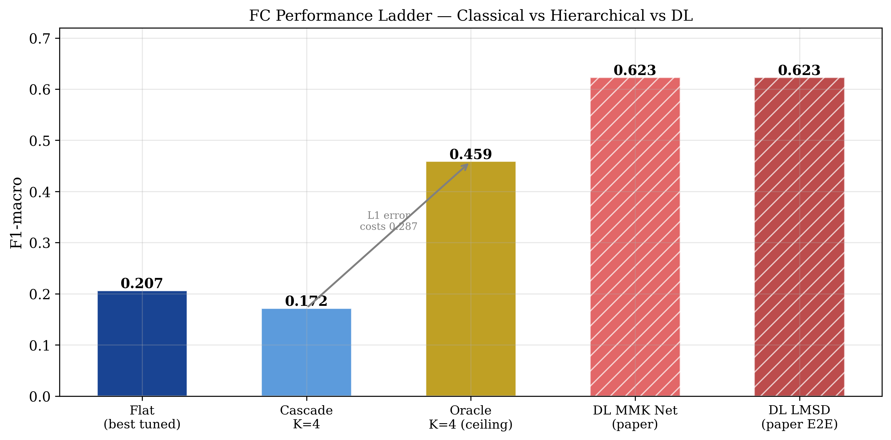
FC — Oracle K=4 Error Decomposition
8/16
▸ Decompose FC error into L1 (group) + L2 (type):
▸
▸ Flat XGB 0.207
▸ Cascade K=4 0.172
▸ Oracle K=4 0.459
▸ DL MMK Net 0.623
▸
▸ 63% of the ceiling is lost to L1 group errors.
▸ Even a perfect L1 leaves a 16-pp gap to DL → temporal features needed.

Slide 10
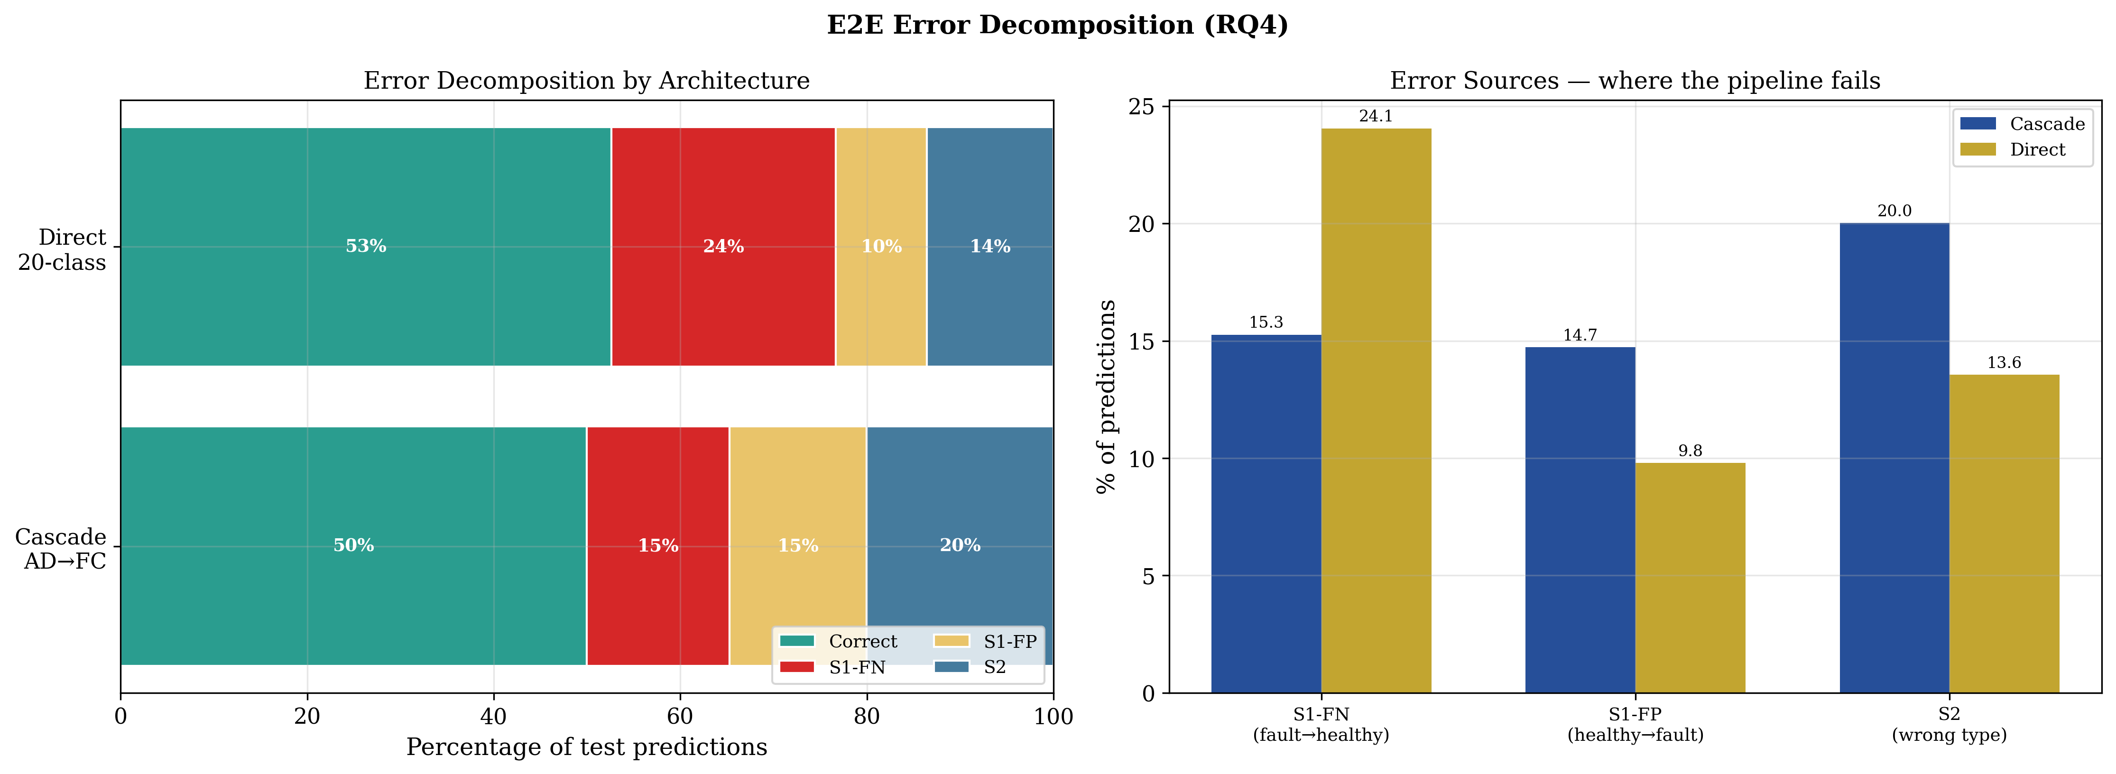
End-to-End — Error Decomposition (RQ4)
9/16
▸ Cascade AD→FC: F1 = 0.235
▸ beats Direct 20-class (0.113)
▸
▸ Error sources:
▸ Correct 50%
▸ S1-FN 15% (missed fault)
▸ S1-FP 15% (false alarm)
▸ S2 20% (wrong type)
▸
▸ → FC is the bottleneck, not detection.

Slide 11
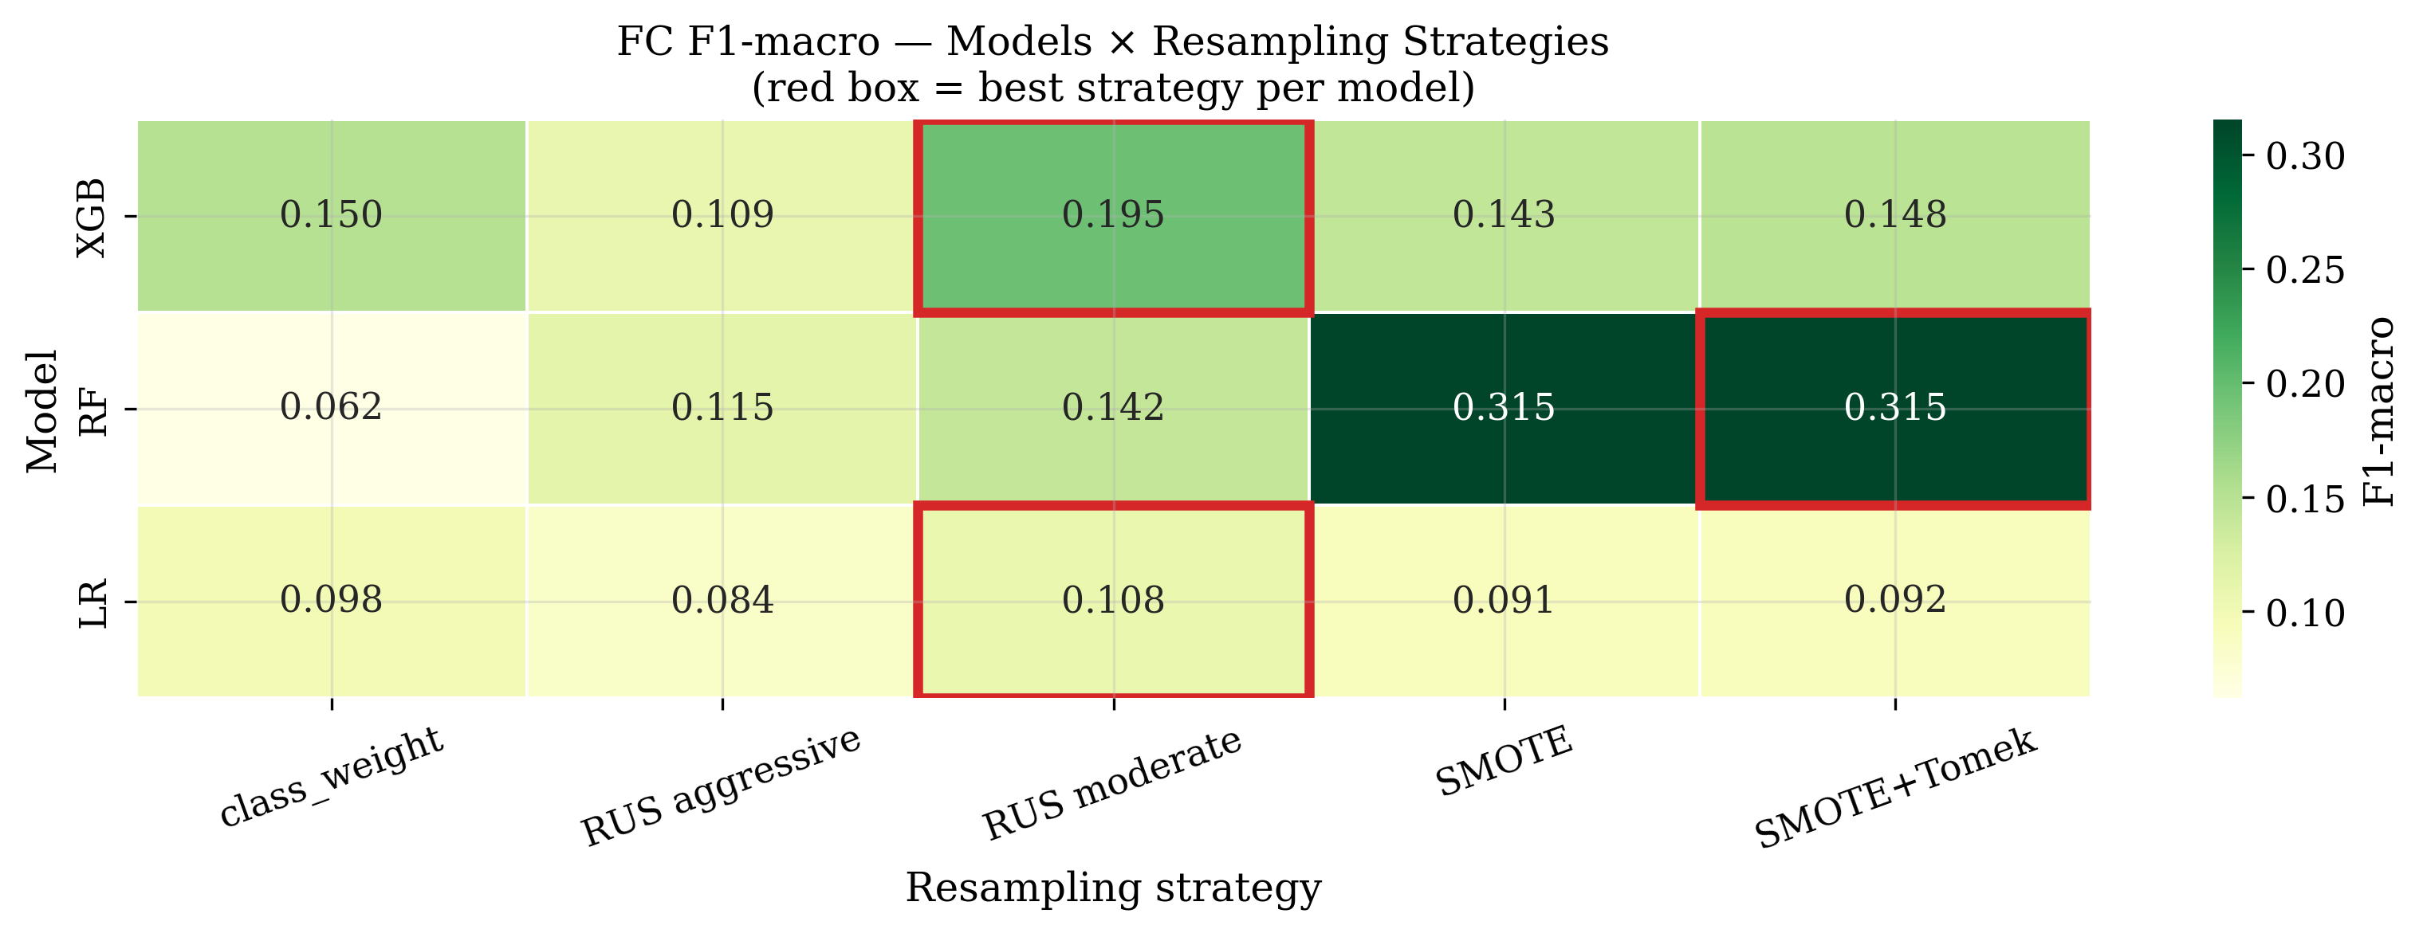
Resampling — The RF + SMOTE Discovery
10/16
▸ Effect is strongly model-dependent:
▸
▸ RF + class_weight 0.062 (worst)
▸ RF + SMOTE 0.315 (BEST)
▸ XGB + RUS mod. 0.195
▸
▸ RF transformed 5× by SMOTE.
▸ Beats prior best (0.207) by +52%.
▸
▸ Gap to DL: 41.6 → 30.8 pp

Slide 12
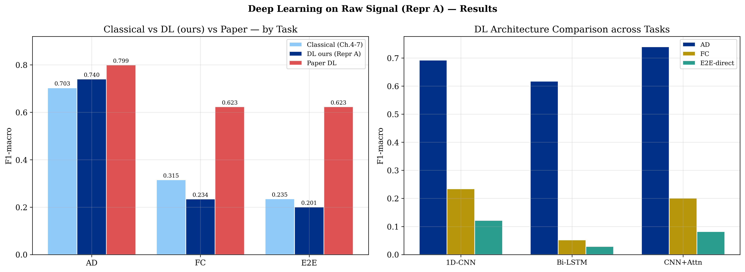
Deep Learning on Raw Signal (Repr A)
11/16
▸ PyTorch + Apple MPS
▸ 1D-CNN · Bi-LSTM · CNN+Attn
▸
▸ AD: CNN+Attn = 0.740
▸ beats classical 0.703 ✓
▸
▸ FC: DL 0.234 < classical 0.315
▸ E2E: DL 0.201 < classical 0.235
▸
▸ Bi-LSTM collapses (FC 0.052)

Slide 13
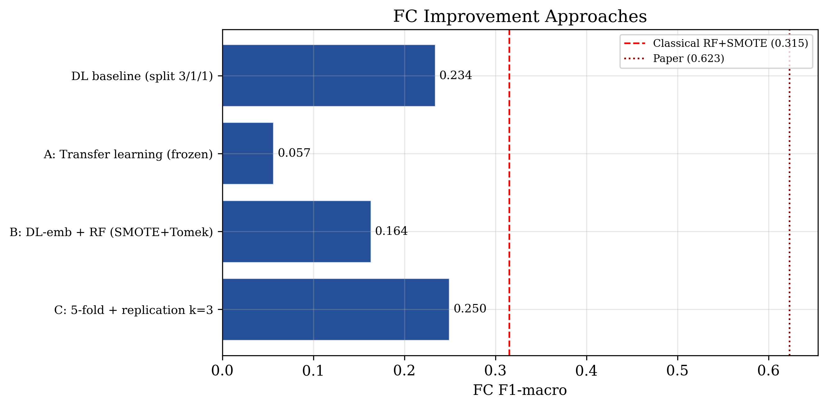
DL on FC — Three Improvement Strategies
12/16
▸ A: Transfer AD→FC 0.057
▸ AD features ≠ FC features
▸ B: DL-emb + RF 0.164
▸ embeddings lack type info
▸ C: 5-fold + repl. 0.250 (best DL)
▸ still < classical 0.315
▸
▸ None beats classical RF+SMOTE.
▸ FC limit is data scarcity,
▸ not the technique.

Slide 14
Master Comparison — Classical vs DL
13/16
Task | Best Classical | Best DL (ours) | Paper DL
AD | 0.703 Ens. F++ | 0.740 CNN+Attn ✓ | 0.799
FC | 0.315 RF+SMOTE ✓ | 0.250 5-fold CNN | 0.623
E2E | 0.235 RF cascade ✓ | 0.201 CNN cascade | 0.623
The winner of each task is decided by its DATA REGIME:
AD — abundant & balanced → DL wins. FC — scarce & imbalanced → classical wins.

Slide 15
Conclusions
14/16
▸ Physics-anchored feature engineering matters most where the task is hardest — Repr F++ gave the largest gains on FC.
▸
▸ The optimal imbalance remedy is model-specific — RF + SMOTE (0.315) far exceeded loss-weighted XGBoost.
▸
▸ Task decomposition succeeds when the first stage is strong — AD→FC cascade beats direct 20-class.
▸
▸ Deep learning's advantage is conditional on the data regime — wins AD, loses FC.
▸
▸ Metric & protocol choices determine the conclusions — F1-macro, error decomposition, anti-leakage.

Slide 16
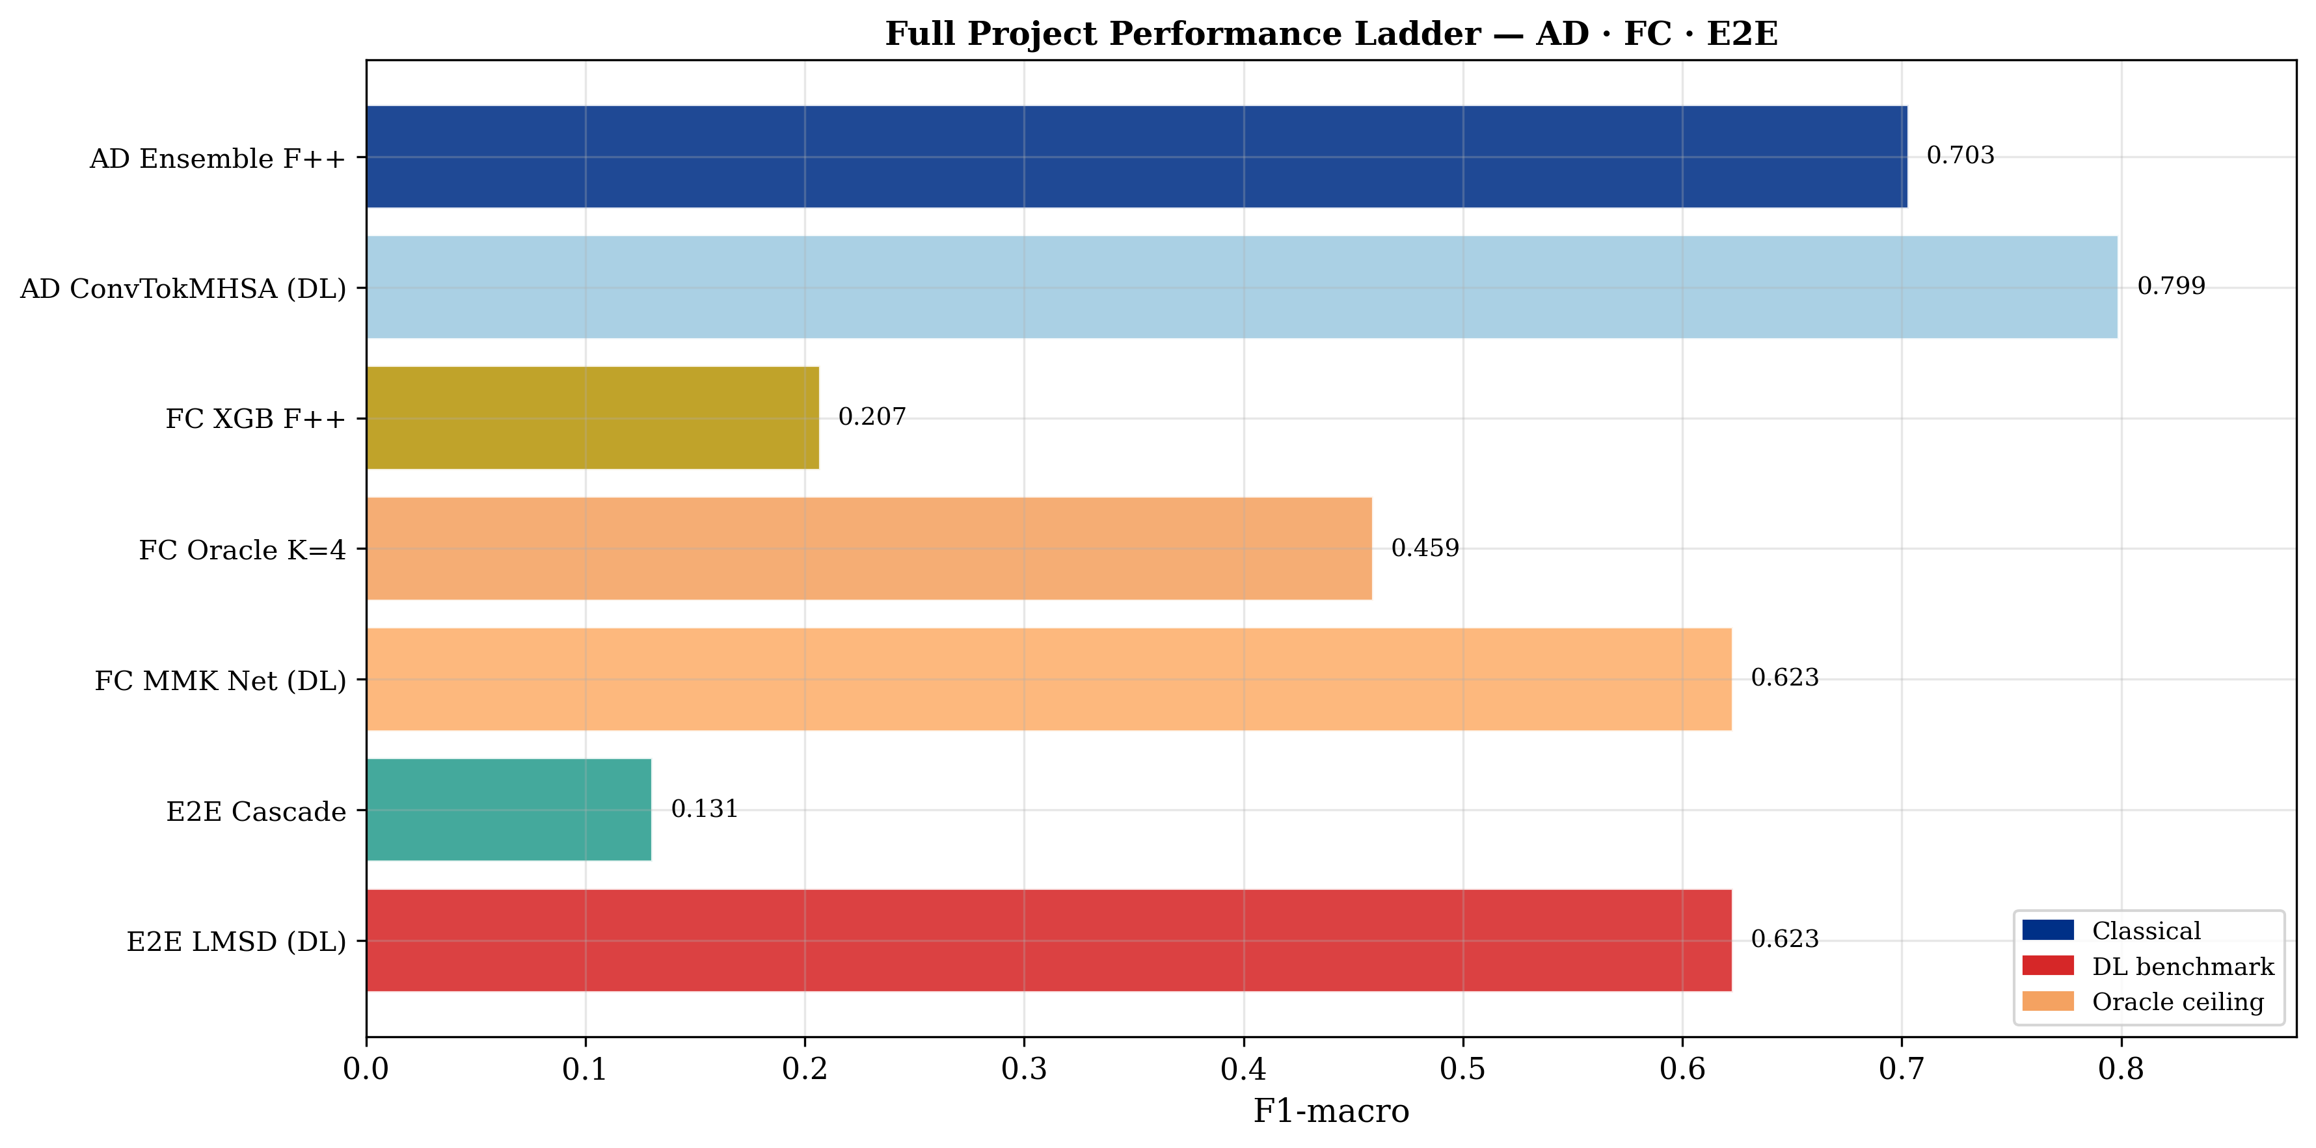
Final Recommendation — Hybrid Pipeline
15/16
Deploy a HYBRID:
AD stage →
Deep CNN+Attn
(abundant data)
FC stage →
Classical RF+SMOTE
(data scarcity)
Each task → the model
its data regime rewards.
Full report: 68 pages · 8 chapters · EDA → Representations → AD → FC → E2E → Resampling → DL

