Slide 1

Annual members and casual riders
Differences in bike usage
André Barbosa
26-07-2021

Slide 2
The Problem
How can we turn casual riders into annual members?
How do annual members and casual riders use Cyclistic bikes differently?

Slide 3
The Data
The last twelve monts’ trip data collected at the bike stations.

Slide 4
The Analysis Process
The data was joined into a single table, cleaned and some calculations were made and visualyzed.

Slide 5
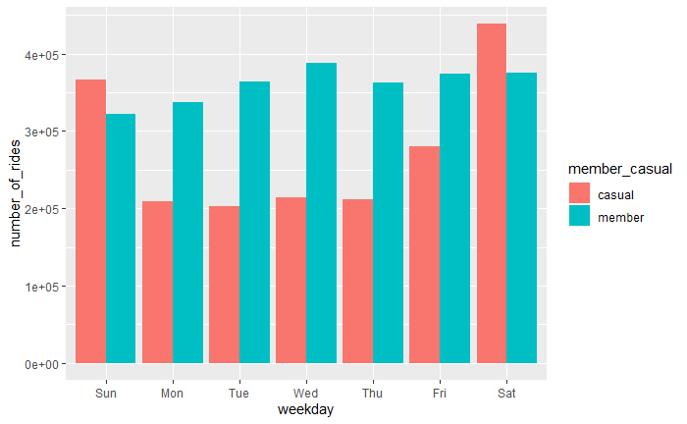
Number Of Rides By Rider Type By Day Of The Week
Member usage is somewhat consisent.
Casual usage peaks during the weekend.

Slide 6
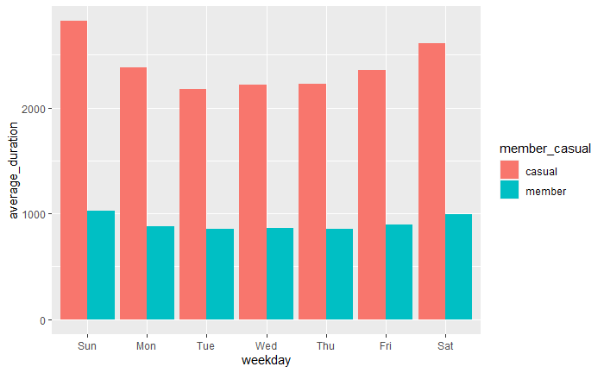
Average Ride Length By Rider Type By Day Of The Week
Casual riders take longer rides than members.

Slide 7
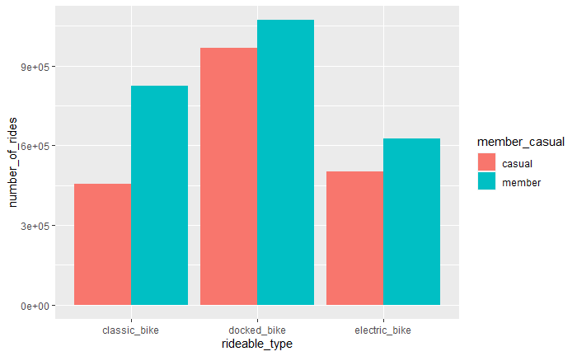
Number Of Rides By Rideable Type By Rider Type
Both types of users prefer docked bikes.
The difference is bigger on casual riders.

Slide 8
Recommendations
Mobility advantages of weekday / daily usage and benefits of membership.
Mobility advantages of the usage for shorter distance and cost/benefit relationship of membership.
Membership for easier use of all types of bikes and reinforcement of docked availability.

Slide 9
Discussion
Credits:
André Barbosa
Data used under license by Motivate International Inc. and the city of Chicago
Study based on previous work by Kevin Hartman
26-07-2021

