Slide 1

Predicting Sepsis Survival Using Clinical Data
Zhaocheng Yang
Instructor: Andras Zsom
TA: Mingjun Ma
Data Science Institute, Brown University
10/25/2024
GitHub

Slide 2

Introduction
What is Sepsis?
A life-threatening condition triggered by an extreme immune response to infection.
Importance
1. High mortality rate
2. Early prediction is critical for timely intervention and treatment
Objective
Build a classification model to predict patient survival using clinical features.
Data Source:
2. Dataset from Norwegian hospital admissions (2011-2012) of patients with sepsis-related diagnoses.
1. UC Irvine Machine Learning Repository

Slide 3
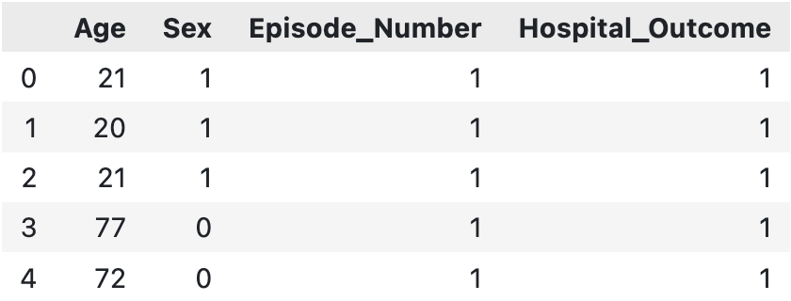
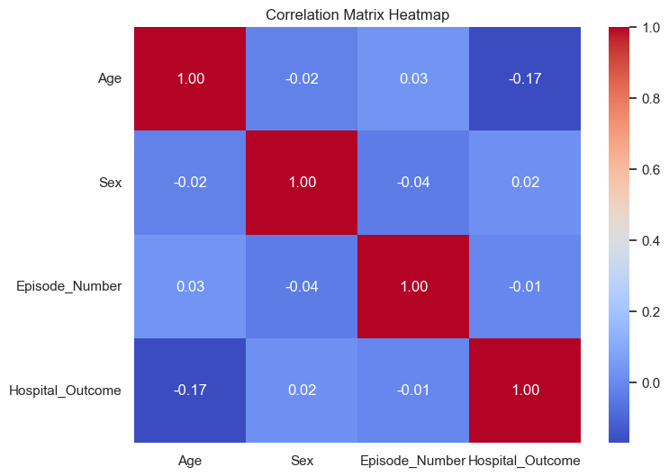
EDA Dataset Overview
Number of rows: 110,341
Number of columns: 4
Missing Values: NO
Age: Age of the patient in years.
Sex: Gender of the patient. (0: male, 1: female)
Episode Number: Number of prior Sepsis episodes
[1, 2, 3, 4, 5]
Hospital_Outcome: Status of the patient after 9,351 days of being admitted to the hospital. (0: Decreased, 1: Alive)

Slide 4
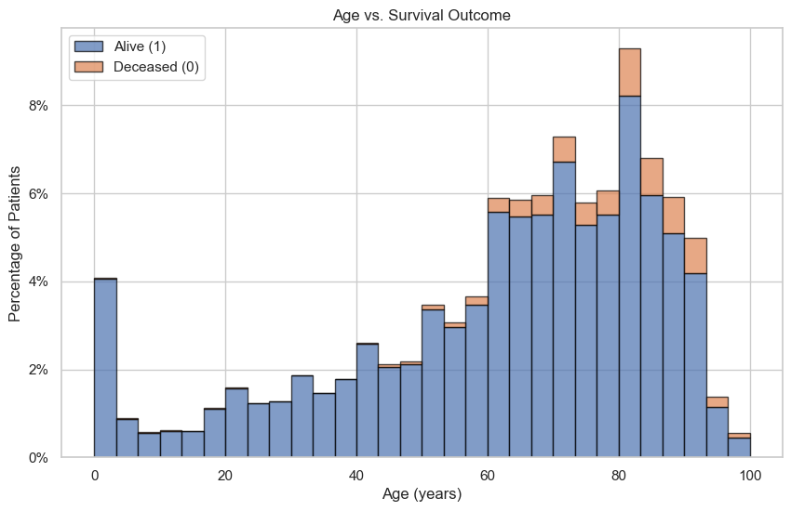
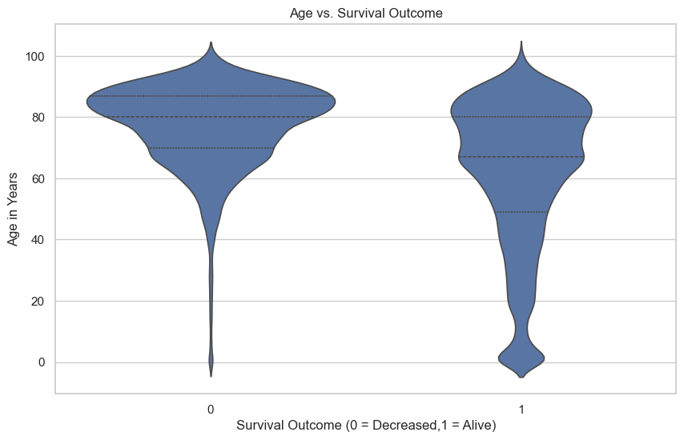
EDA Data Visualization 1
Younger patients have higher survival rates.
Mortality increases with age.

Slide 5
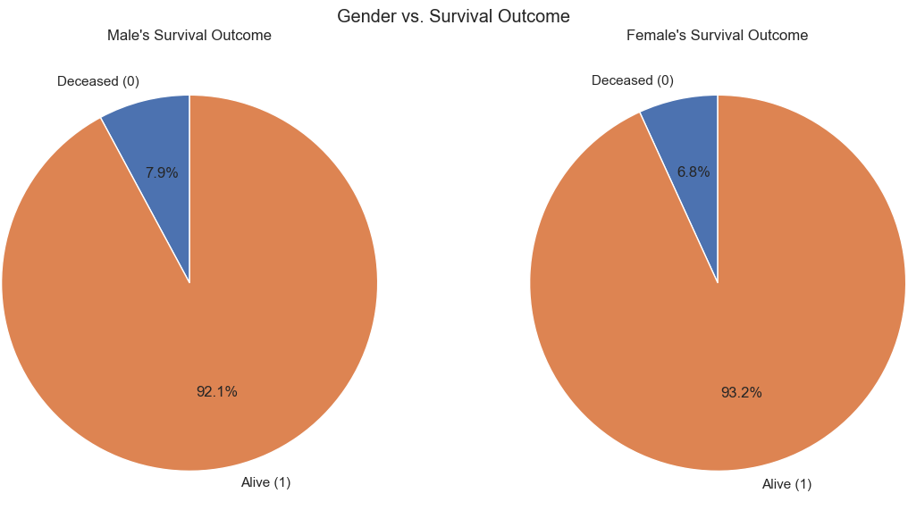
EDA Data Visualization 2
Slightly differences in survival rates between genders.

Slide 6
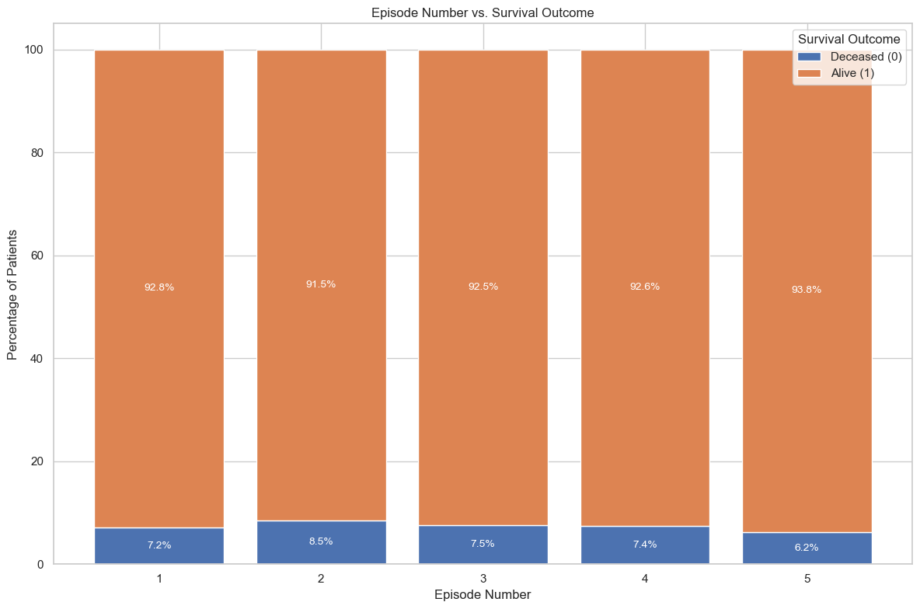
EDA Data Visualization 3
Unexpectedly, the mortality does not always increase with more episodes.

Slide 7
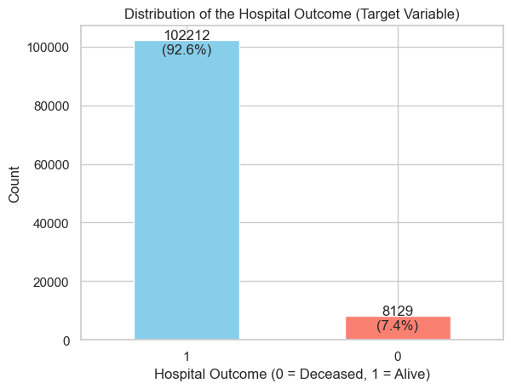
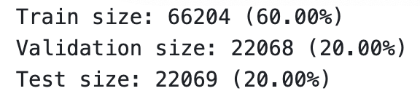
Data Splitting
StratifiedKFold(n_splits=4)
After the Splitting:
 | Train | Validation | Test
1 | 92.6% (61326) | 92.6% (20443) | 92.6% (20443)
0 | 7.4% (4878) | 7.4% (1625) | 7.4% (1626)
The proportion of 0 and 1 remains consistent

Slide 8
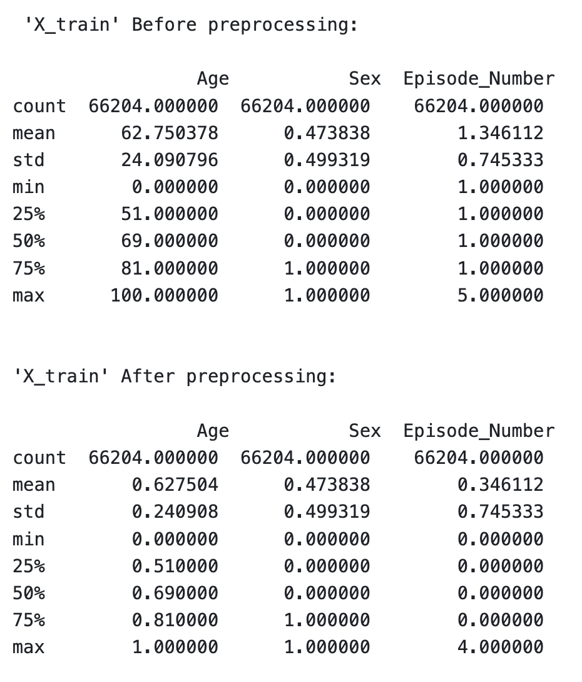
Data Preprocessing
Feature | Type | Transformer
Age | Continuous | MinMaxScaler
Sex | Binary: 0 and 1 | \
Episode_Number | Ordinal: 1,2,3,4,5 | OrdinalEncoder

Slide 9
Thanks for Watching

