Slide 1
本周工作内容
Deavan

Slide 2
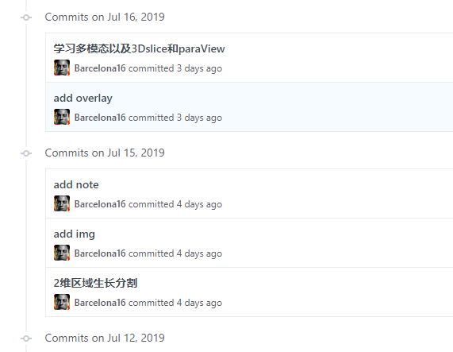
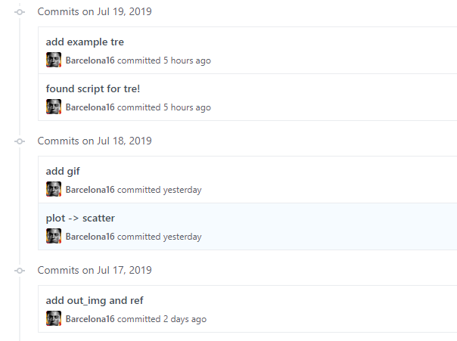
Profile

Slide 3
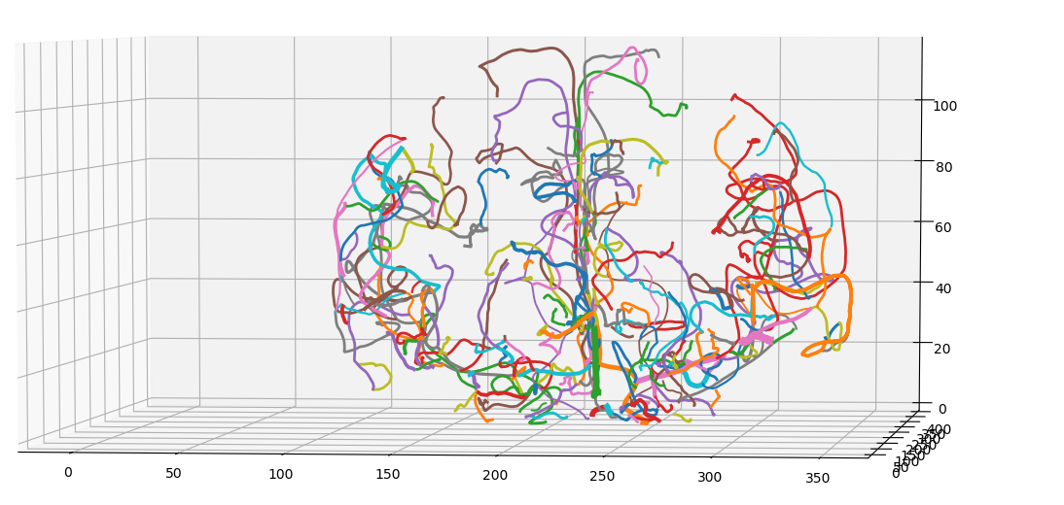
1. About .tre
1、更好的展示.tre文件

Slide 4
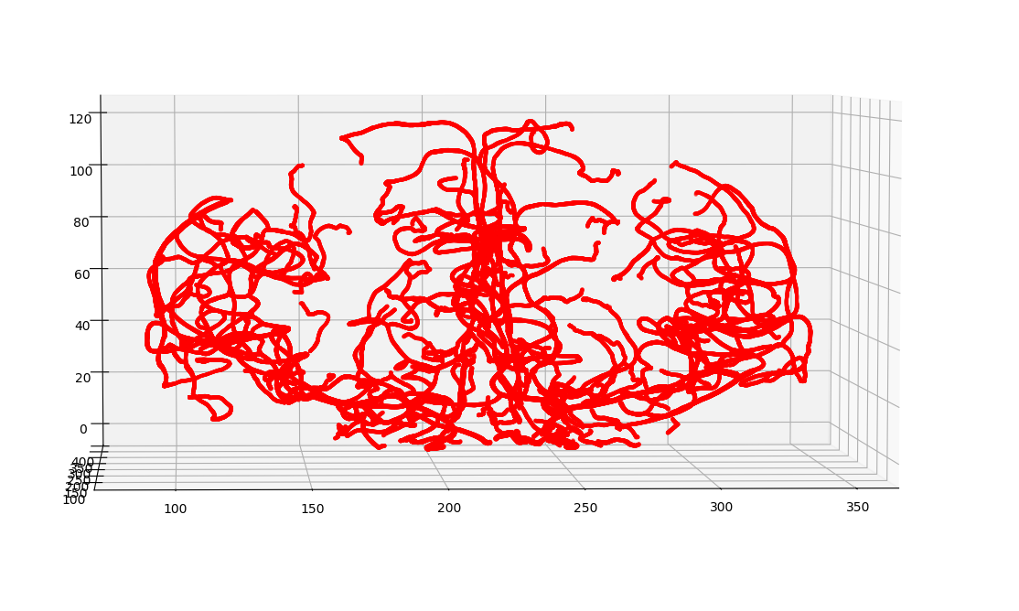
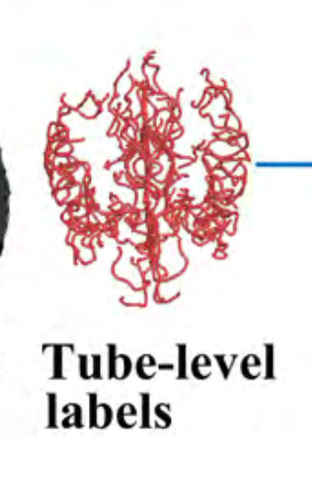
1. About .tre
1、更好的展示.tre文件

Slide 5
问题
1.散点图加入radius之后效果不明显且卡
2.折线图只能设置一个linewidth单一血管半径变化无法体现

Slide 6
解决方法
搁置

Slide 7
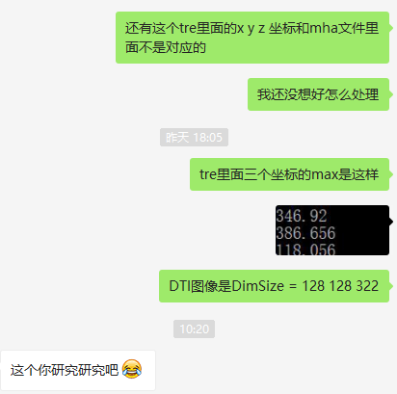
1. About .tre
2、读取.tre的内容
https://itk.org/Wiki/ITK/MetaIO/Documentation

Slide 8

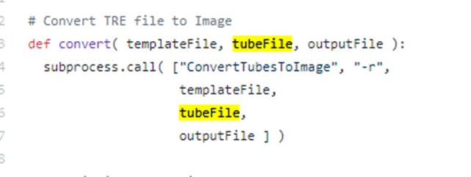
1. About .tre
2、读取.tre的内容
https://github.com/Barcelona16/TubeTK/tree/MicroTumorDetection/Examples/SegmentVesselsUsingNeuralNetworks

Slide 9
2. About metaIO
1、不同文件内容
Images include T1 and T2 acquired at 1x1x1 mm3, Magnetic Resonance Angiograpy (MRA) acquired at 0.5 x 0.5 x 0.8 mm3, and Diffusion Tensor Imaging (DTI) using 6 directions and a voxel size of 2x2x2 mm3. In addition to age and sex, handedness and race were also recorded.

Slide 10
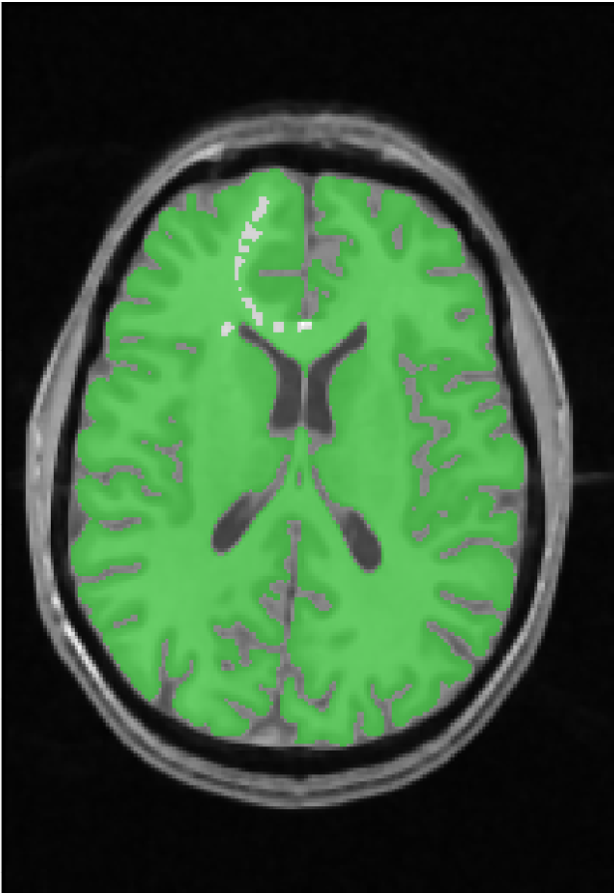
2. About metaIO
2维区域生长算法测试

Slide 11
下周计划
1.”.tre” -> image
2.实现Neural network vessel classification

