Slide 1

How do annual members and casual riders use Cyclistic bikes differently?
Clément Barchon

Slide 2
Goals of our discussion today:
1
2
3
Share an overview of what are the member types, and their repartition
Examine trends among the two member categories
Discuss the possibilities based on the insights gained

Slide 3
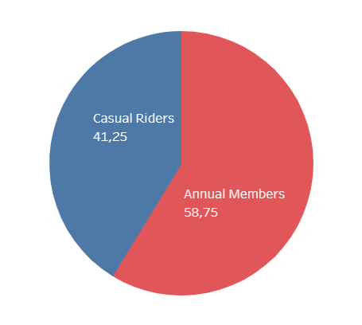
Annual Members, Casual Riders who are they?
Pricing plans
Single-ride passes
Full-day passes
Annual membership
Casual Riders

Slide 4
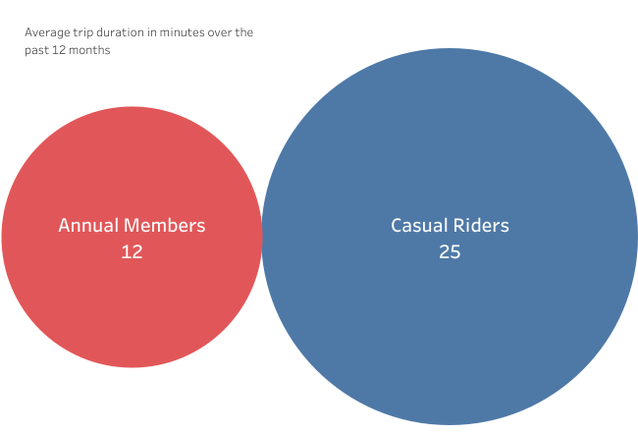
Global Average Trip Duration
Data overview
Our data show trips from 2021/09 to 2022/08 (12 past months)
The data has been made available by Motivate International Inc.
Key takeaway
Casual Riders ride more than twice longer than Annual Members

Slide 5
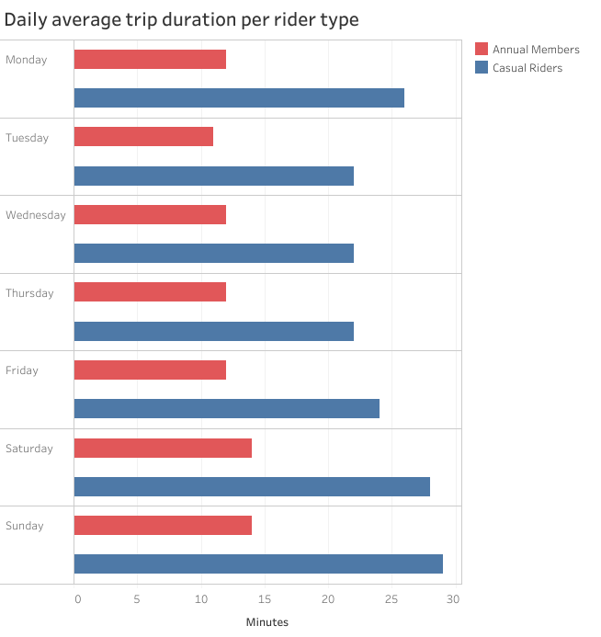
Daily Average Trip Duration
Key takeaway
By looking at the past 12 months’ daily average trip duration, we’re able to identify longer trips (for both customers but more significant for Casual Riders) during the weekend(& Monday for Casual Riders)

Slide 6
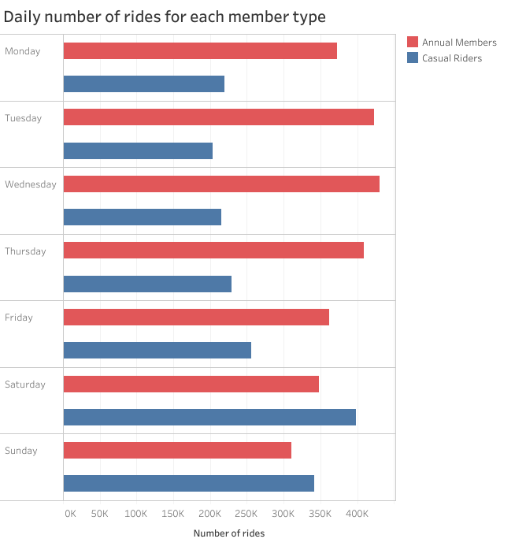
Daily trips number
Key takeaways
During weekdays, Annual Members’ trips number is higher than Casual Riders’ one
During weekend, it is the exact opposite; Casual Riders « ride more »

Slide 7
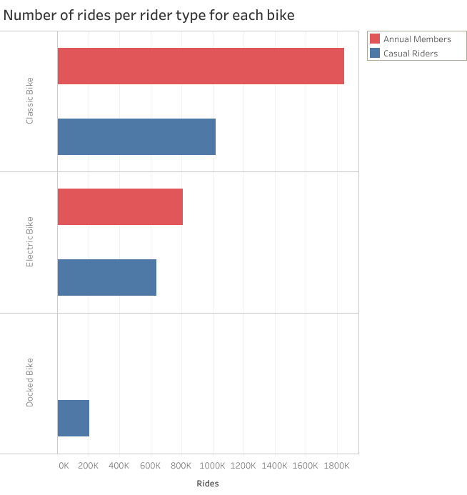
Rideable type
Key takeaways
Annual Members & Casual Riders prefer the same bike type; the classic one
Casual Riders occasionally use docked bikes while Annual Members do not

Slide 8
What could the company start doing after seeing these trends?
Think about creating a « weekend use » membership (may be extended to Monday).
Investigate why Casual Riders ride longer? (they live further from where the bikes are?)
Investigate if the Casual Riders using docked bikes are always (or at least often) the same ones

