Slide 1
Project Work – Group A Members
1. John Etengu – 2025/PCSE/DAY/0229
2. Aitasi Georgina – 2025/PCSE/DAY/0234
3. Kataike Eflance– 2025/PCSE/DAY/0544
4. Asaba Timothy– BTV143/2024/B/C/A/0605
5. Mugabi Whycliff– 2025/PCSE/DAY/0620
The uploaded work on github can be found in the
Github Repository
NB: Final Report Exceeded 12 Pages Because of the diagrams and screens that were inserted

Slide 2
Egg Production Tracking System
Brenda’s Poultry Farm, Muyenga, Kampala
PCSE211 Group Project | Group A
Uganda Institute of Information and Communications Technology
For the lecturer
Please check our GitHub repository for the full files, part by part. The folder for each part (Part 1 to Part 4) holds the full document and diagrams.
The interview notes are in the Part 1 folder, under project resources.
This presentation is a simple summary of those files. The red speaker notes on each slide explain it.
Speaker notes: Welcome. This presentation covers our PCSE211 group project in four parts: Part 1 the problem and whether it is realistic to solve, Part 2 the requirements, Part 3 the analysis and design, and Part 4 how the system would be changed and maintained. Our organisation is Brenda’s Poultry Farm in Muyenga, and we designed a small smartphone system for tracking egg production. We are not presenting live, so every slide has red speaker notes that explain it. This is a simplified summary: the full files are in our GitHub repository, in the folder for each part, and the interview notes are in the Part 1 folder under project resources.
Notes:
Welcome. This presentation covers our PCSE211 group project in four parts: Part 1 the problem and whether it is realistic to solve, Part 2 the requirements, Part 3 the analysis and design, and Part 4 how the system would be changed and maintained. Our organisation is Brenda’s Poultry Farm in Muyenga, and we designed a small smartphone system for tracking egg production. We are not presenting live, so every slide has red speaker notes that explain it. This is a simplified summary: the full files are in our GitHub repository, in the folder for each part, and the interview notes are in the Part 1 folder under project resources.

Slide 3
Part 1: Problem statement
The organisation
Brenda’s Poultry Farm in Muyenga keeps chickens for egg production. One worker records production in a large counter book, and Brenda, the owner, checks the entries and confirms the totals.
70
50–60
1
laying hens
eggs a day
counter book
What goes wrong today
Production totals are added by hand. This can lead to calculation mistakes, makes it hard to know the correct number of eggs produced each day or week, and makes it difficult to compare production over time.
Proposed solution
A small smartphone-based Egg Production Tracking System. The worker enters the daily eggs collected and records damaged eggs separately. The system calculates daily and weekly totals automatically.
It focuses only on egg production records, not sales, general inventory or flock health.
Who is affected
The worker who records the eggs, and Brenda, who checks the figures.
Speaker notes: This slide explains the problem. Brenda’s farm has about 70 laying hens and collects around 50 to 60 eggs a day. One worker writes the eggs in a large counter book and Brenda checks the entries and confirms the totals. The totals are added by hand, so mistakes can happen, it is hard to know the correct number of eggs for a day or a week, and it is hard to compare production over time. Both the worker and Brenda are affected. Our proposed solution is a small smartphone system where the worker enters the eggs collected, damaged eggs are recorded separately, and the system works out daily and weekly totals. It only covers egg records.
Notes:
This slide explains the problem. Brenda’s farm has about 70 laying hens and collects around 50 to 60 eggs a day. One worker writes the eggs in a large counter book and Brenda checks the entries and confirms the totals. The totals are added by hand, so mistakes can happen, it is hard to know the correct number of eggs for a day or a week, and it is hard to compare production over time. Both the worker and Brenda are affected. Our proposed solution is a small smartphone system where the worker enters the eggs collected, damaged eggs are recorded separately, and the system works out daily and weekly totals. It only covers egg records.

Slide 4
Part 1: Development model and options compared
Chosen development model: iterative
We plan a simple version, show it to the lecturer, get feedback and improve the design in stages.
Reason 1: the lecturer checks each part, so feedback is used before the next stage. Reason 2: the system is small, so screens and functions can change without redesigning everything.
Option | Advantages | Disadvantages
Keep using the counter book | No new equipment or training is needed. Staff already know it. | Totals still need to be added by hand, so mistakes can continue.
Use a spreadsheet on a phone | Can calculate totals automatically and may be low-cost. | A spreadsheet may be awkward to use on a small phone screen.
Small smartphone tracking system | Designed for the farm’s egg records; calculates totals and keeps records together. | Needs setup, basic training and a way to back up records.
Speaker notes: Here we explain how we will work and which option we chose. We will use the iterative model: plan a simple version, show it to the lecturer, get feedback and improve the design in stages. We chose it for two reasons: the lecturer checks each part, so feedback can be used before the next stage, and the system is small, so screens and functions can be changed without redesigning everything. The table compares three options. The counter book needs no new equipment but mistakes continue. A spreadsheet on a phone can calculate totals but may be awkward on a small screen. A small smartphone tracking system is built for the farm’s egg records but needs setup, training and a way to back up records.
Notes:
Here we explain how we will work and which option we chose. We will use the iterative model: plan a simple version, show it to the lecturer, get feedback and improve the design in stages. We chose it for two reasons: the lecturer checks each part, so feedback can be used before the next stage, and the system is small, so screens and functions can be changed without redesigning everything. The table compares three options. The counter book needs no new equipment but mistakes continue. A spreadsheet on a phone can calculate totals but may be awkward on a small screen. A small smartphone tracking system is built for the farm’s egg records but needs setup, training and a way to back up records.

Slide 5
Part 1: Feasibility study (TELOS)
Area | Assessment | Reason
Technical | Possible | A simple phone-based system can use entry forms and automatic totals. The farm needs a suitable smartphone.
Economic | Likely affordable | Free or low-cost tools may be used. Setup, training and backup costs should be checked.
Legal | Likely feasible | The system mainly stores egg production figures, so there is no obvious legal barrier. If it stores workers’ names or other personal details, the farm should protect them, limit access to authorised users and follow Uganda’s Data Protection and Privacy Act, 2019.
Operational | Possible | A worker already records production and Brenda checks it. Short training and simple screens should help.
Schedule | Feasible | The group can prepare the design in stages and show each part to the lecturer for feedback.
Speaker notes: TELOS checks if the project is realistic: Technical, Economic, Legal, Operational and Schedule. Technically it is possible because a simple phone system with entry forms and automatic totals is enough, but the farm needs a suitable smartphone. Economically it is likely affordable with free or low-cost tools, though setup, training and backup costs should be checked. Legally it is likely feasible because we mainly store egg figures; if personal details such as workers’ names are stored, they must be protected under Uganda’s Data Protection and Privacy Act, 2019. Operationally it is possible because a worker already records production and Brenda checks it. On schedule it is feasible because we design in stages.
Notes:
TELOS checks if the project is realistic: Technical, Economic, Legal, Operational and Schedule. Technically it is possible because a simple phone system with entry forms and automatic totals is enough, but the farm needs a suitable smartphone. Economically it is likely affordable with free or low-cost tools, though setup, training and backup costs should be checked. Legally it is likely feasible because we mainly store egg figures; if personal details such as workers’ names are stored, they must be protected under Uganda’s Data Protection and Privacy Act, 2019. Operationally it is possible because a worker already records production and Brenda checks it. On schedule it is feasible because we design in stages.

Slide 6
Part 1: Cost-benefit analysis and payback period
Estimated item | Cost (UGX)
Initial setup and configuration | 150,000
Basic user training | 50,000
Total initial cost | 200,000
Backup/support per month | 5,000
Example calculation
1 hour saved a day × 26 days = 26 hours a month
26 hours × UGX 3,000 = UGX 78,000 a month
UGX 78,000 − UGX 5,000 support = UGX 73,000 net benefit a month
Payback = initial cost ÷ monthly net benefit
Possible benefits
Less time spent adding figures
Fewer calculation errors
Easier access to production totals
≈ 2.7 months
Amounts are planning estimates, not prices confirmed by the farm. They assume the farm already has a suitable smartphone and a low-cost tool is used.
UGX 200,000 ÷ UGX 73,000. This is only an estimate based on assumptions, so the group should check that the time saved and costs are reasonable.
Speaker notes: These are planning estimates, not prices confirmed by the farm. We assume the farm already has a suitable smartphone and that a low-cost tool can be used. Setup is about 150,000 shillings and basic training 50,000, so the initial cost is 200,000. Backup and support is about 5,000 a month. Possible benefits are less time adding figures, fewer calculation errors and easier access to totals. As an example, if the system saves one hour a day for 26 days a month and the time is worth 3,000 shillings an hour, that is 78,000 a month. After 5,000 for support the net benefit is 73,000 a month. Payback is 200,000 divided by 73,000, about 2.7 months. We should check that these assumptions are reasonable.
Notes:
These are planning estimates, not prices confirmed by the farm. We assume the farm already has a suitable smartphone and that a low-cost tool can be used. Setup is about 150,000 shillings and basic training 50,000, so the initial cost is 200,000. Backup and support is about 5,000 a month. Possible benefits are less time adding figures, fewer calculation errors and easier access to totals. As an example, if the system saves one hour a day for 26 days a month and the time is worth 3,000 shillings an hour, that is 78,000 a month. After 5,000 for support the net benefit is 73,000 a month. Payback is 200,000 divided by 73,000, about 2.7 months. We should check that these assumptions are reasonable.

Slide 7
Part 1: Three main risks and our recommendation
Risk | How to reduce it
Wrong figures entered | Keep the form simple and let Brenda check the totals regularly.
Worker finds the system difficult | Use clear labels and give the worker a short practice session.
Records are lost or the phone is unavailable | Back up records regularly and keep the counter book as a temporary backup during changeover.
Recommendation
The group recommends planning a small smartphone-based Egg Production Tracking System. Compared with the counter book, it can calculate daily and weekly totals automatically and help reduce manual addition errors. The iterative model will let the group improve the design after feedback from the lecturer and farm users. Before use, the farm should confirm the estimated costs, smartphone availability and backup method.
Speaker notes: We identified three main risks. Wrong figures entered: we keep the form simple and Brenda checks the totals regularly. The worker finds the system difficult: we use clear labels and give a short practice session. Records are lost or the phone is unavailable: we back up regularly and keep the counter book as a temporary backup during changeover. Our recommendation is to plan the small smartphone Egg Production Tracking System. Compared with the counter book it can calculate daily and weekly totals automatically and reduce adding errors. The iterative model lets us improve the design after feedback. Before use, the farm should confirm the estimated costs, smartphone availability and backup method.
Notes:
We identified three main risks. Wrong figures entered: we keep the form simple and Brenda checks the totals regularly. The worker finds the system difficult: we use clear labels and give a short practice session. Records are lost or the phone is unavailable: we back up regularly and keep the counter book as a temporary backup during changeover. Our recommendation is to plan the small smartphone Egg Production Tracking System. Compared with the counter book it can calculate daily and weekly totals automatically and reduce adding errors. The iterative model lets us improve the design after feedback. Before use, the farm should confirm the estimated costs, smartphone availability and backup method.

Slide 8
Part 2: Scope, users and evidence
In scope | Out of scope (this version)
Record date and number of eggs collected | Record sales or payments
Record damaged eggs separately | Manage general stock or inventory
Calculate daily and weekly totals | Manage flock health or treatment
View saved records and summaries | Provide a desktop/computer version
User | Main tasks | Skills | No.
Poultry workers | Collect eggs, sort them, identify damaged eggs and count the eggs each day | Basic poultry farming and counting | 3
Brenda (owner) | Review production records, check daily and weekly totals and confirm the figures | Basic smartphone skills | 1
Record-keeping worker | Enter daily egg figures into the smartphone system and check the entries | Basic smartphone skills | 1
Interview (19 October 2026)
The worker explained that daily production is written in a large counter book, manual calculations can be wrong, damaged eggs are counted separately, and Brenda checks and confirms the totals.
Observation (19 October 2026)
About two counter books with egg-production records were observed. This supports the need for an easier way to save and find production figures.
Interview notes: GitHub → Part 1 folder → project resources
Speaker notes: Part 2 is the requirements. In scope: recording the date and eggs collected, recording damaged eggs separately, calculating daily and weekly totals, and viewing saved records and summaries. Out of scope: sales or payments, general stock, flock health and a computer version, because the system is smartphone-only and small. There are three kinds of users: poultry workers, Brenda the owner, and the record-keeping worker. We gathered requirements with two techniques on 19 October 2026: an interview and an observation of the counter books. The interview notes are in our GitHub repository: open the Part 1 folder, then project resources.
Notes:
Part 2 is the requirements. In scope: recording the date and eggs collected, recording damaged eggs separately, calculating daily and weekly totals, and viewing saved records and summaries. Out of scope: sales or payments, general stock, flock health and a computer version, because the system is smartphone-only and small. There are three kinds of users: poultry workers, Brenda the owner, and the record-keeping worker. We gathered requirements with two techniques on 19 October 2026: an interview and an observation of the counter books. The interview notes are in our GitHub repository: open the Part 1 folder, then project resources.

Slide 9
Part 2: Functional requirements
ID | Requirement | Priority | Source
FR-01 | The system shall let a worker enter the date and number of eggs collected each day. | Must | Interview
FR-02 | The system shall let the user record damaged eggs separately from intact eggs. | Must | Interview
FR-03 | The system shall save each production entry for later viewing. | Must | Observation; project scope
FR-04 | The system shall calculate the total eggs recorded for a selected day. | Must | Interview: manual calculation errors
FR-05 | The system shall calculate the total eggs recorded for a selected week. | Must | Interview: need for weekly figures
FR-06 | The system shall show intact and damaged egg counts separately for a selected day. | Must | Interview
FR-07 | The system shall let Brenda review and confirm saved production entries. | Should | Interview: owner checks totals
FR-08 | The system shall let a user view previous production records by date. | Should | Observation; project scope
FR-09 | The system shall warn the user if a required field, such as date or egg count, is missing. | Should | Project scope: fewer incomplete records
FR-10 | The system shall let a user correct an entry when a recording mistake is found. | Should | Project scope: support accuracy
Speaker notes: These are the ten functional requirements, what the system must do. We prioritised them with MoSCoW. Must means essential to the main purpose: entering the date and eggs, recording damaged eggs separately, saving entries, and calculating the daily and weekly totals, and showing intact and damaged counts separately. Should means important but not essential for the first usable version: Brenda reviewing and confirming entries, viewing past records, warning about missing fields, and correcting mistakes. The last column shows the source of each requirement, which is the interview, the observation or the project scope.
Notes:
These are the ten functional requirements, what the system must do. We prioritised them with MoSCoW. Must means essential to the main purpose: entering the date and eggs, recording damaged eggs separately, saving entries, and calculating the daily and weekly totals, and showing intact and damaged counts separately. Should means important but not essential for the first usable version: Brenda reviewing and confirming entries, viewing past records, warning about missing fields, and correcting mistakes. The last column shows the source of each requirement, which is the interview, the observation or the project scope.

Slide 10
Part 2: Non-functional requirements
ID | Type | SMART requirement | Priority
NFR-01 | Performance | The system shall display a requested daily or weekly total within 3 seconds under normal conditions. | Must
NFR-02 | Usability | A worker with basic smartphone skills shall enter and save a sample record correctly after no more than 30 minutes of training. | Must
NFR-03 | Security | The system shall require an authorised user to sign in before viewing or changing saved records. | Must
NFR-04 | Reliability | A saved production record shall still be available after the user closes and reopens the system. | Must
NFR-05 | Compatibility | The main entry and summary screens shall fit a smartphone display without horizontal scrolling. | Should
External interface: a smartphone screen with simple fields for date, intact egg count and damaged egg count, plus clear buttons to save entries and view totals, in plain English with readable text. The targets above are proposed and can be checked during testing.
Speaker notes: Non-functional requirements describe how well the system must work, and ours are measurable so they can be tested. Performance: a daily or weekly total must show within 3 seconds. Usability: a worker with basic smartphone skills must be able to enter and save a sample record correctly after no more than 30 minutes of training. Security: a user must sign in before viewing or changing records. Reliability: a saved record must still be there after closing and reopening the system. Compatibility: the main screens must fit a phone without sideways scrolling. The user interface is a simple phone screen with fields for date, intact eggs and damaged eggs, and clear buttons, in plain English.
Notes:
Non-functional requirements describe how well the system must work, and ours are measurable so they can be tested. Performance: a daily or weekly total must show within 3 seconds. Usability: a worker with basic smartphone skills must be able to enter and save a sample record correctly after no more than 30 minutes of training. Security: a user must sign in before viewing or changing records. Reliability: a saved record must still be there after closing and reopening the system. Compatibility: the main screens must fit a phone without sideways scrolling. The user interface is a simple phone screen with fields for date, intact eggs and damaged eggs, and clear buttons, in plain English.

Slide 11
Part 2: Acceptance criteria and priorities
Requirement | Test | Expected result
FR-02, FR-06 | Enter 55 intact eggs and 3 damaged eggs for one date. | The two counts stay separate and display correctly.
FR-04, FR-05 | Enter sample records for several days and request daily and weekly totals. | Totals match the sum of saved entries.
NFR-01 | Request a daily or weekly total and time the result. | The total appears within 3 seconds.
NFR-04 | Save a record, close the system and reopen it. | The saved record is still available.
Why these priorities
Must: recording production, separating damaged eggs, saving records and calculating totals. Without them the system would not solve the main problem.
Should: reviewing past records and correcting entries. They improve accuracy but come after the basic functions.
Left out: sales and flock-health features, to keep this version focused.
SMART: the non-functional targets are measurable, e.g. a total within 3 seconds and a sample entry after no more than 30 minutes of training.
Speaker notes: The left table shows how we will test the requirements. For FR-02 and FR-06 we enter 55 intact and 3 damaged eggs and expect the two counts to stay separate. For FR-04 and FR-05 we enter sample records for several days and expect the totals to match the saved entries. For NFR-01 we time a total and expect it within 3 seconds. For NFR-04 we save a record, close and reopen the system, and expect the record to still be there. On the right we justify the priorities. Recording, separating damaged eggs, saving and totals are Musts because without them the main problem is not solved. Reviewing past records and correcting entries are Shoulds. Sales and flock health are left out to keep this version focused.
Notes:
The left table shows how we will test the requirements. For FR-02 and FR-06 we enter 55 intact and 3 damaged eggs and expect the two counts to stay separate. For FR-04 and FR-05 we enter sample records for several days and expect the totals to match the saved entries. For NFR-01 we time a total and expect it within 3 seconds. For NFR-04 we save a record, close and reopen the system, and expect the record to still be there. On the right we justify the priorities. Recording, separating damaged eggs, saving and totals are Musts because without them the main problem is not solved. Reviewing past records and correcting entries are Shoulds. Sales and flock health are left out to keep this version focused.

Slide 12
Part 3: Context diagram
Date, intact egg count, damaged egg count
Daily and weekly totals, production records
0
Egg Production Tracking System
Record-Keeping Worker
Farm Owner (Brenda)
Save confirmation, recorded production figures
Request production records and daily/weekly reports
How to read it: boxes are the people outside the system, the circle is the whole system shown as one process (0), and each arrow is information moving in the direction shown.
Speaker notes: A context diagram shows the whole system as one circle with the people outside it and the information flowing in and out. The record-keeping worker sends in the date, intact egg count and damaged egg count, and receives a save confirmation and the recorded production figures. Brenda, the farm owner, sends a request for production records and daily or weekly reports, and receives the daily and weekly totals and the production records. Nothing else enters or leaves the system. This is the big picture; the next slide opens the circle to show what happens inside, and its flows must match these four.
Notes:
A context diagram shows the whole system as one circle with the people outside it and the information flowing in and out. The record-keeping worker sends in the date, intact egg count and damaged egg count, and receives a save confirmation and the recorded production figures. Brenda, the farm owner, sends a request for production records and daily or weekly reports, and receives the daily and weekly totals and the production records. Nothing else enters or leaves the system. This is the big picture; the next slide opens the circle to show what happens inside, and its flows must match these four.

Slide 13
Part 3: Level 1 data flow diagram
Save confirmation and recorded figures
Date, intact eggs, damaged eggs
Entered production details
Valid production record
Record-Keeping Worker
1.0 Enter production details
2.0 Check and save records
D1 Production records
Saved production records
Production records
Request records or daily/weekly reports
4.0 View production reports
Daily and weekly totals
3.0 Calculate production totals
Farm Owner (Brenda)
Production records and daily/weekly reports
The four steps replace the single circle of the context diagram. Everything entering or leaving the worker and Brenda matches it, so the two diagrams balance.
Speaker notes: The Level 1 DFD opens up the circle from the context diagram into four steps. The worker gives the date, intact eggs and damaged eggs to 1.0, Enter production details. These go to 2.0, Check and save records, which stores a valid production record in D1, the Production records data store, and returns a save confirmation and the recorded figures to the worker. 3.0, Calculate production totals, reads the saved records and produces daily and weekly totals. 4.0, View production reports, receives the totals and the saved records and gives reports to Brenda when she requests them. The diagram balances with the context diagram: the same information enters and leaves for the worker and Brenda.
Notes:
The Level 1 DFD opens up the circle from the context diagram into four steps. The worker gives the date, intact eggs and damaged eggs to 1.0, Enter production details. These go to 2.0, Check and save records, which stores a valid production record in D1, the Production records data store, and returns a save confirmation and the recorded figures to the worker. 3.0, Calculate production totals, reads the saved records and produces daily and weekly totals. 4.0, View production reports, receives the totals and the saved records and gives reports to Brenda when she requests them. The diagram balances with the context diagram: the same information enters and leaves for the worker and Brenda.

Slide 14
Part 3: Entity relationship diagram and data dictionary
USERS
Key | Field | Type | Meaning
PK | user_id | int | Unique ID per user
 | full_name | char(50) | User’s full name
 | role | char(50) | Worker or owner
PRODUCTION_RECORDS
Key | Field | Type | Meaning
PK | record_id | int | Unique ID per record
FK1 | entered_by_user_id | int | Who entered the record
FK2 | confirmed_by_user_id | int | Who confirmed it
 | record_date | date | Day eggs were collected
 | intact_egg_count | int | Number of good eggs
 | damaged_egg_count | int | Number of damaged eggs
 | date_entered | date | Day record was saved
Enters (1 to many)
Confirms (1 to many)
How to read it
PK = primary key: a unique ID for each row.
FK = foreign key: a field that links to another table.
One user can enter many records and can confirm many records.
Each record is entered by one user.
Speaker notes: The ERD shows the information we store. USERS holds each person who uses the system: user_id is the primary key, plus full name and role. PRODUCTION_RECORDS holds one row for each day’s eggs: record_id is the primary key, then the record date, the intact and damaged egg counts and the date entered. It has two foreign keys back to USERS: entered_by_user_id for who entered the record and confirmed_by_user_id for who confirmed it. The relationship is one-to-many: one user can enter many records and confirm many records. The Meaning column is our short data dictionary, explaining what each field is for.
Notes:
The ERD shows the information we store. USERS holds each person who uses the system: user_id is the primary key, plus full name and role. PRODUCTION_RECORDS holds one row for each day’s eggs: record_id is the primary key, then the record date, the intact and damaged egg counts and the date entered. It has two foreign keys back to USERS: entered_by_user_id for who entered the record and confirmed_by_user_id for who confirmed it. The relationship is one-to-many: one user can enter many records and confirm many records. The Meaning column is our short data dictionary, explaining what each field is for.

Slide 15
Part 3: Module diagram
User Access Module
Enter username and password
Check login details and user role
EGG PRODUCTION TRACKING SYSTEM
Enter daily intact and damaged egg counts
Production Records Module
Save production record and calculate total eggs
Reports Module
View daily production summary
View weekly production summary
Read left to right: the system is divided into modules, and each module performs its own tasks.
Speaker notes: The module diagram shows how the system is divided into smaller parts. The whole system on the left is split into three modules. The User Access Module handles entering the username and password and checking the login details and user role. The Production Records Module is the main one: it handles entering the daily intact and damaged egg counts, then saving the production record and calculating the total eggs. The Reports Module shows the daily and weekly production summaries. Read it from left to right: system, then modules, then the tasks each module performs. The next slide explains cohesion and coupling using this diagram.
Notes:
The module diagram shows how the system is divided into smaller parts. The whole system on the left is split into three modules. The User Access Module handles entering the username and password and checking the login details and user role. The Production Records Module is the main one: it handles entering the daily intact and damaged egg counts, then saving the production record and calculating the total eggs. The Reports Module shows the daily and weekly production summaries. Read it from left to right: system, then modules, then the tasks each module performs. The next slide explains cohesion and coupling using this diagram.

Slide 16
Part 3: Cohesion and coupling
Cohesion
Cohesion means how well the tasks inside one module belong together. The system aims for functional cohesion, the best type in the lecturer’s notes: each module has one clear job.
In the diagram, each module is connected only to its own tasks, and every task sits under one module. User Access: “enter username and password” and “check login details and user role” both serve one purpose, letting the right person log in. Production Records: “enter daily counts” and “save record and calculate total” both capture the day’s production. Reports: the daily and weekly summaries both display results. No task looks out of place.
Coupling
Coupling means how much one module depends on another. The system aims for data coupling, the best type in the lecturer’s notes: modules share only the information they need.
In the diagram, User Access, Production Records and Reports each branch separately from the system box, and no arrows run between the modules. So none of them controls or changes the inside of another. The only link is data: Reports uses the saved production records to prepare the daily and weekly summaries. It does not control how Production Records works or change its data directly. Keeping the modules separate makes the system easier to understand and update.
Speaker notes: Cohesion is about the inside of a module, and coupling is about the links between modules. On the left, cohesion: we aim for functional cohesion, where each module has one clear job. In the diagram, the two login tasks serve one purpose, the two recording tasks capture the day’s production, and the two report tasks display summaries, so nothing looks out of place. On the right, coupling: we aim for data coupling, where modules share only the information they need. The diagram shows no arrows between modules, and the only link is that Reports uses the saved production records. Keeping modules separate makes the system easier to understand and update.
Notes:
Cohesion is about the inside of a module, and coupling is about the links between modules. On the left, cohesion: we aim for functional cohesion, where each module has one clear job. In the diagram, the two login tasks serve one purpose, the two recording tasks capture the day’s production, and the two report tasks display summaries, so nothing looks out of place. On the right, coupling: we aim for data coupling, where modules share only the information they need. The diagram shows no arrows between modules, and the only link is that Reports uses the saved production records. Keeping modules separate makes the system easier to understand and update.

Slide 17
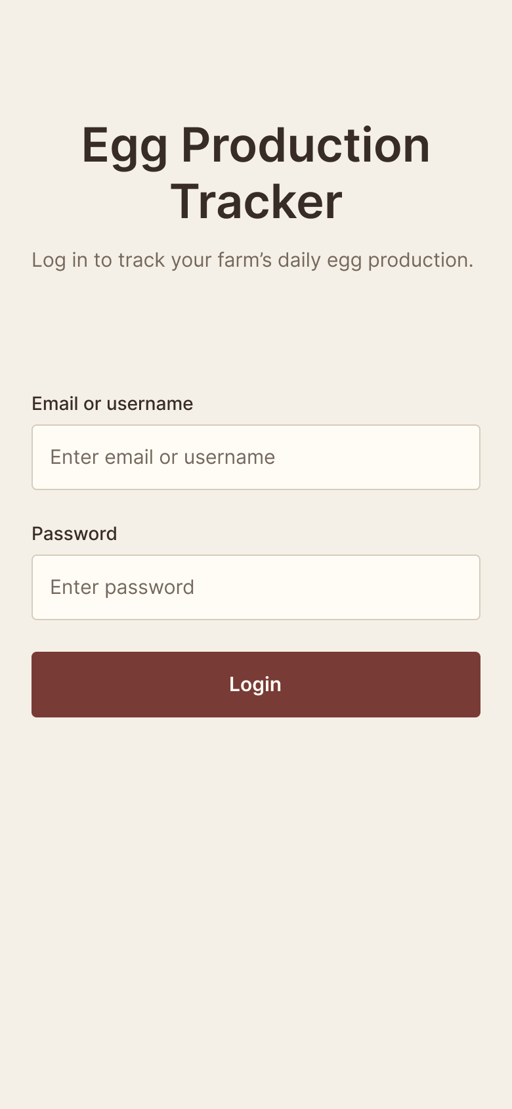
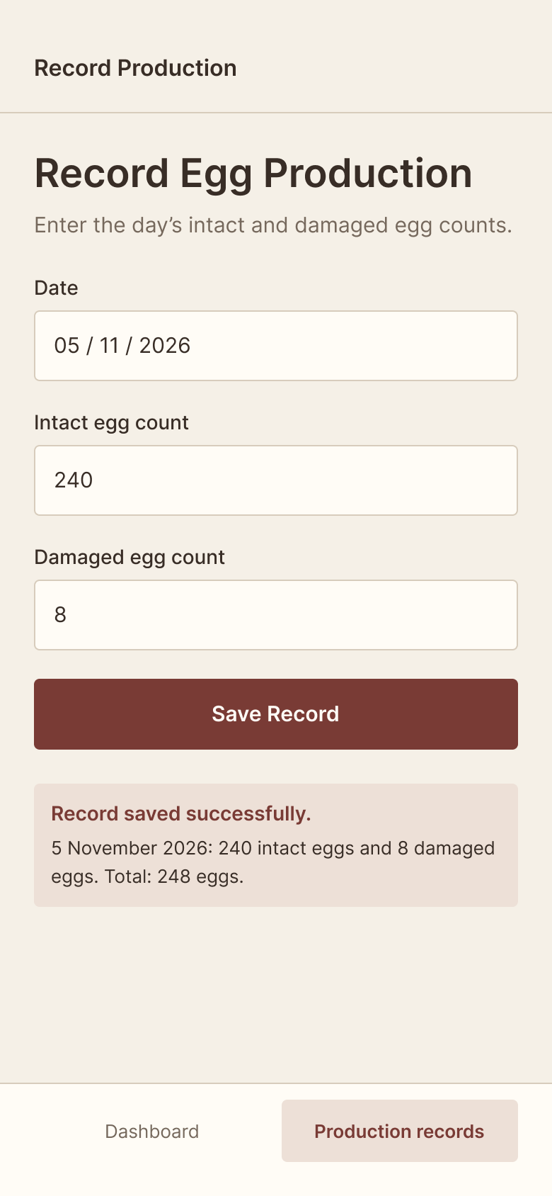
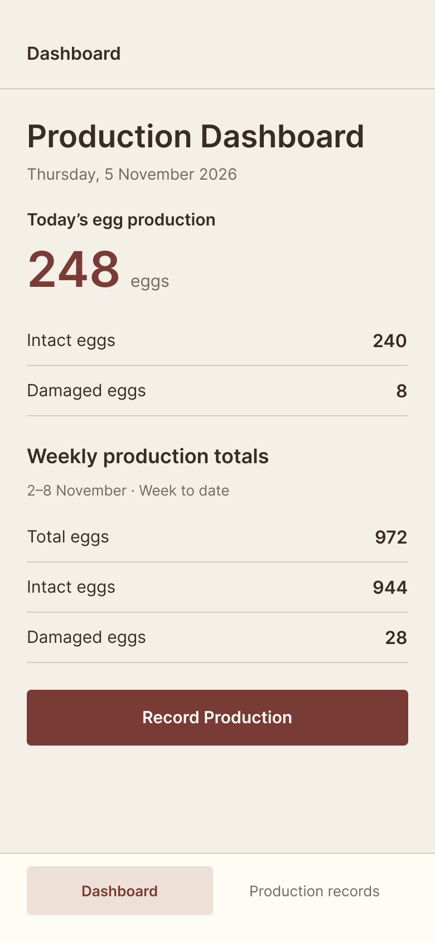
Part 3: Screen designs
Login
The user enters an email or username and a password, then taps Login. Only authorised users can view or change saved records (NFR-03).
Record production
The worker enters the date, intact egg count and damaged egg count, then taps Save Record. A message confirms the save and shows the total, e.g. 240 + 8 = 248 eggs (FR-01, FR-02, FR-04).
Production dashboard
Shows today’s total with intact and damaged eggs separately, and the weekly totals, e.g. 972 eggs for 2–8 November. A button goes straight to recording (FR-04 to FR-06).
Speaker notes: These are our three main screens, designed for a smartphone. Login: the user enters an email or username and a password, so only authorised users can view or change records. Record Production: the worker enters the date, intact egg count and damaged egg count and taps Save Record; a message then confirms the save and shows the total, for example 240 intact and 8 damaged gives 248 eggs. Production Dashboard: shows today’s total with intact and damaged eggs separately, and the weekly totals, for example 972 eggs for 2 to 8 November. The screens use plain words, clear buttons and simple forms for users with basic phone skills.
Notes:
These are our three main screens, designed for a smartphone. Login: the user enters an email or username and a password, so only authorised users can view or change records. Record Production: the worker enters the date, intact egg count and damaged egg count and taps Save Record; a message then confirms the save and shows the total, for example 240 intact and 8 damaged gives 248 eggs. Production Dashboard: shows today’s total with intact and damaged eggs separately, and the weekly totals, for example 972 eggs for 2 to 8 November. The screens use plain words, clear buttons and simple forms for users with basic phone skills.

Slide 18
Part 4: Change requests and maintenance
Handling a change request
1
Record and understand the request
2
Discuss why the change is needed and how it may affect the system
3
Check it against the project scope, time and resources
4
If approved, update the requirements and relevant designs, then make the change
5
Test that the system still works correctly
6
Review and document the updated version
Four types of maintenance (with an example from our system)
Corrective
Fixing an error where the system calculates the daily egg production total incorrectly.
Adaptive
Updating the system so it continues to work when the farm changes to a newer smartphone or operating system.
Perfective
Improving the production reports so Brenda can view weekly egg production more clearly.
Preventive
Regularly backing up production records and reviewing the system to find possible problems before they cause failures.
Speaker notes: Part 4 covers looking after the system after it is built. When the owner or a worker asks for a change, we follow six steps: record and understand the request, discuss why it is needed and how it may affect the system, check it against scope, time and resources, update the requirements and designs and make the change if approved, test that the system still works, and finally review and document the new version. There are four types of maintenance. Corrective fixes errors, such as a wrong daily total. Adaptive keeps the system working on a newer phone or operating system. Perfective improves things, such as clearer weekly reports. Preventive means regular backups and reviews.
Notes:
Part 4 covers looking after the system after it is built. When the owner or a worker asks for a change, we follow six steps: record and understand the request, discuss why it is needed and how it may affect the system, check it against scope, time and resources, update the requirements and designs and make the change if approved, test that the system still works, and finally review and document the new version. There are four types of maintenance. Corrective fixes errors, such as a wrong daily total. Adaptive keeps the system working on a newer phone or operating system. Perfective improves things, such as clearer weekly reports. Preventive means regular backups and reviews.

